Slide 1
Chapter 5
The Laws of Motion
5-1 The Concept of Force
5-2 Some Particular Forces
5-3 Mass
5-4 Newton's Second Law
5-5 Newton's First Law
5-6 Newton's Third Law
5-7 Analysis Models Using Newton Laws
5-8 Force of Friction

Slide 2
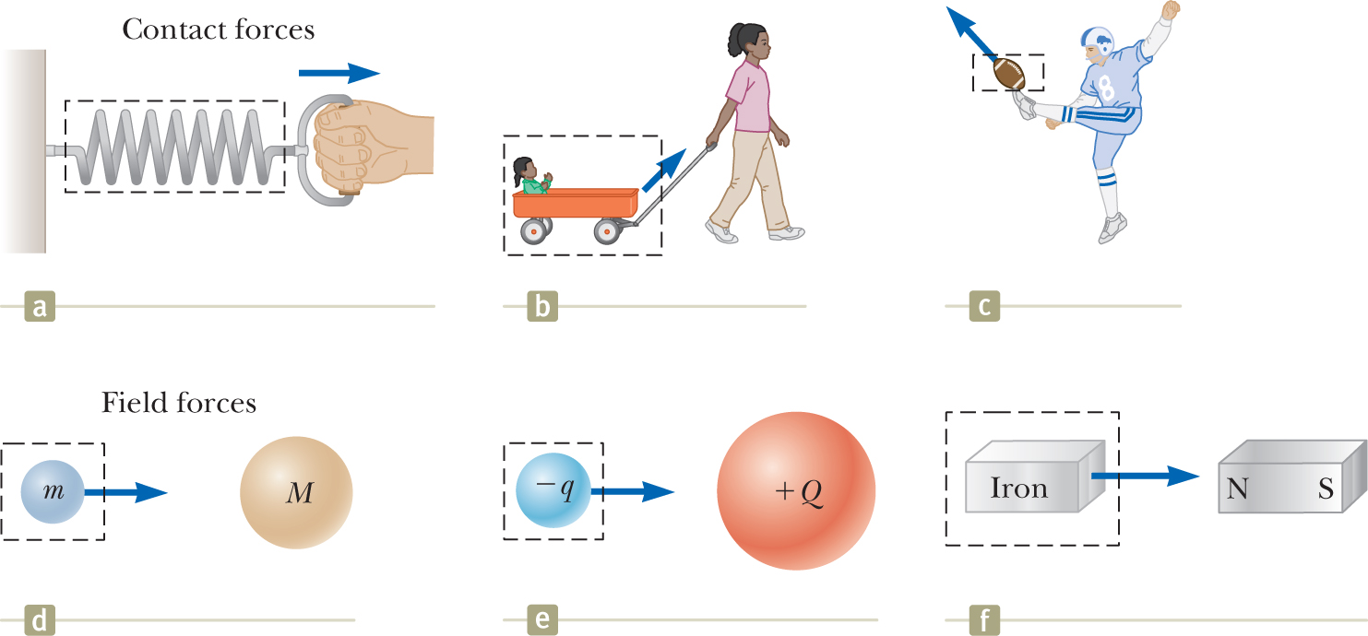
5-1 Force
Force causes acceleration
A force causes an object to accelerate.
A force acts on an object to change its velocity.
Force
Acceleration

Slide 3



5-1 Force
Force is a vector quantity
Force is a vector quantity. It has a direction and magnitude.
Add F₁ and F₂ vectorially to find their net force F_{net}.
F_{net} is also called the resultant force.
You can use either F₁ and F₂ or the net force F_{net} .
Principle of superposition: A force that has the magnitude and direction of the net force has the same effect on the body as all the individual forces together.

Slide 4


5-1 Force
Checkpoint 1
Indicate the correct net force direction.
Solution
Wrong
Wrong
Correct
Solution
Correct
Correct
Wrong

Slide 5
5-2 Some Particular Forces
Types
We will deal with the following forces
Gravitational force
Normal force
Tension force
Frictional force
Spring force (chapter 7)

Slide 6

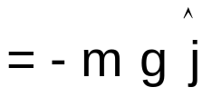
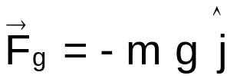
5-2 Some Particular Forces
Gravitational force
Earth exerts a gravitational force F_{g} on any object near its surface. The gravitational force pulls the object directly down toward the ground.
Magnitude of the gravitational force
Mass of the object
Free fall acceleration
F_{g} = m g
In SI units, g = 9.8 m/s²
Incline
Gravitational force
Earth
Earth
Directly down toward the ground.

Slide 7

5-2 Some Particular Forces
Normal force
When an object presses against a surface, the surface deforms and pushes the object with a normal force F_{N} that is perpendicular to the surface.
Normal force
wall
Incline
Table
Push
Pull by gravity
Pull by gravity
Normal force is always perpendicular to the surface.

Slide 8

5-2 Some Particular Forces
Tension
When a rope attached to an object is pulled tight, the rope pulls the object with a tension force T directed away from the object and along the rope.
The magnitude of the tension force is called tension.
Tension force
The tension force is directed away from the object and is along the rope.
The rope is massless and unstretchable so that the rope is only used as a connection between two objects and pulls both objects with the same tension even if the objects and the rope are accelerating and even if the rope runs around a massless frictionless pulley.
massless frictionless pulley
massless unstretchable cord
Table
The cord pulls both objects with
the same tension
massless ≡ mass is negligible compared to the object's mass

Slide 9

5-2 Some Particular Forces
Friction
When we slide or attempt to slide an object over a surface, the motion is resisted by a frictional force f which is directed parallel to the surface and opposite to the direction of the intended motion.
Attempt to slide
Sliding
Frictional force
stationary
stationary
moving
Force
Force
Velocity
Frictional forces is directed along the surface and opposite to the direction of the motion or intended motion

Slide 10






5-2 Some Particular Forces
Free-body diagram
The free-body diagram is
a diagram used to show all external forces acting on the object.
Free-body diagram for block A
Each force on the object is drawn as an arrow with its tail on the object.
Sometimes, the acceleration is shown.
Block A
Table
Block B
Block A
The object is shown as a dot.
A coordinate system is usually included.

Slide 11
5-2 Some Particular Forces
Free-body diagram
The free-body diagram is
a diagram used to show all external forces acting on the object.
Free-body diagram for block B
Each force on the object is drawn as an arrow with its tail on the object.
Sometimes, the acceleration is shown.
Block A
Table
Block B
Block B
The object is shown as a dot.
A coordinate system is usually included.

Slide 12





5-2 Some Particular Forces
Free-body diagram
The free-body diagram is
a diagram used to show all external forces acting on the object.
Free-body diagram for block B
Free-body diagram for knot K
Cord 1
Cord 2
Knot K
Cord 3
Block B
Knot K
Block B
Since knot K is massless, the gravitational force on it is zero.
Knot K is massless

Slide 13




5-2 Some Particular Forces
Free-body diagram
The free-body diagram is
a diagram used to show all external forces acting on the object.
Free-body diagram for block B
Cord
Block B
Block
Incline

Slide 14


5-3 Mass
Weight
The weight W of an object is equal to the magnitude F_{g} of the gravitational force on the object.
Weight of an object
Its mass
Free fall acceleration
unknown mass
reference mass
marked in weight or mass units
It is accurate only where the value of g is the same as where the scale was calibrated.
equal-arm balance
A spring scale
Weight and mass are different quantities.
On Earth
On the Moon
mass = 0.30 kg
mass = 0.30 kg
g = 9.8 m/s²
g = 1.6 m/s²
weight = (0.30 kg)(9.8 m/s²) = 2.9 N
weight = (0.30 kg)(1.6 m/s²) = 0.49 N
Mass is a property of an object.
It does not change with location.
The SI unit for weight is Newton.
The SI unit for mass is kg

Slide 15
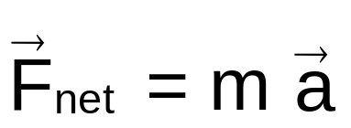



5-4 Newton's Second Law
Force, mass, and acceleration
Newton's second law: The net force on an object is equal to the product of the object's mass and its acceleration.
The vector sum of all forces that act on the object.
Mass m

Slide 16
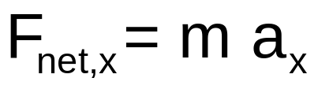
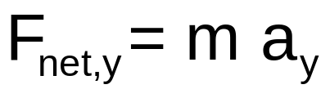
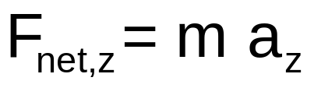
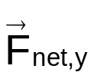


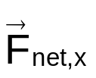
5-4 Newton's Second Law
By components
Newton's second law: The net force on an object is equal to the product of the object's mass and its acceleration.
The acceleration component along a given axis is caused only by the sum of the force components along that same axis.

Slide 17

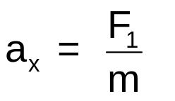
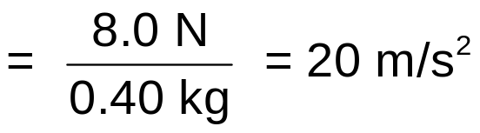
5-4 Newton's Second Law
Example 1
A puck moves in one dimension over a frictionless surface. The puck's mass is m = 0.40 kg. What is the acceleration of the puck, if F₁ = 8.0 N?
Solution
Newton's second law along the x axis
Puck

Slide 18

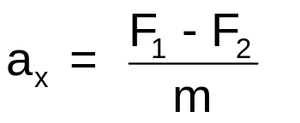
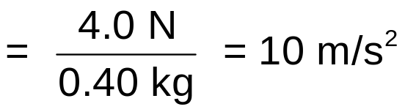
5-4 Newton's Second Law
Example 2
A puck moves in one dimension over a frictionless surface. The puck's mass is m = 0.40 kg. What is the acceleration of the puck, if F₁ = 8.0 N, and F₂ = 4.0 N?
Solution
Newton's second law along the x axis
Puck

Slide 19



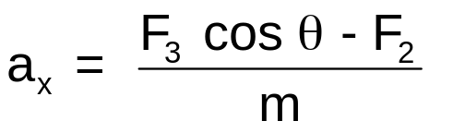
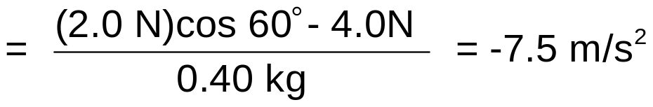
5-4 Newton's Second Law
Example 3
A puck moves in one dimension over a frictionless surface. The puck's mass is m = 0.40 kg. What is the acceleration of the puck, if F₂ = 4.0 N, F₃ = 2.0 N, and θ = 60⁰?
Solution
Newton's second law along the x axis
Puck
The net force accelerates the puck in the negative direction.

Slide 20


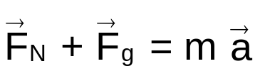



5-4 Newton's Second Law
Checkpoint 4
Solution
Newton's second law
Elevator cab moving upward
Along the y axis
Table
Elevator
Is the magnitude of the normal force F_{N} greater than, less than, or equal to m g if the elevator moving upward
at a constant speed and
at increasing speed?
For constant speed,
a = 0 and F_{N} = m g
For upward increasing speed,
a > 0 and F_{N} > mg

Slide 21
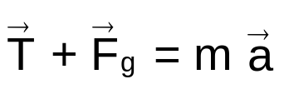




5-4 Newton's Second Law
Checkpoint 5
If the suspended object weighs 50 N. Is T equal to, greater than, or less than 50 N when the object is moving upward
at constant speed,
increasing speed, and
at decreasing speed
Solution
Newton's second law
Along the y axis
For constant speed,
a = 0 and T = 50 N.
For upward increasing speed,
a > 0 and T > 50 N.
For upward decreasing speed,
a < 0 and T < 50 N.

Slide 22






5-5 Newton's First Law
Special case of Newton's Second Law
Newton's first law: If no net force acts on an object (F_{net} = 0), the object cannot accelerate, that is, the object's velocity cannot change.
Newton's first law is a special case of Newton's second law.
There may be multiple forces on an object, but if their net force is zero,
the object cannot accelerate.
If the object at rest,
it stays at rest.
If the object is moving,
it continues to move with the same velocity
(same magnitude and same direction).

Slide 23
5-5 Newton's First Law
Equilibrium
Newton's first law: If no net force acts on an object (F_{net} = 0), the object cannot accelerate, that is, the object's velocity cannot change.
When the sum of the forces on an object is zero, we say that
the object is in equilibrium,
or
the forces on the object balance one another,
or
the forces on the object cancel one another.

Slide 24




5-6 Newton's Third Law
Third-law force pair
Two objects interact when they exert forces on each other.
Newton's third law: When two objects interact, the forces on the objects from each other are always equal in magnitude and opposite in direction.
Notation
object 2
object 1
on
from
The force on object 1 from object 2
If object 2 exerts a force on object 1,
then object 1 exerts an equal and opposite force on object 2.
Forces occur in pairs.
A single force cannot exist.
The two forces between two interacting objects are called
a third-law force pair or action-reaction pair.

Slide 25


5-6 Newton's Third Law
Interaction between two objects
Newton's second law applies to a single object, whereas Newton's third law applies to an interaction between two objects.
Force on the book due to the table (normal force)
Book
Book
Table
Force on the book due to Earth (gravitational force)
Table
Earth
F_{BT} and F_{BE} are not a third-law pair because they are forces on a single object, whereas a third-law pair is two forces between two interacting objects.
Earth

Slide 26

5-6 Newton's Third Law
Interaction between two objects
Newton's second law applies to a single object, whereas Newton's third law applies to an interaction between two objects.
Force on the book due to the table (normal force)
Book
Book
Table
Force on the table due to the book (normal force)
Table
Earth
F_{BT} and F_{TB} are a third-law pair because they are forces on two interacting objects.
The book pushes the table with a force which is equal in magnitude and opposite in direction to the force that the table pushes the book with.
Earth

Slide 27
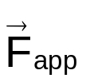
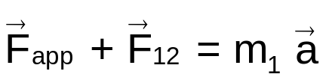
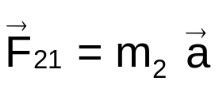
5-6 Newton's Third Law
Accelerating objects
Newton's third law holds for stationary and accelerating objects.
object 1
object 2
Applied force
Forces on object 1
Newton's second law
Object
1
Object
2
Normal force
Forces on object 2
Newton's second law
Object
1
Object
2
Normal force
Forces between object 1 and 2
Newton's third law
Object
1
Object
2
Normal force
Normal force

Slide 28





5-7 Applying Newton's Laws
Inertial reference frames
Newton's laws are not true in any reference frame.
They are valid only in a reference frame that is not accelerating.
A reference frame in which Newton's laws hold is called
an inertial reference frame.
Frame B is accelerating.
Belal cannot apply Newton's first law.
He sees the ball accelerating toward left even when there is no net force exerted on the ball.
Frame A is not accelerating.
Ahmad can apply Newton's first law.
Since there is no net force exerted on the ball, the ball cannot accelerate.
Accelerating
No force on the ball.
It is stationary relative to Frame A.

Slide 29

5-7 Applying Newton's Laws
Checkpoint 9
If frame A is an inertial reference frame and frame B is moving at constant velocity with respect to frame A. Is frame B an inertial reference frame?
Solution
Since frame B is not accelerating, it is an inertial frame.
Belal can apply Newton's first law.
He sees the ball moving at constant velocity toward left.
There is no net force on the ball and the ball's acceleration is zero.
constant velocity
No force on the ball.
It is stationary relative to Frame A.

Slide 30








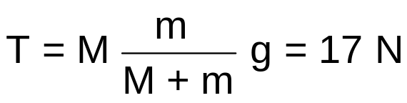
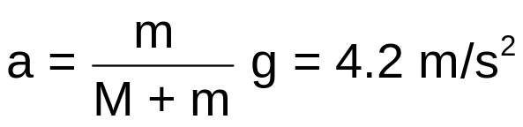
5-7 Applying Newton's Laws
Example 6
Block A
What is the acceleration of block A and block B? What is the tension in the cord?
Assume that the cord and the pulley are massless, and the cord is unstretchable.
M = 4.0 kg
Table
frictionless
m = 3.0 kg
Block B
Solution
Since the cord is unstretchable, both blocks have the same acceleration.
2nd law for block A
2nd law for block B
Along the x axis
Along the y axis
Block A
Along the y axis
Block B
Block A does not accelerate vertically
Solve for a

Slide 31












5-7 Applying Newton's Laws
Example 7
What are the tensions in the three cords? Assume that the cords and the knot are massless, and the cords are unstretchable.
Cord 1
Cord 2
Knot K (Massless)
Cord 3
M = 10 kg
Block B
Solution
Since the knot and block are stationary, their acceleration = 0.
2nd law for the knot
2nd law for block B
Along the y axis
Along the x axis
Knot K
Block B
Along the y axis

Slide 32



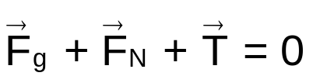











5-7 Applying Newton's Laws
Example 8
Cord
What is the tension in the cord and what is the normal force on the bock? Assume that the cord is massless and unstretchable.
Block B
m = 10 kg
frictionless
Incline
Solution
Newton's second law for the block
since the block is at rest
Along the x axis
Block
Along the y axis
Replace F_{g} with its components.

Slide 33
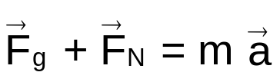




5-7 Applying Newton's Laws
Example 9
What is the acceleration of the bock?
Block B
m = 10 kg
frictionless
Incline
Solution
Newton's second law for the block
Block
Along the x axis
The acceleration of the object is 4.9 m/s² along the direction of the negative x axis
Replace F_{g} with its components.

Slide 34




5-7 Applying Newton's Laws
Checkpoint 10
A horizontal force F is applied to a block on a ramp.
What is the component of F that is perpendicular to the ramp?
Does the presence of F increase or decrease the magnitude of the normal force on the block from the ramp?
Block B
m = 10 kg
frictionless
Incline
Solution
The component of F that is perpendicular to the ramp is
Block
Since its component that is normal to the surface pushes the block toward the surface, the presence of F increases the magnitude of the normal force.
Replace F with its components.

Slide 35
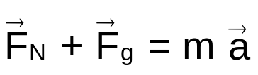
5-7 Applying Newton's Laws
Example 10
What is the reading of the scale in terms of the elevator cab's acceleration?
Solution
The scale reads the magnitude of the force the man exerts on the scale. This force is the normal force on the scale from the man. But according to Newton's third law, the magnitude of this force is equal to the magnitude of the normal force F_{N} on the man from the scale.
Scale
Newton's second law
Elevator
Along the y axis
man
F_{N} is called the apparent weight while mg is called the actual weight.

Slide 36

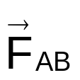
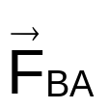


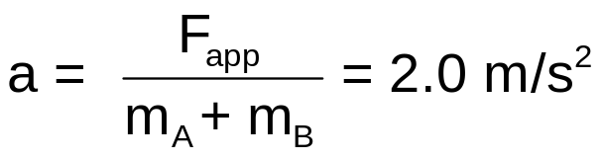

5-7 Applying Newton's Laws
Example 12
A constant horizontal force of magnitude 10 N is applied to block A of mass m_{A} = 2.0 kg which pushes against block B of mass m_{B} = 3.0 kg. What is the acceleration of the blocks?
Applied force
A
B
Solution 1
Newton's second law for block A
Normal force on Block A from Block B
block A
Newton's second law for block B
Normal force on Block B from Block A
block B
But from Newton's third law
Solve for a

Slide 37

5-7 Applying Newton's Laws
Example 13
A constant horizontal force of magnitude 10 N is applied to block A of mass m_{A} = 2.0 kg which pushes against block B of mass m_{B} = 3.0 kg. What is the acceleration of the blocks?
Applied force
A
B
Solution 2
Since the two blocks form a rigidly connected object, we can consider them as one object. We will call it block C which has mass of m_{A} + m_{B}. The only external force acting on block C is F_{app}
Newton's second law for block C
block c
Solve for a

Slide 38
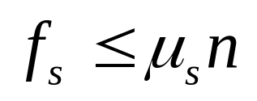
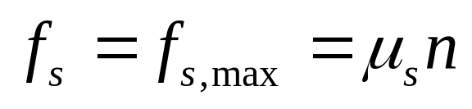
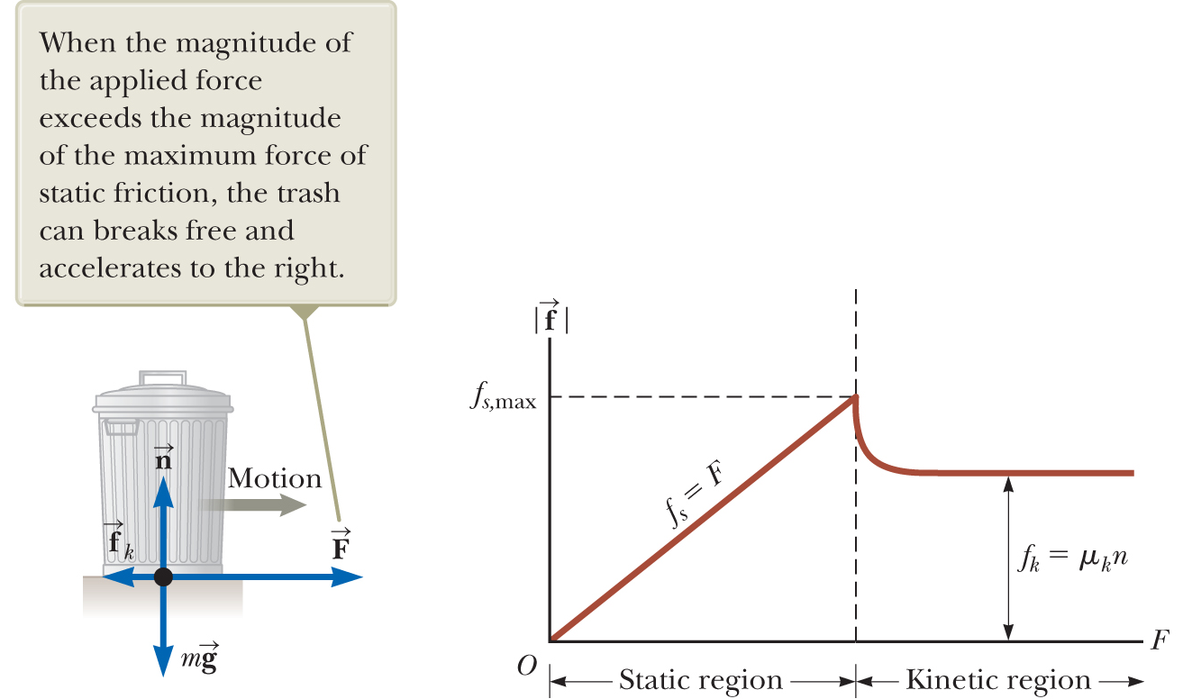
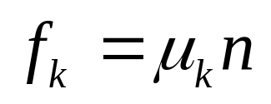
Forces of Friction

Slide 39
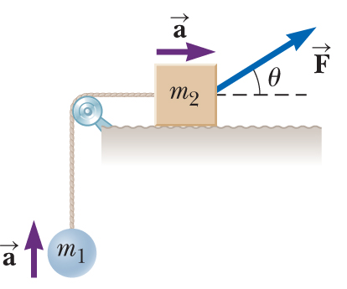
A block of mass m₂ on a rough, horizontal surface is connected to a ball of mass m₁ by a lightweight cord over a lightweight, frictionless pulley as shown in the figure. A force of magnitude F at an angle θ with the
horizontal is applied to the block as shown, and the block slides to the right. The coefficient of kinetic friction between the block and surface is μ_{k}.
Determine the magnitude of the acceleration of the two objects.
μ_{k}

Slide 40
