Slide 1
Chapter 7
Energy of a system
7-1 What is Energy?
7-2 Kinetic Energy
7-3 Work
7-4 Work and Kinetic Energy
7-5 Work Done by the Gravitational Force
7-6 Work Done by a General Variable Force
7-7 Work Done by a Spring Force

Slide 2

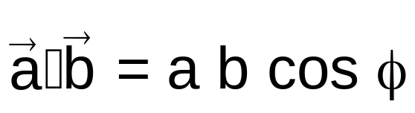


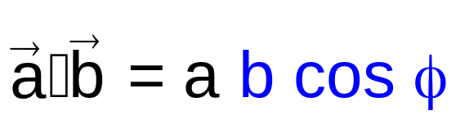
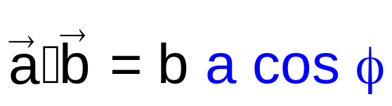
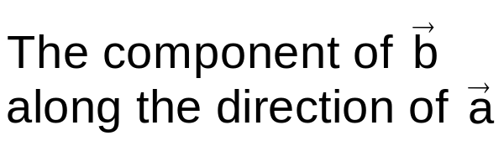
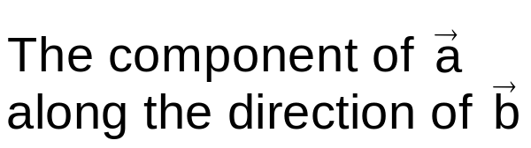


3-6 Multiplying Vectors
Scalar Product
Scalar quantity
Angle between the two vectors
Scalar product is also called dot product and read as a dot b.

Slide 3


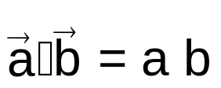
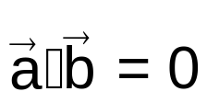
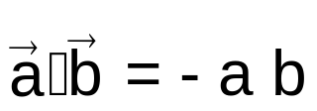
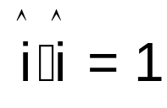
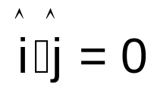


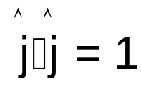
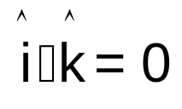

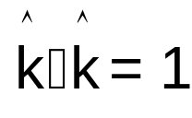
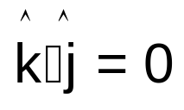
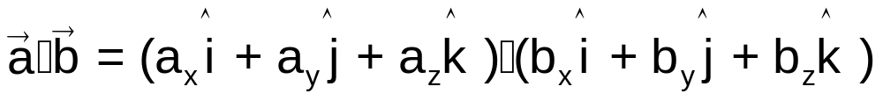
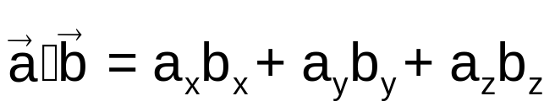
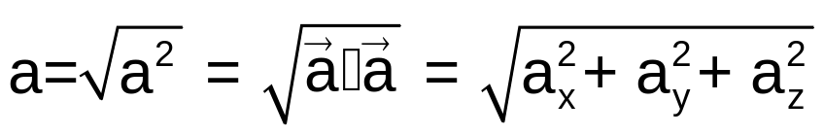
3-6 Multiplying Vectors
Scalar Product
y
x
z
Magnitude of a vector:

Slide 4
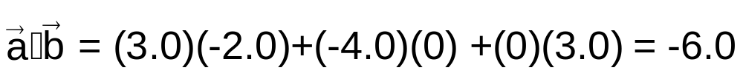
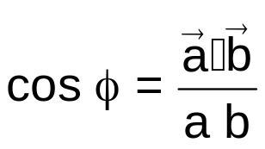
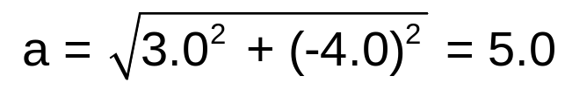
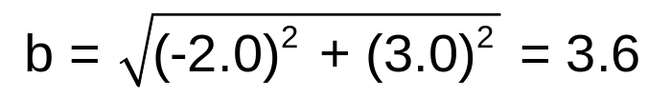
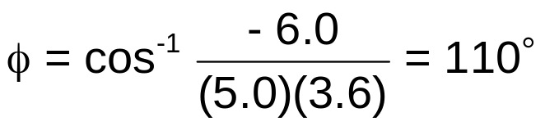
3-6 Multiplying Vectors
Example 7
Solution

Slide 5
7-1 What is Energy?
Quantity associated to the state of a system
Energy is a number that we associate with a system of one or more objects.
Energy is a scalar quantity.
Energy can be used to predict the behavior of a system.
Energy can be transformed from one type to another and transferred from one object to another, but the total amount of energy of an isolated system is always the same.
Energy of an isolated is conserved.
In this chapter,
we study two type of energy = kinetic energy & potential energy
and
one way in which energy can be transferred = work.

Slide 6





7-3 Work
Transfer of energy
The force increases the kinetic energy of the object.
The force decreases the kinetic energy of the object.
The force has transferred energy to the object from you.
The force has transferred energy from the object to you.
Positive work is done on the object by the force.
Negative work is done on the object by the force.
Work W is energy transferred to or from an object by means of a force acting on the object.
Energy transferred to the object is positive work.
Energy transferred from the object is negative work.

Slide 7




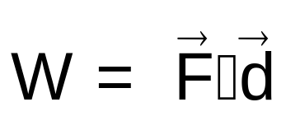
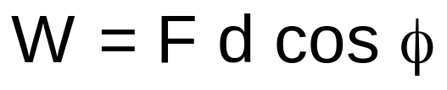
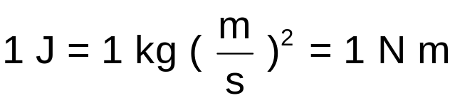
7-4 Work and Kinetic Energy
Work by a constant force
The force does not change in magnitude or direction as the object moves.
Work done by a constant force
Constant force
Displacement
Work is a scalar quantity.
SI unit for work is the joule.
Angle between the force and displacement
F cos φ is the component of the force along the direction of the displacement.
All the work is done by the force component along the displacement.
The force component perpendicular to the displacement does zero work.

Slide 8




7-4 Work and Kinetic Energy
Positive and negative work
The force does positive work on the object
The force does zero work on the object
The force does negative work on the object
A force does positive work when it has a vector component in the same direction as the displacement and it does negative work when it has vector component in the opposite direction.
A force does zero work when it has no component along the displacement.

Slide 9



7-4 Work and Kinetic Energy
Work by several forces
Work done by the two forces = work done by F₁ + work done by F₂
= work done by F_{Net}

Slide 10
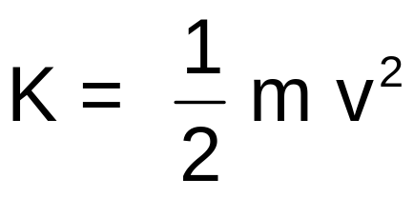
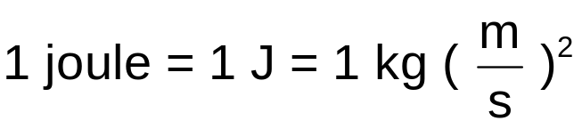
7-2 Kinetic Energy
Formula
Kinetic energy
Speed
Mass
SI unit for energy is the joule

Slide 11

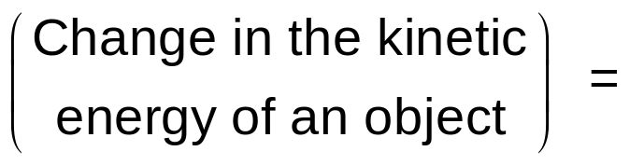
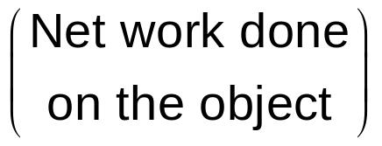




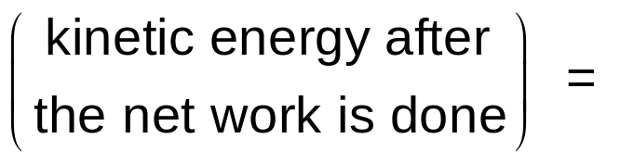
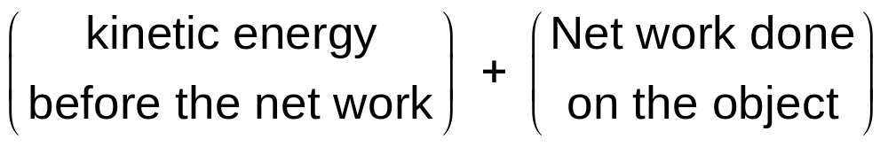
7-4 Work and Kinetic Energy
Work-kinetic energy theorem
Work-kinetic energy theorem
If the net work done on the object is positive,
the object's kinetic energy increases by the amount of the work.
If the net work done on the object is negative,
the object's kinetic energy decreases by the amount of the work.

Slide 12








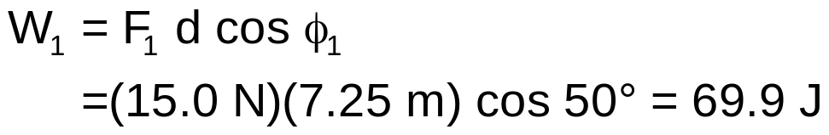

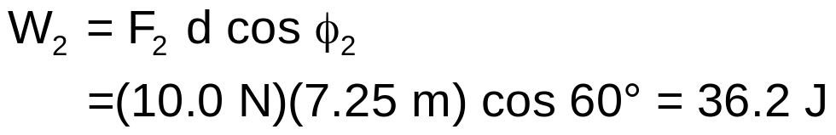

7-4 Work and Kinetic Energy
Example 2
Two men slide an initially stationary box of mass 250 kg on a frictionless surface for a distance d = 7.25 m to the right.
F₁ = 15.0 N, and F₂ = 10.0 N.
What is the net work done on the box by the two men during the displacement?
Solution
Box

Slide 13




7-4 Work and Kinetic Energy
Example 3
Two men slide an initially stationary box of mass 250 kg on a frictionless surface for a distance d = 7.25 m to the right.
F₁ = 15.0 N, and F₂ = 10.0 N.
What is the work done on the box by the gravitational force and the normal force during the displacement?
Solution
The work done by the gravitational force is
The work done by the normal force is
Box
The work is zero because the forces are perpendicular to the displacement.

Slide 14
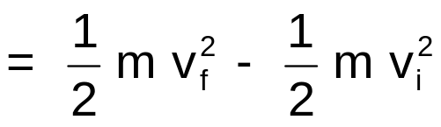

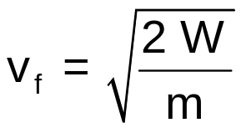
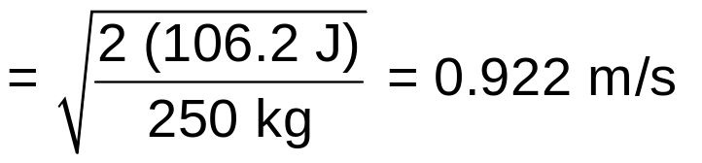
7-4 Work and Kinetic Energy
Example 4
Two men slide an initially stationary box of mass 250 kg on a frictionless surface for a distance d = 7.25 m to the right.
F₁ = 15.0 N, and F₂ = 10.0 N.
The box is initially stationary. What is the final speed of the box at end the displacement?
Work done by the two men = 106.2 J
Solution
The speed of the box changes because its kinetic energy is changed when energy is transferred to it by the forces of the two men.
Box
initially stationary

Slide 15
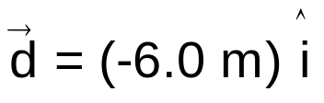
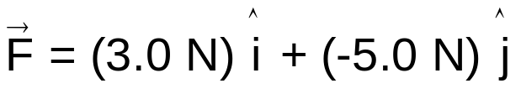
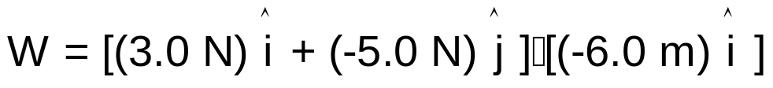


7-4 Work and Kinetic Energy
Example 5
How much work does the force do on the box during the displacement?
Frictionless
Solution

Slide 16

7-4 Work and Kinetic Energy
Example 6
Work done by the force = -18 J
Frictionless
If the box's initial kinetic energy is 20 J, what is its kinetic energy at the end of the displacement?
Solution

Slide 17







7-5 Work Done by the Gravitational Force (Potential energy)
Thrown object
Work done by the gravitational force
Angle between the gravitational force and displacement
Rising object
Falling object
Object's kinetic energy decreases because the gravitational force does negative work on it.
Object's kinetic energy increases because the gravitational force does positive work on it.

Slide 18









7-5 Work Done by the Gravitational Force
Example 8
m = 10 kg
d = 4.0 m
h = 2.0 m
The box is stationary before and after the lift.
What is the work done by the gravitational force?
cable
Frictionless ramp
Solution
The work done by the gravitational force is
The work done by gravitational force depends only on the vertical displacement.

Slide 19






7-5 Work Done by the Gravitational Force
Example 9
m = 10 kg
d = 4.0 m
h = 2.0 m
The box is stationary before and after the lift.
The work done by the gravitational force = - 20 J
What is the work done by the force T?
cable
Frictionless ramp
Solution
Work-kinetic energy theorem
The box is stationary before and after the lift → ΔK = 0
The normal force is perpendicular to the displacement → W_{N} = 0
The work done by the applied force

Slide 20


7-5 Work Done by the Gravitational Force
Checkpoint 3
cable
cable
Frictionless ramp
Frictionless ramp
You raise the box by the same height h but with a larger ramp.
Is the work done by the force T greater, smaller, or the same as before?
Is the tension needed to move the box greater than, smaller than, or the same as before?
Solution
The work done is the same as before.
W_{g} depends only on the vertical displacement.
Tension to move the box is smaller
Smaller θ → smaller T

Slide 21












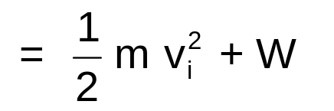


7-6 Work Done by the Gravitational Force
Example 10
m = 5.0 kg
v_{i} = 2.0 m/s
d = 1.0 m
a = g/10
What is the work W_{g} done by the gravitational force?
What is the work W_{T} done by the upward pull T?
What is the net work W done on the object?
What is the object's final kinetic energy?
Descending
Solution
Finding T
Newton's second law along the y axis

Slide 22
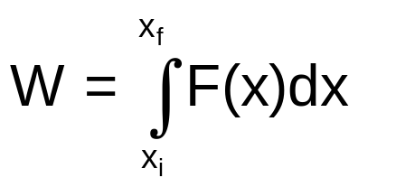




7-6 Work Done by a General Variable Force
One Dimension
Work done by one dimensional variable force
One dimensional variable force
The work is the area between the F(x) curve and the x axis and between the limits x_{i} and x_{f}.
Area = Work

Slide 23





7-6 Work Done by a General Variable Force
Constant force
The work is the area between the F(x) curve and the x axis from x_{i} to x_{f}.
When the force is constant, the work is
Area = Work
Area = Work

Slide 24

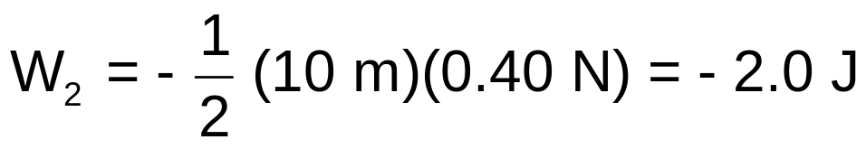

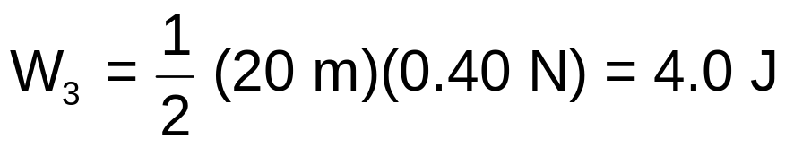
7-6 Work Done by a General Variable Force
Example 11
How much work W is done by the force to move the object from x_{i} = 0 m to x_{f} =40 m?
F(N)
0.4
0.2
3
0
x(m)
10
20
30
40
2
-0.2
1
-0.4
Solution
The work is the area between the F(x) curve and the x axis

Slide 25


7-7 Work Done by a Spring Force
The spring force
Relaxed state
Zero force
Zero displacement
Stretched
Negative force
Positive displacement
Compressed
Positive force
Negative displacement
The spring force acts to restore the relaxed state.
The spring force is a restoring force.

Slide 26



7-7 Work Done by a Spring Force
Hooke's law
Spring force
Displacement
Hooke's law
Spring constant
(or force constant)
Hooke's law
The spring force is a variable force because it is a function of x
Hooke's law is a linear relationship between F_{x} and x
The spring constant k measure the stiffness of the spring.
The larger k is, the lager the force needed for a given displacement.
The SI unit for k is
Newton per meter
N/m

Slide 27
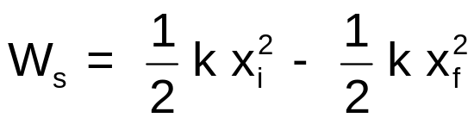
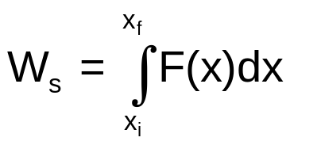
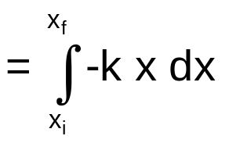
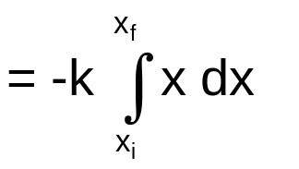
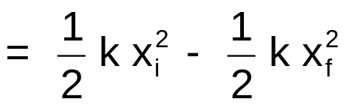
7-7 Work Done by a Spring Force
Formula
Work done by a spring force
Initial
Final position
Initial position
Final
Spring constant
Work W_{s} is positive if the block ends up closer to the relaxed state.
Work W_{s} is negative if the block ends up farther away form x = 0.
Derivation

Slide 28



7-7 Work Done by a Spring Force
Work done by an applied force
Initial
Final
If the initial and final kinetic energies of the object are the same, K_{f} = K_{i}, then

