Slide 1

Chapter 8
Potential Energy and Conservation of Energy
Notes:
1

Slide 2
8-1 Potential Energy
Potential energy U is energy that can be associated with the configuration of a system of objects that exert forces on one another
A system of objects may be:
Earth and a bungee jumper
Gravitational potential energy accounts for kinetic energy increase during the fall
Elastic potential energy accounts for deceleration by the bungee cord
Physics determines how potential energy is calculated, to account for stored energy
Notes:
2

Slide 3

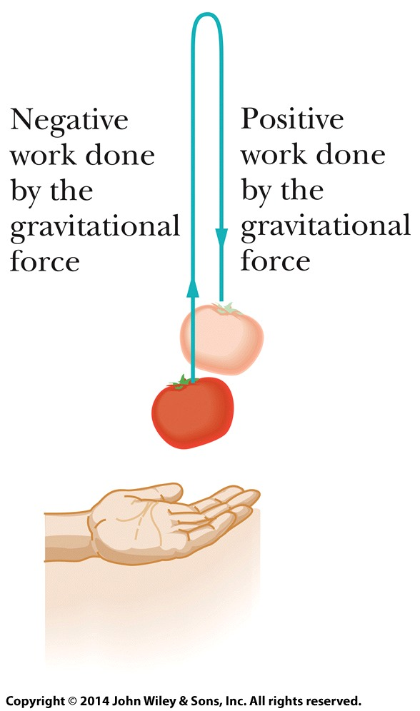
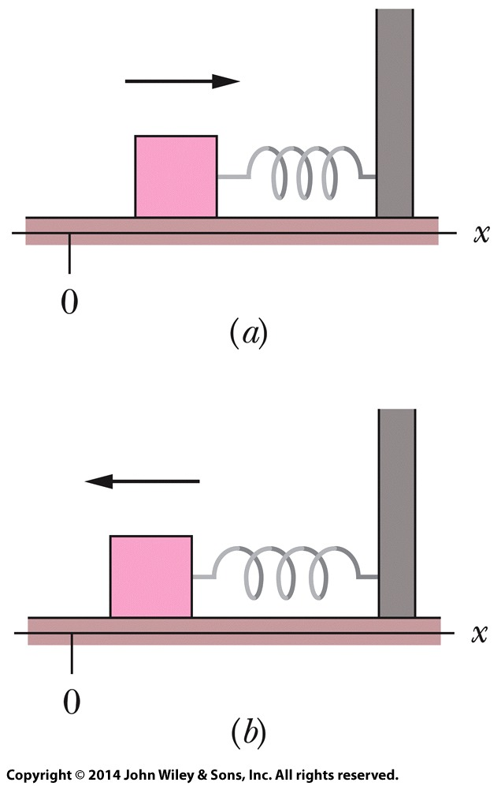
8-1 Potential Energy
For an object being raised or lowered:
The change in gravitational potential energy is the negative of the work done
This also applies to an elastic block-spring system
Eq. (8-1)
Figure 8-2
Figure 8-3
Notes:
3

Slide 4
8-1 Potential Energy
Conservative forces are forces for which W₁ = -W₂ is always true
Examples: gravitational force, spring force
Otherwise we could not speak of their potential energies
Nonconservative forces are those for which it is false
Examples: kinetic friction force, drag force
Kinetic energy of a moving particle is transferred to heat by friction
Thermal energy cannot be recovered back into kinetic energy of the object via the friction force
Therefore the force is not conservative, thermal energy is not a potential energy
Notes:
4

Slide 5

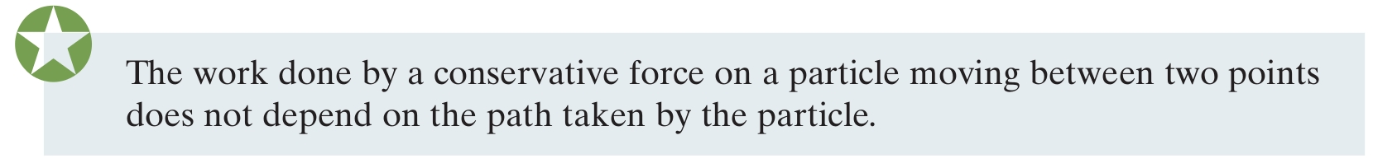
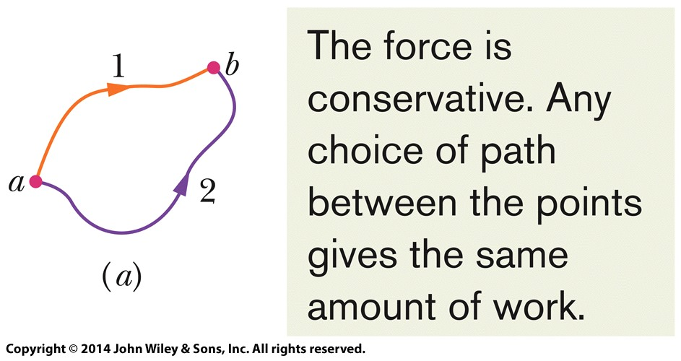
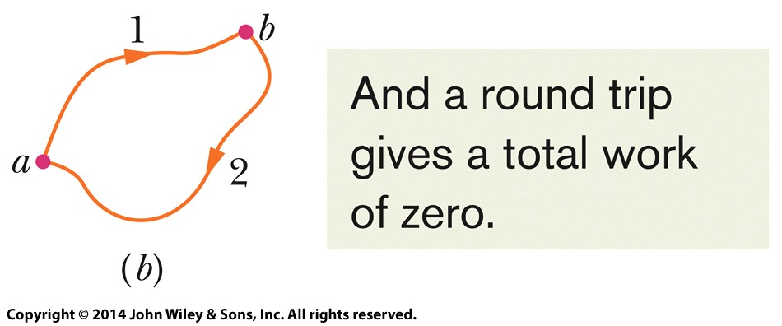
8-1 Potential Energy
When only conservative forces act on a particle, we find many problems can be simplified:
A result of this is that:
Figure 8-4
Notes:
5

Slide 6
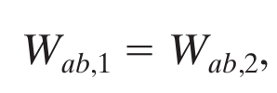
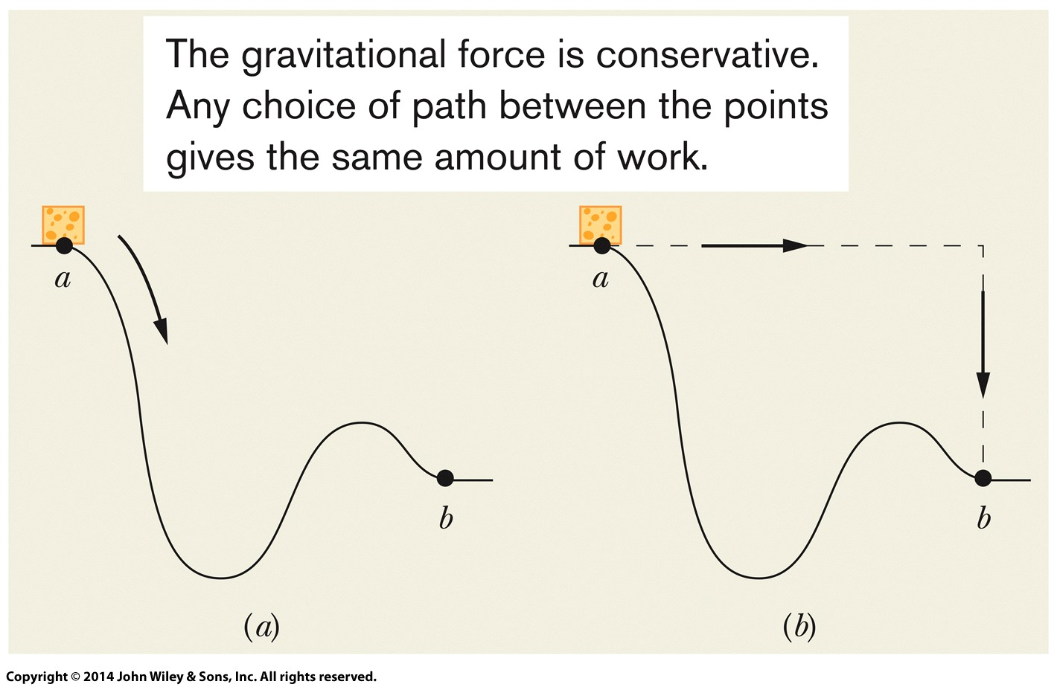
8-1 Potential Energy
Mathematically:
This result allows you to substitute a simpler path for a more complex one if only conservative forces are involved
Eq. (8-2)
Figure 8-5
Notes:
6

Slide 7
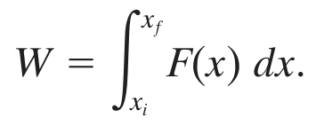
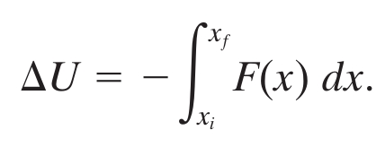

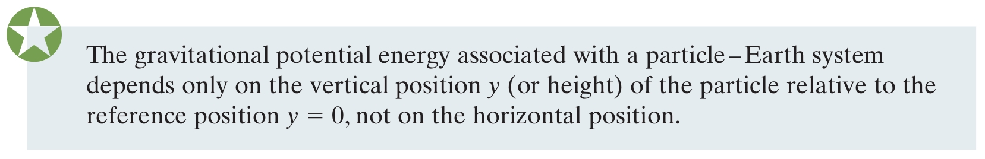
8-1 Potential Energy
For the general case, we calculate work as:
So we calculate potential energy as:
Using this to calculate gravitational PE, relative to a reference configuration with reference point y_{i} = 0:
Eq. (8-5)
Eq. (8-6)
Eq. (8-9)
Notes:
7

Slide 8
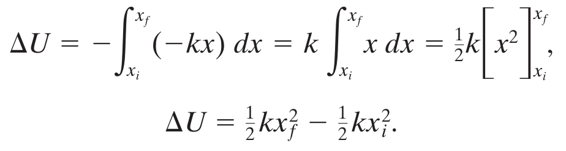

8-1 Potential Energy
Use the same process to calculate spring PE:
With reference point x_{i} = 0 for a relaxed spring:
Notes:
8

Slide 9



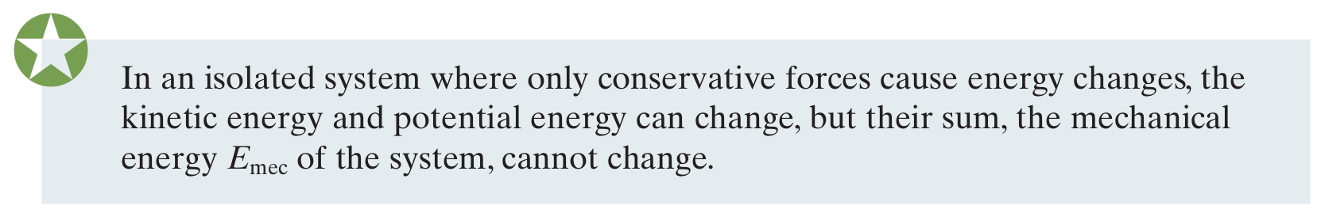
8-2 Conservation of Mechanical Energy
The mechanical energy of a system is the sum of its potential energy U and kinetic energy K:
Work done by conservative forces increases K and decreases U by that amount, so:
Using subscripts to refer to different instants of time:
In other words:
Eq. (8-12)
Eq. (8-15)
Eq. (8-17)
Notes:
9

Slide 10

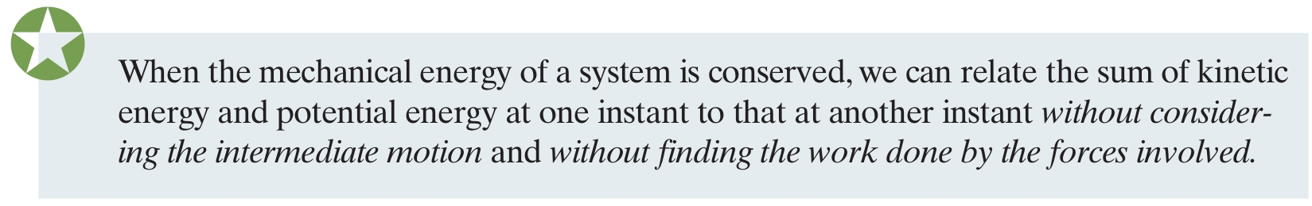
8-2 Conservation of Mechanical Energy
This is the principle of the conservation of mechanical energy:
This is very powerful tool:
One application:
Choose the lowest point in the system as U = 0
Then at the highest point U = max, and K = min
Eq. (8-18)
Notes:
10

Slide 11
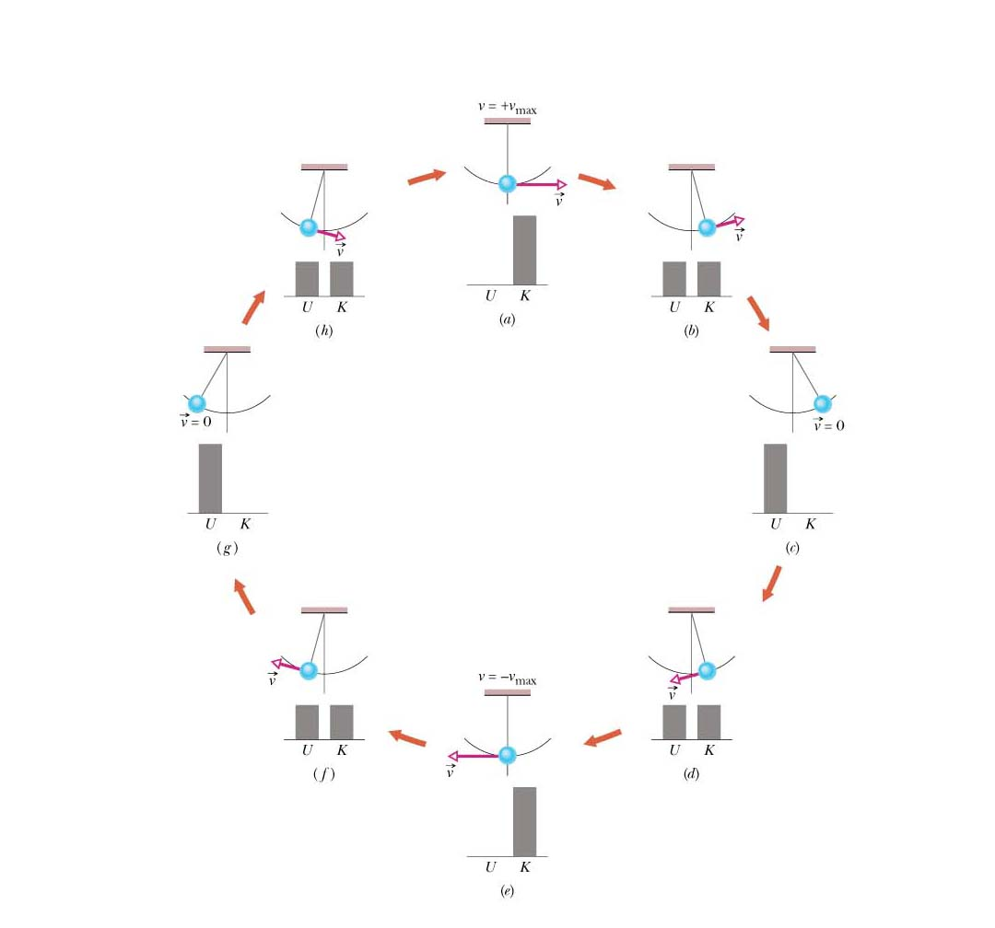
An example of the principle of conservation of mechanical energy is given in the figure. It consists of a pendulum bob of mass m moving under the action of the gravitational force.
The total mechanical energy of the bob-Earth system remains constant. As the pendulum swings, the total energy E is transferred back and forth between kinetic energy K of the bob and potential energy U of the bob-Earth system.
We assume that U is zero at the lowest point of the pendulum orbit. K is maximum in frames a and e (U is minimum there). U is maximum in frames c and g (K is minimum there).
(8-10)

Slide 12
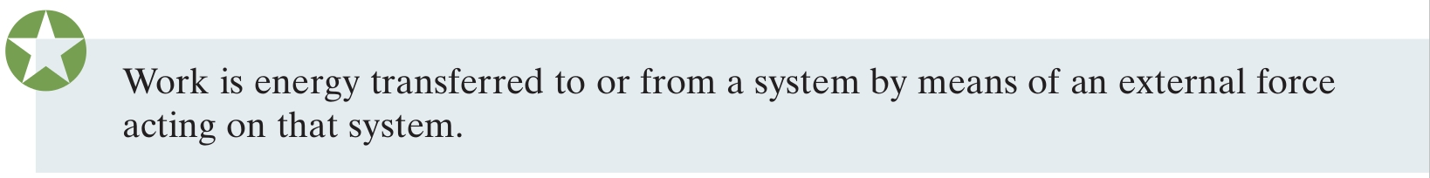
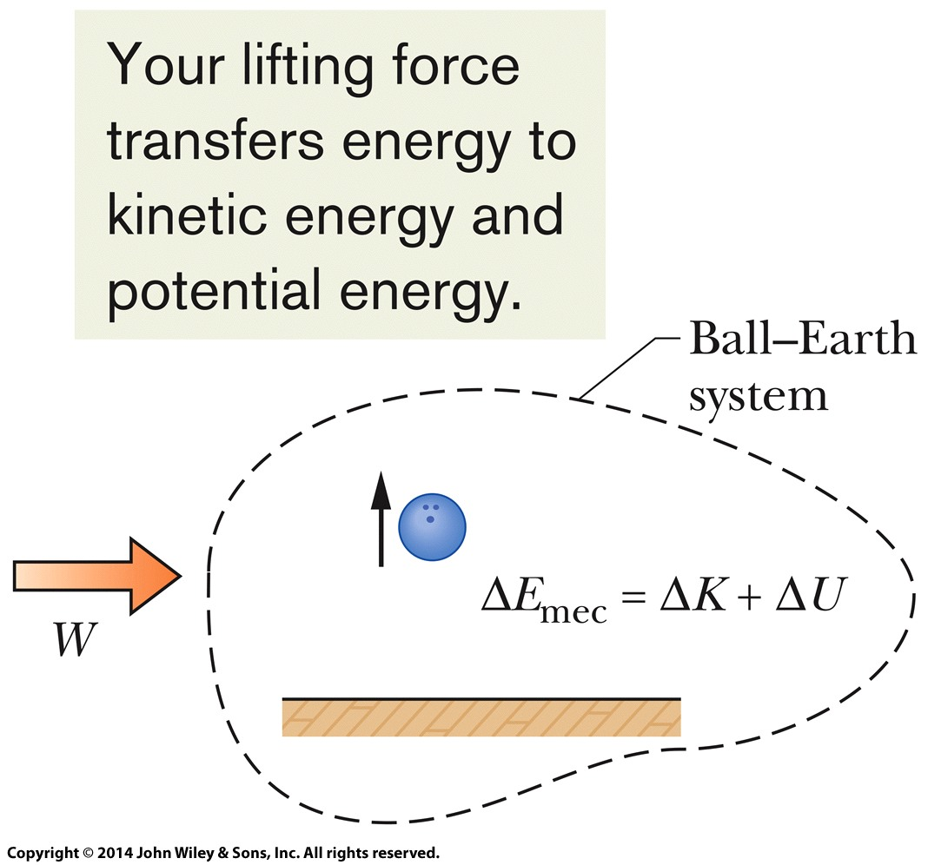


8-4 Work Done on a System by an External Force
We can extend work on an object to work on a system:
For a system of more than 1 particle, work can change both K and U, or other forms of energy of the system
For a frictionless system:
Eq. (8-25)
Eq. (8-26)
Figure 8-12
Notes:
12

Slide 13

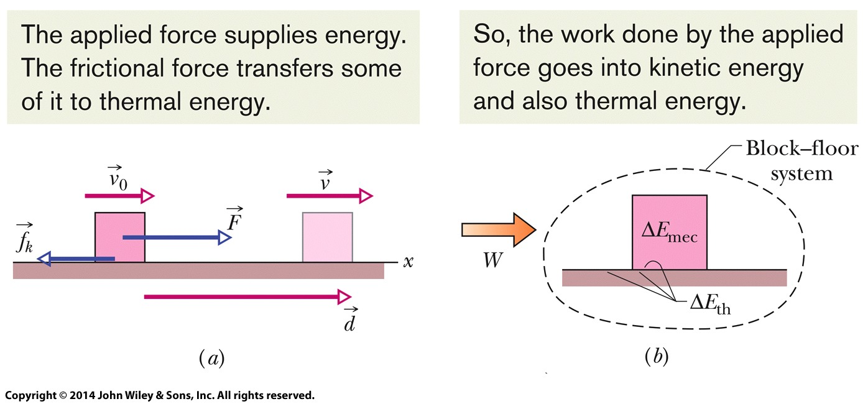
8-4 Work Done on a System by an External Force
For a system with friction:
The thermal energy comes from the forming and breaking of the welds between the sliding surfaces
Eq. (8-31)
Eq. (8-33)
Figure 8-13
Notes:
13

Slide 14
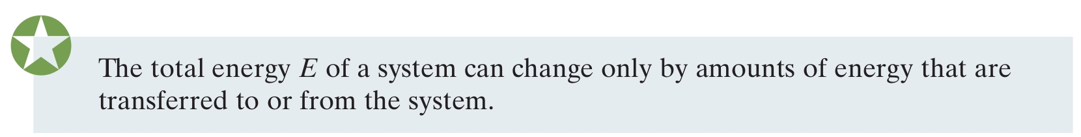
8-5 Conservation of Energy
Energy transferred between systems can always be accounted for
The law of conservation of energy concerns
The total energy E of a system
Which includes mechanical, thermal, and other internal energy
Considering only energy transfer through work:
Eq. (8-35)
Notes:
14

Slide 15


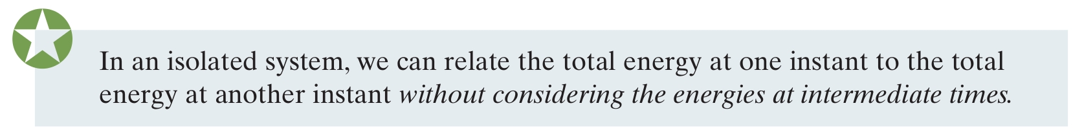
8-5 Conservation of Energy
An isolated system is one for which there can be no external energy transfer
Energy transfers may happen internal to the system
We can write:
Or, for two instants of time:
Eq. (8-36)
Eq. (8-37)
Notes:
15

Slide 16
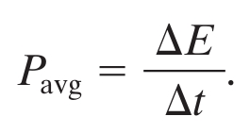
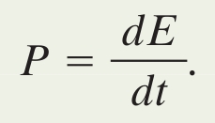
8-5 Conservation of Energy
We can expand the definition of power
In general, power is the rate at which energy is transferred by a force from one type to another
If energy ΔE is transferred in time Δt, the average power is:
And the instantaneous power is:
Eq. (8-40)
Eq. (8-41)
Notes:
16

Slide 17
8 Summary
Conservative Forces
Net work on a particle over a closed path is 0
Potential Energy
Energy associated with the configuration of a system and a conservative force
Eq. (8-6)
Gravitational Potential Energy
Energy associated with Earth + a nearby particle
Elastic Potential Energy
Energy associated with compression or extension of a spring
Eq. (8-9)
Eq. (8-11)
Notes:
17

Slide 18
8 Summary
Mechanical Energy
For only conservative forces within an isolated system, mechanical energy is conserved
Eq. (8-12)
Work Done on a System by an External Force
Without/with friction:
Conservation of Energy
The total energy can change only by amounts transferred in or out of the system
Eq. (8-26)
Eq. (8-33)
Eq. (8-35)
Notes:
18

Slide 19
8 Summary
Power
The rate at which a force transfers energy
Average power:
Instantaneous power:
Eq. (8-40)
Eq. (8-41)
Notes:
19

