Slide 1
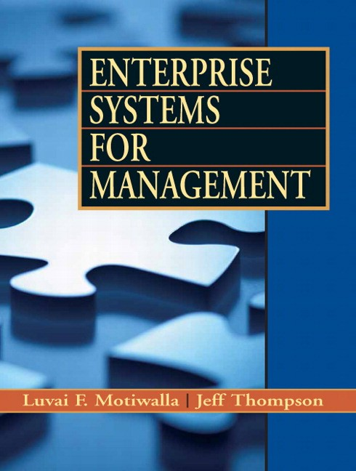
CHAPTER 4
DEVELOPMENT LIFE CYCLE

Slide 2
Learning Objectives
Review the Systems Development Life Cycle (SDLC).
Examine the problems and alternatives with SDLC.
Know the key issues in ERP implementation strategy.
Understand ERP Implementation Life Cycle.
Examine the rapid implementation methodologies.
Compare and contrast SDLC and ERP Life Cycles.
Examine the role of people like top management, consultants, and subject matter experts (SMEs) in the ERP Life Cycle.

Slide 3
Preview
There are various technical and organizational challenges in implementing ERP systems depending on the organization, scope of implementation, business processes, and skill level of the end users.
The System Development Life Cycle (SDLC) provides useful guidelines to the ERP implementation process.
Discussion on the key phases of the ERP life cycle with emphasis on roadblocks in each phase and solutions available to overcome these roadblocks

Slide 4
Systems Development Life Cycle (SDLC)
SDLC includes a systematic process of planning, designing, and creating an information system for organizations.
For complex systems (e.g. ERP), it is often better to have a structured methodology to coordinate the design and development tasks properly among the members of a large systems development team.
SDLC uses Systems Approach, which basically states that Complex problems needs to be broken up into smaller manageable problems using a systems’ hierarchy, and then developing a solution for each problem within the hierarchy. It provides a structured top-down problem identification and bottom-up solution process for managing complex problems.
SDLC process requires both technical and nontechnical problem solving skills, therefore the development team must understand technology as well as the organization's business processes, culture, people,

Slide 5
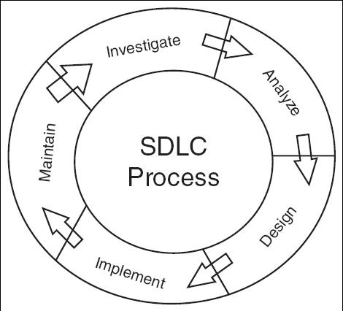
Traditional SDLC Methodology

Slide 6
SDLC Phases
The SDLC consists of tasks that are divided into phases or stages. The SDLC begin when someone in the organization identifies the need for a new system (to gain a competitive advantage, improve operational efficiencies, expand business globally, …).
Investigation Phase
  The team should do a thorough analysis of the costs and benefits. The benefits derived from the new system as well as the cost associated with a new system are sometimes not very obvious.
  Cost and benefits that can be quantified (purchasing new hardware) called tangible, whereas those that cannot be quantified easily (training employees) are called intangible.
  A good development team will highlight these issues in their investigation report to top management such that they can plan for these expenses and revenues over a long period of time, which means implementing a successful system.
Analysis Phase
  To determine the user requirements of the new system by focusing on the problems of the current system.
  Through observations, interviews and focus groups, the team must find the bottlenecks and constrains of the existing system and find out from the users their current and future needs.

Slide 7
SDLC Phases
Design Phase
  Focus is on the new system’s architecture, user interface, and reporting requirements.
  The functional requirements from the analysis phase have to be converted to system and process flow charts, user input screens, sample reports, and the like. These requirements are grouped by input, process and output stages.
  The design phase produces the blueprint or technical specifications of the new system.
Implementation Phase
  The implementation phase begin with acquisition of hardware, software, development of custom applications, new system testing, training, and data conversion from old to the new system.
  Once the system is implemented the development team hands the system over to the maintenance staff, which takes care of day-to-day operations and upgrades.
  The systems development process stays in a continuous cycle to stay current and to provide needed changes

Slide 8
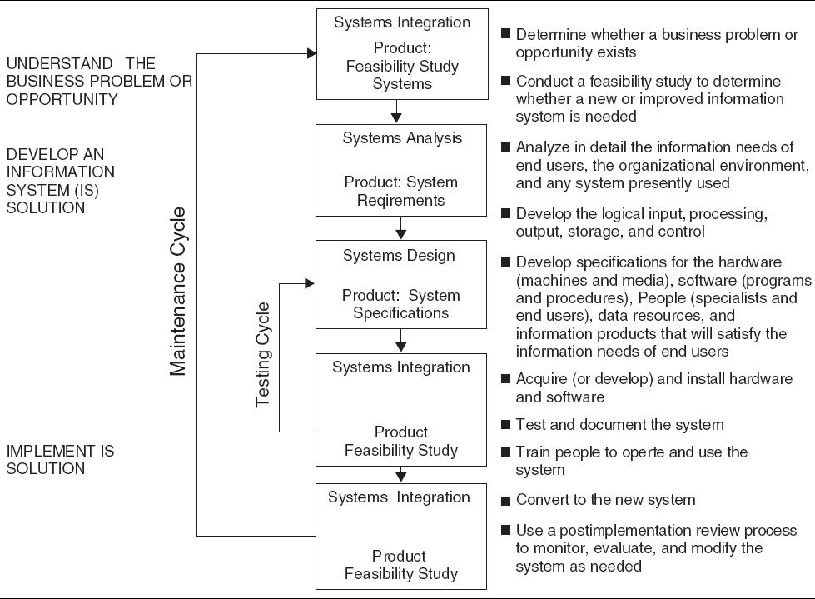
SDLC Approach

Slide 9
Rapid SDLC Approaches
The SDLC process has several problems, even though it is rigorous in making sure that the new system is complete and successful in the organization.
Takes long time for developing a new system
The cost associated with the SDLC process is very high
Most information systems do not require such a rigorous SDLC process, therefore organizations over years have used rapid approaches to SDLC that are quicker and less expensive to this process. One rapid development approach is prototype:
Prototyping
  This approach does not go through the analysis and design phases.
  It implements a skeleton or a prototype of the actual system with a focus on data input (user interface) and output (screen display).
  The idea is to demonstrate the system functionality to the users and get their feedback on the prototype.
  Their feedback is incorporated into the new system and demonstrated back to the users.
  This approach has proven to be very effective with user interactive systems because the prototype is eventually converted into a full-scale system.

Slide 10
Rapid SDLC Approaches
End user development is another rapid development approach
End User Development (EUD)
  Lets end users create their own applications
  Users are trained by the IT staff to develop customized applications. (e.g. small decision-making application with an Excel spreadsheet or departmental employee tracking system with an Access database).

Slide 11
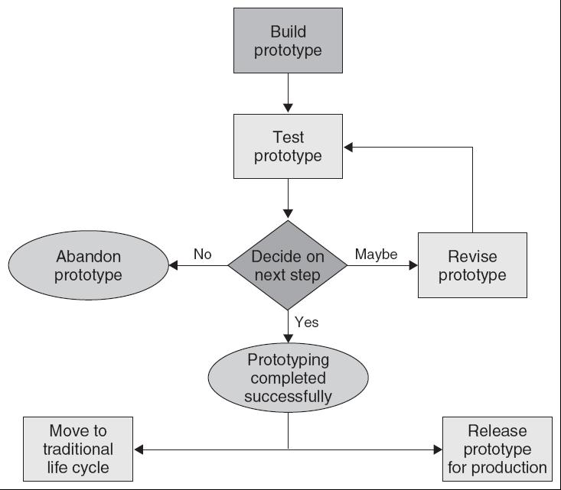
Prototype Development

Slide 12
Differences between ERP and Other Software
ERP | Other Packaged Software
Millions of dollars | Hundreds to Thousands
Mission critical | Support or productivity improvement
One to several years | Almost instantly
Requires significant change management strategy from beginning to end for success; business process change, training, communications, etc. | Requires some training and support
Requires in-house employee time, consultants and vendor support in millions of dollars | Requires little or no consulting support or vendor technical support

Slide 13
ERP Implementation Plan
ERP applications are prepackaged software, which may cost millions of dollars, developed by commercial software vendors and custom installed for organizations to automate and integrate various business processes.
Without these systems a bank would not be able to service its customers for withdrawals or deposit, and a manufacturing company would not be able to assemble and ship their products.
ERP Implementation Plan is used to create a roadmap or blueprint to meet cost, scope and time constraints of an implementation. There are three major implementation plan:
Comprehensive (most expensive, lengthy and costly approach)
  Involves implementation of the full functionality of the ERP software in addition to industry-specific modules
  Requires a high level of business process re-engineering
Middle-of-the-Road
  Involves some changes in the core ERP modules and a significant amount of business process re-engineering
Vanilla (minimum cost and time required)
  Utilizes core ERP functionality and use the best practice business processes built into the software. Company require to align business processes to the ERP, rather than modify the software. Business process re-engineering is eliminated.

Slide 14
ERP Implementation Methodology
Methodology refer to a systematic approach to solving a business problem.ERP methodology builds on the theory that the enterprise can maximize its returns by maximizing the utilization of its fixed supply of resources.
An ERP development life cycle provides a systematic approach to implementing ERP software in the changing but limited-resource organizational environment.
There are many different vendor-driven methodologies that use traditional ERP development life cycle or rapid ERP life cycles (e.g. Total Solution, FastTrack, Rapid-Re, ASAP and BIM).
The traditional ERP life cycle accomplishes one stage at a time and requires formal milestone approvals prior to moving to the next stage.
In a rapid ERP life cycle, once a company commits to the implementation, employees are empowered to make the decisions to keep the project moving forward.

Slide 15
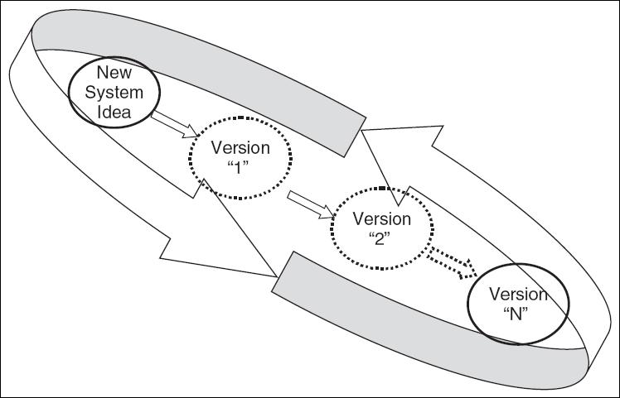
Rapid Application Development Process

Slide 16
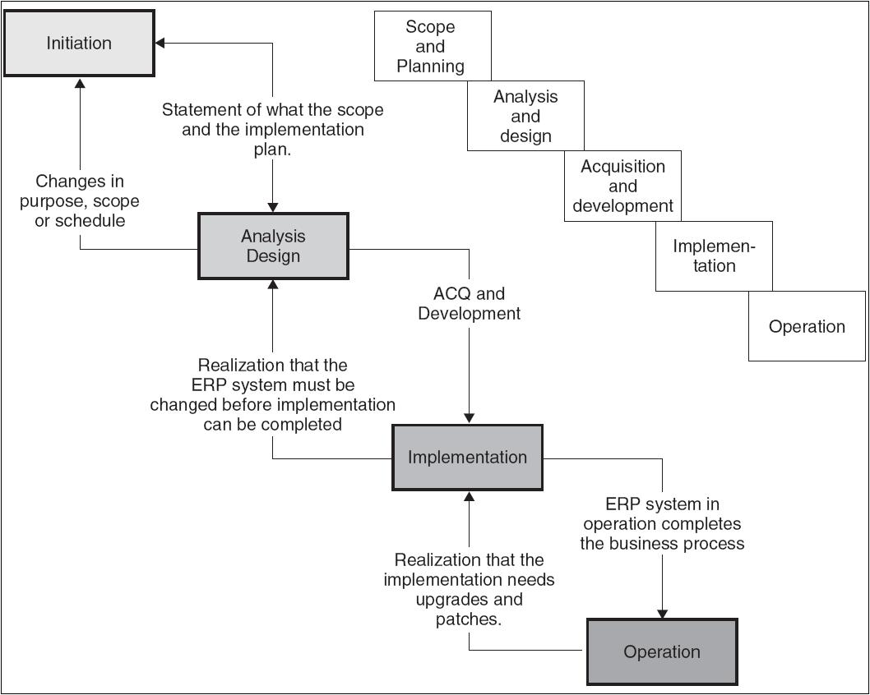
Traditional ERP Life Cycle

Slide 17
Traditional ERP Life Cycle
The traditional ERP life cycle has a deliverable at the end of each stage that is reviewed by management and upon which a decision is made either to continue with the project or not. The traditional ERP life cycle includes the following major stages:
Scope and Commitment Stage
  This is similar to the investigation stage in SDLC. In addition to conducting the feasibility study, a scope of the ERP implementation is developed within the resource and time requirement.
  A number of characteristics of the ERP implementation are defined. How large will the ERP implementation need to be defined at the planning stage?
  Develop a long-term vision for the new system and a short-term implementation plan and top management’s commitment for both the vision and implementation plan..
  Vendor Selection is another key activity towards the end of this stage.

Slide 18
List of Scopes and Commitments
Gap Analysis | Evaluation of the functions provided by the ERP system compared with the operational processes necessary to run your business
Physical Scope | Establishes which sites will be addressed, the geographical locations of the sites, and the number of users.
BPR (Business Process Reengineering) Scope | Will the current processes be refined, replaced, or eliminated? What users, departments, sites will be affected?
Technical Scope | How much modification will be done to the ERP software? What processes will be utilized as is and which will be customized?
Resource Scope | How much time and budget is allocated for the project?
Implementation Scope | Which modules should be implemented? How should the modules be connected to the existing system?

Slide 19
Traditional ERP Life Cycle (Cont’d)
Analysis and Design Stage
  Analysis of user requirements
  ERP team has first to make a decision on the software and decide on the consultant and SMEs (subject Matter Experts).
  Map the differences between the current business process and the embedded process in the ERP software, and to develop long term plan on whether to change the business process or to customize the ERP software to support existing processes..
  Design a change management plan, a list of embedded processes, user interface screens, and customizable reports in the ERP software that will need customization.
  Creating plans for data conversion, system conversion and training
  Team must develop a detailed change management strategy and execution plan for the release of the new system.

Slide 20
Traditional ERP Life Cycle (Cont’d)
Acquisition & Development Stage
  Similar to acquisition and testing stage of traditional SDLC. Organization has to purchase the license and build the production version of the software to be made available to the end-users.
  The entire production platform must be configured and built with necessary hardware, network, security, software, database and real production data.
  The tasks identified in the gap analysis are executed at this stage. These include customization of embedded software rules, data in the database tables, input screen and reports that come with ERP system.
  While the technical team is working on the installation, the change management team works with end-users on implementing the changes in business processes and preliminary training with the sandbox of the software.
  Data team similarly works on migrating data from the old system to the new system.
  Finally, the ERP system needs to be configured with proper security.

Slide 21
Traditional ERP Life Cycle (Cont’d)
Implementation Stage
  Focus is on installing and releasing the system to the end-users (Go-Live) and on monitoring the system release to the end-users.
  Errors found in the production version have to go through the help desk. Any changes are then made to the development version, retest and migrated to the production system a regularly scheduled updates.
  System conversion is a major activity and needs to be managed carefully (4 Phases or approaches)
    Phased: gradual movement of the company from the existing legacy system to the ERP implementation
    Pilot: implements a small version of the final system
    Parallel: has the most upfront cost because ERP system is implemented and used in conjunction with the legacy system.
    Direct Cut or big bang: is the highest risk approach but the most straightforward and clean. The company move from the legacy system directly to use the ERP system.
  Feedback received from system usage needs to be transferred to the post-implementation team for ongoing system support.

Slide 22
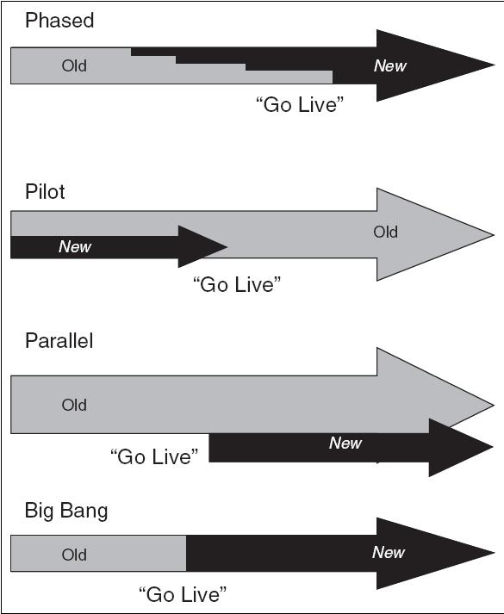
ERP Conversion Approaches

Slide 23
Traditional ERP Life Cycle (Cont’d)
Operation Stage
  This is often managed by the operation team with assistance from implementation team.
  Handover or knowledge transfer is the major activity as support for the new system which is transferred to the help desk and support staff.
  Training of new users to the system as ERP modules are released.
  Managing of new releases of the software, installation of patches and upgrades.
  Managing the software contract with the ERP vendor.

Slide 24
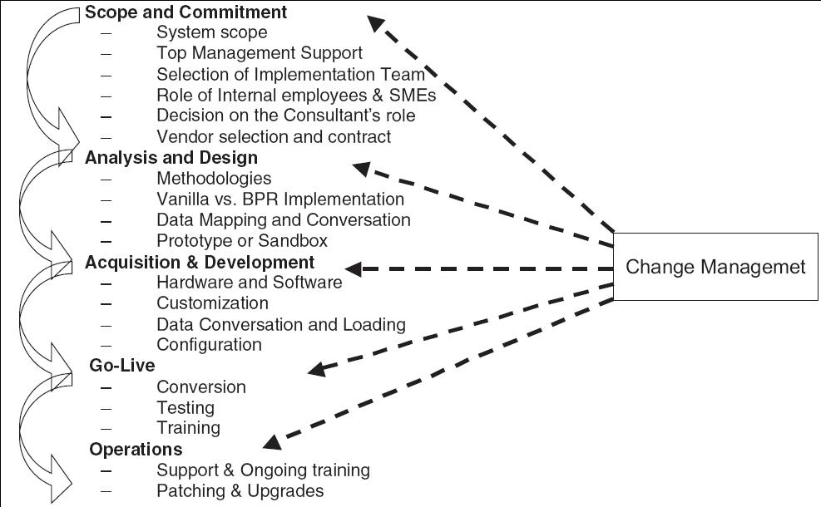
ERP Life Cycle Phases Summary

Slide 25
Rapid ERP life cycles
Total Solution (Ernst & Young, LLP)
Phases
  Value Proposition. Does the solution make sound business sense?
  Reality Check. Is the organization ready for change?
  Aligned approach. Setting the right expectations that deliver both short-term and long-term value.
  Success Dimension. Getting the right blend of people, skills, methods, and management in the team.
  Delivering Value. Measuring results and celebrating success.

Slide 26
Rapid ERP life cycles
Fast Track (Deloitte & Touche)
Phases
  Scoping and Planning: Project definition and scope. Project planning is initiated.
  Visioning and Targeting: Needs assessment. Vision and targets identified. As-is modeling.
  Redesign: To-be Modeling. Software design and development.
  Configuration: Software development. Integration test planning.
  Testing and Delivery: Integration testing. Business and system delivery.

Slide 27
Rapid ERP life cycles
Fast Track (Deloitte & Touche)
Areas (groups) as an individual thread to be woven into a cohesive fabric through its five phase work plan.
  Project Management (project organization, risk management, planning, communications, budgeting, quality assurance).
  IT Architecture (hardware and network selection, installation, operations, design, development).
  Process and Systems Integrity (security, audit control).
  Change Leadership (leadership, commitment, organizations design, change-readiness, policies, performance measurements).
  Training and Documentation (needs assessment, training design and delivery, management, end-users, operations, and helpdesk.

Slide 28
Rapid ERP life cycles
Accelerated SAP (ASAP)
  Project Preparation. Proper planning and assessing organizational readiness is essential.
  Business Blueprint. The engineer delivers a complete toolkit of predefined business processes.
  Realization. Based on the business blueprint steps are taken to configure the R3 system (is the former name of the main enterprise resource planning software produced by SAP AG).
  Final Preparation. In this phase, the R3 system is fine-tuned. Necessary adjustments are made.
  Go-Live and Support. Procedures and measurements are developed to review the benefits of the R3 investment on an ongoing basis.

Slide 29
Business Integration Methodology (BIM)
Business Integration Methodology (Accenture)
  The Planning Phase. Help define appropriate strategies and approaches for achieving an enduring competitive advantage and building stakeholder value.
  The Delivering Phase. Translates the business architecture into a specific business capability.
  The Managing Phase. The Managing Phase is the directs, coordinates, and monitors the activities outlined in the other phases, in order to achieve improved business results.
  The Operating Phase. Operates the new business capabilities that were created in the Delivering Phase.

Slide 30
Comparing and Contrasting SDLC with ERPLC
Goal | Develop a new system to support the organization requirements | Implement a packaged system to support the organization requirements
Analysis | Evaluate user needs through observations and interviews and create system specifications | Vendor analysis and evaluation of business process changes due to the implementation
Design | Develop new system architecture, user interface, and reporting tools | Installation and Customization plan of ERP software, data conversion, and change management strategies
Implementation | Acquire hardware, software, develop applications, installation, testing, training, and conversion | “Go-Live” conversion or releasing the system to the users, training, and support

Slide 31
Comparing and Contrasting SDLC with ERPLC (Cont’d)
Consultant Role | Technical support mainly during design and implementation | Change management, process change, and technical support from beginning to end
Management Role | Some oversight and support | Significant oversight and involvement especially in change management
End-User Role | Focus group providing input during various stages with most involvement during Implementation stage | Multiple groups such as SMEs (Subject Matter Experts), advance users, and self-service users are part of implementation team with continuous involvement
Operations | Maintains, updates, and provides technical support | Maintains, updates, upgrades, monitors change management strategy

Slide 32
Implications for Management
It is critical to have solid top management commitment.
It is important to have strong and experienced program management.
It is a good practice to minimize the type and number of customizations that are implemented.
It is critical to emphasize training and change management.
Effective and frequent communication keeps everyone on the same page and give the greatest chance of problems being identified early.

Slide 33
Summary
A review of the systems development life cycle—both traditional and alternative approaches—and points out the benefits and limitations of the traditional and the newer approaches.
The ERP life cycle has variations from the SDLC process. The key reason is that organizations buy ERP as prepackaged software, and then have to customize them as well as change their company’s business processes.
There are three routes for the company in choosing an appropriate implementation strategy; they are: a comprehensive, vanilla, or middle-of-the-road strategy.

Slide 34
Summary (Cont’d)
There are rapid implementation methodologies developed by ERP consulting firms. These are: Total Solution, Fast-Track, Rapid-Re, ASAP, BIM.
Accelerated implementation approaches are very popular and require the use of experienced consultants to leverage the knowledge of techniques that have worked well with other organizations.

Slide 35
Summary (Cont’d)
ERP applications generally do not require the rigorous traditional SDLC process.
ERP software is mission critical, has a major impact on the organization business processes, and impacts a lot of people.

Slide 36
Review Questions
What is the role of the systems approach in the SDLC?
Briefly discuss the key phases of the SDLC methodology.
Discuss the alternate approaches of SDLC and the benefits of these alternatives.
Compare and contrast the three major ERP implementation categories.
What is ERP implementation methodology? Give examples.

Slide 37
Review Questions (Cont’d)
List the major tasks in the scope and commitment phase of the ERP life cycle.
List the major tasks in the analysis and design phase of the ERP life cycle.
List the major tasks in the acquisition and development phase of the ERP life cycle.
What is the role of change management in the ERP life cycle?
List the major differences between the ERP life cycle and SDLC.

