Slide 1
Careem’s
Advanced
Search

Slide 2
Table of contents
01
02
03
04
Problem vs. solution
Product overview
Feedback
update

Slide 3
Introduction

Slide 4
01
Problem
vs. solution

Slide 5

Careem
Its an application that takes care of people who do not have a car :
Taxi
Transporter
Shopping
Food delivery

Slide 6
Problem
Getting lost and not knowing where the products are nor which restaurant sells them

Slide 7
02
Product overview

Slide 8
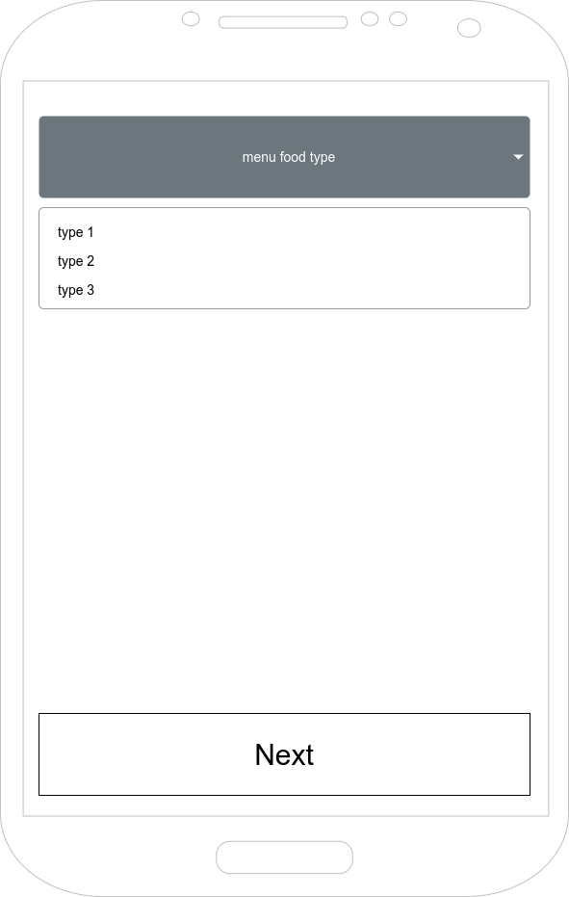
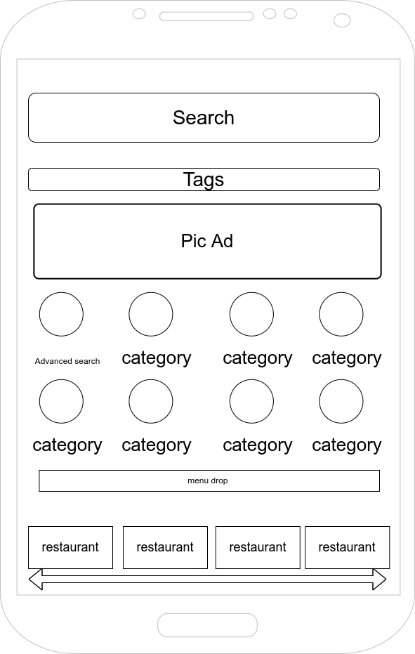

Slide 9
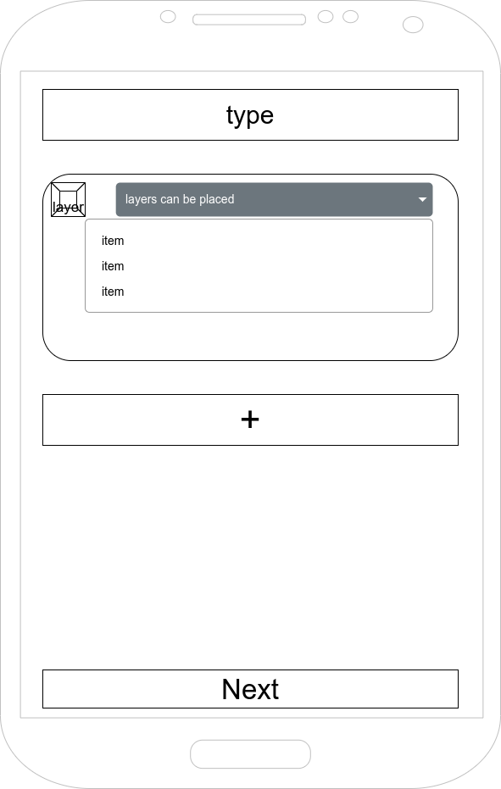
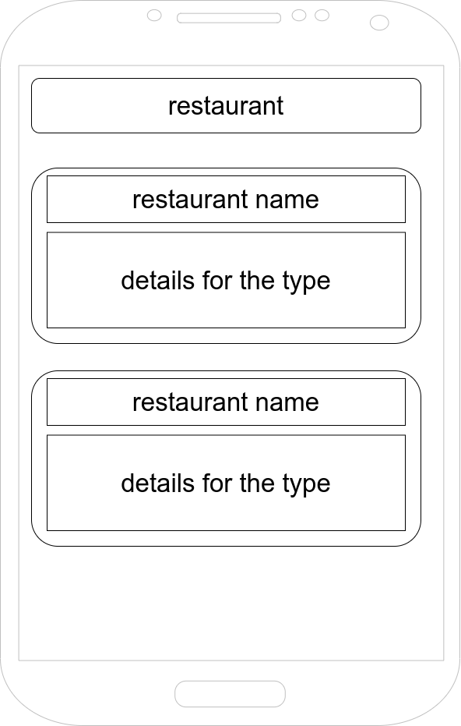

Slide 10
Nielsen's heuristics
Visibility of system status
User control and freedom
Consistency and standards
Flexibility and efficiency of use
Aesthetic and minimalist design
Error prevention
Screen shift
Edit and back
Default
Layers
Minimum data
limit

Slide 11
Nielsen's heuristics
Visibility
Consistency
Mapping
Constraints
Feedback
Each screen shows something
Next button
Simple
Hardware
Screen shift

Slide 12
PACT
People The people who are going to be users of the feature:
people who are 18+
people who can use smartphones
people who are comfortable ordering online food
people who want specific food in their way
Activities People can use my app to search the catalogue of food goods and order from new restaurants. In a subsequent version, users might be able to specify minimal defaults, so it will be used pretty frequently for brief periods of time. Since it would be accessible to everyone, more people could use it to browse restaurants and see which ones serve the foods they prefer. The user will want to view their findings or be able to browse easily and without being delayed, therefore the app should load and respond rather rapidly.

Slide 13
PACT
Context
this app can be used according to your location and what restaurants can deliver the food to you, from those restaurants you may make your choice from the menu (without using the advanced search feature) or you can start using the new feature and order from it if you had anything in mind and the process of delivery is the same as any other order, careems application will track the food and the driver until it gets to your pointed location.
Activities Since the program only accesses data while it is being used, it will be easy on the battery. When the app is closed, neither power nor data are needed. The interface and overall feel of the software are straightforward and efficient. The user will have a wonderful experience because the software is quick and dependable. To access or utilize the app, all you'll need is a smartphone that you can get from the app store.

Slide 14
03
Feedback

Slide 15
Survey
21-32
76.4%
33-45
51%
46-56
92%
Do you like the way that you found the advanced searching feature?
Gender
do you like the 2nd screen?
72%
28%
should I combine screen 2 and 3?

Slide 16
04
Update

Slide 17
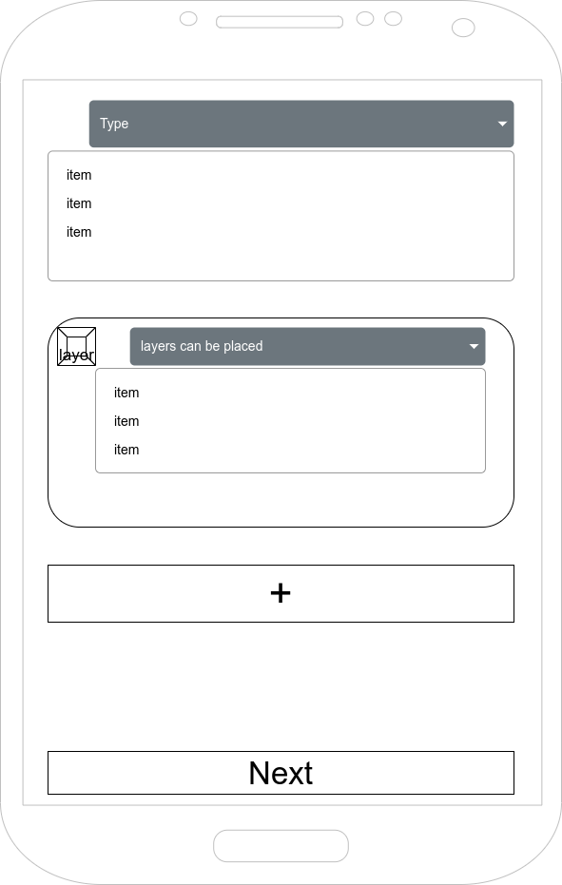

Slide 18
Why should i care!

Slide 19
Thanks!
Do you have any questions?
abdelkareem.soubar@htu.edu.jo

