Slide 1

Students Performance Analysis
SIC – AI702 – G13
Notes:
Note:
1

Slide 2
Agenda
Team Members
Project Overview
Dataset Columns
Exploratory Data Analysis
Preprocessing & Feature Engineering
Descriptive Analysis
Dashboard
Statistical Analysis
Conclusion & Suggestions
Samsung Innovation Campus

Slide 3




Team Members
Abdelrahman Alaa
Kareem Taha
Nouran Ashraf
Samsung Innovation Campus

Slide 4
Project Overview
Samsung Innovation Campus
Notes:
Note:
2

Slide 5
Project Overview
Goal: Analyze student performance and identify key factors affecting outcomes.
Process: EDA → Preprocessing → Feature Engineering → Visualization → Insights
Tools: Pandas, Matplotlib, Seaborn, Scipy, Power BI
Focus: Gender, Ethnicity, Parental Education, Lunch, Test Prep vs. Scores (Math, Reading, Writing)
Outcome: Actionable insights to support educators and improve learning strategies
Dataset: Kaggle – Student Performance in Exams
Samsung Innovation Campus

Slide 6
Dataset Columns
Samsung Innovation Campus
Notes:
Note:
2

Slide 7
Dataset Columns
Demographics
gender – Male / Female
race/ethnicity – Student’s group (A, B, C, D, E.)
Family & Background
parental level of education – Highest education level of parents
Support Factors
lunch – Standard / Free or Reduced
test preparation course – None / Completed
Performance Scores
math score (0–100)
reading score (0–100)
writing score (0–100)
Samsung Innovation Campus

Slide 8
Exploratory Data Analysis
Samsung Innovation Campus
Notes:
Note:
2

Slide 9
Insights summary
Demographics
Slightly more females than males
Majority in Group C ethnicity
Most parents have some college education
Support Factors
Majority have standard lunch
Most did not complete test preparation
Scores
Averages across subjects: 66–69
Performance is consistent across math, reading, and writing
Presence of outliers (very low scores in math & writing)
Key Takeaways
Lunch type and test preparation may influence performance
Data suggests opportunities to improve outcomes through targeted support
Samsung Innovation Campus

Slide 10
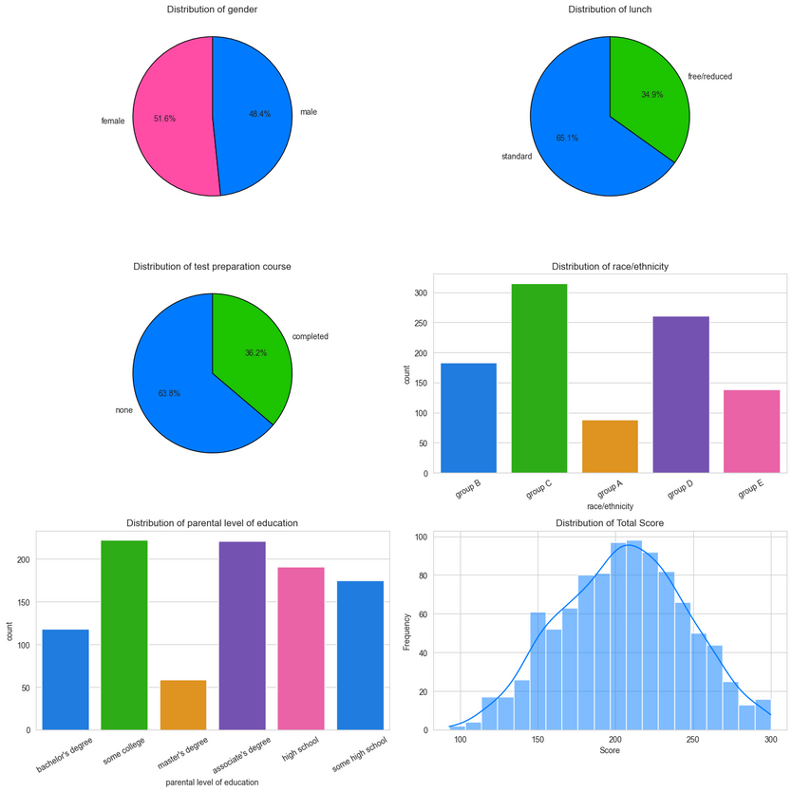
Samsung Innovation Campus

Slide 11
Preprocessing & Feature Engineering
Samsung Innovation Campus
Notes:
Note:
2

Slide 12
Preprocessing & Feature Engineering
Data Cleaning
No missing values or duplicate records
~10 extreme score values detected (still within the valid 0–100 range)
Retained in the dataset as natural variations in student performance
Feature Engineering
Created Total Score ((Math + Reading + Writing) ÷ 3)
Derived Performance Level:
Poor (0–50)
Average (51–70)
Excellent (71–100)
Samsung Innovation Campus

Slide 13
Descriptive Analysis
Samsung Innovation Campus
Notes:
Note:
2

Slide 14
Business Questions
Gender – Are there performance differences between male and female students?
Race/Ethnicity – Do student groups vary in Total Score and Performance Level?
Parental Education – Does parents’ education influence student performance?
Lunch Type – Does free/reduced lunch impact performance compared to standard lunch?
Test Preparation – Does completing the prep course improve exam results?
Subjects – Are scores consistent across Math, Reading, and Writing?
Samsung Innovation Campus

Slide 15
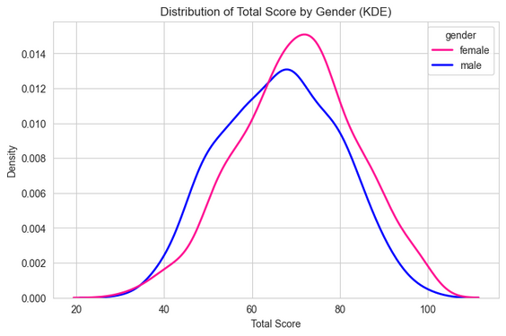
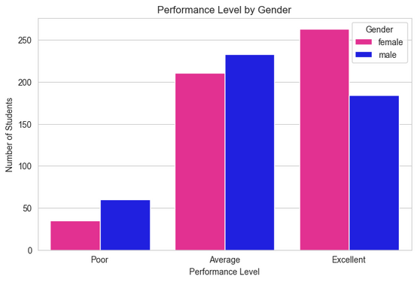
Q1: Performance by Gender
Key Findings:
Females show slightly higher Total Scores than males overall.
Samsung Innovation Campus

Slide 16
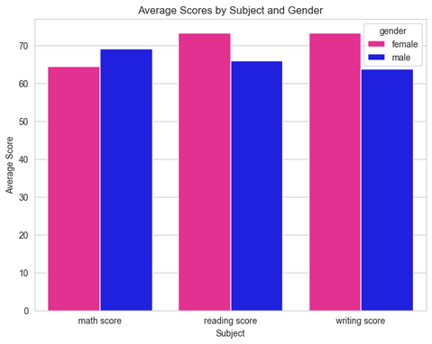
Q1: Performance by Gender
Subject Breakdown:
Math: Males perform slightly better.
Reading & Writing: Females perform noticeably better.
This explains the skew toward higher overall scores for females.
Samsung Innovation Campus

Slide 17
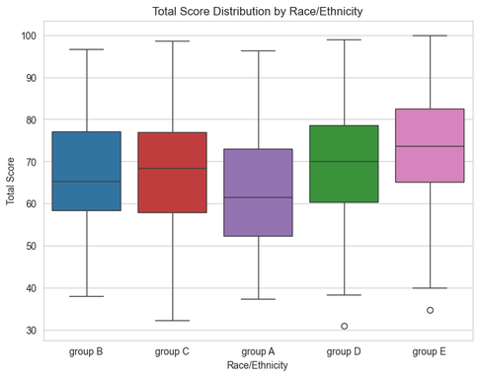
Q2: Performance by Race/Ethnicity
Key Findings:
Group E → Highest median scores, consistent performance.
Group A → Lowest median scores, wider variability (weaker performance).
Groups B, C, D → Middle range with overlapping distributions.
Samsung Innovation Campus

Slide 18
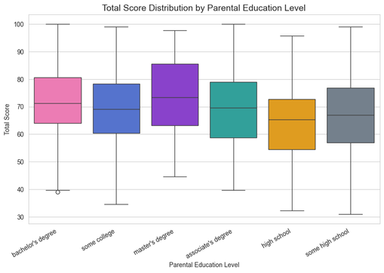
Q3: Impact of Parental Education
Key Findings:
Master’s degree → Highest median scores & stronger performance.
High school / Some high school → Lowest scores, high variability.
Associate’s, Bachelor’s, Some college → Middle range with overlapping distributions.
Samsung Innovation Campus

Slide 19
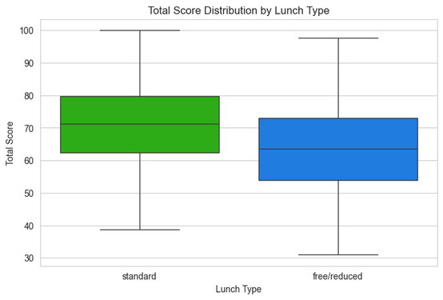
Q4: Impact of Lunch Type
Key Findings:
Standard lunch → Consistently higher scores across all subjects.
Free/Reduced lunch → Lower performance overall.
Suggests a possible link between nutrition and academic achievement.
Samsung Innovation Campus

Slide 20
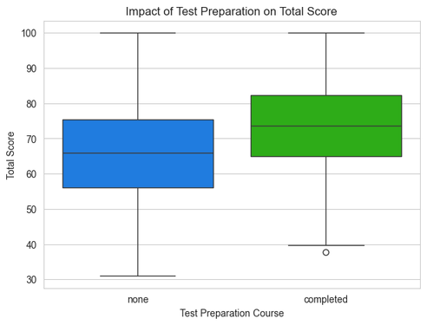
Q5: Effect of Test Preparation
Key Findings:
Completed course → Students achieved notably higher scores.
No course → Lower overall performance.
Highlights the positive impact of preparation on academic outcomes.
Samsung Innovation Campus

Slide 21
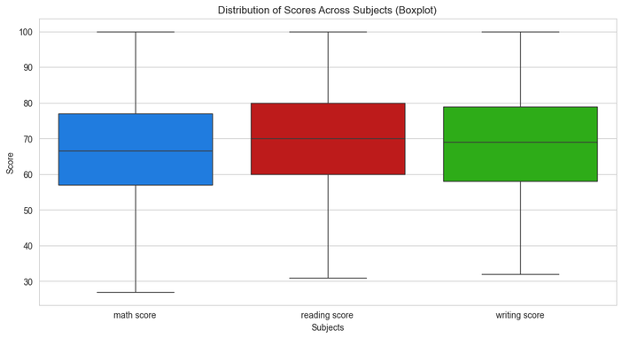
Q6: Performance Across Subjects
Key Findings:
Reading → Slightly higher score distribution compared to Math and Writing.
Math & Writing → Similar distributions, but with more low-score outliers.
Overall → Performance is fairly consistent across subjects, with Reading standing out slightly.
Samsung Innovation Campus

Slide 22
Dashboard
Samsung Innovation Campus
Notes:
Note:
2

Slide 23
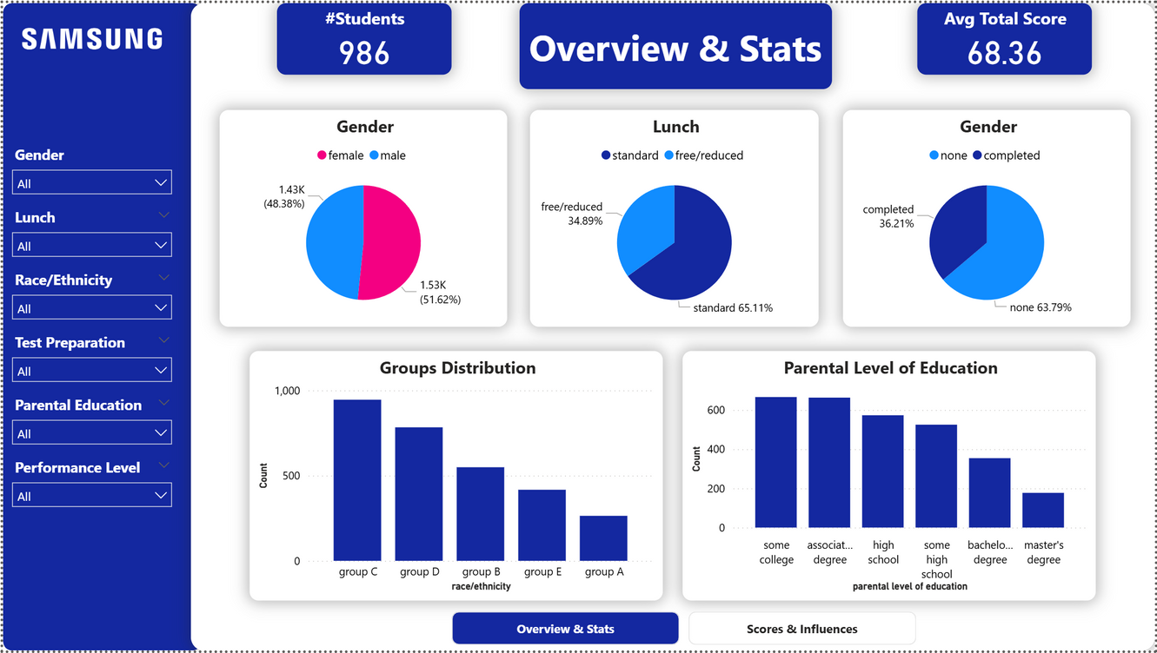

Slide 24
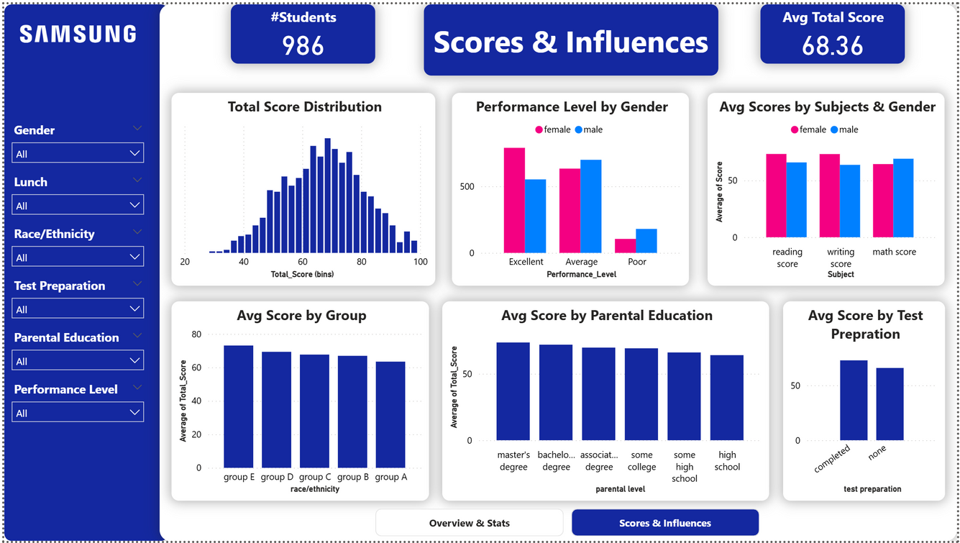

Slide 25
Statistical Analysis
Samsung Innovation Campus
Notes:
Note:
2

Slide 26
Methodology & Statistical Techniques
Data Preparation
Ordinal Encoding: Parental education levels (some high school → master's degree)
Categorical Analysis: Chi-square tests for independence
Derived Variables: Total score calculation, performance level binning
Statistical Methods
Correlation Analysis - Pearson correlations between subject scores
t-Tests - Independent samples t-tests for group comparisons
Effect Size Analysis - Cohen's d for practical significance
Chi-Square Tests - Testing independence between categorical variables
Samsung Innovation Campus

Slide 27
Research Questions
Parental Education → Does parental education level affect student performance?
Test Preparation → Does completing test preparation improve performance?
Demographics & Test Prep → Do gender, race/ethnicity, lunch type, or parental education influence test preparation enrollment?
Performance Levels & Test Prep → Do low, medium, and high performers benefit equally from test preparation?
Overall Factors → Which factors (SES, test prep, parental education, gender) have the strongest effect on student performance?
Samsung Innovation Campus

Slide 28
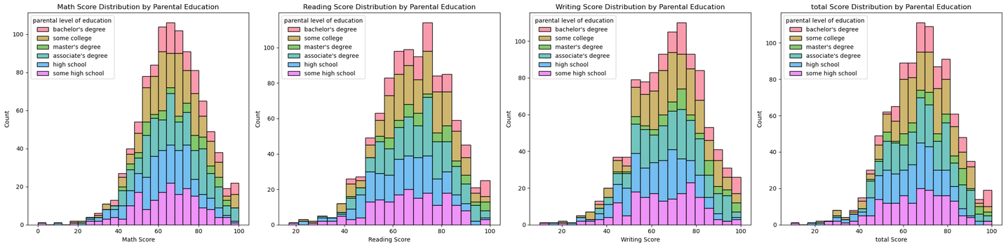
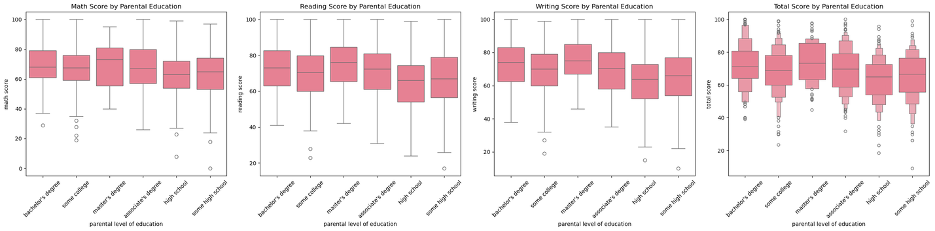
Q1: Impact of Parental Education

Slide 29
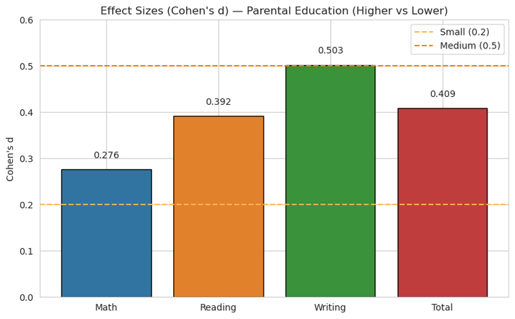
Q1: Impact of Parental Education
Method:
Grouping: Students categorized by Parental Education
Higher: Bachelor’s / Master’s
Lower: All other levels
Statistical Test: Performed t-tests to compare group means
Effect Size: Calculated Cohen’s d to measure practical significance
Findings:
Higher education → Better Reading & Writing scores
Moderate overall effect
T-test → all values < 0.05

Slide 30
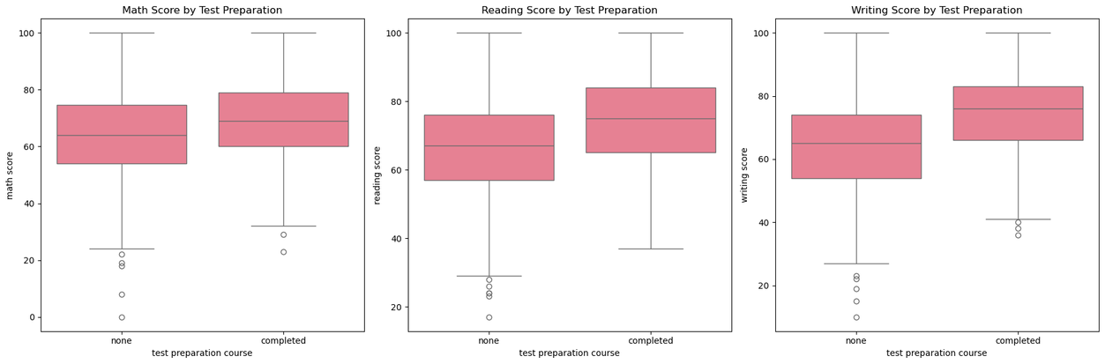
Q2: Test Preparation
Methods:
Compared students who completed vs. did not complete test preparation
Applied t-tests to compare means across subjects
Calculated Cohen’s d effect sizes to measure impact

Slide 31
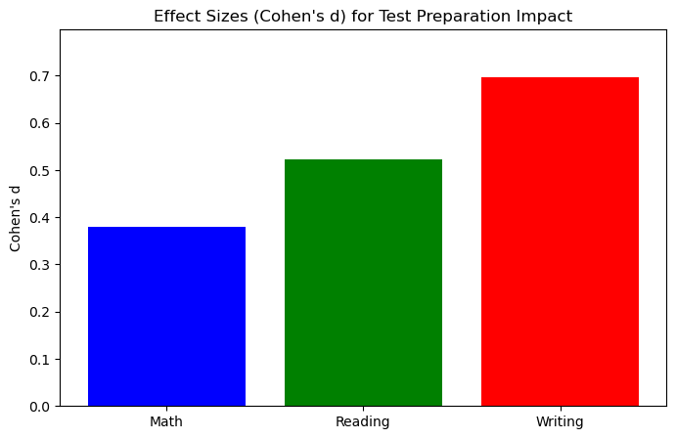
Q2: Test Preparation
Findings:
t-test ⟶ all p-values < 0.05 means there is a significant difference when talking the test
Completed course → Higher scores across all subjects
Strongest impact → Writing
Samsung Innovation Campus

Slide 32
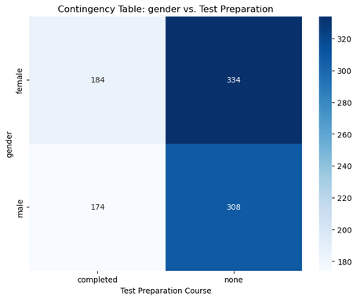
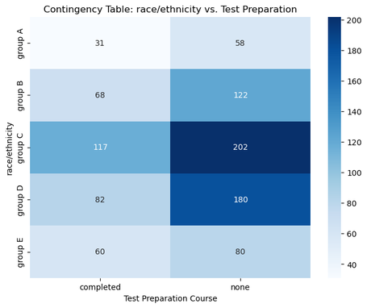
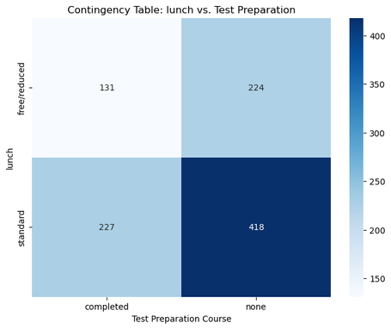
Q3: Demographics & Test prep
Method:
Conducted Chi-square tests of independence
Examined test preparation enrollment vs. demographics:
Gender
Race/Ethnicity
Lunch Type (SES)
Parental Education

Slide 33
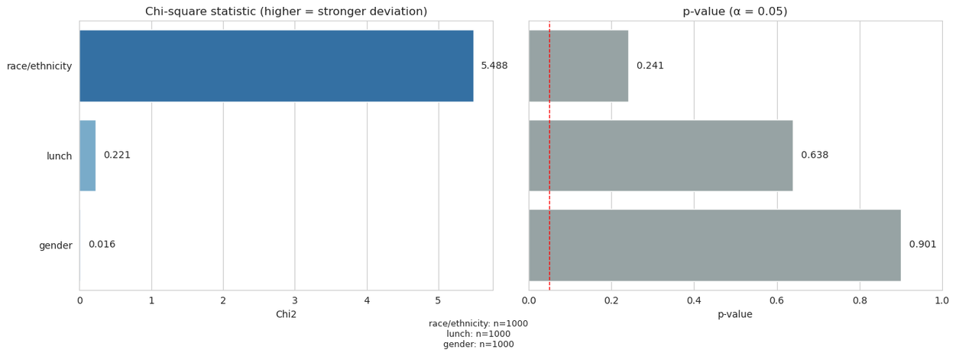
Q3: Demographics & Test prep
Findings:
No significant associations found for gender, race/ethnicity, lunch type, or parental education (p > 0.05)
Test preparation enrollment is independent of demographic background

Slide 34
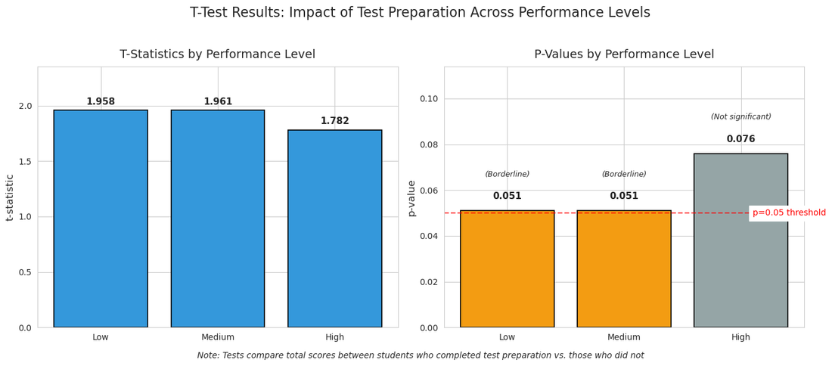
Q4: Performance Levels & Test Prep
Method:
Split students into bins (Low / Medium / High performers)
Conducted t-tests within each group
Measured effect sizes with Cohen’s d

Slide 35
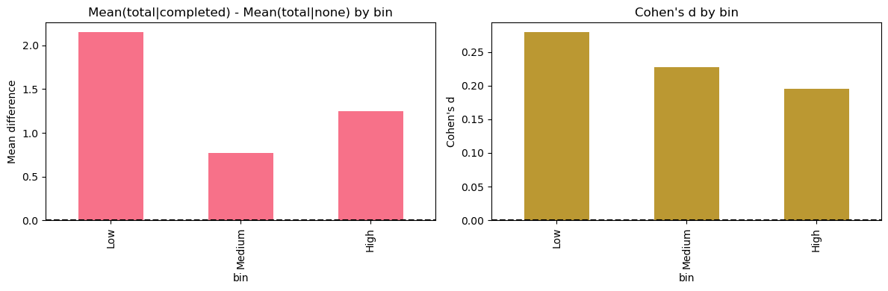
Q4: Performance Levels & Test Prep
Findings:
Suggests slightly stronger benefits for low and medium performers, though effects remain modest

Slide 36
Q5: Main factors affecting students performance
Method:
Comprehensive effect size analysis across multiple factors:
Socioeconomic Status (Lunch Type)
Test Preparation completion
Parental Education level
Gender differences
Used Cohen’s d effect sizes for all subjects
Created heat maps, bar charts, radar plots to compare impacts
Ranked factors by average effect size across subjects

Slide 37
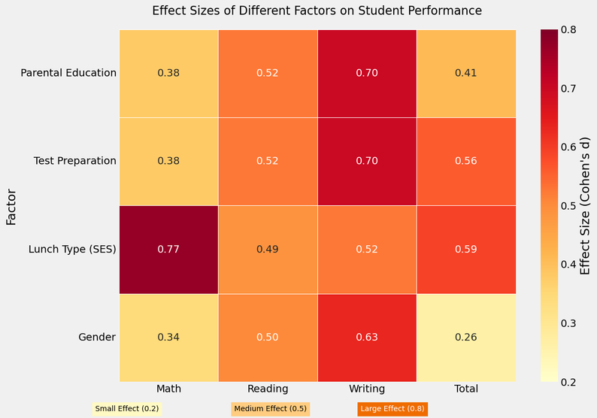
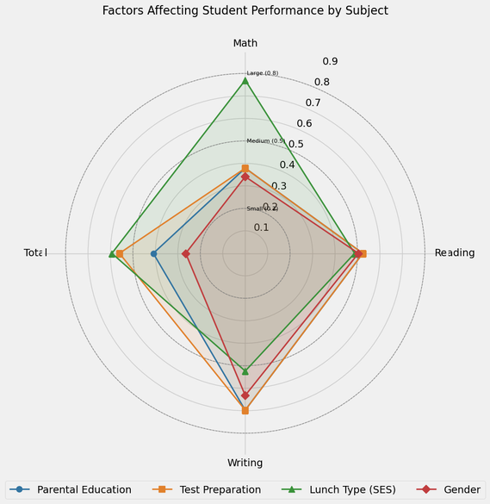
Q5: Main factors affecting students performance

Slide 38
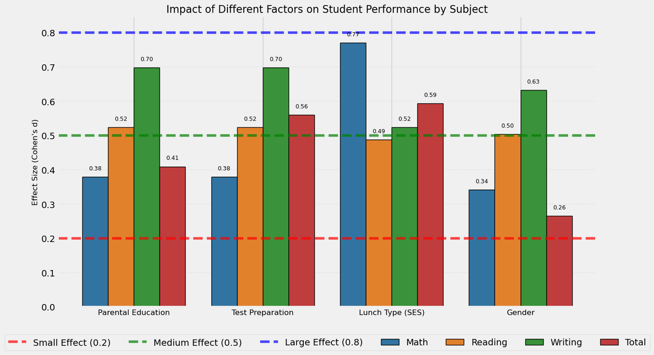
Q5: Main factors affecting students performance

Slide 39
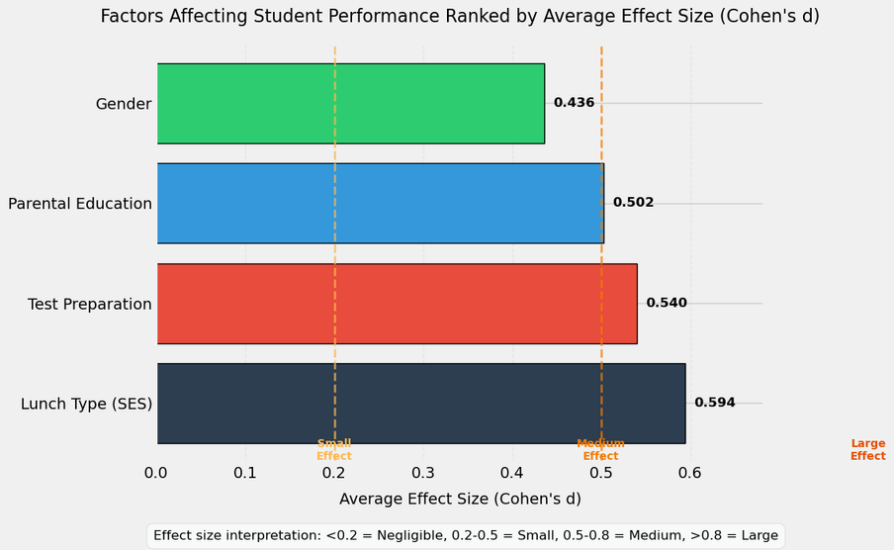
Q5: Ranking most effective factors on students performance
Findings:
Socioeconomic status (lunch type) emerges as the most influential predictor, especially for math scores

Slide 40
Conclusion & Suggestions
Samsung Innovation Campus
Notes:
Note:
2

Slide 41
Conclusions
Key Conclusions
Socioeconomic factors (lunch type, parental education) are the strongest predictors of performance.
Test preparation has a clear positive effect, especially in writing.
Math, reading, and writing are strongly correlated → overall performance.
Gender differences exist: males stronger in math, females stronger in literacy.
Race/ethnicity shows only minor effects on performance.
Samsung Innovation Campus

Slide 42
Suggestions
For Institutions
Target socioeconomic disparities with support programs.
Expand affordable test preparation access, especially for disadvantaged students.
Apply gender-responsive teaching (math focus for females, literacy for males).
Use insights to design data-driven education policies.
For Families
Engage children in learning activities regardless of education level.
Treat test prep as an investment, particularly to boost writing.
Support students facing nutritional or socioeconomic challenges with extra guidance.
Samsung Innovation Campus

Slide 43

ⓒ2020 SAMSUNG. All rights reserved.
Samsung Electronics Corporate Citizenship Office holds the copyright of book.
This book is a literary property protected by copyright law so reprint and reproduction without permission are prohibited.
To use this book other than the curriculum of Samsung innovation Campus or to use the entire or part of this book, you must receive written consent from copyright holder.
Notes:
14

