Slide 1
Module-5 (08 hrs)

Slide 2
Classes and objects: Programmer-defined types, Attributes, Rectangles, Instances as return values, Objects are mutable, Copying,
Classes and functions: Time, Pure functions, Modifiers, Prototyping versus planning,
Classes and methods: Object-oriented features, Printing objects, Another example, A more complicated example, Theinit method, The __str__ method, Operator overloading, Type-based dispatch, Polymorphism, Interface and implementation,
Chapters 13, 15, 16, 17, 18

Slide 3
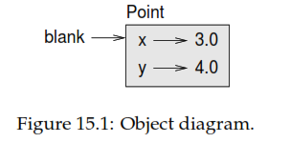
Programmer-defined types
A programmer-deﬁned type is also called a class. A class deﬁnition looks like this
Class point:
‘’’’’ Represents a point in a 2D space”””

Slide 4
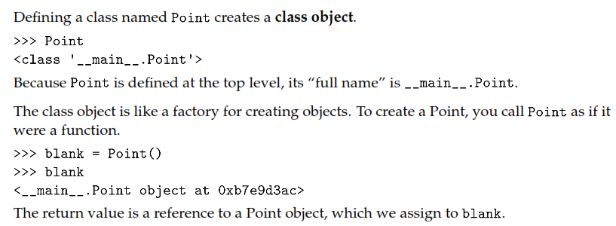
The header indicates that the new class is called point. The body is a docstring that explains what the class is for.
You can deﬁne variables and methods inside a class deﬁnition.
Deﬁning a class named point creates a class object.

Slide 5
Creating a new object is called instantiation, and the object is an instance of the class.
When you print an instance, Python tells you what class it belongs to and where it is stored in memory
Every object is an instance of some class, so “object” and “instance” are interchangeable.

Slide 6
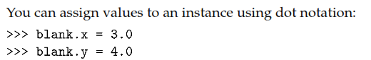
Attributes
In this case, though, we are assigning values to named elements of an object. These elements are called attributes.
The variable blank refers to a Point object, which contains two attributes. Each attribute refers to a ﬂoating-point number.

Slide 7
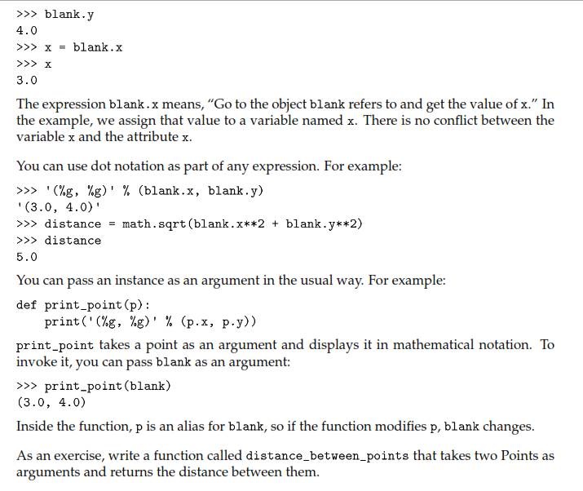
Rectangles

Slide 8
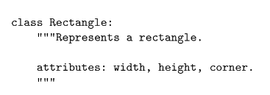
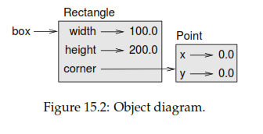
Rectangles
The docstring lists the attributes: width ,height are numbers; corner is a Point object
that speciﬁes the lower-left corner.

Slide 9
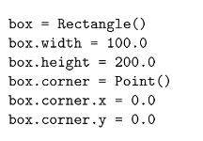

Slide 10
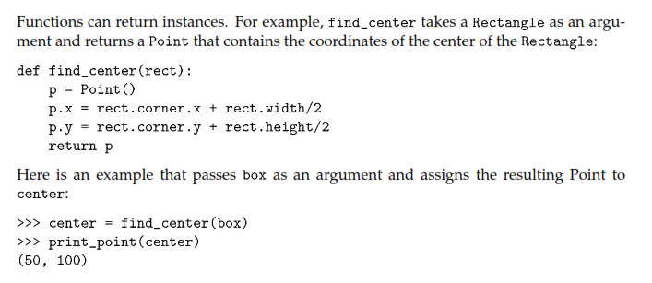
Instances as return values

Slide 11
Objects are mutable
You can change the state of an object by making an assignment to one of its attributes. For example, to change the size of a rectangle without changing its position, you can modify the values of width and height.

Slide 12
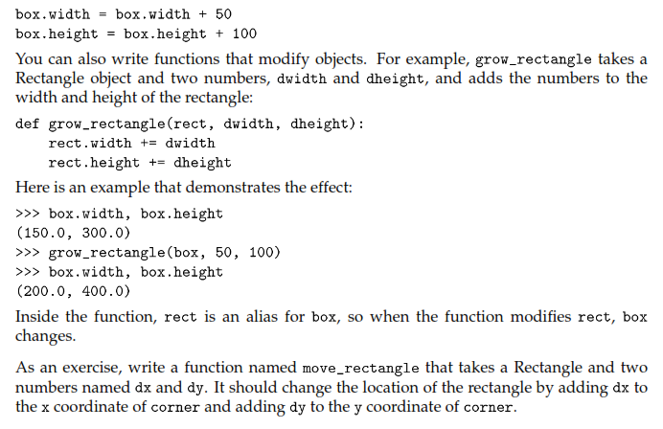

Slide 13
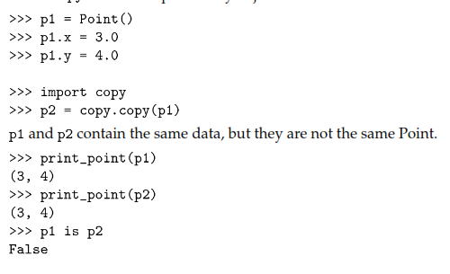
Copying
Copying an object is often an alternative to aliasing. The copy module contains a function called copy that can duplicate any object:

Slide 14
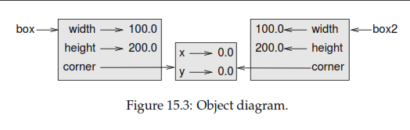


Slide 15
Debugging
When you start working with objects, you are likely to encounter some new exceptions. If you try to access an attribute that doesn’t exist, you get an attribute error:

Slide 16
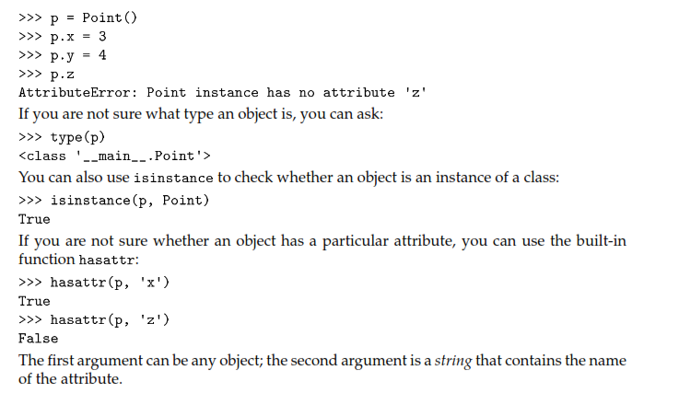

Slide 17
class: A programmer-deﬁned type. A class deﬁnition creates a new class object.
class object: An object that contains information about a programmer-deﬁned type. The class object can be used to create instances of the type.
instance: An object that belongs to a class.
instantiate: To create a new object.
attribute: One of the named values associated with an object.
embedded object: An object that is stored as an attribute of another object.
shallow copy: To copy the contents of an object, including any references to embedded
objects; implemented by the copy function in the copy module.
deep copy: To copy the contents of an object as well as any embedded objects, and any
objects embedded in them, and so on; implemented by the deepcopy function in the
copy module.
object diagram: A diagram that shows objects, their attributes, and the values of the attributes.

Slide 18
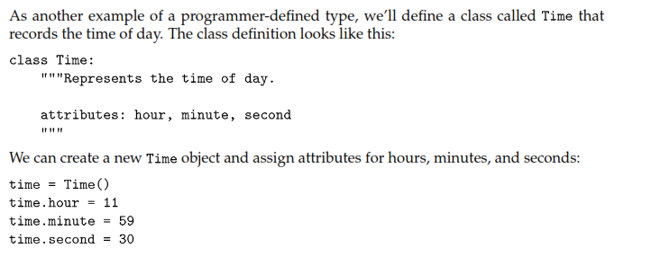
Classes and functions
Time

Slide 19
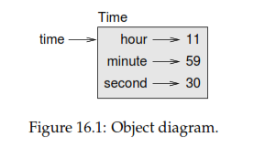

Slide 20
Pure functions

