Slide 1
OOP

Slide 2
You’ve most likely had to fill out paper or electronic forms numerous times in your life: for doctor’s visits, for online purchases, or to RSVP to a wedding.
Forms exist as a uniform way for another person or organization to collect the information they need about you.
Different forms ask for different kinds of information. You would report a sensitive medical condition on a doctor’s form, and you would report any guests you’re bringing on a wedding RSVP, but not the other way around.

Slide 3
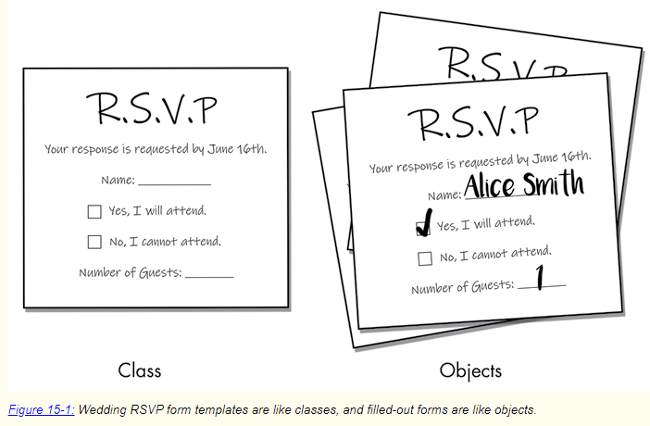

Slide 4
In Python, class, type, and data type have the same meaning. Like a paper or electronic form, a class is a blueprint for Python objects (also called instances), which contain the data that represents a noun.
This noun could be a doctor’s patient, an ecommerce purchase, or a wedding guest.
Classes are like a blank form template, and the objects created from that class are like filled-out forms that contain actual data about the kind of thing the form represents.
For example, in Figure 15-1, the RSVP response form is like a class, whereas the filled-out RSVP is like an object.

Slide 5
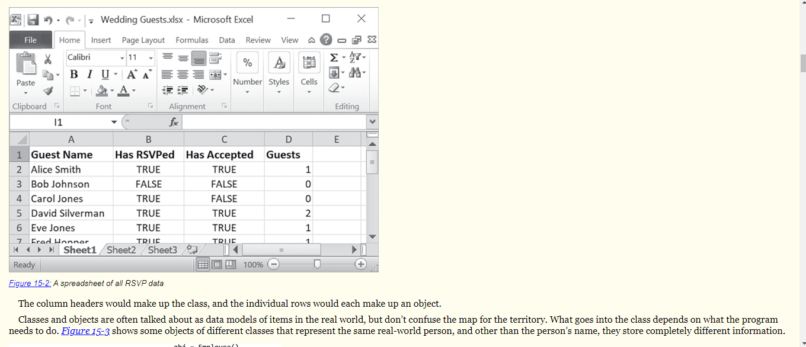

Slide 6
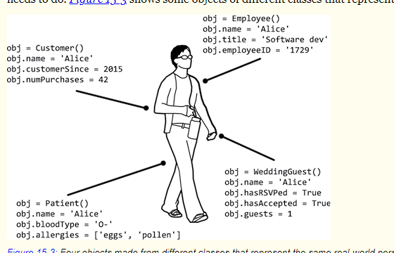

Slide 7
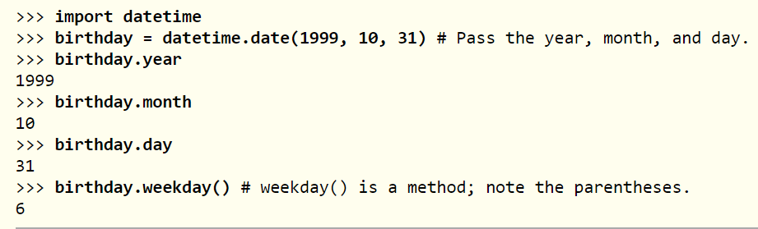
Creating Objects from Classes

Slide 8
Attributes are variables associated with objects.
The call to datetime.date() creates a new date object, initialized with the arguments 1999, 10, 31 so the object represents the date October 31, 1999.
We assign these arguments as the date class’s year, month, and day attributes, which all date objects have.

Slide 9
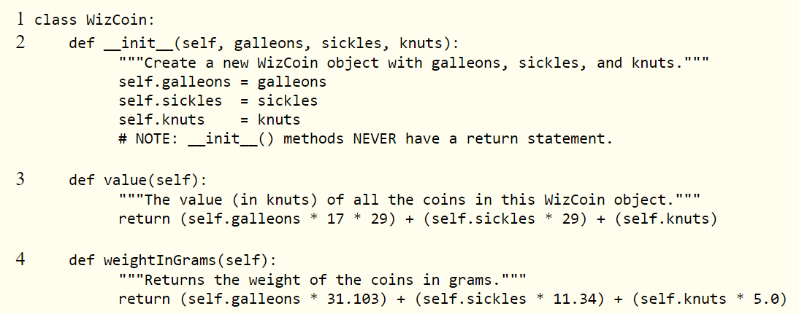
Creating a Simple Class: WizCoin

Slide 10
Inside the block of code following the class statement are the definitions for three methods: __init__() (short for initializer) 2
value()
3, and weightInGrams()
4. Note that all methods have a first parameter named self, which we’ll explore in the next section.

Slide 11
As a convention, module names (like wizcoin in our wizcoin.py file) are lowercase, whereas class names (like WizCoin) begin with an uppercase letter.

Slide 12
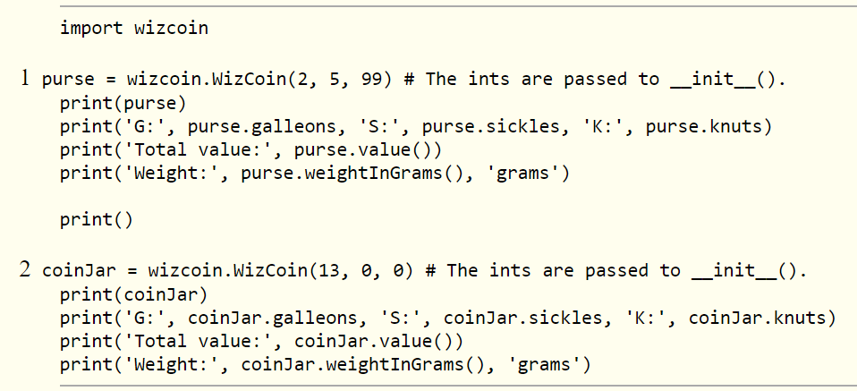

Slide 13
The calls to WizCoin() 1 2 create a WizCoin object and run the code in the __init__() method for them.
We pass in three integers as arguments to WizCoin(), which are forwarded to the parameters of __init__().
These arguments are assigned to the object’s self.galleons, self.sickles, and self.knuts attributes.
Note that, just as the time.sleep() function requires you to first import the time module and put time. before the function name, we must also import wizcoin and put wizcoin. before the WizCoin() function name.

Slide 14
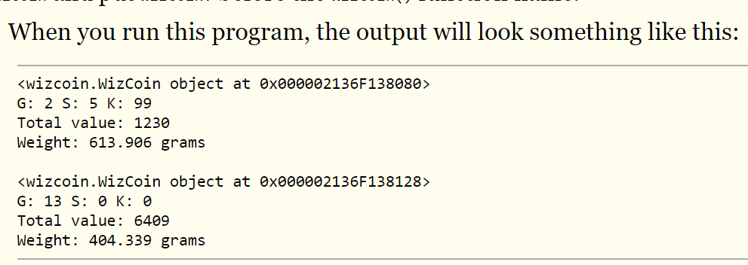

Slide 15
If you get an error message, such as ModuleNotFoundError: No module named 'wizcoin', check to make sure that your file is named wizcoin.py and that it’s in the same folder as wcexample1.py.

Slide 16
Methods, __init__(), and self
Methods are functions associated with objects of a particular class.
Recall that lower() is a string method, meaning that it’s called on string objects. You can call lower() on a string, as in 'Hello'.lower(), but you can’t call it on a list, such as ['dog', 'cat'].lower().
Also, notice that methods come after the object: the correct code is 'Hello'.lower(), not lower('Hello'). Unlike a method like lower(), a function like len() is not associated with a single data type; you can pass strings, lists, dictionaries, and many other types of objects to len().

Slide 17
we create objects by calling the class name as a function. This function is referred to as a constructor function (or constructor, or abbreviated as ctor, pronounced “see-tore”) because it constructs a new object. We also say the constructor instantiates a new instance of the class.
Calling the constructor causes Python to create the new object and then run the __init__() method.
Classes aren’t required to have an __init__() method, but they almost always do.
The __init__() method is where you commonly set the initial values of attributes.

Slide 18
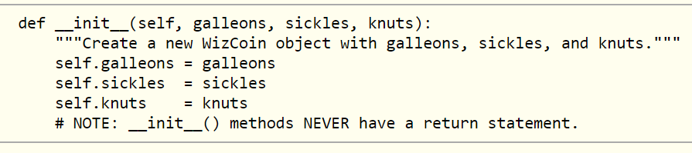

Slide 19
When the wcexample1.py program calls WizCoin(2, 5, 99), Python creates a new WizCoin object and then passes three arguments (2, 5, and 99) to an __init__() call. But the __init__() method has four parameters: self, galleons, sickles, and knuts.
The reason is that all methods have a first parameter named self. When a method is called on an object, the object is automatically passed in for the self parameter.
The rest of the arguments are assigned to parameters normally.
If you see an error message, such as TypeError: __init__() takes 3 positional arguments but 4 were given, you’ve probably forgotten to add the self parameter to the method’s def statement.

Slide 20
Attributes
Attributes are variables associated with an object.
The Python documentation describes attributes as “any name following a dot.” For example, consider the birthday.year expression in the previous section. The year attribute is a name following a dot.

Slide 21
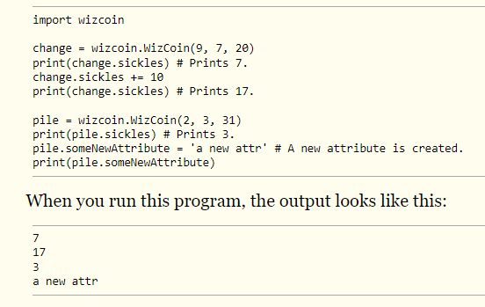

Slide 22
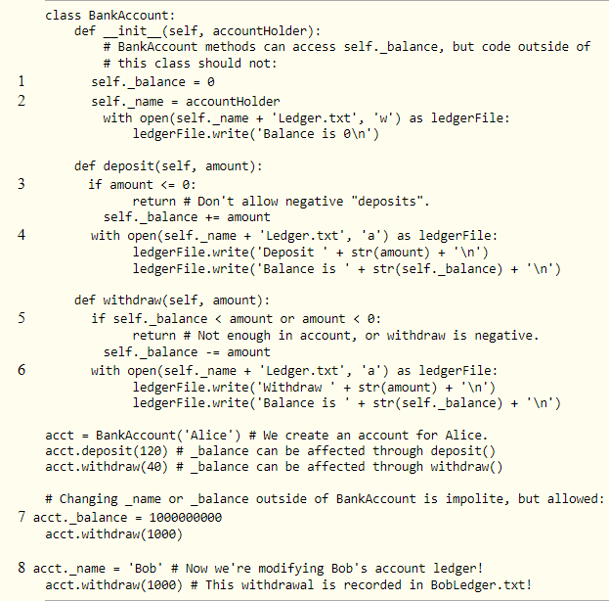

Slide 23
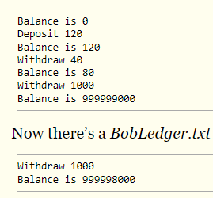

Slide 24
Inheritance
Similar to functions, inheritance is a code reuse technique that you can apply to classes.
It’s the act of putting classes into parent-child relationships in which the child class inherits a copy of the parent class’s methods, freeing you from duplicating a method in multiple classes.

Slide 25
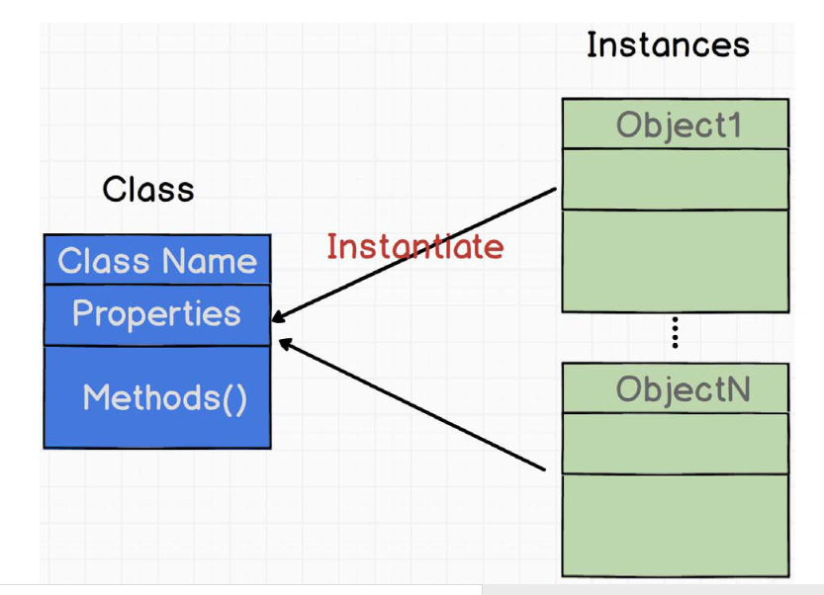

Slide 26
When we want to create an Object from a particular Class, we need to instantiate that class.
The Objects we are creating are called Class Instances and we can create as many instances as we want.
The method at the top of the Class declaration is known as the constructor method or init().

Slide 27
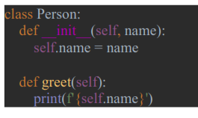

Slide 28
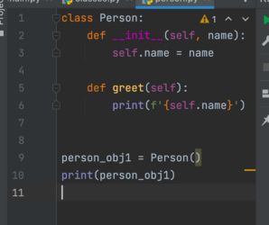

Slide 29
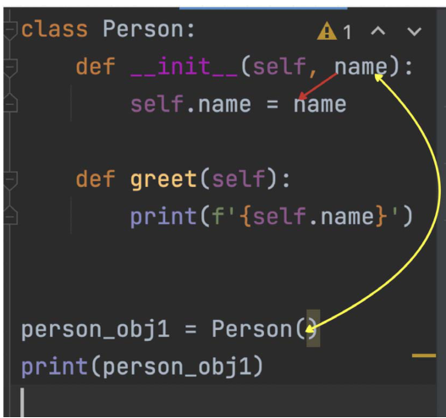
when we instantiate an Object of the Class Person, we need to provide the argument or arguments that are listed in the init constructor. In our case, the init constructor requires only one parameter and that is the ‘name’

Slide 30
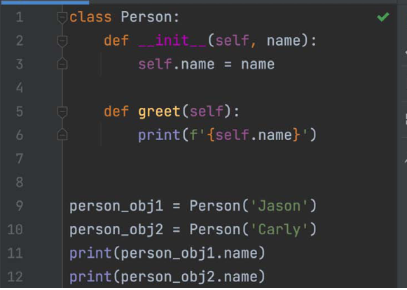

Slide 31
As you can see, we have created another instance of the Person Class and this instance now has a different name attribute (Carly) and when the __init__ method is called, the name parameter will assign ‘Carly’ because the of ‘self’ keyword which will tell the constructor that the parameter belongs to the person_obj2 Object.
So, we have followed the good old DRY (DO Not Repeat Yourself) principle because we were able to create two separate instances/objects that called the same class with different name attributes.
The objects accessed the same class and its methods and properties. If this was not OOP, then we would have to write the same code for both of the objects.
This is making the code to be more dynamic.
The self-keyword is bound to the object that is instantiated.
In the Person Class, the init constructor is very simple, accepting only one parameter but it can be much more complex, for example, let’s say we want the constructor to be called with name, last name, and age parameters and we can also change the greet() function to print all of the details:

Slide 32
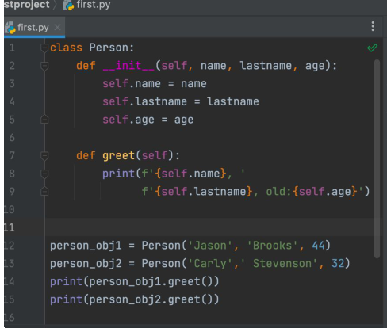

Slide 33
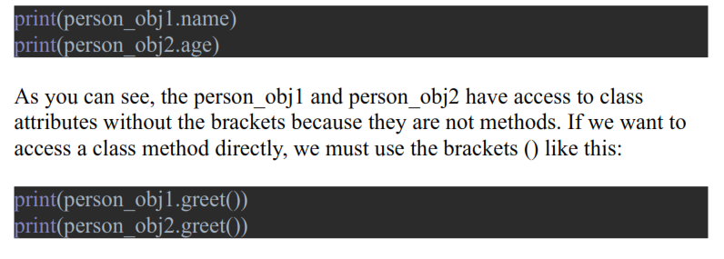
Now when we instantiate an Object from the Person class, we need to pass two additional arguments like last name and age.
The name, lastname, and age are class attributes and they can be accessed by the Object/instance. The class attributes are properties that the Object has access to using the dot notation and the property:

Slide 34
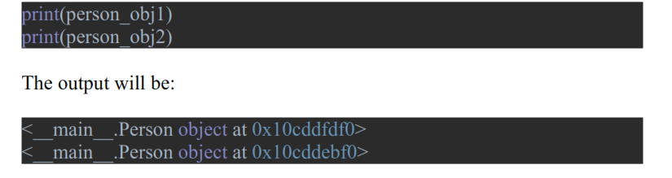
As you can see, both Person objects are stored in different locations in the computer memory.
This is perfect because now each of these objects can have its own methods and attributes that will be hidden from the other object

Slide 35
Class can have attributes and methods.
The attributes are initialized by the constructor method that will have a ‘self’ keyword as a default parameter.
When we create a new object or instance of the class Person, we immediately call the constructor and initialize all of the parameters to the values that are unique to that object.
Each instance of the Person class can access the class methods and attributes and they are independent of each other, meaning they are stored in different memory locations.

Slide 36
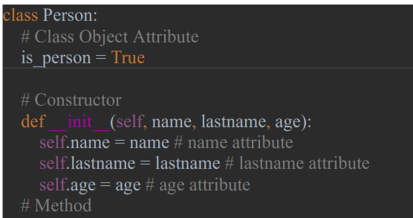
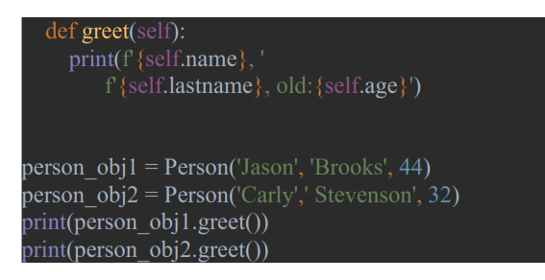

Slide 37
we have the is_person Class Object attribute that is set to be Boolean True. The difference between this attribute and the rest of the attributes is that the Class Object attributes are static.
In the method greet(self), we pass the self-keyword so we can get access to the name, lastname, and age from the object that calls the method because the self is bound to the object.
But this static attribute can also be called by the class itself:

Slide 38
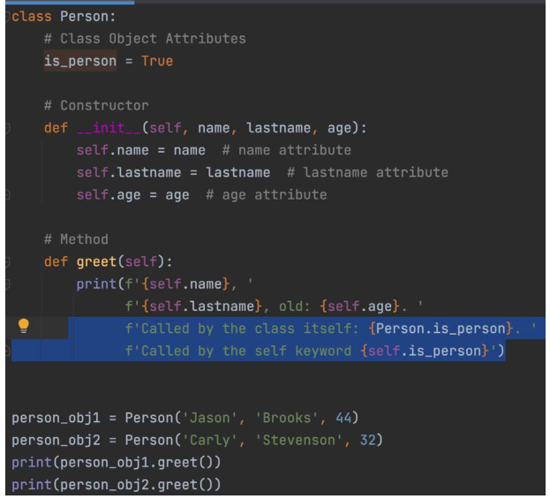

Slide 39
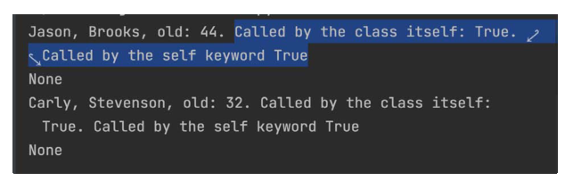
Class object attributes are the ones that will not change, they are static and can be accessed directly by the class itself or the instances/objects.
The class object attributes belong to the class and they are initialized to some value in the Class itself, and the attributes defined in the constructor or other methods like name, age, and lastname will have values that are dynamically assigned by the calling objects. If we run the above code the output is

Slide 40
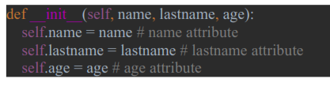

__init__ Constructor

Slide 41
As soon as the person_obj1 is instantiated from the class Person, the constructor function will be called. Why is the constructor function so important? Well, the constructor will do its job and it will construct a new Object or instance of the Person Class so that the new object can use the Class attributes and methods.
The constructor’s first parameter is the self keyword. This self-keyword as you can see have a different color if we compare it to the rest of the constructor parameters. When I first started to learn Python, I understood that the self is just a reference to the calling object, and each object will have its own self.
Each object we create is unique and therefore the self-keyword must belong to only one object.

Slide 42
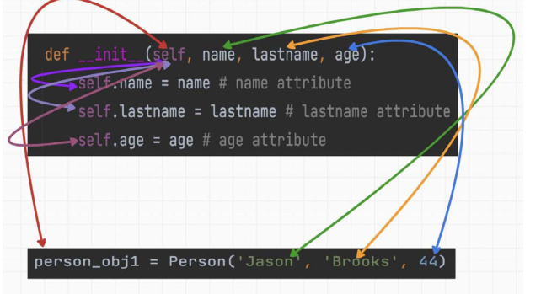

Slide 43
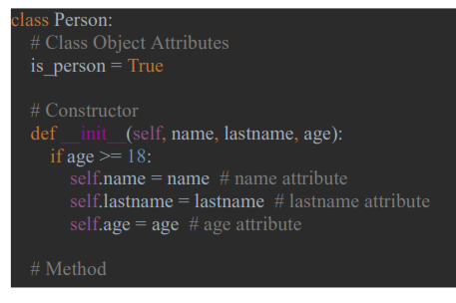
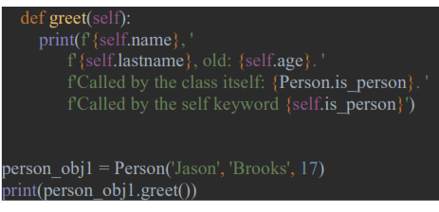

Slide 44
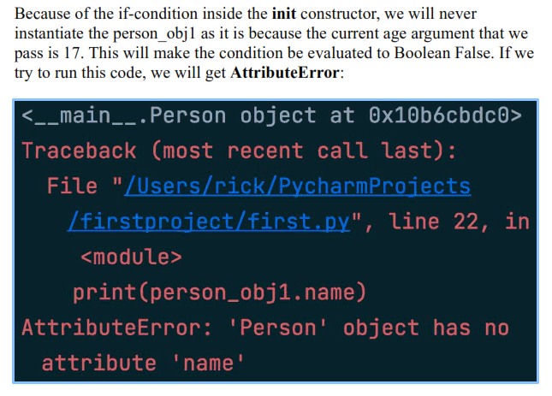

Slide 45
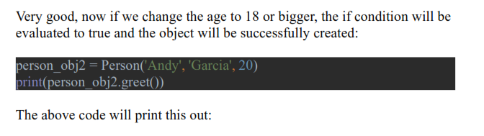
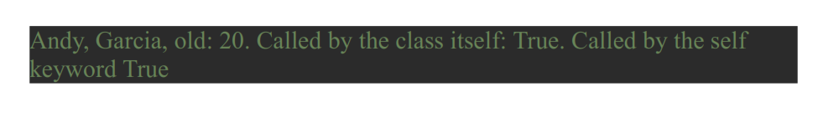

Slide 46
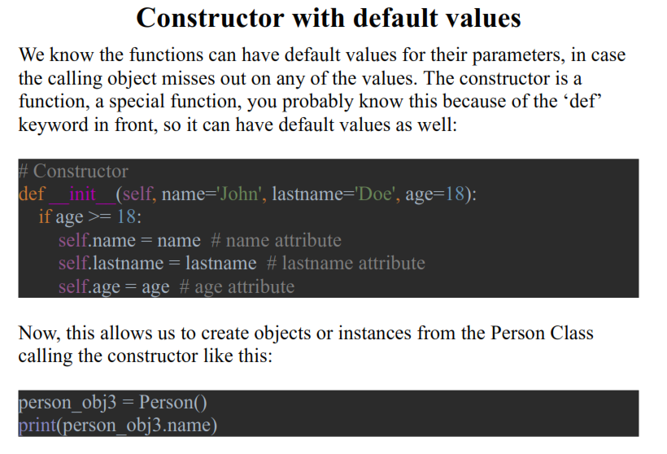

Slide 47
The output from the code above will be John even though we didn’t pass any arguments to the Person() constructor. The default values we have in our code are called safeguards so we can have proper control of how we instantiate Objects from a Class.

Slide 48
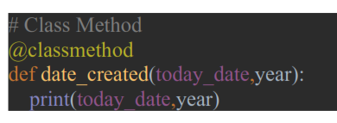
Create Class Methods using @classmethod
@classmethod keyword which is known as a decorator. We need to use the decorator before the function declaration

Slide 49
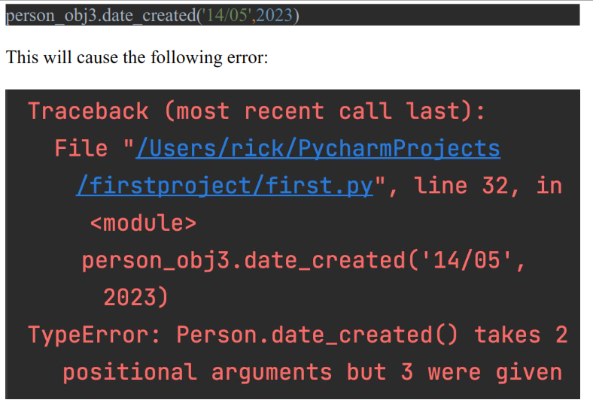
As we can see, before the method declaration, we used the @classmethod decorator and then the rest of the method syntax is the same as before. Can this method be accessed by the Objects of the Person Class?

Slide 50
The error says we supplied 2 parameters but 3 were given. If you remember, each method inside the Class should have the self-keyword as a first parameter, but here we are missing this keyword.
The Class method does not belong to the Object therefore the ‘self’ keyword is no longer needed but we need to use a keyword that will tie this method to the Class.
Therefore, we use the ‘cls’ which stands for class and is standard nowadays.

Slide 51
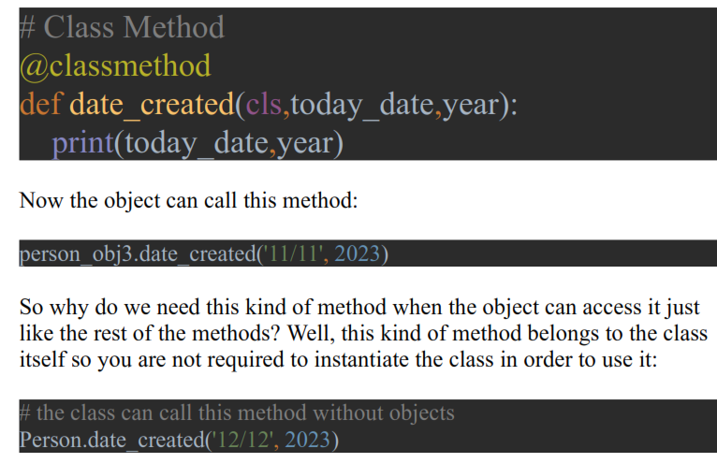

Slide 52
To summarize what we have learned about the Class method:
the class method is bound to the class and not to the object
the class method has access to the class and its state like all of the
attributes of that class
It can access and modify the class states and attributes

Slide 53
Static method @staticmethod
The static method is very similar to the class method but the difference is
that we don’t have to use the class implicit keyword ‘cls’.
The static method does not have access to the Class state and therefore cannot modify the Class. So why do we need these static class methods then?
Well, these methods can be used as utility-type methods that can take parameters and perform some action.
To create a static method, we need to use the decorator @staticmethod:

Slide 54
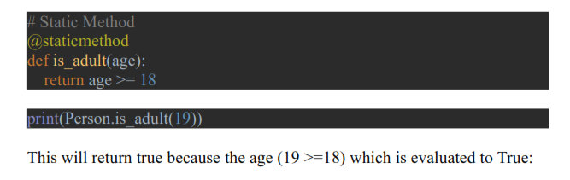

Slide 56
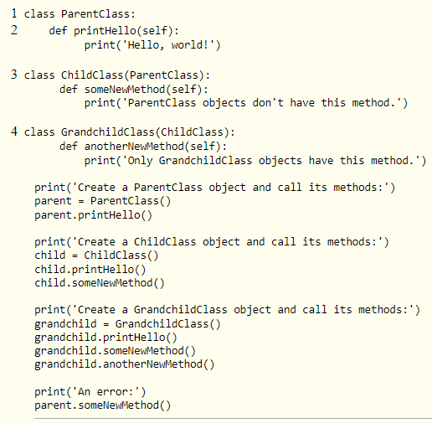

Slide 57
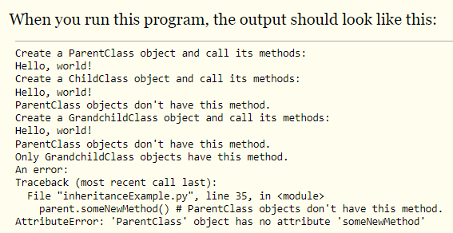

Slide 58
We’ve created three classes named ParentClass 1, ChildClass 3, and GrandchildClass 4.
The ChildClass subclasse sParentClass, meaning that ChildClass will have all the same methods as ParentClass.
We say that ChildClassinherits methods from ParentClass. Also, GrandchildClass subclasses ChildClass, so it has all the same methods as ChildClass and its parent, ParentClass.

Slide 59
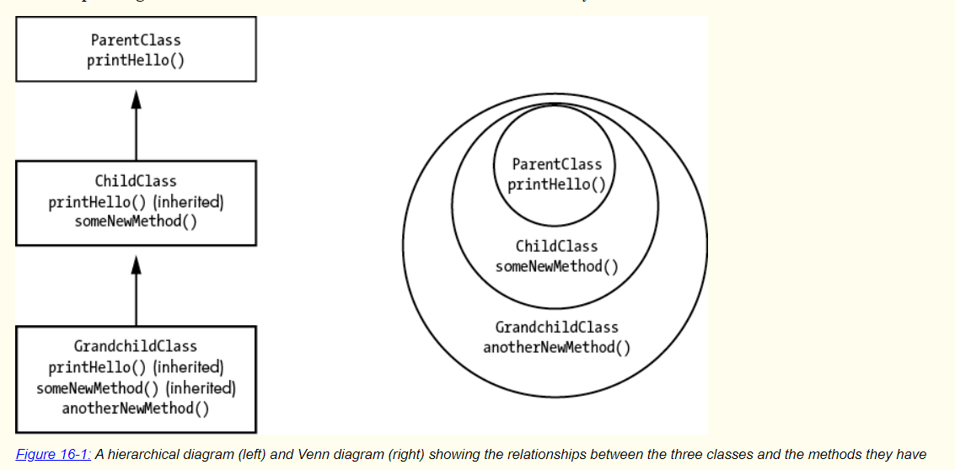

Slide 60
The primary purpose of inheritance is code reuse. If your program needs a class with a set of methods that is a complete superset of some other class’s methods, inheritance allows you to avoid copying and pasting code.

Slide 61
Encapsulation
The word encapsulation has two common but related definitions. The first definition is that encapsulation is the bundling of related data and code into a single unit. To encapsulate means to box up. This is essentially what classes do: they combine related attributes and methods.
For example, our WizCoin class encapsulates three integers for knuts, sickles, and galleons into a single WizCoin object.
The second definition is that encapsulation is an information hiding technique that lets objects hide complex implementation details about how the object works. BankAccount objects present deposit() and withdraw() methods to hide the details of how their _balance attributes are handled. Functions serve a similar black box purpose: how the math.sqrt() function calculates the square root of a number is hidden. All you need to know is that the function returns the square root of the number you passed it.

Slide 62
Polymorphism
Polymorphism allows objects of one type to be treated as objects of another type.
For example, the len() function returns the length of the argument passed to it.
You can pass a string to len() to see how many characters it has, but you can also pass a list or dictionary to len() to see how many items or key-value pairs it has, respectively.
This form of polymorphism is called generic functions or parametric polymorphism, because it can handle objects of many different types.

