Slide 1
Adsorption

Slide 2
Adsorption
Surface Phenomenon
Adsorbate
Adsorbent
Desorption= Reverse of absorption
Gas-Solid
Liquid-Solid
Gas-Liquid
Liquid-liquid (in case of immiscible liquids in contact)
Chemisorption
Physisorption

Slide 3
Adsorption is the consequence of surface energy. All the ions and atoms in the bulk of the material are held bonded by the other neighboring counterparts, while those on the surface aren’t wholly surrounded by the adsorbent ions or atoms. Thus, those adsorbent atoms are capable of attracting adsorbate.

Slide 4
Adsorption Isotherm
Freundlich Adsorption Isotherms
Langmuir Adsorption Isotherms

Slide 5
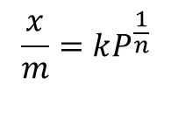
Freundlich Adsorption Isotherms
$$\frac{x}{m}=kP^{\frac{1}{n}}$$
x = mass of the gas adsorbed,
m = mass of the adsorbent,
P = pressure of the system,
k, n = constants

Slide 6

Langmuir Adsorption Isotherms
$$\frac{x}{m}=abc\left(1+ac\right)$$
x= weight of the solute adsorbed,
m= mass of the adsorbent
c = equilibrium concentration of the solute
a, b= constants
Langmuir adsorption isotherm is applicable for monolayer adsorption onto a homogeneous surface

Slide 7
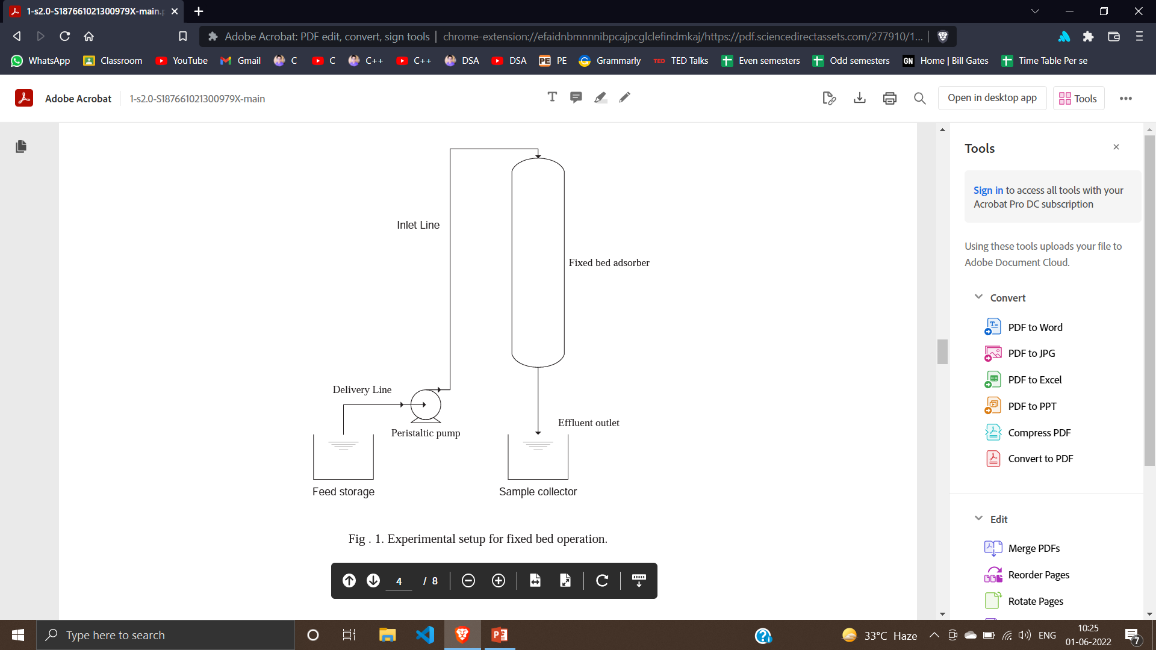
Fixed Bed Adsorption

Slide 8
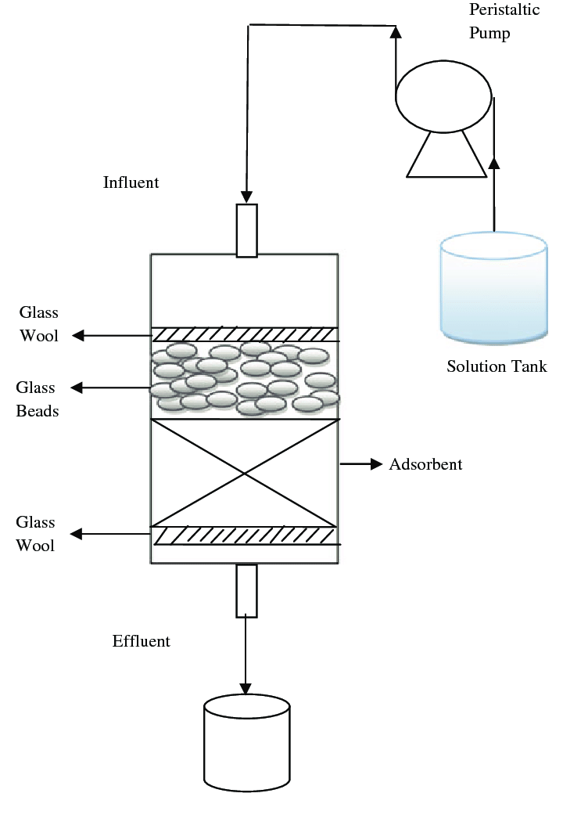
Fixed Bed Adsorber Internals
Glass Wool = to restrain the movement of the bed
Design parameters for the bed:
Diameter of the tower
Length of the bed
Cycle time for bed change over
Length of the bed

Slide 9
Fixed Bed Adsorbent Column
Adsorption Rate can be analyzed in two ways:
Mass Transfer coefficient approach
Mass transfer zone concept

Slide 10
Mass Transfer Zone concept:
A total resistance to mass transfer is expressed in terms of an unused adsorbent which must be added to the adsorbent equilibrium requirement.
MTZ is where the dynamic adsorption takes place.
MTZ can be defined as the length it takes the adsorbent to bring the impurities from their initial concentration to the final specification.

Slide 11
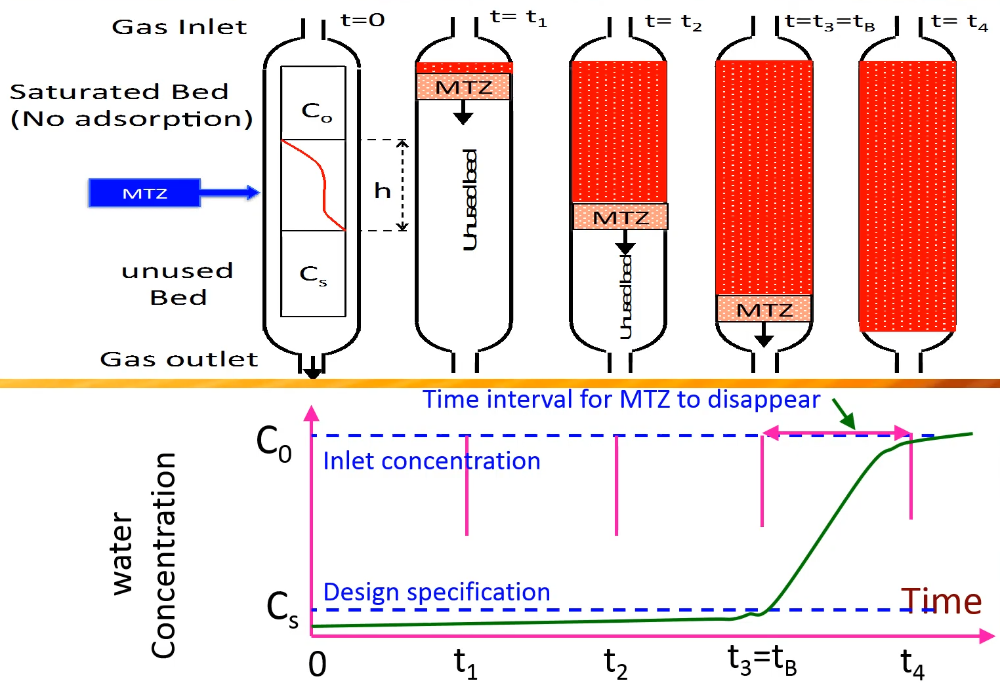
Breakthrough Curve

Slide 12
MTZ:
Length of the mass transfer zone depends on :
Rate of adsorption
Fluid superficial velocity
Type of adsorbent and pore structure and distribution
Gas inlet and outlet concentration

Slide 13
Moving Bed Adsorption with heat integration for CO2 capture
A moving bed adsorption (MBA) process with heat integration is proposed as a potentially viable post-combustion process for the capture of CO₂ from large-scale CO₂-emitting plants.
The proposed process consists of an adsorption bed and two desorption beds through which the adsorbent particles continuously circulate.
The adsorbent particles and CO2 flow in opposite directions in the adsorption bed, which is operated at low temperature and atmospheric pressure.

Slide 14
The adsorbents discharged from the adsorption bed are transferred to a desorption bed operated at a high temperature and 1 atm, then transferred to another desorption bed operated at a high temperature and in a vacuum and returned to the adsorption bed. A heat integration scheme in which the thermal energy removed from the adsorption bed is reused in the desorption beds is designed.

