Slide 1
0513 Data meeting
For Viola genome project
SNU, School of Biological Science
Hyunsu Lim
Notes:
sp.. 를 yeodensis로 바꾸기

Slide 2
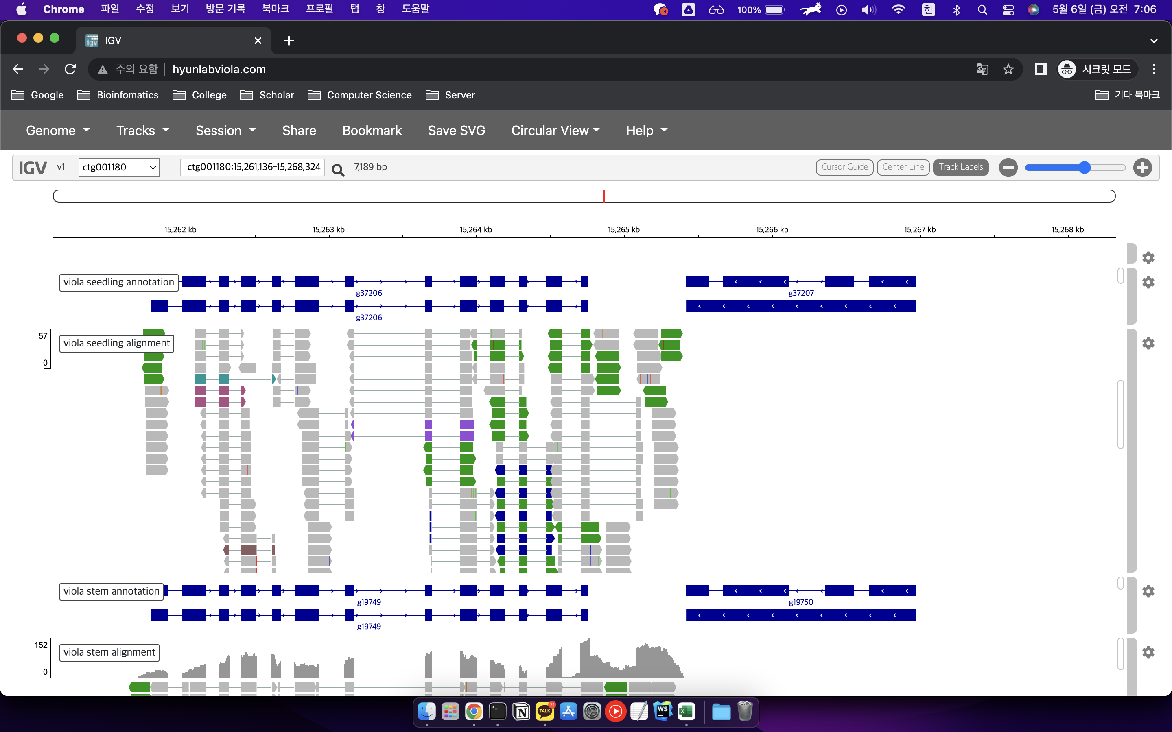
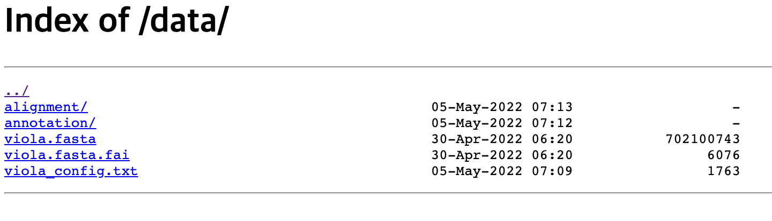
Last work
Annotation for Viola yedoensis transcriptome
Genome Browser for Viola yedoensis

Slide 3
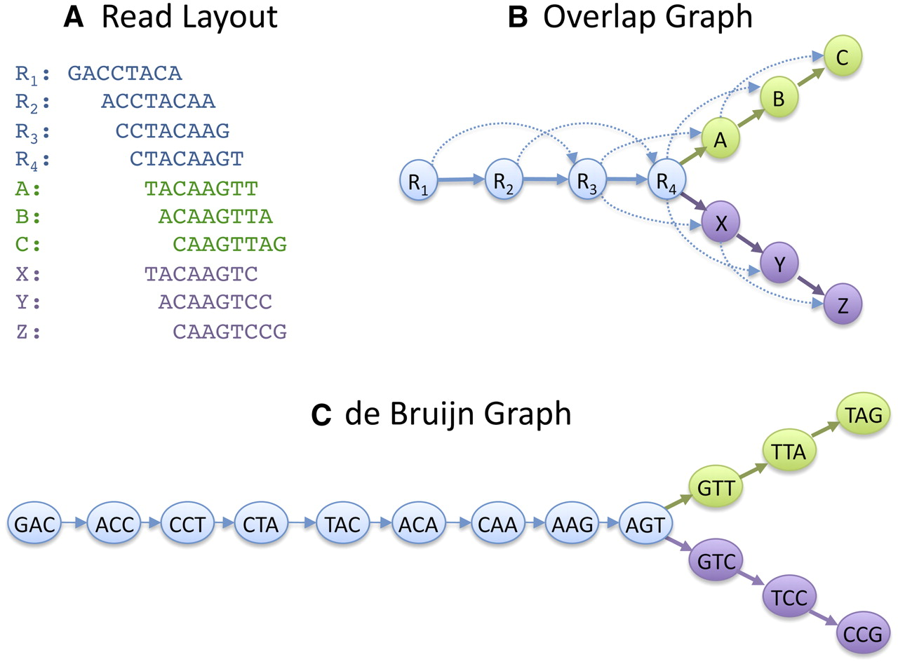
Conventional Genome assembly
Using Graph Theory
=> Genome assembly
is NP-hard problem
mathmatically
Schatz, M. C., Delcher, A. L., & Salzberg, S. L. (2010). Assembly of large genomes using second-generation sequencing. Genome research, 20(9), 1165-1173.

Slide 4
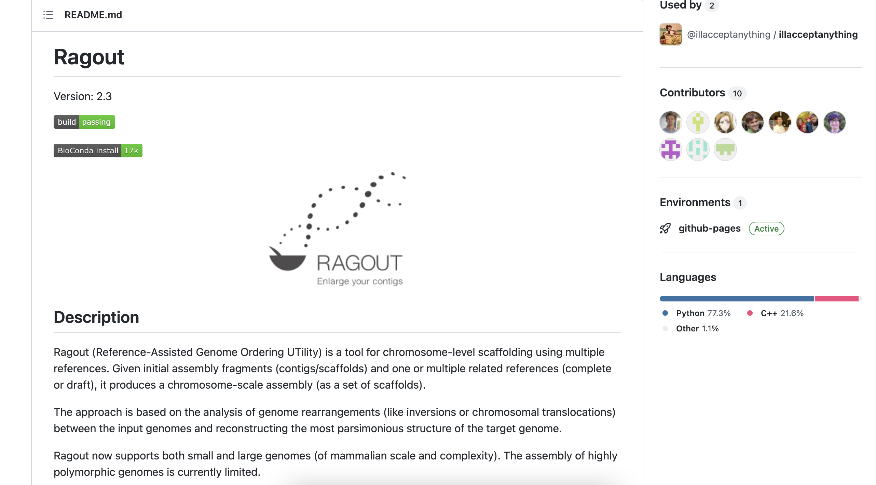
Existing Synteny graph-based Genome assembly tool
Ragout 2.3.0

Slide 5
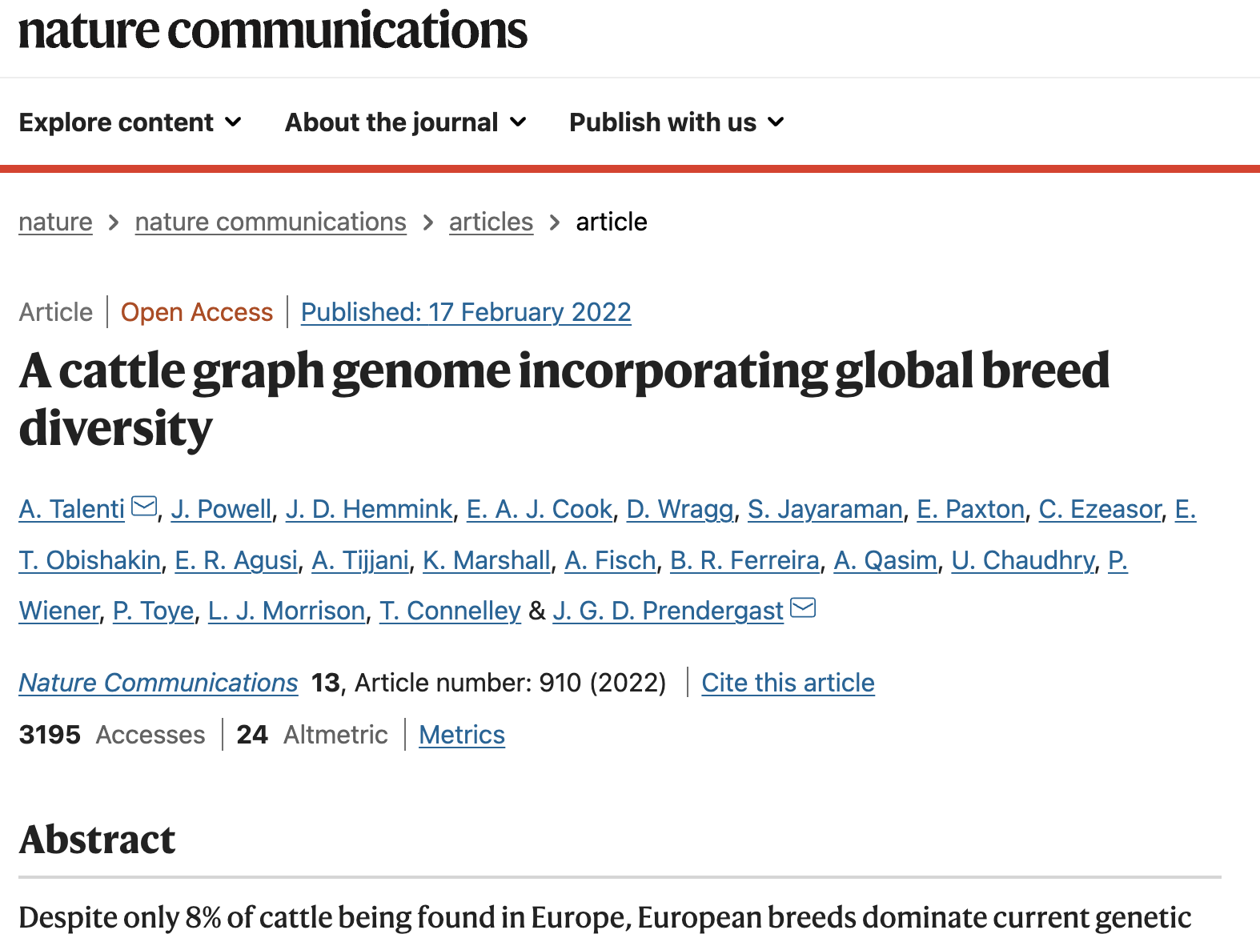
Existing Synteny graph-based Genome assembly tool
Ragout 2.3.0. !!!(needs reference)!!!

Slide 6
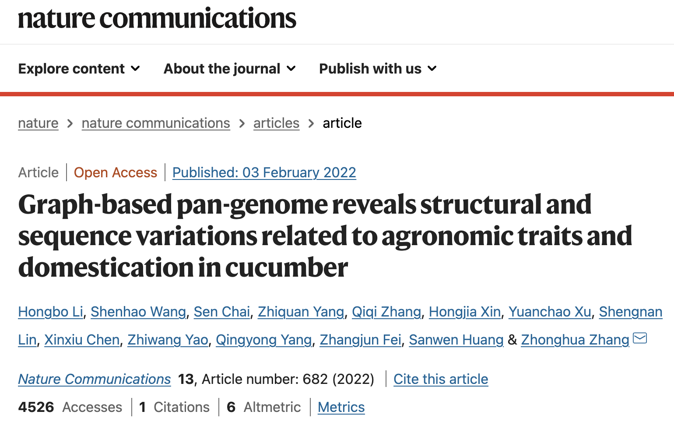
Scaffolding Scenario 1 (conventional)
1. Divide into linkage/synteny groups manually (ALLMAPS), (BOSS)
2. Build Draft Scaffold
3. Scaffold through linked contigs (ARCS)
4. Comparison between Hi-C data for validation (JUICY), (QUAST)
Number of Papers just do this

Slide 7
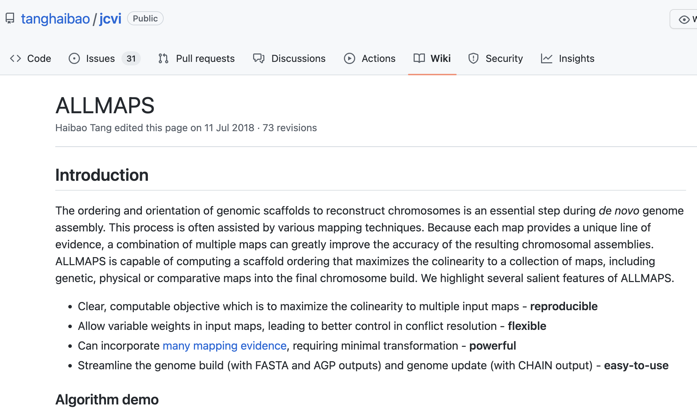
Dividing into linkage groups
ALLMAPS => Can divide genome into linkage groups

Slide 8
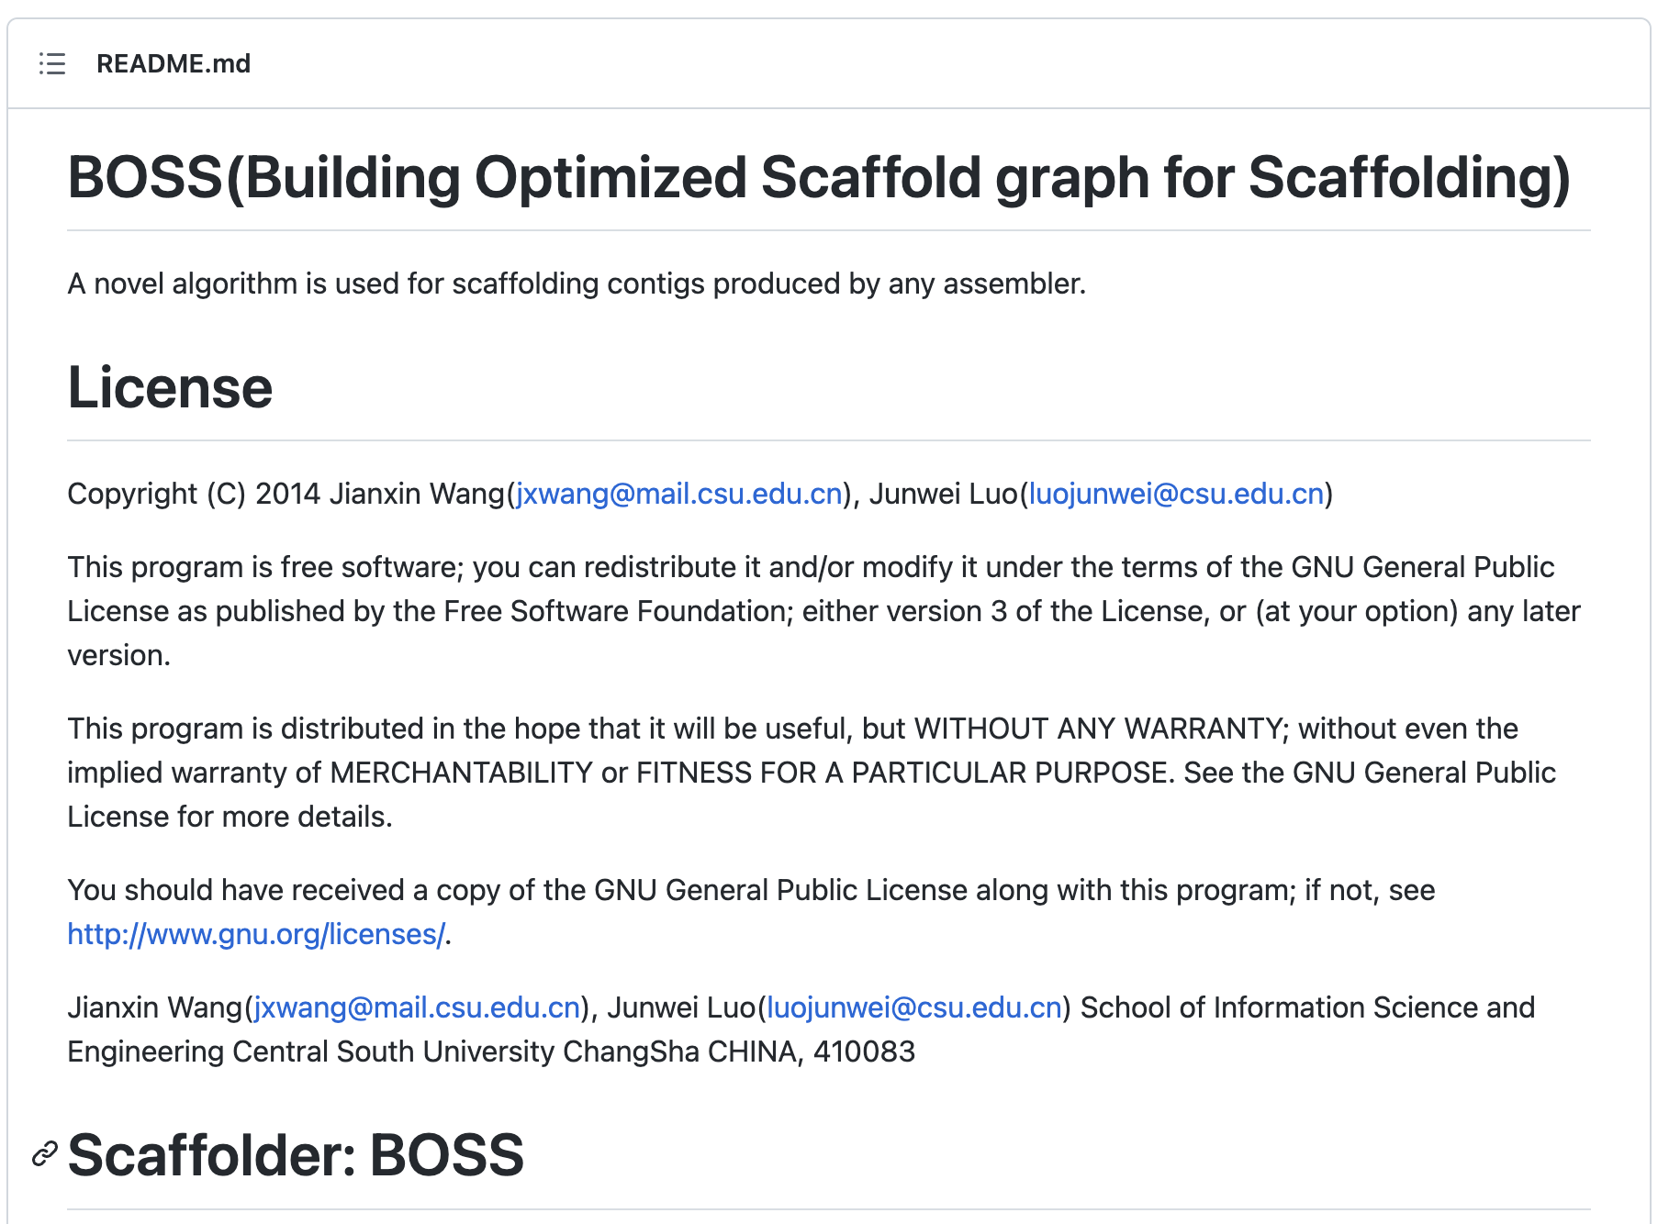
Dividing into linkage groups
BOSS => figure out contig order

Slide 9
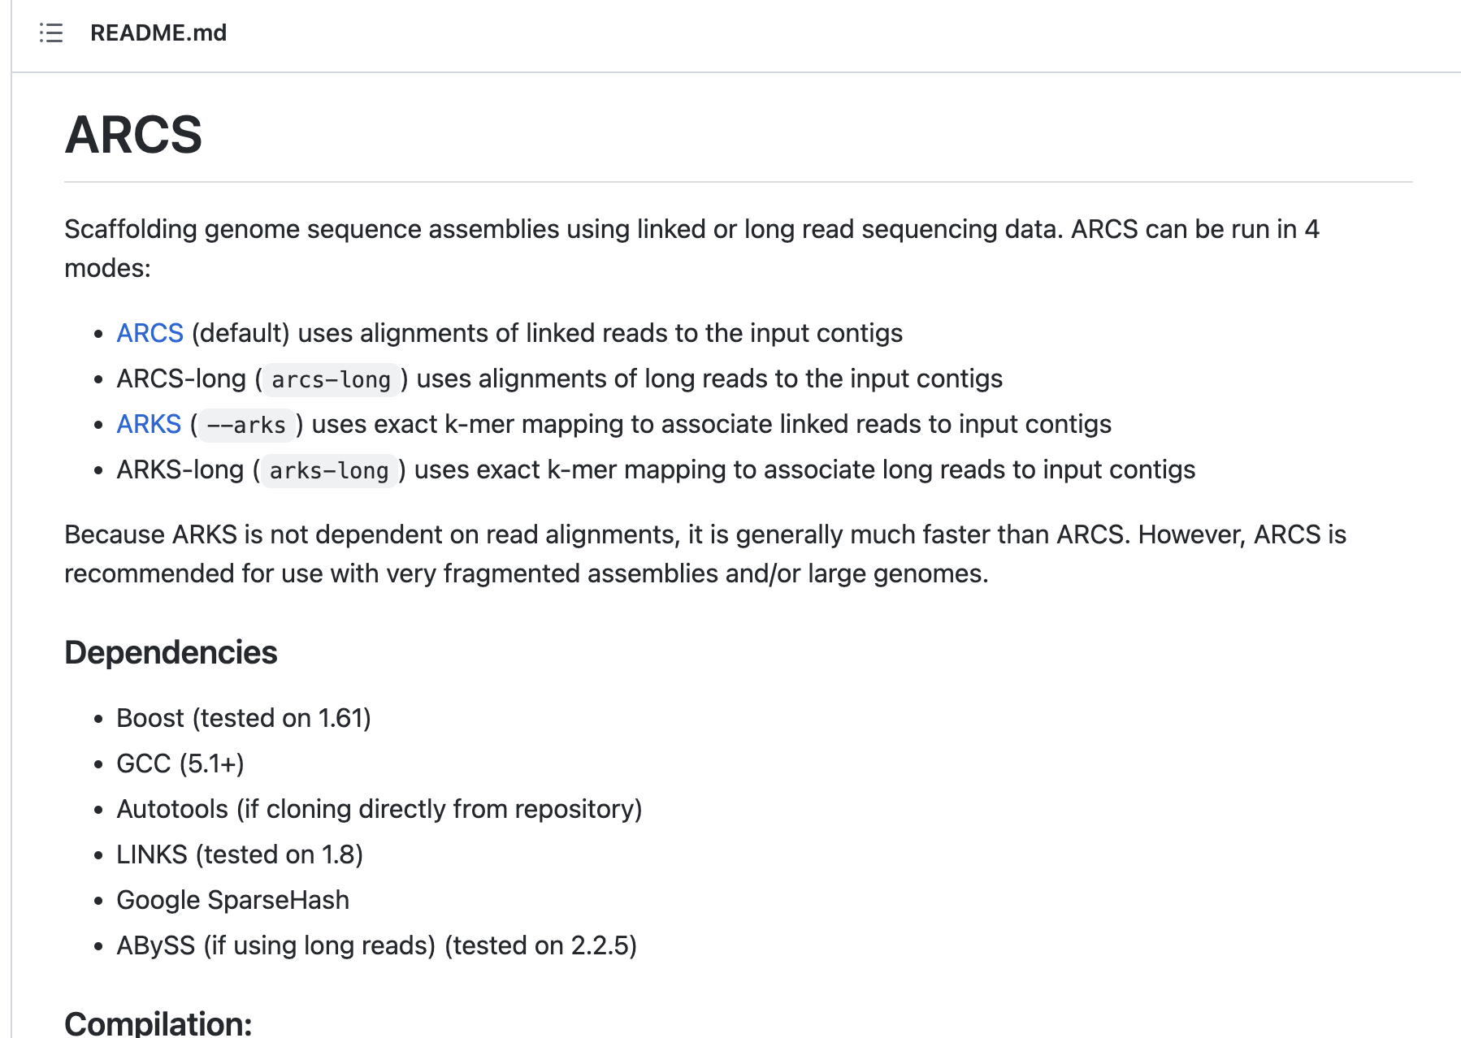
Scaffold through linked contigs
ARCS => requires draft scaffold

Slide 10
Scaffolding Scenario 2 (novel)
1. Deconstruct existing genomes into long contig level
2. Build assembly graph with graph assemblers (generating training dataset)
3. Build deep graph neural network to extract some context from assembly graph
4. Train Graph neural network and test it
5. Validate with Hi-C data (JUICY, QUAST)

Slide 11
Post Work
Study Pipeline 1
Pipeline 1 execution
~ Pipeline 2 step 2 prep.

