Slide 1
0728 Data meeting
For Viola philippica genome project
SNU, School of Biological Science
Hyunsu Lim
Notes:
sp.. 를 yeodensis로 바꾸기

Slide 2
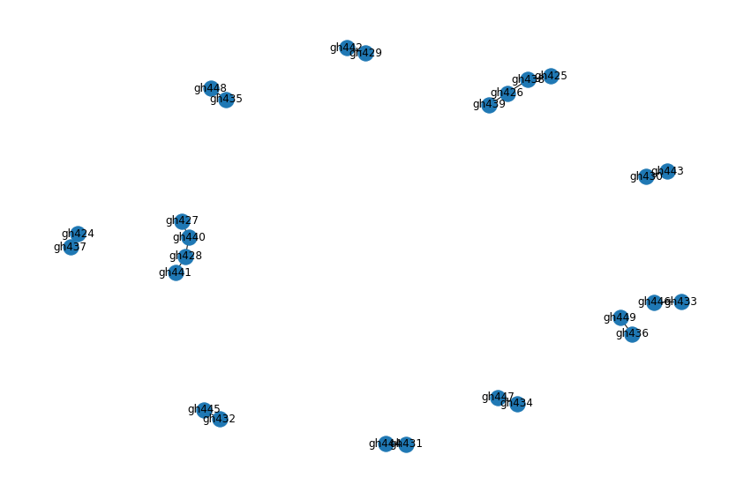
Last Work
Cotton에서 검증

Slide 3
Projects
in silico synteny base Viola Genome Scaffolding
Synteny search 관련 연구 탐색
Max subgraph plot 재조합 수치별 BUSCO search 결과
Viola genome annotation
InterPro/InterProScan공부
Genome browser 세션
www.hyublabviola.com/catgenome
파이프라인 CWL로 migration

Slide 4
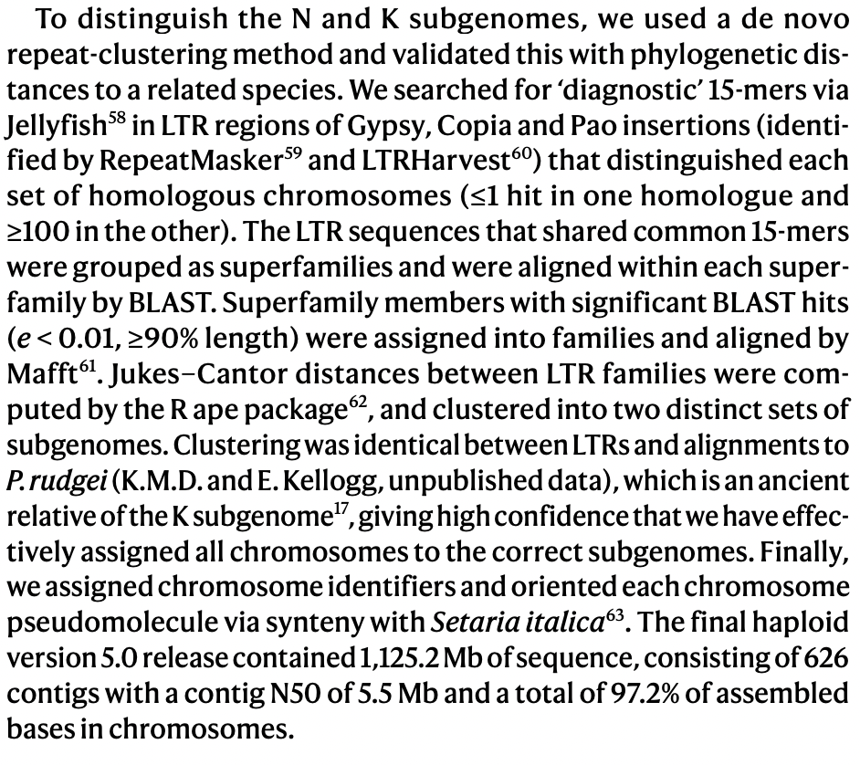
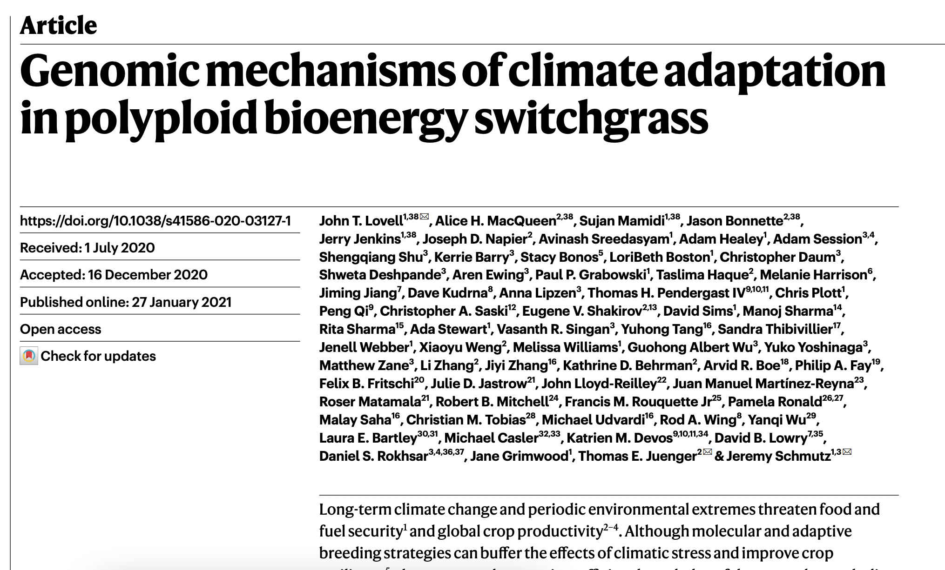

Slide 5
Next Work
in silico synteny base Viola Genome Scaffolding
V. philippica InterProScan
Polyploid genome research
Viola genome annotation
V. philippica InterProScan
CWL migration완료

