Slide 1
0321 Field Search
For Viola project
School of Biological Science
Hyunsu Lim

Slide 2
Possessions
Sequencing result of Viola sp. (V. yedoensis, V. pubscens)
Short read sequencing
.fastq file
Predicted gene annotation result
From 해찬, Dr. Dhivya
해찬 : BRAKER(Genemark + AUGUSTUS)
Dr. Dhivya : AUGUSTUS
.gtf or .gff3 file (convertible)
Assembly
Contig level assembly
Contig level BUSCO synteny, Contig level dotplot >> Contig level synteny
틀린 내용 정정 부탁드립니다. Viola 프로젝트 관련 미팅을 많이 진행하지 못했고, 아직 미숙하여 프로젝트 내용을 자세히 알지 못합니다.

Slide 3
Assembly and Synteny
History

Slide 4
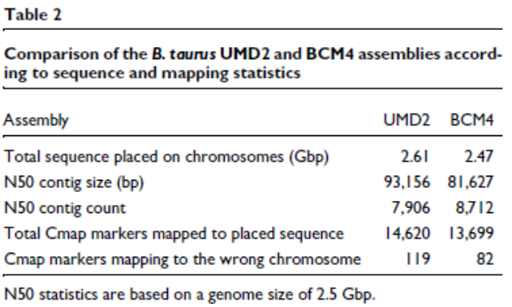
Domestic Cow WG assembly (2009)
A Whole-Genome Assembly of the domestic cow, Bos taurus
Source : mixture of BAC hierarchical sequencing and WG shotgun sequencing
Result : Assembled 35M sequence reads and applied variety of assembly improvement technique. Errors are corrected. (Such as gaps, erroneous inversions, deletion, translocation corrected. SNP errors corrected.)
Zimin, A. V., Delcher, A. L., Florea, L., Kelley, D. R., Schatz, M. C., Puiu, D., ... & Salzberg, S. L. (2009). A whole-genome assembly of the domestic cow, Bos taurus. Genome biology, 10(4), 1-10.

Slide 5
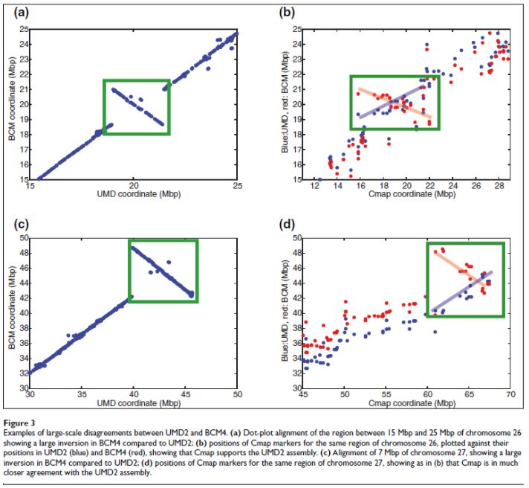
Domestic Cow WG assembly (2009)
A Whole-Genome Assembly of the domestic cow, Bos taurus
Zimin, A. V., Delcher, A. L., Florea, L., Kelley, D. R., Schatz, M. C., Puiu, D., ... & Salzberg, S. L. (2009). A whole-genome assembly of the domestic cow, Bos taurus. Genome biology, 10(4), 1-10.

Slide 6
Automating Identification of Synteny (2009)
Automated Identification of Conserved Synteny after Whole-Genome Duplication
Concise defeminations for some terms
Conserved Synteny : The tendency of neighboring genes to retain their relative positions and orders on chromosomes over evolutionary time >> leaks STATISTICAL DEFINITION
Concise definitions for Homology, >> Ortholog, Paralog
The Synteny Database construction (Not Working)
Database that automatically construct circle plot, dot plot on given species
Catchen, J. M., Conery, J. S., & Postlethwait, J. H. (2009). Automated identification of conserved synteny after whole-genome duplication. Genome research, 19(8), 1497-1505.

Slide 7
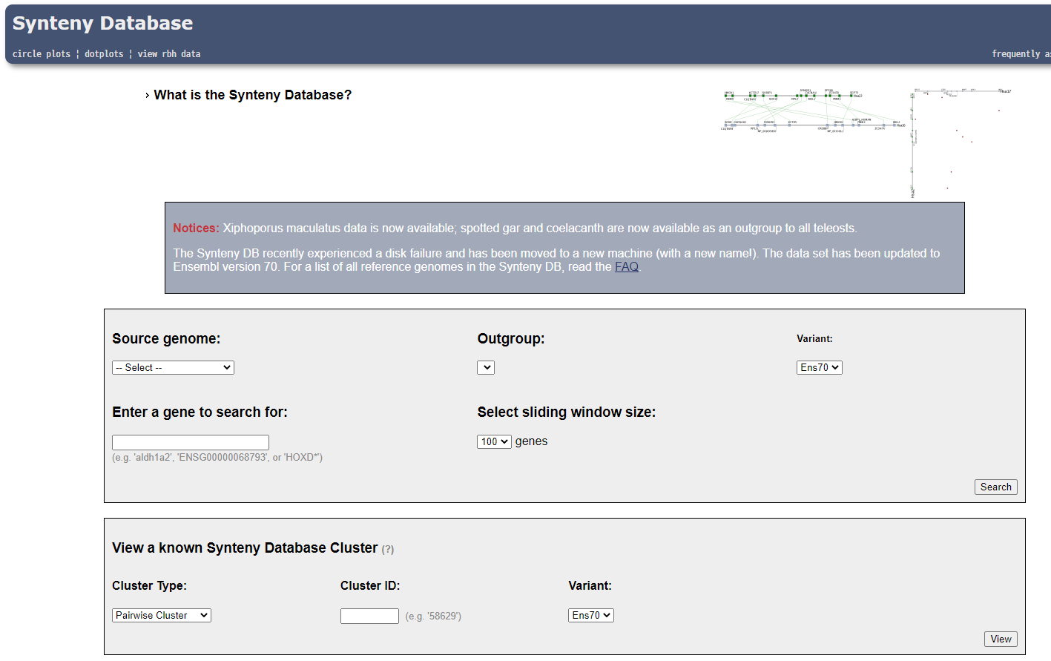
Automating Identification of Synteny (2009)
Automated Identification of Conserved Synteny after Whole-Genome Duplication
Catchen, J. M., Conery, J. S., & Postlethwait, J. H. (2009). Automated identification of conserved synteny after whole-genome duplication. Genome research, 19(8), 1497-1505.

Slide 8
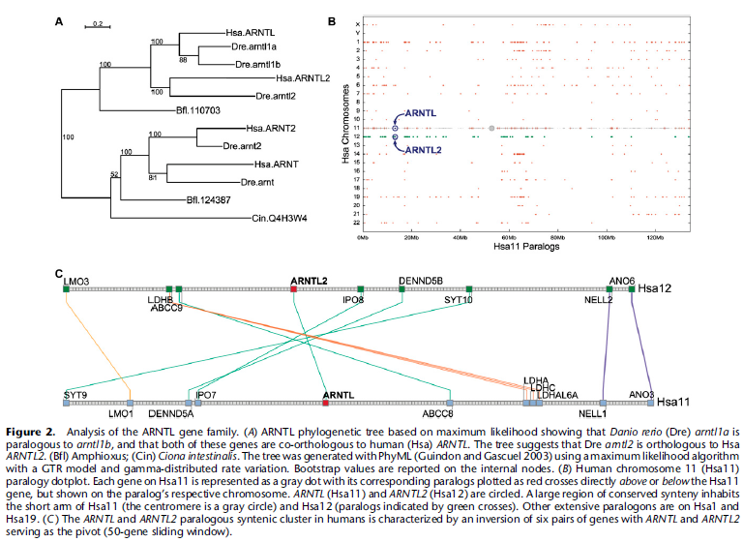
Automating Identification of Synteny (2009)
Automated Identification of Conserved Synteny after Whole-Genome Duplication
Catchen, J. M., Conery, J. S., & Postlethwait, J. H. (2009). Automated identification of conserved synteny after whole-genome duplication. Genome research, 19(8), 1497-1505.

Slide 9
Chicken Genome Assembly (2017)
A new chicken genome assembly provides insight into avian genome structure
Good case study for general assembly study >>
General Pipelines for annotation and assembling genome
Sequencing
PacBio
Assembly
SSPACE tool
GGA merger tool
Assembled with BLAST-base alignment algorithm (NG Assembler)
Difficulties with Handling repetitive regions >> Repeatmasker
SAMtools for variant detection
Warren, W. C., Hillier, L. W., Tomlinson, C., Minx, P., Kremitzki, M., Graves, T., ... & Cheng, H. H. (2017). A new chicken genome assembly provides insight into avian genome structure. G3: Genes, Genomes, Genetics, 7(1), 109-117.

Slide 10
halSynteny (2020)
halSynteny: a fast, easy-to-use conserved synteny block construction method for multiple whole-genome alignments
Introduce HAL format, for synteny analyze and alignment
Graph based alignment and check the overlap
This paper contains the history of alignments and recent aligners
Krasheninnikova, K., Diekhans, M., Armstrong, J., Dievskii, A., Paten, B., & O’Brien, S. (2020). halSynteny: a fast, easy-to-use conserved synteny block construction method for multiple whole-genome alignments. GigaScience, 9(6), giaa047.

Slide 11
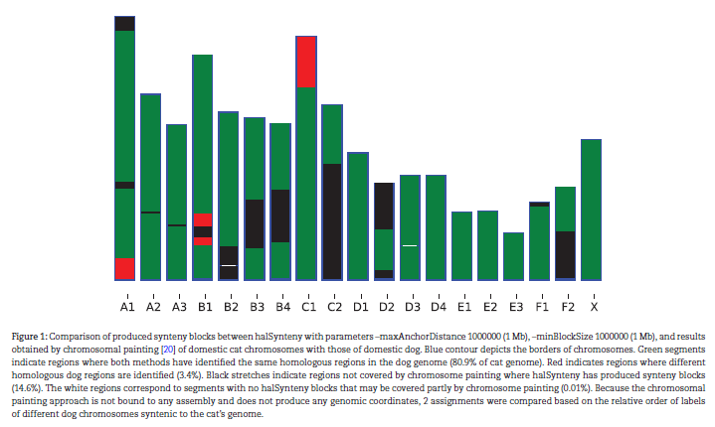
halSynteny (2020)
halSynteny: a fast, easy-to-use conserved synteny block construction method for multiple whole-genome alignments
Krasheninnikova, K., Diekhans, M., Armstrong, J., Dievskii, A., Paten, B., & O’Brien, S. (2020). halSynteny: a fast, easy-to-use conserved synteny block construction method for multiple whole-genome alignments. GigaScience, 9(6), giaa047.

Slide 12
A chromosome-scale assembly of the bilberry genome (2022)
A chromosome-scale assembly of the bilberry genome identifies a complex locus controlling berry anthocyanin composition
Used Illumina, ONT and Hi-C
Represents 96.6% BUSCO
K-mer analysis >> indicates the sequenced sample may be 2 individuals
ALT allele was purged >> represents one haplotype
Gene annotated (with EDTA tool)
Wu, C., Deng, C., Hilario, E., Albert, N. W., Lafferty, D., Grierson, E. R., ... & Chagné, D. (2022). A chromosome‐scale assembly of the bilberry genome identifies a complex locus controlling berry anthocyanin composition. Molecular Ecology Resources, 22(1), 345-360.

Slide 13
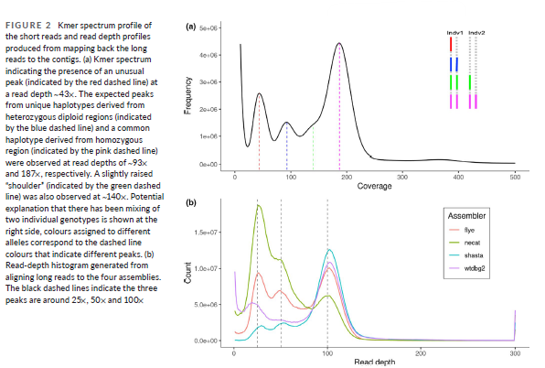
A chromosome-scale assembly of the bilberry genome (2022)
A chromosome-scale assembly of the bilberry genome identifies a complex locus controlling berry anthocyanin composition
Wu, C., Deng, C., Hilario, E., Albert, N. W., Lafferty, D., Grierson, E. R., ... & Chagné, D. (2022). A chromosome‐scale assembly of the bilberry genome identifies a complex locus controlling berry anthocyanin composition. Molecular Ecology Resources, 22(1), 345-360.

Slide 14
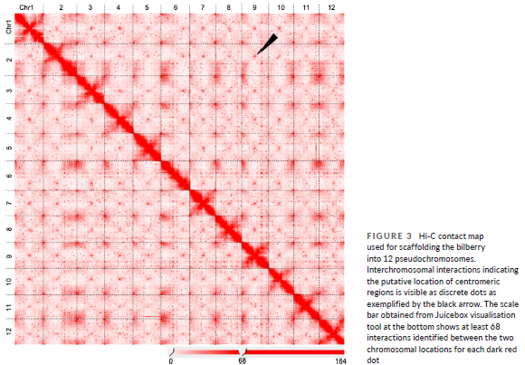
A chromosome-scale assembly of the bilberry genome (2022)
A chromosome-scale assembly of the bilberry genome identifies a complex locus controlling berry anthocyanin composition
Wu, C., Deng, C., Hilario, E., Albert, N. W., Lafferty, D., Grierson, E. R., ... & Chagné, D. (2022). A chromosome‐scale assembly of the bilberry genome identifies a complex locus controlling berry anthocyanin composition. Molecular Ecology Resources, 22(1), 345-360.

Slide 15
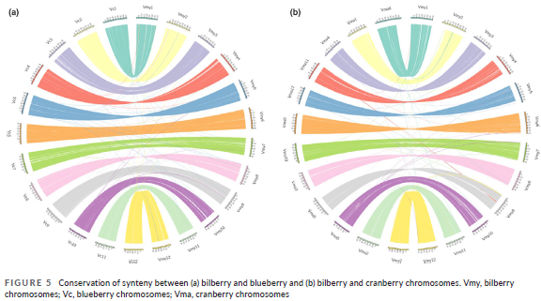
A chromosome-scale assembly of the bilberry genome (2022)
A chromosome-scale assembly of the bilberry genome identifies a complex locus controlling berry anthocyanin composition
Wu, C., Deng, C., Hilario, E., Albert, N. W., Lafferty, D., Grierson, E. R., ... & Chagné, D. (2022). A chromosome‐scale assembly of the bilberry genome identifies a complex locus controlling berry anthocyanin composition. Molecular Ecology Resources, 22(1), 345-360.

Slide 16
GENESPACE (2022.3)
GENESPACE: syntenic pan-genome annotations for eukaryotes
Genome annotation tool using syntenic results
GENESPACE overcomes the challenge of accurately finding homeologous or meiotically homologous gene pairs by constraining ortho-groups within syntenic regions
Riparian plot
Lovell, J. T., Sreedasyam, A., Schranz, M. E., Wilson, M. A., Carlson, J. W., Harkess, A., ... & Schmutz, J. (2022). GENESPACE: syntenic pan-genome annotations for eukaryotes. bioRxiv

Slide 17
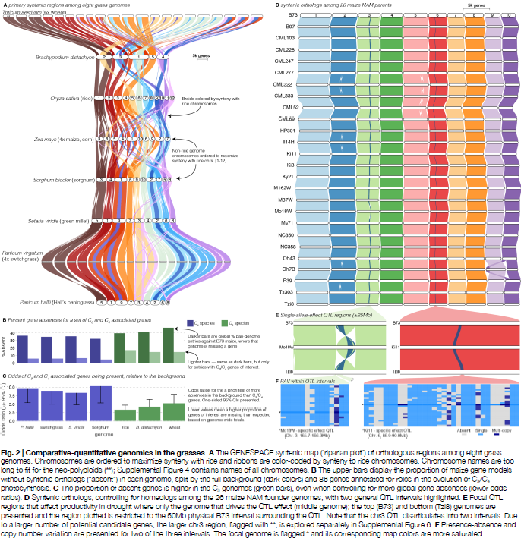
GENESPACE (2022.3)
GENESPACE: syntenic pan-genome annotations for eukaryotes
Lovell, J. T., Sreedasyam, A., Schranz, M. E., Wilson, M. A., Carlson, J. W., Harkess, A., ... & Schmutz, J. (2022). GENESPACE: syntenic pan-genome annotations for eukaryotes. bioRxiv

Slide 18
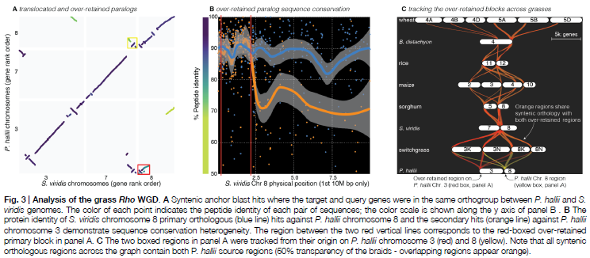
GENESPACE (2022.3)
GENESPACE: syntenic pan-genome annotations for eukaryotes
Lovell, J. T., Sreedasyam, A., Schranz, M. E., Wilson, M. A., Carlson, J. W., Harkess, A., ... & Schmutz, J. (2022). GENESPACE: syntenic pan-genome annotations for eukaryotes. bioRxiv

Slide 19
Further Study
DO we have to ALIGN and match? Cannot score sequences at once?
Deep Learning approach >> LSTM, Transformer
Building homology searcher (Sequence based)
Building general and universal file format for synteny analyze
>> developing HAL format
Gene Annotation
Synteny analysis
Sequence Assembly

