Slide 1
0325 Data meeting
For Viola project
SNU, School of Biological Science
Hyunsu Lim

Slide 2
Possessions
Sequencing result of Viola sp. (V. yedoensis, V. pubscens)
Short read sequencing
.fastq file
Predicted gene annotation result
From 해찬, Dr. Dhivya
해찬 : BRAKER(Genemark + AUGUSTUS)
Dr. Dhivya : AUGUSTUS
.gtf or .gff3 file (convertible)
Assembly
Contig level assembly

Slide 3
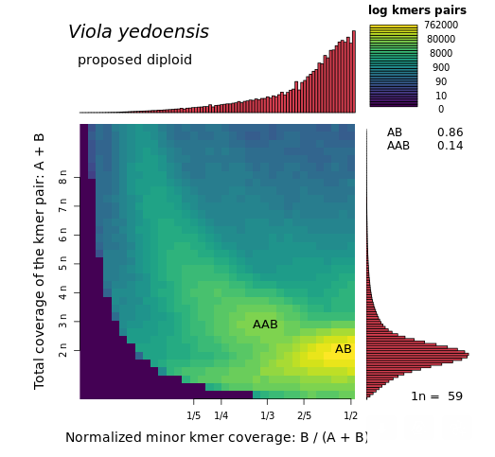
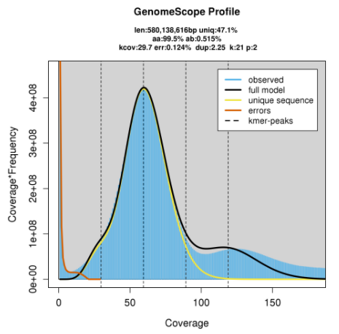
Polyploidy of Viola sp.

Slide 4
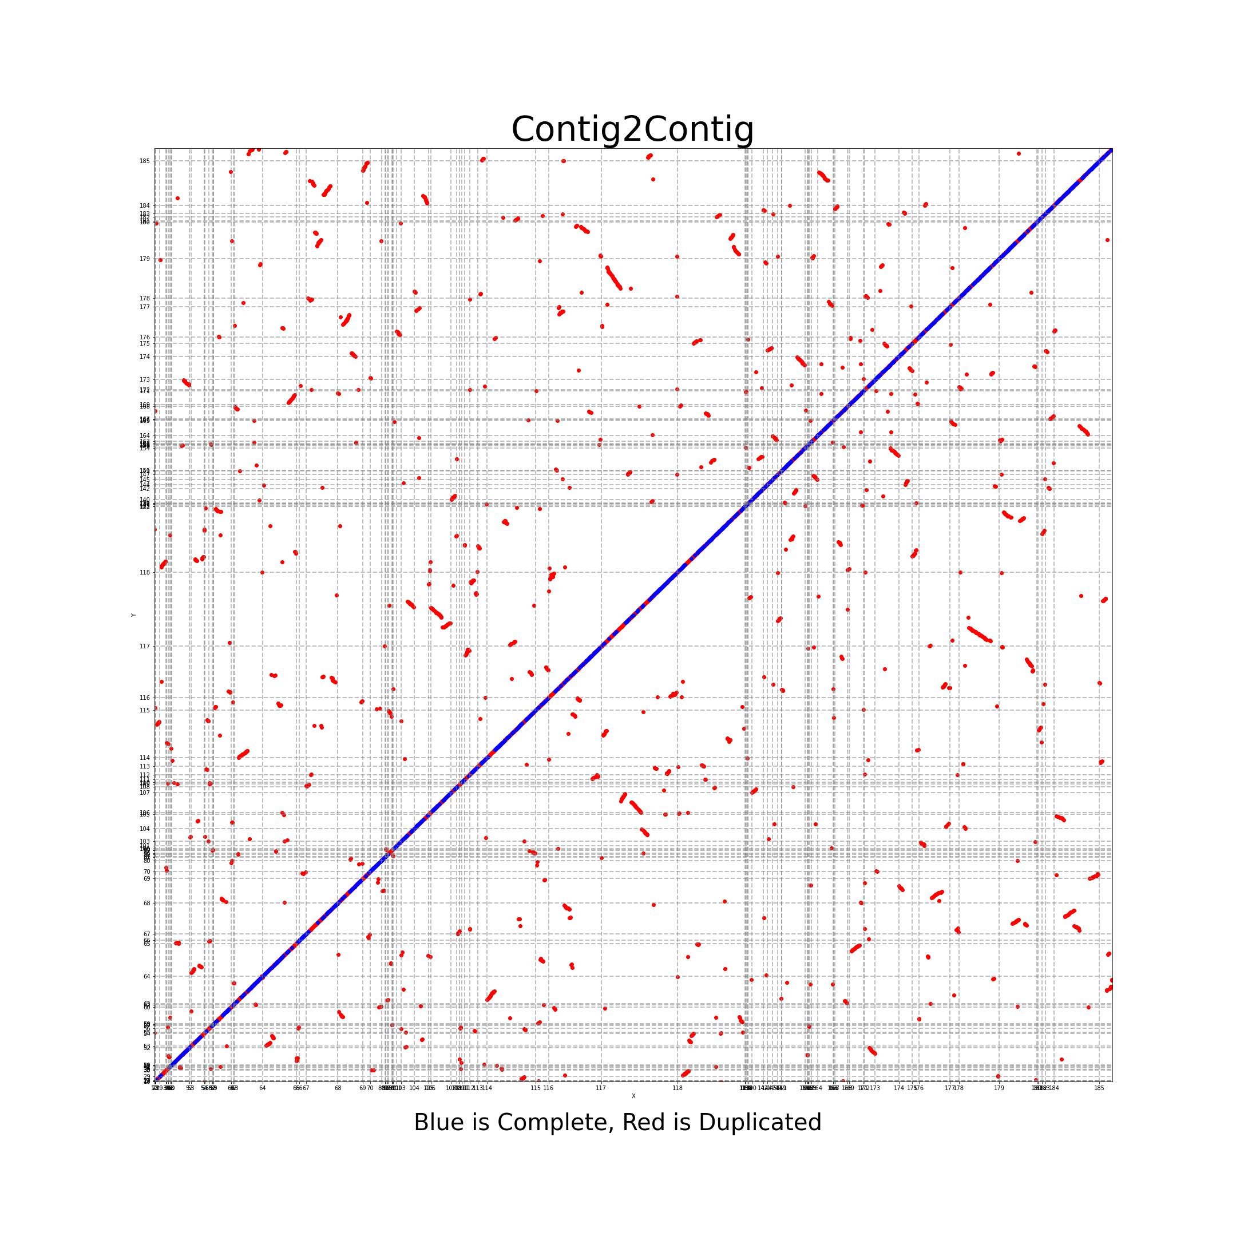
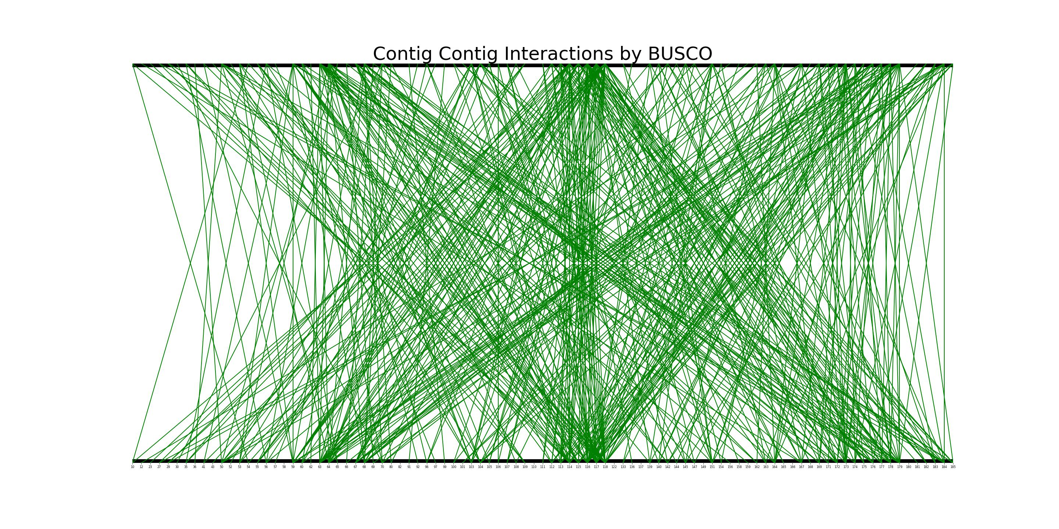
Contig2Contig plots

Slide 5
Aim point
Scaffold level assembly of Viola sp.
Full macro-synteny of Viola spp.
Gene Annotation
Synteny analysis
Sequence Assembly
(Perhaps, Scaffold Level)

Slide 6
Synteny based genome assembly pipeline for Viola sp.
Scenario

Slide 7
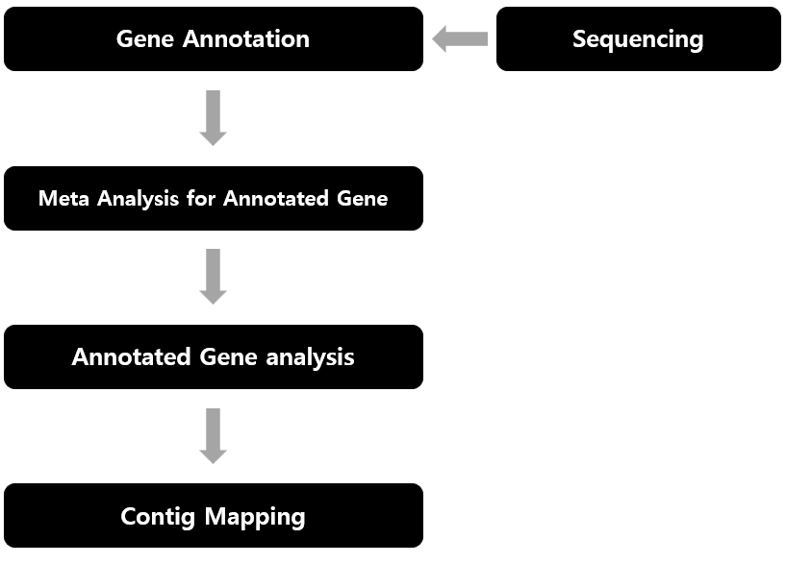

Slide 8
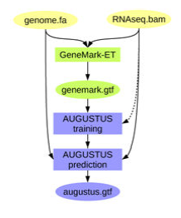
GENEMARK
Gene Annotation
Sequencing
AUGUSTUS
Meta Analysis for Annotated Gene
BRAKER
Annotated Gene analysis
Contig Mapping
Hoff, K. J., Lange, S., Lomsadze, A., Borodovsky, M., & Stanke, M. (2016). BRAKER1: unsupervised RNA-Seq-based genome annotation with GeneMark-ET and AUGUSTUS. Bioinformatics, 32(5), 767-769.
Notes:
GeneMark는 unsupervised tool 이고 ab inito한 방법으로 유전체를 annotation. Augustus는 supervised tool이고 RNAseq 결과와 Annotation된 결과를 학습하여

Slide 9
Gene Annotation
Sequencing
Phase 1: GO
Meta Analysis for Annotated Gene
Phase 2: Copy Number
Annotated Gene analysis
Phase 3: Synteny Search
Contig Mapping

Slide 10
Gene Annotation
Sequencing
Meta Analysis for Annotated Gene
Annotated Gene analysis
Phase 1: Manual Mapping
Contig Mapping
Phase 2: DL based Mapping

Slide 11
Scenario
Gene Annotation from Nucleotide Sequence (AGUSTUS && GENEMARK) from HMM and hint-based approach
Meta-analysis of Annotated Gene
Calculation of length, number and portion of CDS and UTR, etc. Comparison with existing Viola sp. data.
Quality check
Notes:
Viola sp. 와 매칭할 때 어느 종인지 확인 또는 어느 종에서 어느 종으로 가고 있는지 어느 정도 유추해 볼 수 있음.

Slide 12
Scenario
Annotated Genome analysis – Phase 1
Cannot compute 47773² homology score matrix, local approach required.
Run BLAST2GO(Robles et al., 2005) to specify significant genes
Drawing phylogenetic tree(ML) may possible

Slide 13
Scenario
Annotated Genome analysis - Phase 2
Copy number checking for each gene
Reflect the homology
Check whether BUSCO gene has 2 copy
Exploratory data analysis for each gene combined with GO result

Slide 14
Scenario
Annotated Genome analysis - Phase 3
Check what genes are on contigs
Homology reflected
Store at <universal file format>
Contig level synteny calculation and plotting
Using SyRI(Schneeberger et al., 2019)

Slide 15
Scenario
Contig mapping – Phase 1
Vanish contigs without genes, and genes with single copy
Start manual mapping
If possible, end at Phase 1

Slide 16
Scenario
Contig mapping – Phase 2
In case of sophisticated mapping issue
Pure algorithmic approach
Cannot calculate 2¹⁸⁶ times >> Lacking general algorithm : development required
Deep Learning Approach (algorithm with supervised learning that clusters contigs to scaffold in de novo way)
Notes:
학습 데이터는 알고리즘을 통해 제작. 임의의 긴 서열을 생성한 뒤 쪼개어 임의로 쪼개어 contig으로 만들고 개시 코돈으로 시작하는 암호화 부위만 임의의 유전자로 정하여 사용.(또는 단백질 번역체 사용) 또, Contig level로 RefSeq을 쪼개어 사용. >> 이 학습데이터 생성 알고리즘만으로도 의미 있음

Slide 17
Significance
1-2 Machine Learning method could be used
AUGUSTUS, Contig Scaffolder(if manually impossible)
Contig Scaffolder and their training dataset are independently significant
Suggestion for <Synteny file format>
Guideline for “cheap and brief” polyploid assembly (Requirements : ONLY sequence file!) >> Needs more accurate results like Hi-C, Long-read sequencing(PacBio, ONT)

Slide 18
Further Study
Gene Annotation
Comparison with general assembly pipeline
Post-genomic analysis for successful Viola genome
Converter for <universal synteny file format>
Complementary pipelines between three components
Synteny analysis
Sequence Assembly

