Slide 1
0401 Data meeting
For Viola genome project
SNU, School of Biological Science
Hyunsu Lim
Notes:
sp.. 를 yeodensis로 바꾸기

Slide 2
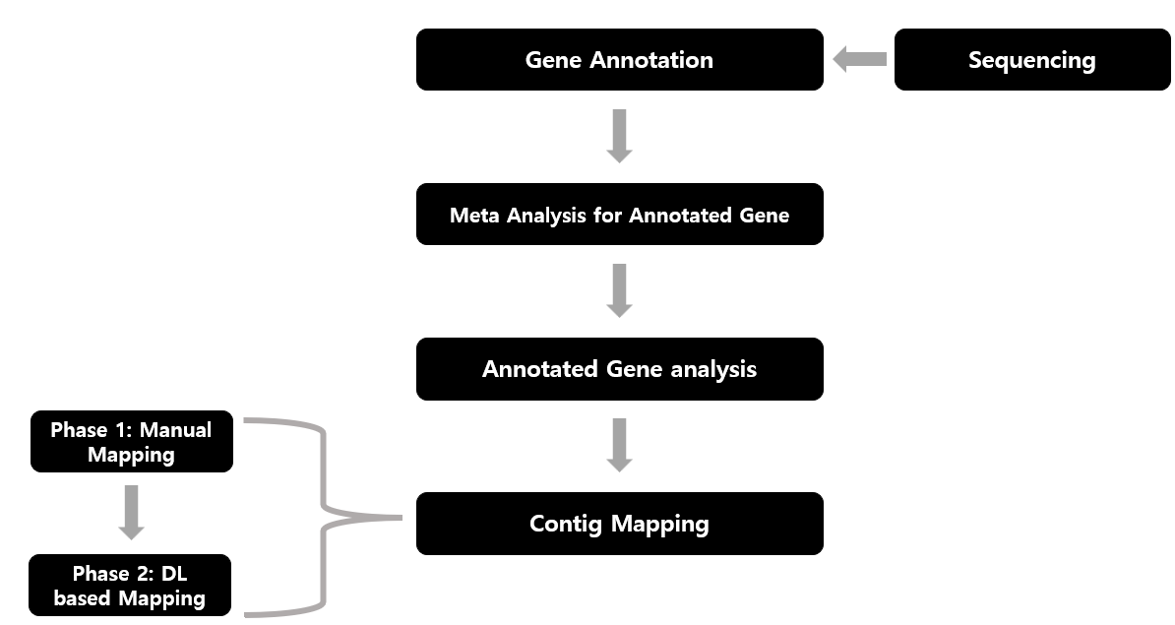
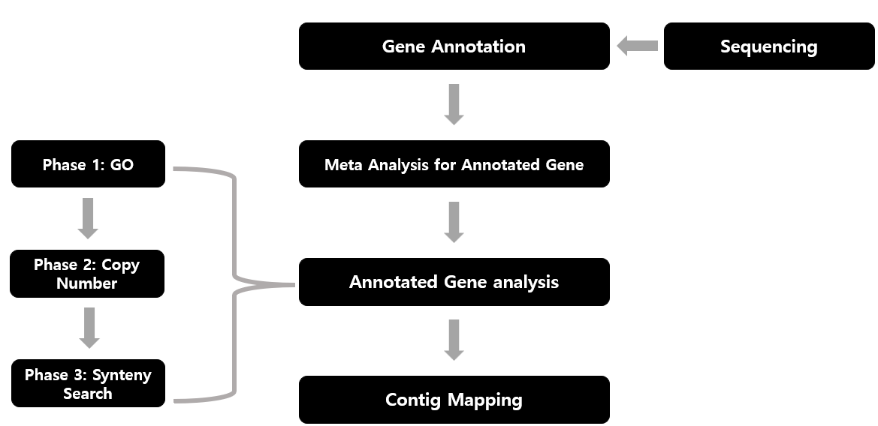
Last work
Synteny based Assembly scenario for Viola sp. genome

Slide 3
Synteny based genome assembly pipeline for Viola sp.

Slide 4
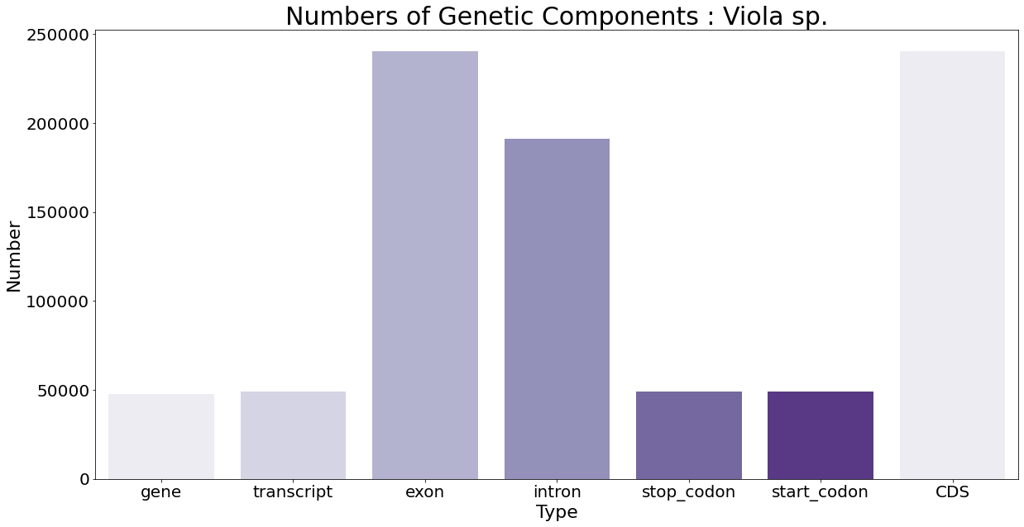
Meta-analysis for Viola sp. genome
{'gene': 47773, 'transcript': 48987, 'exon': 240410, 'intron': 191450, 'stop_codon': 48972, 'start_codon': 48969, 'CDS': 240410}
Notes:
Difference between genes and transcript : Alternative Splicing and exon shuffling
Difference between Stop codon and Start codon : Splicing method(in case of initial, terminal exon
Stop 코돈 개수가 gene보다 많아야 함. 그리고 transcript보다는 작아야 함.

Slide 5
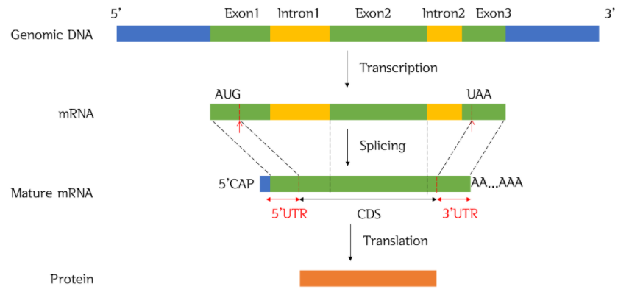
Explanations for Number Variation
Gene < start, stop codon < Transcript (Alternative splicing)
CDS < Exon
1
2
3
4
1
2
3
2
3
1
2
Gene : 1, start_codon : 2, stop_codon : 3, transcript : 4

Slide 6
Meta-analysis for Viola sp. genome
 | Avg. genes per contig | Max genes per contig | Contigs not contain genes
Viola sp. | 379.15 | 3287 | 60
 | Max length | Contig number | N50
Viola sp. | 29,447,517 | 186 | 9,658,868
Suggested Total genome size : 688,346,803
Bottom table provided by NICEM

Slide 7
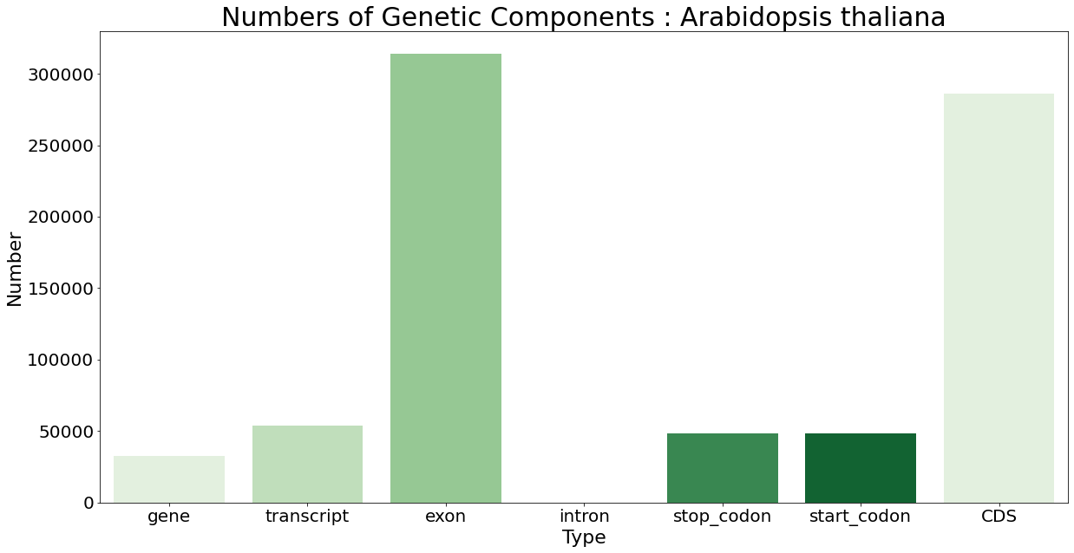
Meta-analysis for other plants
{'gene': 32833, 'transcript': 54013, 'exon': 313952, 'intron': 0, 'stop_codon': 48313, 'start_codon': 48315, 'CDS': 285977}

Slide 8
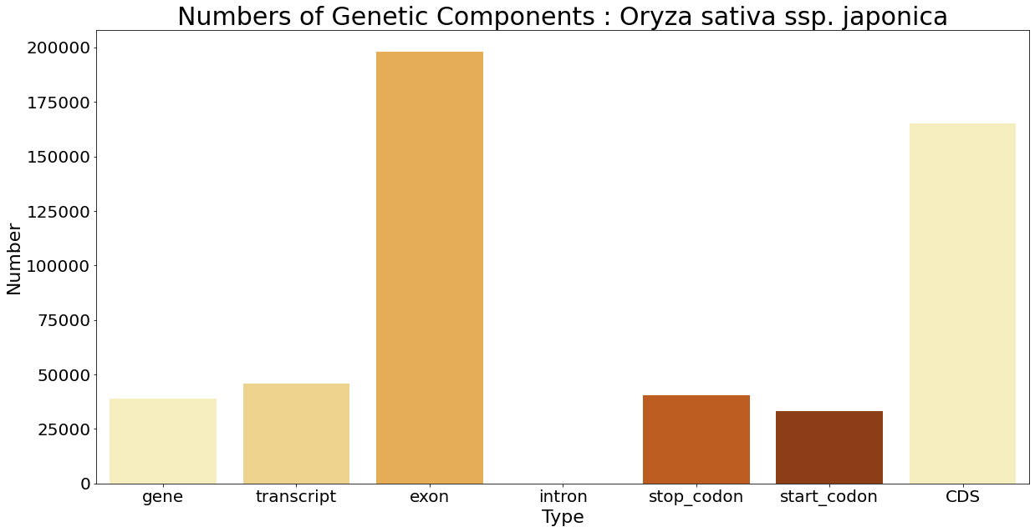
Meta-analysis for other plants
{'gene': 38978, 'transcript': 45772, 'exon': 198053, 'intron': 0, 'stop_codon': 40418, 'start_codon': 33170, 'CDS': 165166}
Notes:
IRGSP-10
Start가 gene보다 적지???

Slide 9
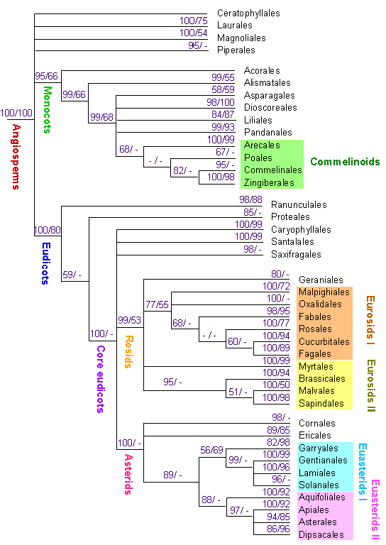
Meta-analysis for other plants
 | Genes (C+NC) | Gene density (Kb/gene) | Avg. exons per gene
A. thaliana | 32833 | 3644.74 | 9.56
Viola sp. | 47773 | 14,408.70 | 5.03
O. sativa | 38978 | 9622.08 | 5.08
2020-1 식물계통분류학 및 실험 슬라이드 中, 장진성 교수님

Slide 10
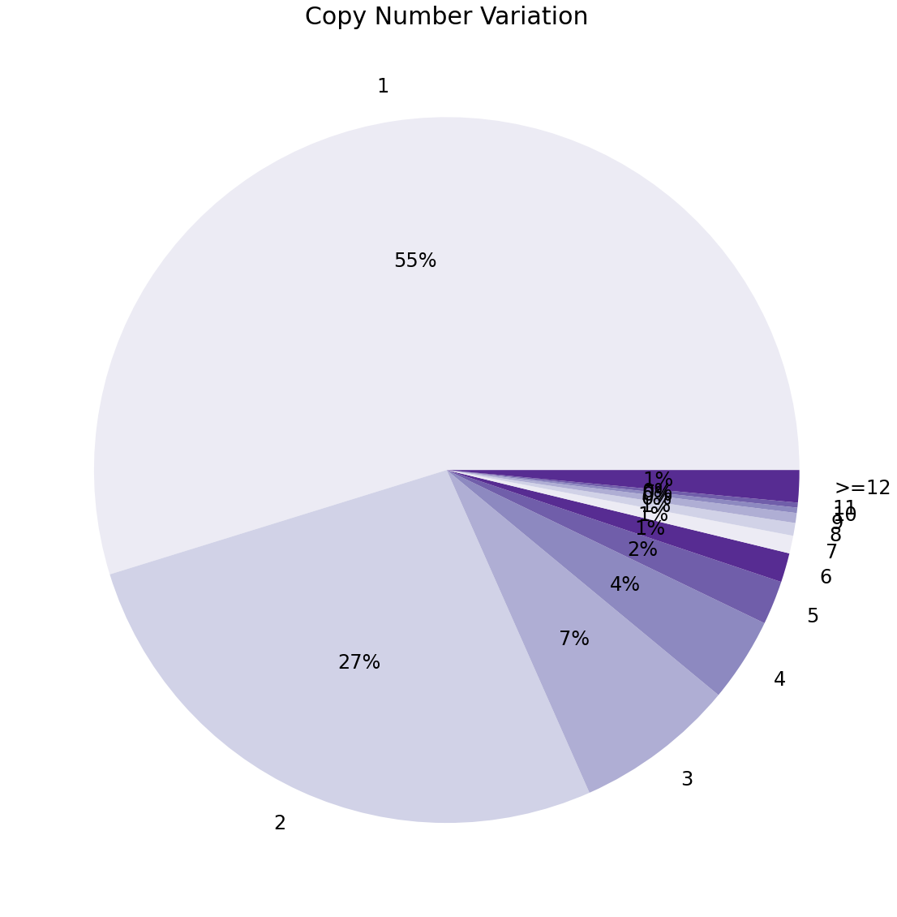
Copy number variation
Method
BLAST itself
Threshold : E-Value 1e-500 (Almost identical)
maximum 111 copy (Tn, Repetitive region)
Further study : check for other plants
Notes:
전체 데이터베이스에서 저 값의 오차가 발생할확률
다른 식물에서 어떤지 확인

Slide 11
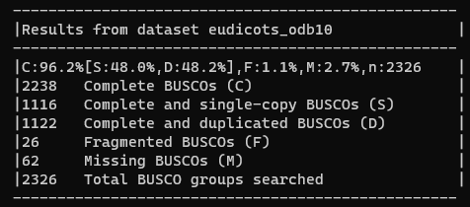
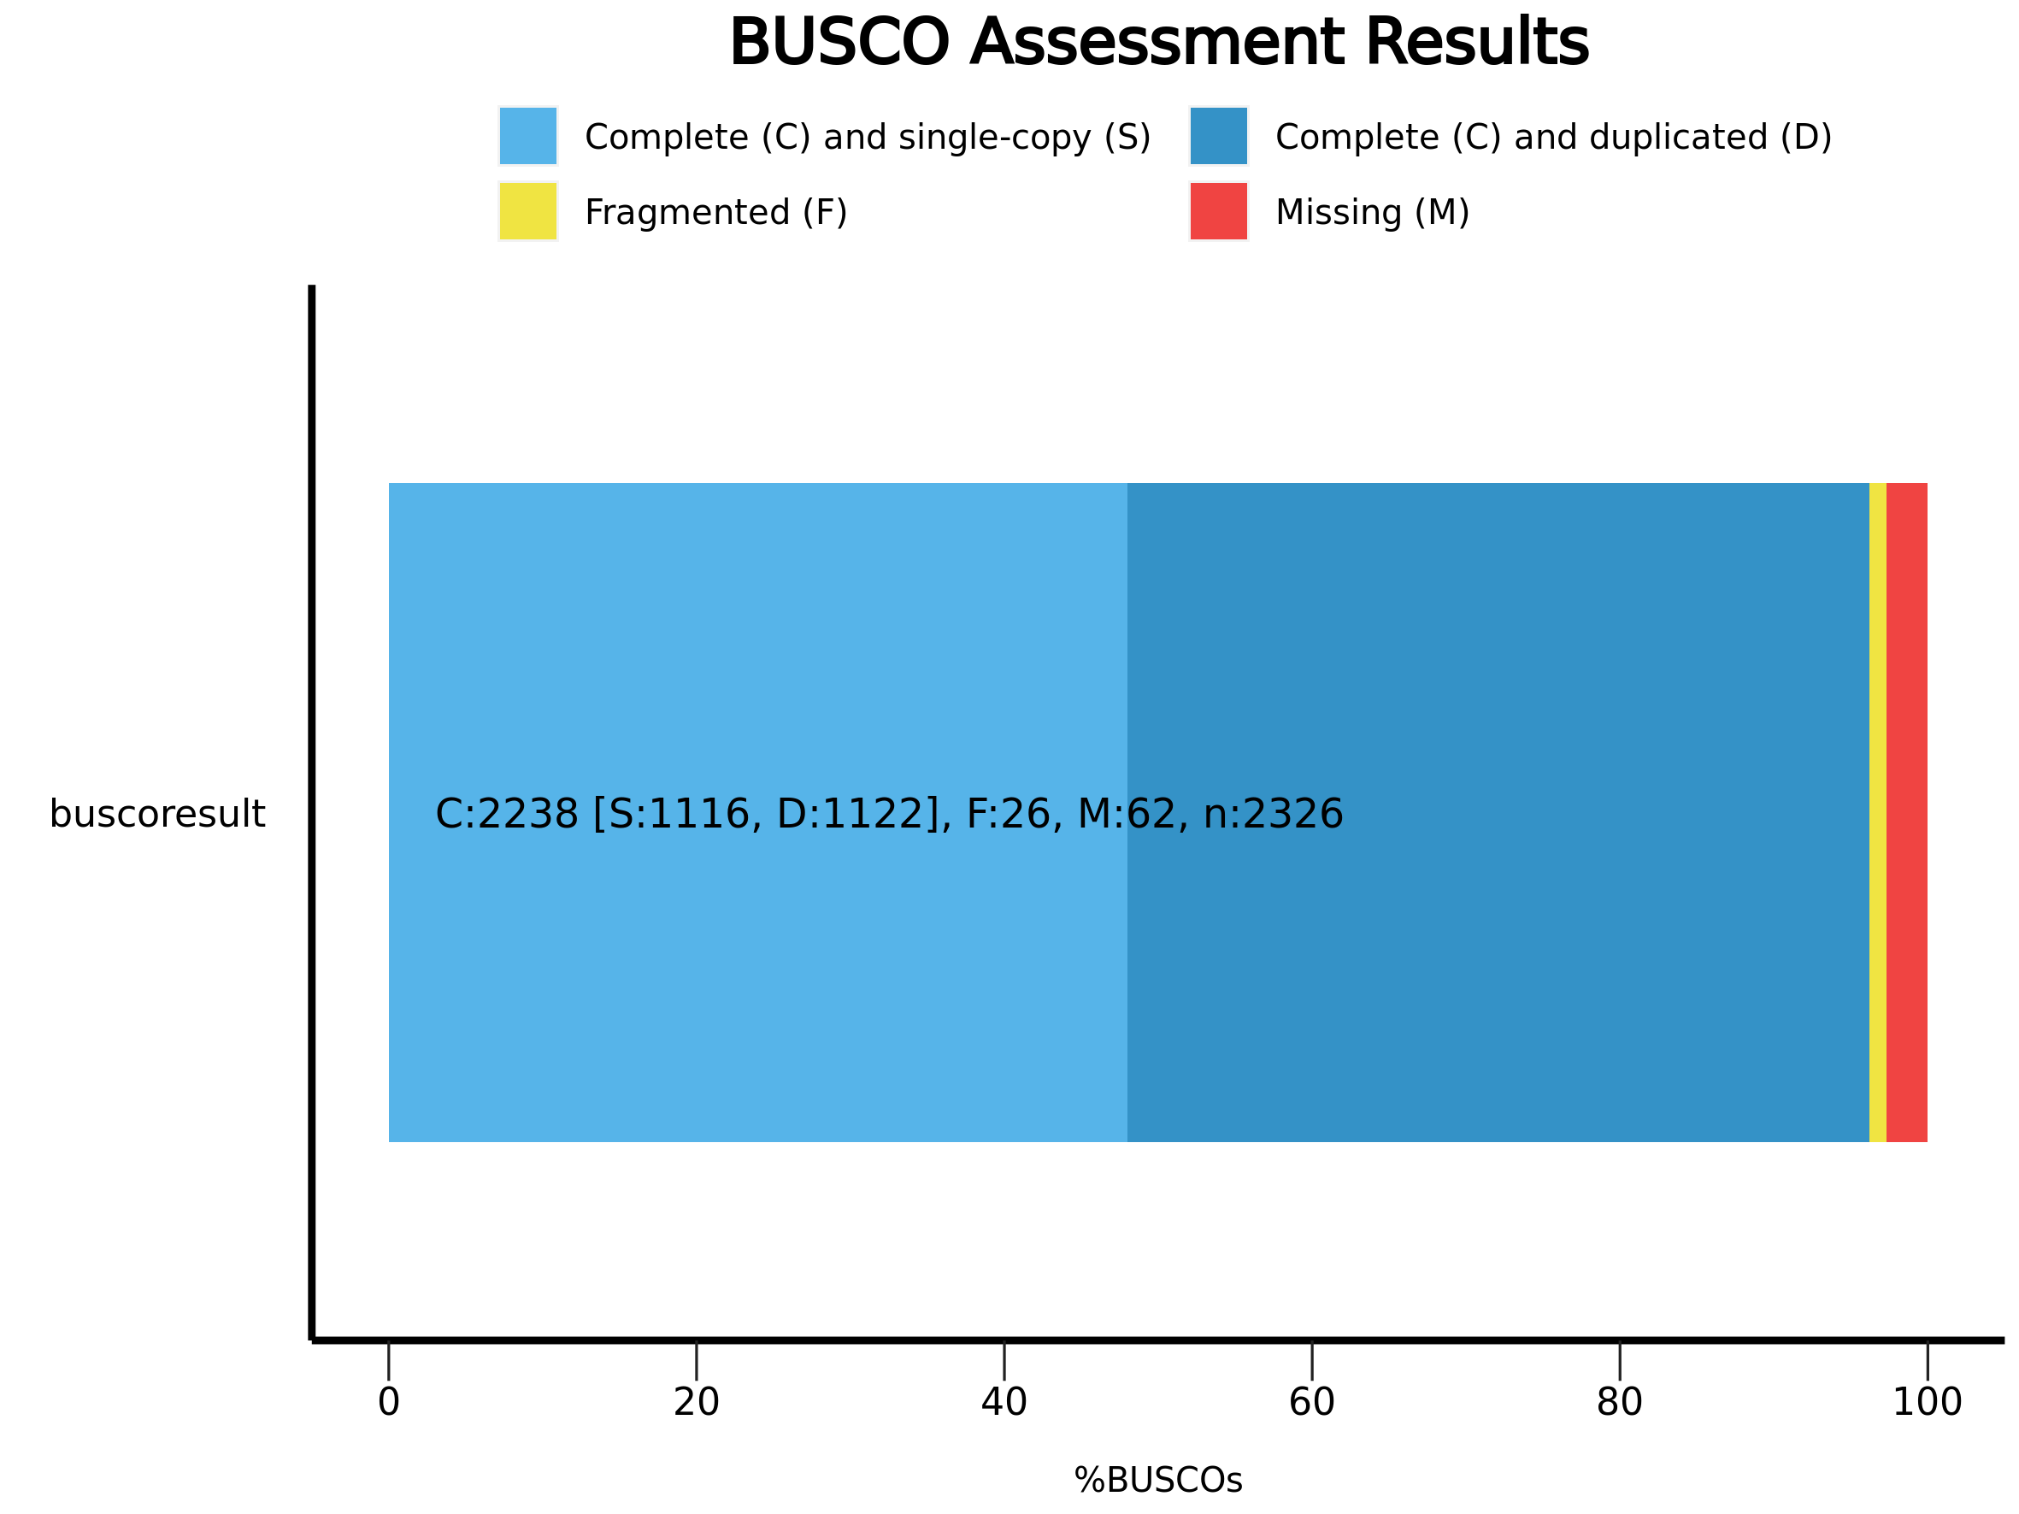
BUSCO Duplication
Notes:
Kmer분석 설명

Slide 12
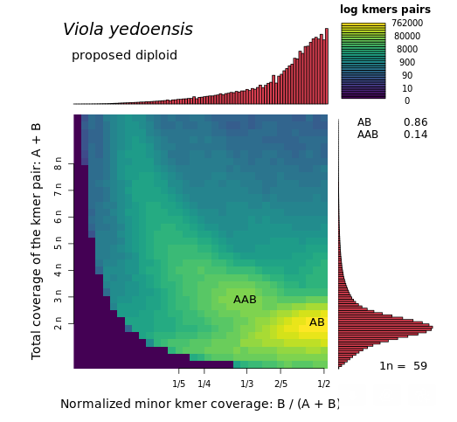
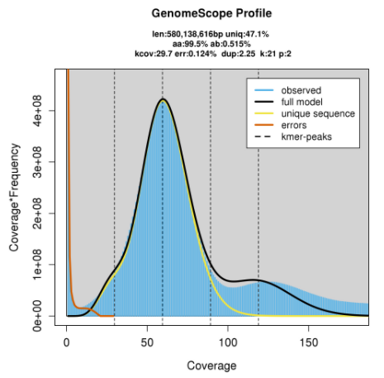
k-mer analysis
k-mer analysis by NICEM, 구현조 박사님
Notes:
Kmer분석 설명
BUSCO 가 org 당 한 개인 건지 확실히 확인.

Slide 13
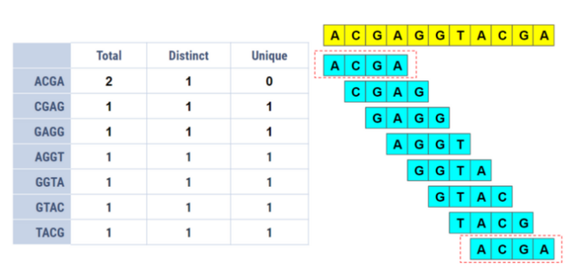
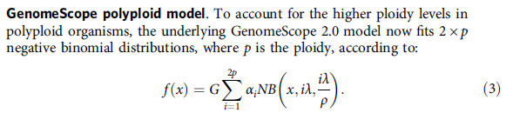

Explanations for k-mer
21-mer count per read : 59 (frequent)
Gunavaran. (2020). https://medium.com/swlh/bioinformatics-1-k-mer-counting-8c1283a07e29
Ranallo-Benavidez, T. R., Jaron, K. S., & Schatz, M. C. (2020). GenomeScope 2.0 and Smudgeplot for reference-free profiling of polyploid genomes. Nature communications, 11(1), 1-10.

Slide 14
Post Work
MMSeq2 for alternating BLAST
GO analysis for Viola sp. based on Arabidopsis thaliana
Viola sp. Gene annotation (Pipeline by 해찬)

