Slide 1
Linux Command Line : Introduction

Slide 2
Things we are going to cover :
Command Line Interface
Linux File System
Dissect Terminal

Slide 3
Command Line Interface (CLI)
What is CLI?
Interface:
Interface is a program or software in Operating Systems through which we communicate with the computer.
Ex: Graphic User Interface(GUI), Command Line Interface(CLI) etc.
GUI:
GUI contains buttons, windows, tabs, cursors etc., through which we can communicate easily with the computer.
Ex: Windows, Linux, Mac etc.,

Slide 4
Command Line Interface (CLI)
CLI
Interaction with the computer is through written text and well-known commands which have a specific function.
Ex: Linux Command Line, Windows Command Prompt, Mac Terminal etc.
CLI is the only interface during the early ages of computers
Operating Systems like Windows, Linux, Mac contain both the interfaces. But they give priorities to one type of interface.
  Windows gives more priority to GUI than CLI
  Whereas Linux gives more priority to CLI than GUI

Slide 5
Linux Command Line
Why CLI?
Greater control over system
Some operations can only be performed through Command Line
Also, it’s one of the best tools at our disposal

Slide 6
Linux Command Line
How does it work?
In Linux, Command Line contains two parts namely Shell, Terminal.
Terminal is the window through which we run commands and get output
Shell is the core of the CLI which interprets the given command and interacts with kernel.
Kernel, which is the core of the Linux operating system interacts with the hardware and processes the command and gives the corresponding output to the Shell.

Slide 7
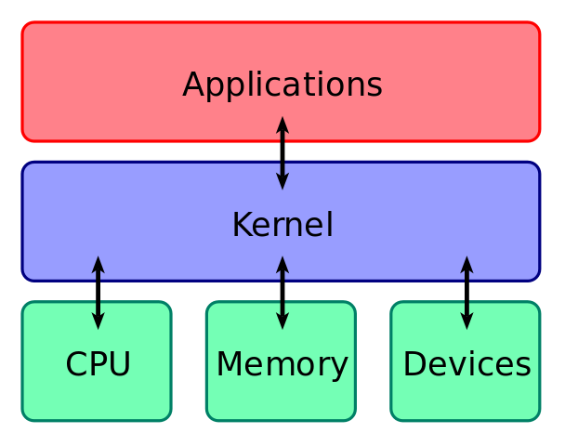
Linux Command Line
Terminal
Command Line
Shell

Slide 8
Linux File System
Files are organised in heirarchial manner
Every directory is contained in a super directory called root directory.
  It is designated with the symbol /
Every directory or file in linux has a path from root directory.
  Ex: /home/Desktop/hello
Root directory contains every file of the system.
Each sub directory contains files which have a specific role in the operating system.
Some of the sub directories of root directory are bin, dev, boot, home, etc, temp and so on.

Slide 9
Time to see
the terminal

