Slide 1
Background Subtraction.
Karel Joshua Harjono, Stephen Lee, Tanmaya Karmarkar, Trevor Winser
Computer Vision 2025

Slide 2
Introduction
Fundamental technique in computer vision
Differentiate foreground objects from the background in images and videos.
Helps in motion detection (e.g., tracking players in sports, security surveillance).
Efficient for object segmentation (e.g., detecting a volleyball in a game).
Used in video analytics (e.g., people counting, traffic monitoring).

Slide 3
How Does it Work?
Background Model
A reference background is created (either from a single frame or multiple frames).
Foreground Detection
The difference between the current frame and the background is computed.
Thresholding & Masking
A binary mask is generated to highlight moving objects.
Post-processing
Morphological operations refine the detected objects.

Slide 4
Common Approaches
Frame Differencing – Subtract the first frame from the current frame.
Running Average Method – Update background over time using an average.
Gaussian Mixture Model (GMM) – Adaptive background modeling for dynamic scenes.

Slide 5
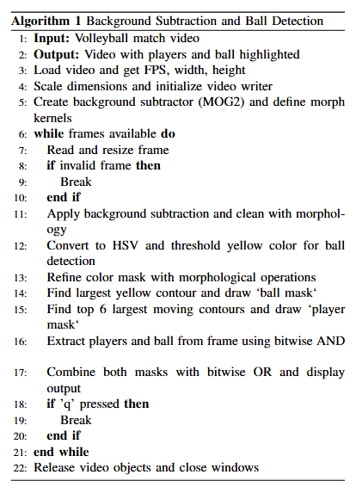








Our Approach
Preprocessing: Frames are read and resized for consistent processing.
Background Subtraction: Motion in the frame is isolated using background subtraction and cleaned with morphological operations to reduce noise.
Ball Detection: The frame is converted to the HSV color space, and a threshold is applied to isolate the yellow ball. Morphological operations refine this mask, and the largest yellow contour is assumed to be the ball.
Player Detection: The top-k largest moving contours are selected to identify players. These are drawn as the 'player mask’.
Masking and Display: Bitwise operations extract and combine the player and ball regions, and the result is displayed.
Exit Conditions: The loop continues until all frames are processed or the 'q' key is pressed. Finally, all video resources are released.

Slide 6
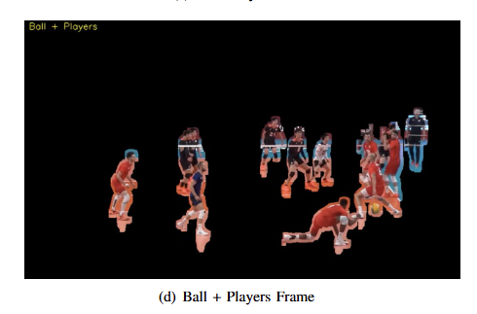
Application
Volleyball /Player Detection using Background Subtraction
Demo

Slide 7
Python OpenCV – Background subtraction
BackgroundSubtractorKNN
BackgroundSubtractorMOG2
BackgroundSubtractorGMG
The Gaussian Mixture Model (GMM) is a probabilistic model used to represent data as a mixture of multiple Gaussian distributions. It is widely used in clustering, density estimation, and background subtraction
The background is identified as the most persistent Gaussian component.
Foreground objects (moving objects) are detected when they deviate
significantly from the background model.

Slide 8
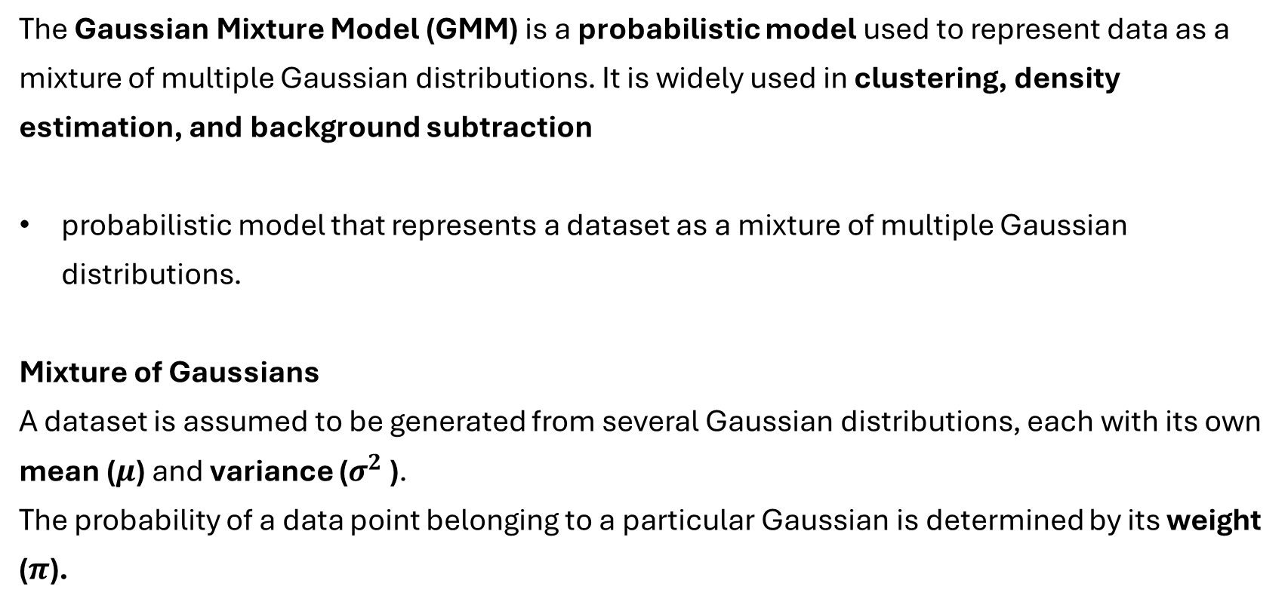
Gaussian Mixture Model (GMM)
The Gaussian Mixture Model (GMM) is a probabilistic model used to represent data as a mixture of multiple Gaussian distributions. It is widely used in clustering, density estimation, and background subtraction
probabilistic model that represents a dataset as a mixture of multiple Gaussian distributions.
Mixture of Gaussians
A dataset is assumed to be generated from several Gaussian distributions, each with its own mean ($μ$) and variance ($σ^{2}$ ).
The probability of a data point belonging to a particular Gaussian is determined by its weight ($π$).

Slide 9
GMM in Background Subtraction
In computer vision, GMM is used in Background Subtraction (BackgroundSubtractorMOG2)
Each pixel is modeled using a mixture of Gaussians.
The background is identified as the most persistent Gaussian component.
Foreground objects (moving objects) are detected when they deviate
significantly from the background model.

Slide 10

How does GMM work :
Multiple Gaussians per Pixel
Each Gaussian component has a weight,updated over time.
Foreground Detection
Adaptability
$$P\left(x\right)=\sum_{1}^{K}{π_{i}N(x|μ_{i}, σ_{i})}$$
Notes:
Each pixel is modeled as a mixture of K Gaussian distributions rather than asingle value. This allows it to adapt to changes likelighting variations, waving trees, or moving water.
Each Gaussian component has a weight,updated over time. Background pixels tend to belong tostable, high-weight Gaussians, while foreground objectsintroduce new, low-weight Gaussians.
new pixel value is comparedto existing Gaussians. If it matches a background dis-tribution, it is classified as background; otherwise, it isconsidered foreground.
Over time, the model adapts by updatingor replacing Gaussian components to account for gradualscene changes.

Slide 11
KNN in Background Subtraction
KNN maintains a history of pixel values over time and determines the background dynamically.
Maintaining a History
Each pixel stores a history of its last N observed values.
These values form a dataset of pixel intensities.
Classifying Foreground vs. Background
For a new pixel value, KNN finds the K nearest neighbors.
If most of these neighbors are close (within a threshold), the pixel is classified as background.
Otherwise, it is classified as foreground (indicating motion).
Updating the Background Model
The history is updated over time by replacing old pixel values with new ones.
Notes:
Instead of using a single reference background image,
Store Training Data – KNN memorizes the entire dataset instead of learning parameters.
Calculate Distance – When given a new data point, it calculates the distance to all training points.
Find Nearest Neighbors – Selects the K closest points (smallest distances).
Updating the Background Model
This allows the model to adapt to gradual background changes (e.g., lighting changes, slow-moving objects).

Slide 12
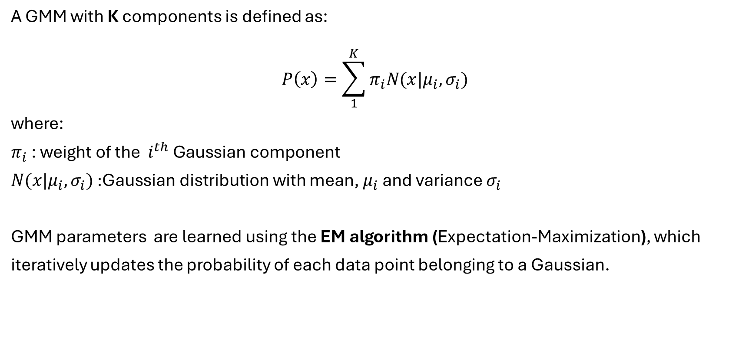
Mathematical Representation
A GMM with K components is defined as:
$$P\left(x\right)=\sum_{1}^{K}{π_{i}N(x|μ_{i}, σ_{i})}$$
$$\text{where}\text{:}$$
$π_{i}$ : $\text{weight} \text{of} \text{the} i^{th} \text{Gaussian} \text{component}$
$N(x|μ_{i}, σ_{i}\text{) :}\text{Gaussian} \text{distribution}$ with mean, $μ_{i}$ and variance $σ_{i}$
GMM parameters are learned using the EM algorithm (Expectation-Maximization), which iteratively updates the probability of each data point belonging to a Gaussian.

Slide 13
Experiments
history (default=500)
Number of frames used to learn the background model.
Larger values make adaptation to changes slower.
varThreshold (default=16)
Threshold for deciding whether a pixel is foreground or background.
Higher values make the model more tolerant to variations.
detectShadows (default=True)
Enables detection of shadows (marked in gray).
varThresholdGen (default=9)
Controls the update speed of the variance threshold.
Lower values make the model more sensitive to noise.
backgroundRatio (default=0.7)
Defines the proportion of the model that is considered background.
nMixtures (default=5)
Number of Gaussian components in the mixture model.
complexityReductionThreshold (default=0.05)
Reduces computational cost by removing insignificant Gaussians.

Slide 14
Experiments
history (default=500)
Number of frames used to learn the background model.
Larger values make adaptation to changes slower.
detectShadows (default=True)
Enables detection of shadows (marked in gray).
backgroundRatio (default=0.7)
Defines the proportion of the model that is considered background.
nMixtures (default=5)
Number of Gaussian components in the mixture model.

Slide 15
Volleyball Detection Using Background Subtraction & Color Filtering
Steps
Load the Video & Initialize Parameters and Setup Video Writer
Background Modeling - Capture Initial Frames to Compute Background
Compute Background Model Using Median Filtering
Foreground Detection Using MOG2 (Create subtractor)
Apply Background Subtraction
Color Filtering for Volleyball Detection
Combining Movement & Color Detection
Morphological Processing - to remove noise and fill gaps in the detected object.
Finding & Drawing the Volleyball

Slide 16
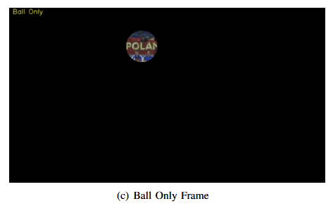
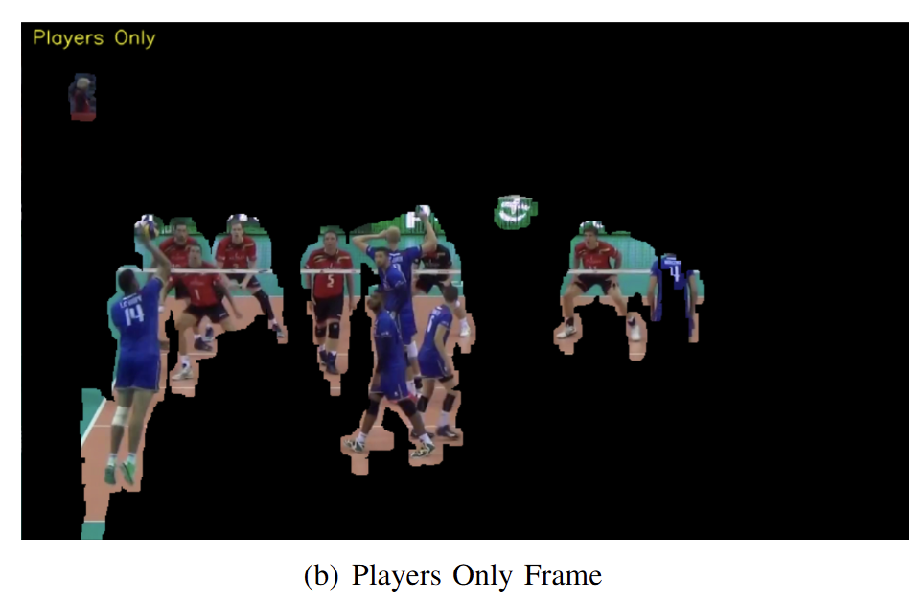
Challenges – specific to our application.
Moving Components
Audience
Advertisements
Net and static volleyballs
Still Components
Players

Slide 17
Future Enhancements
Dynamic Background Adaptation: Improve tracking in videos with changing lighting conditions.
Multiple Object Detection: Handle overlapping objects or occlusions.
Machine Learning Integration: Enhance accuracy with deep learning-based object tracking.
Notes:
A few improvements we could not implement due to time constraints were the following:
Dynamic Background Adaption, so handling scenes that have lighting conditions that are not consistent
Multiple Object Detection to handle distinction between players on the court among other circumstances
Machine Learning Integration to better handle the texture of the volleyball with a nuanced understanding of the various rotations and distortions that appear in various frames.

Slide 18
Conclusion
We successfully applied background subtraction techniques to detect and track a volleyball along with the players in a sports video.
By combining Gaussian Mixture Model for motion detection and HSV-based color filtering, we effectively isolated the volleyball and the players from the background.
By leveraging computer vision techniques, we can build real-time sports analytics, player tracking, and ball trajectory prediction systems, improving game analysis and performance evaluation.

