Slide 1

KPMG data challenge
Karel Goense

Slide 2
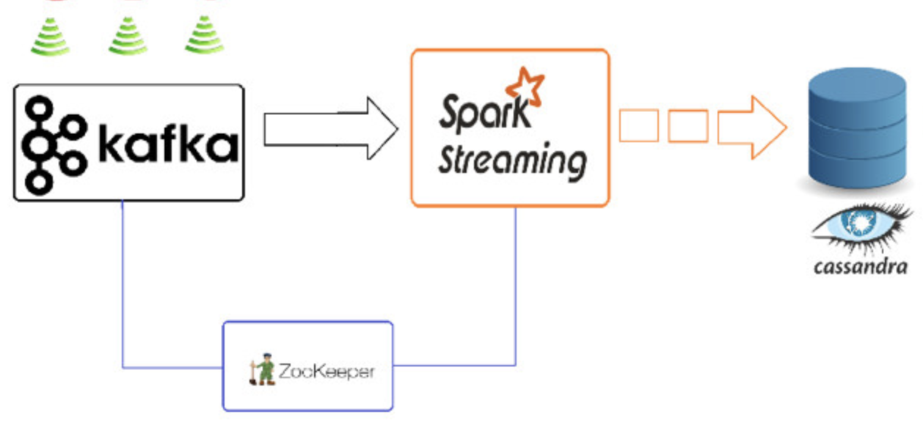
Twitter data

Slide 3
Real time twitter data gets filtered using chosen keywords (blockchain)
Hashtags are extracted and posted in an ’events’ topic
Spark pulls messages from ‘events’ topic into a direct stream
Data is transformed and checked for identical hashtags
Keys (hashtags), and values (count of hashtag) are stored in a Cassandra database

Slide 4
Q & A

