Slide 1
CSC3060 – Computer Systems
Chapter 5:
Optimizing Program Performance
Prof. Wei Chung Hsu
School of Data Science
Chinese University of Hong Kong, Shenzhen

Slide 2
Program Optimization
The focus is now shifting from simply writing correct programs to writing programs that perform efficiently.
Optimization matters because the right change in software can deliver orders-of-magnitude gains in speed, cost, power, and usability — often far more cheaply than changing hardware.
In performance-critical systems, optimization is especially valuable because even small gains can lead to significant practical benefits.
This chapter explores how programmers can evaluate performance, identify bottlenecks, and apply optimization techniques to reduce execution time.
By connecting programming decisions to the behavior of the underlying hardware, this chapter shows that performance improvement is a deliberate and measurable process rather than a matter of trial and error.
Notes:
My experience: 1) at Cray-2, the chief architect wrote a letter to Seymore Cray. 2) One deal with the Department of Defense (Now department of WAR). Our benchmark was 10% off. My change increased the performance saved 15millions

Slide 3
The Deepseek Example
DeepSeek has put strong pressure on the LLM market by showing that highly capable models can be trained and served at much lower cost (2K GPU vs. 16K)
DeepSeek’s impact is roughly a 5×–20× improvement in cost efficiency in some comparisons.
While many AI experts believe that the major cost-performance improvements come from LLM models (such as MoE and GQA), the actual significant gains in efficiency stemmed from system performance enhancements.
Optimization Type | Estimated Performance Contribution | Key Technologies
PTX & System-Level | ~60-70% | Direct PTX programming, thread optimization, cache management
Model Architecture | ~20-30% | MoE design, GQA attention
Training Techniques | ~10% | Multi-step scheduling, reinforcement learning
Notes:
My experience: 1) at Cray-2, the chief architect wrote a letter to Seymore Cray. 2) One deal with the Department of Defense (Now department of WAR). Our benchmark was 10% off. My change increased the performance saved 15millions

Slide 4
Is Code Optimization Hard?
Code optimization is fun
If you like solving puzzles and mysteries
Measurable wins could sometimes lead to high rewards
Creative constraints (work with limits: time, resource, memory, …)
And you like using all of your computer science knowledge
Performance / Efficiency is critical in every part of the system
Compilers (4180), Parallel Programming (4005), HPC (4107), and Computer architecture (6031) are all related to these objectives
Data structures (3200) and Algorithms (4120) make huge differences

Slide 5
Is Code Optimization Hard?
Code optimization is fun
If you like solving puzzles and mysteries
Measurable wins could sometimes lead to high rewards
Creative constraints (work with limits: time, resource, memory, …)
And you like using all of your computer science knowledge
Performance / Efficiency is critical in every part of the system
Compilers (4180), Parallel Programming (4005), HPC (4107), and Computer architecture (6031) are all related to these objectives
Data structures (3200) and Algorithms (4120) make huge differences
Examples:
Google: An extra 0.5 seconds in search page generation reduced traffic by about 20%.
Amazon: Every 100 ms of latency can cost about 1% in sales.
High-frequency trading: Microseconds to milliseconds of execution system improvement matters a lot.
Netflix: Even small percentage improvements in video encoding can save millions of dollars in CDN annually.

Slide 6
Using the Compiler in Program Optimizations
An optimizing compiler is one of your most important partners in performance optimization work. It can automatically apply many low-level improvements. The first step is to enable compiler optimizations
-On, n is 0, 1, 2, 3, or 4 (in older compilers)
-O0 : No optimizations, very fast compilation. Generated code is for debugging
-O1 : Basic optimizations. –O is also –O1
-O2 : This is the recommended default for optimizations. It provides highly optimized code that is safe, stable, and does not increase code size by much.
-O3: Aggressive Optimizations, including loop unrolling and SIMDilization.
-O4: Previously, -O4 enabled Link-Time Optimization (LTO); now, -O4 also implies -O3 along with LTO (-O3 -flto).
Notes:
How do we define “make this as efficient as possible” in a way that a computer can carry out?
One obvious goal is to minimize the number of instructions we execute. Don’t do the same calculation over and over again. Don’t do unnecessary calculations at all.
Another obvious goal, as you’re seeing right now in cache lab, is to avoid waiting for memory. That means making the best possible use of the registers, and accessing memory in a pattern that maximizes locality, and stuff like that.
And another important goal, for reasons we’ll talk about later today, is to avoid branching, especially unpredictable branching.

Slide 7
Using the Compiler in Program Optimizations
An optimizing compiler is one of your most important partners in performance optimization work. It can automatically apply many low-level improvements. The first step is to enable compiler optimizations
-On, n is 0, 1, 2, 3, or 4 (in older compilers)
-O0 : No optimizations, very fast compilation. Generated code is for debugging
-O1 : Basic optimizations. –O is also –O1
-O2 : This is the recommended default for optimizations. It provides highly optimized code that is safe, stable, and does not increase code size by much.
-O3: Aggressive Optimizations, including loop unrolling and SIMDilization.
-O4: Previously, -O4 enabled Link-Time Optimization (LTO); now, -O4 also implies -O3 along with LTO (-O3 -flto).
O3 trades more aggressive transformations for larger code, higher compile time, harder debugging, and sometimes worse runtime performance
Notes:
How do we define “make this as efficient as possible” in a way that a computer can carry out?
One obvious goal is to minimize the number of instructions we execute. Don’t do the same calculation over and over again. Don’t do unnecessary calculations at all.
Another obvious goal, as you’re seeing right now in cache lab, is to avoid waiting for memory. That means making the best possible use of the registers, and accessing memory in a pattern that maximizes locality, and stuff like that.
And another important goal, for reasons we’ll talk about later today, is to avoid branching, especially unpredictable branching.

Slide 8
More Optimization Flags
Other than the tiered optimization flags, here are some additional flags that might be useful:
-O3 -flto (Link-Time Optimization) Enable whole program optimization
-march=native (Target CPU-specific instructions)
-march=native Tells the compiler to generate code optimized specifically for the CPU architecture it is currently compiling on.
-mtune=native Optimizes the scheduling of instructions for the current CPU without breaking compatibility with older CPUs
-fprofile-use (Profile-Guided Optimization)
-fprofile-generate: compile an instrumented code to generate profiles
-fprofile-use: use profile data to guide the code optimizations.
-Ofast is simply –O3 -ffast-math. This allows the compiler to reorder FP ops.
Notes:
How do we define “make this as efficient as possible” in a way that a computer can carry out?
One obvious goal is to minimize the number of instructions we execute. Don’t do the same calculation over and over again. Don’t do unnecessary calculations at all.
Another obvious goal, as you’re seeing right now in cache lab, is to avoid waiting for memory. That means making the best possible use of the registers, and accessing memory in a pattern that maximizes locality, and stuff like that.
And another important goal, for reasons we’ll talk about later today, is to avoid branching, especially unpredictable branching.

Slide 9
Why not let the Compiler do all Optimizations
While compilers are very powerful and sophisticated, they have their limits:
Compilers Cannot Change Your Algorithm (this may change in the future)
Compilers must obey the rules and semantics of the programming language. The compiler can only apply optimizations if the resulting program behaves exactly as if it were executing the unoptimized code.
Memory aliasing, FP associativity, Function side effects, Volatile variables, Memory consistency
Lack of Runtime and Domain Knowledge (this may demand dynamic translators)
Many specific optimization problems are NP-hard.
optimal register allocation, optimal code scheduling, memory layout and packing, phase ordering.
Boundary crossing issues (separate compilation)
Link-time optimizations
Notes:
How do we define “make this as efficient as possible” in a way that a computer can carry out?
One obvious goal is to minimize the number of instructions we execute. Don’t do the same calculation over and over again. Don’t do unnecessary calculations at all.
Another obvious goal, as you’re seeing right now in cache lab, is to avoid waiting for memory. That means making the best possible use of the registers, and accessing memory in a pattern that maximizes locality, and stuff like that.
And another important goal, for reasons we’ll talk about later today, is to avoid branching, especially unpredictable branching.

Slide 10
AI-assisted Compiler Optimizations
An optimizing compiler can automatically apply many low-level improvements, but it cannot replace good algorithms, good data layout, or measurement-driven engineering.
Today’s autotuning system may search for a more efficient data layout
AI-assisted optimization has made real progress, especially in compiler heuristics tuning, optimization pass selection/phase ordering, inlining and register-allocation heuristics, code generation cost models, autotuning kernels for CPUs/GPUs/TPUs, and ML-guided scheduling.
AI may understand the algorithm you implemented and substitute it with a more suitable or better-performing one in the future
Today, there is no end-to-end AI compiler yet, but such compilers may come out in the future.

Slide 11
General Goals of Compiler Optimizations
Minimize the number of instructions
Don’t do calculations more than once (CSE – Common Subexpression Elimination)
Don’t do unnecessary calculations at all (DCE – Dead Code Elimination)
Avoid slow instructions (multiplication, division) (SR -- Strength Reduction)
Minimize the execution cycles
Keep everything in registers whenever possible (RA – Register Allocation)
Exploit ILP to hide latencies (CS: Code Scheduling)
Access memory in cache-friendly patterns (Locality Improvement)
Load data from memory early, and only once (Preload & Redundant Load Elimination)
Avoid branching
Avoid branching (conditional move in x86, conditional execution in ARM)
Loop unrolling, procedure inlining, and unswitching can reduce branches.
Notes:
How do we define “make this as efficient as possible” in a way that a computer can carry out?
One obvious goal is to minimize the number of instructions we execute. Don’t do the same calculation over and over again. Don’t do unnecessary calculations at all.
Another obvious goal, as you’re seeing right now in cache lab, is to avoid waiting for memory. That means making the best possible use of the registers, and accessing memory in a pattern that maximizes locality, and stuff like that.
And another important goal, for reasons we’ll talk about later today, is to avoid branching, especially unpredictable branching.

Slide 12
Limits to Compiler Optimization
Generally cannot improve algorithmic complexity
Must not cause any change in program behavior
A programmer may not care about “edge case” behavior, But the compiler does not know that
e.g., Exceptions, Aliasing
Often only analyze one function at a time
Whole-program analysis (“LTO”) is expensive, but gaining popularity (e.g., GCC and LLVM)
Exception: inlining merges many functions into one
Tricky to anticipate run-time inputs
Profile-guided optimization can help with common cases, but…
“Worst case” performance can be just as important as “normal.”
Especially for code exposed to malicious input (e.g., network servers)
Memory dependencies are often unknown (e.g., memory aliasing)
Notes:
Compilers aren’t magic and they aren’t creative. This means they can’t do everything for you.
In most cases they can’t make your algorithm better. They can edit all the unnecessary instructions out of your bubble sort, but it will still be bubble sort, not quicksort.
They don’t know what’s in or out of scope of your design, so they can’t change any behavior, not even edge-case behavior you never cared about… unless the language says it’s OK. A language spec might allow its compilers to apply the associative law to floating-point calculations even though floating point arithmetic isn’t associative.
They usually only look at one function at a time, just to keep compilation time down—except that inlining merges many functions into one.
And they typically have no information about what will happen when the program is run.

Slide 13
Basic Compiler Optimizations
entry
Local optimizations
work inside a single basic block
constant folding, strength reduction, dead code elimination, (local) CSE, …
Global optimizations
process the entire control flow graph of a function
Loop transformations, code motion, (global) CSE, …
setup
Easy?
easy
complex
loop
Done?
exit
Notes:
A fundamental idea in compiler theory is the control flow graph. That was Fran Allen’s insight: draw a flowchart of all the decisions that the program makes, and use mathematical graph theory to analyze it. It’s a directed graph and it can have cycles – those are the loops.
We can divide optimizations into two classes based on how they interact with the control flow graph. Local optimizations work on one basic block at a time – that’s a chunk of “straight line” code, containing neither gotos nor labels. They have limited impact but they’re reliable. Doing local optimizations is just about always a win.
Global optimizations, on the other hand, process an entire function at once. They can move code between basic blocks and rearrange the graph. They can be very powerful but they’re not always a good idea.

Slide 14
Data Dependence Graph and Control Flow Graph
Control Flow Graph (CFG) and the Data Flow Graph (DFG) are the two most critical data structures used to understand and optimize your code. While the CFG models the paths of execution, the DFG models the movement of information.
By looking at both graphs simultaneously, the compiler knows exactly where the program is going (CFG) and what it is carrying along the way (DFG), which forms the mathematical foundation for almost all -O1, -O2, and -O3 optimizations.
The Data Dependency Graph (DDG) we used in code scheduling is a graph to track instruction execution order constraints. DFG is used to determine the values of the variable flow. It enables various optimizations such as CSE, DCE, Reaching definitions and register allocations.
Notes:
Probably the most obvious local optimization there is: if you can have the compiler do some math, instead of doing it when the program is run, that’s a win. For example, you remember all those wacky expressions you had to write in data lab to get big constants? If you go back and disassemble your solutions you’ll probably see hex FF00 instead of hex FF shift left 8, and so on.
Really clever compilers might be able to fold through C library functions with constant arguments.

Slide 15
Constant folding
Do arithmetic in the compiler long mask = 0xFF << 8; → long mask = 0xFF00;
Any expression with constant inputs can be folded
Might even be able to remove library calls… size_t namelen = strlen("Harry Bovik");
➔size_t namelen = 11;
Notes:
Probably the most obvious local optimization there is: if you can have the compiler do some math, instead of doing it when the program is run, that’s a win. For example, you remember all those wacky expressions you had to write in data lab to get big constants? If you go back and disassemble your solutions you’ll probably see hex FF00 instead of hex FF shift left 8, and so on.
Really clever compilers might be able to fold through C library functions with constant arguments.

Slide 16
Dead Code Elimination (DCE)
Don’t emit code that will never be executed if (0) { puts("Kilroy was here"); } if (1) { puts("Only bozos on this bus"); }
Don’t emit code whose result is overwritten x = 23; x = 42;
These may look silly, but...
Can be produced by other optimizations
Can be produced by conditional compilations
Assignments to x might be far apart
Notes:
If code is never going to be executed, don’t write it out! And don’t do any calculations that would only be used by code that’s never executed, or that has its result overwritten before it’s used.
You might be thinking “why would anyone write that in the first place?” but other optimizations often make code be dead. Maybe that “if zero” was “if some arithmetic that the constant folder evaluated to zero” in the source code.

Slide 17
Common Subexpression Elimination (CSE)
Factor out repeated calculations, only do them once
norm[i] = v[i].x*v[i].x + v[i].y*v[i].y;
➔
elt = &v[i];
x = elt->x;
y = elt->y;
norm[i] = x*x + y*y;
Note that the compiler is very good at
CSE (Common Sub-expression Elimination).
Programmers are not supposed to do it.
Notes:
If you’ve got to do a calculation, only do it once, and remember the result. This complex expression reads from memory four times, but we can calculate the address of v[i] just once…
… and we can load dot x and dot y from memory once each
… and finally we can do all the arithmetic in registers.
This can be a local or a global optimization and there are at least five different algorithms for it.

Slide 18
More Common Subexpressions
More CSE Examples
float dist2 = (x1 - x2) * (x1 - x2) + (y1 - y2) * (y1 - y2);
A = (A+B+C) * (A+B+D) – (A+D+B) //A,B,C,D are integers, A+B is a common subexpression
A = B[i][j][k] + C[i][j][k]; //B,C are float [L][M][N]; i* (M*N) + j*N + k is a common subexpression.
A = A->b->c->e + A->b->c->d; //A->b->c is a common subexpression
Notes:
If you’ve got to do a calculation, only do it once, and remember the result. This complex expression reads from memory four times, but we can calculate the address of v[i] just once…
… and we can load dot x and dot y from memory once each
… and finally we can do all the arithmetic in registers.
This can be a local or a global optimization and there are at least five different algorithms for it.

Slide 19
LICM (Loop Invariant Code Motion)
Move calculations out of a loop
Only valid if every iteration would produce same result long j; for (j = 0; j < n; j++) a[n*i+j] = b[j];
→ long j;
int ni = n*i; for (j = 0; j < n; j++) a[ni+j] = b[j];
Notes:
Sometimes a program computes the same value over and over because the expression is inside a loop. If every iteration of the loop computes the same result, we say the calculation is a ‘loop invariant’ and we move it to above the loop. It’s CSE in time instead of space. In the example, n times I is invariant so we make a temp variable for it.

Slide 20
Inlining
Copy body of a function into its caller(s)
Can create opportunities for many other optimizations
Can make code much bigger and therefore slower (size; i-cache)
int pred(int x) {
if (x == 0)
return 0;
else
return x - 1;
}
int func(int y) {
return pred(y)
+ pred(0)
+ pred(y+1);
}
int func(int y) {
int tmp;
if (y == 0) tmp = 0; else tmp = y - 1;
if (0 == 0) tmp += 0; else tmp += 0 - 1;
if (y+1 == 0) tmp += 0; else tmp += (y + 1) - 1;
return tmp;
}
Notes:
One of the most important global optimizations is inlining. Take a short function and copy its body in place of all calls to it. Obviously this cuts out the function call overhead, but it also gets around that one-function-at-a-time restriction and gives the compiler opportunities to do more other optimizations. Here we have two simple functions and there’s not much to do to either one by itself, but if we combine them…

Slide 21
Procedure Inlining
Copy body of a function into its caller(s)
Can create opportunities for many other optimizations
Can make code much bigger and therefore slower (if there are many call sites)
int pred(int x) {
if (x == 0)
return 0;
else
return x - 1;}
int func(int y) {
return pred(y)
+ pred(0)
+ pred(y+1);
}
int func(int y) {
int tmp;
if (y == 0) tmp = 0; else tmp = y - 1;
if (0 == 0) tmp += 0; else tmp += 0 - 1;
if (y+1 == 0) tmp += 0; else tmp += (y + 1) - 1;
return tmp;
}
Always true
Does nothing
Can constant fold
Notes:
Now each of the function calls is an expression that we can optimize based on the value of x at each call site.

Slide 22
Inlining
Copy body of a function into its caller(s)
Can create opportunities for many other optimizations
Can make code much bigger and therefore slower
int func(int y) {
int tmp;
if (y == 0) tmp = 0; else tmp = y - 1;
if (0 == 0) tmp += 0; else tmp += 0 - 1;
if (y+1 == 0) tmp += 0; else tmp += (y + 1) - 1;
return tmp;
}
int func(int y) {
int tmp = 0;
if (y != 0) tmp = y - 1;
if (y != -1) tmp += y;
return tmp;
}
Notes:
And so inlining plus local optimizations produces this much simpler function.
This kind of opportunity to simplify the code after inlining, comes up a whole lot in C++ with template functions. If you ever wondered why almost the entire implementation of std::string and std::map is in the header files? It’s so the compiler can inline all of it and then simplify it down to the cases that matter for the actual program.
The catch to inlining is that if you do it too much, the program can become really big. Too big for the instruction cache. That makes it slow no matter what.

Slide 23
To Inline or Not To Inline
Procedure inlining is one of the most powerful optimizations a compiler can perform, but it is a delicate balancing act. The compiler must weigh the benefits of eliminating the function call overhead (and unlocking further optimizations) against the cost of code bloat.
Function size
Execution Frequency
Is the call inside a loop? Is it an error handling call?
Number of call sites
Constant Arguments and Secondary Optimizations
Constant parameters can trigger additional optimizations
Recursion and Depth Limits
GPU kernels try to inline all calls.
Notes:
One of the most important global optimizations is inlining. Take a short function and copy its body in place of all calls to it. Obviously this cuts out the function call overhead, but it also gets around that one-function-at-a-time restriction and gives the compiler opportunities to do more other optimizations. Here we have two simple functions and there’s not much to do to either one by itself, but if we combine them…

Slide 24
Memory Aliasing
/* Sum rows of n X n matrix a and store in vector b. */
void sum_rows1(double *a, double *b, long n) {
long i, j;
for (i = 0; i < n; i++) {
b[i] = 0;
for (j = 0; j < n; j++)
b[i] += a[i*n + j];}
}
.L_inner_loop:
fld fa5, 0(a3) # 1. LOAD: Read b[i] from memory into float register fa5
fld fa4, 0(a4) # 2. LOAD: Read current a[...] from memory into fa4
fadd.d fa5, fa5, fa4 # 3. MATH: Add them together (Double precision)
fsd fa5, 0(a3) # 4. STORE: Write the result immediately back to b[i] in memory
addi a4, a4, 8 # 5. Move pointer 'a' forward by 8 bytes (sizeof(double))
bne a4, a5, .L_inner_loop # 6. If 'a' pointer hasn't reached the end, loop again
Code updates b[i] on every iteration
Why couldn’t the compiler optimize this away? Such as keeping it in a register
Notes:
A is N-by-N square matrix and we want to sum up the values in each row and put the sums in another array B.
The compiler loads b[i] from memory, adds a[i][j], and writes it back, on each cycle. Why?

Slide 25
Memory Aliasing
/* Sum rows of n X n matrix a and store in vector b. */
void sum_rows1(double *a, double *b, long n) {
long i, j;
for (i = 0; i < n; i++) {
b[i] = 0;
for (j = 0; j < n; j++)
b[i] += a[i*n + j];}
}
.L_inner_loop: // Allocating b[i] in register fa5
fld fa4, 0(a4) # 2. LOAD: Read current a[...] from memory into fa4
fadd.d fa5, fa5, fa4 # 3. MATH: Add them together (Double precision)
addi a4, a4, 8 # 5. Move pointer 'a' forward by 8 bytes (sizeof(double))
bne a4, a5, .L_inner_loop # 6. If 'a' pointer hasn't reached the end, loop again
Code updates b[i] on every iteration
Why couldn’t the compiler optimize this away? Such as keeping it in a register
Notes:
A is N-by-N square matrix and we want to sum up the values in each row and put the sums in another array B.
The compiler loads b[i] from memory, adds a[i][j], and writes it back, on each cycle. Why?

Slide 26
How to know if aliasing gets in the way?
Compilers can output detailed messages saying "cannot reorder memory operations" or "cannot vectorize loop due to potential memory dependencies". These messages are direct indicators that pointer aliasing is forcing the compiler to load/store to memory rather than keep values in registers.
If you use GCC
gcc -O3 -fopt-info-missed=missed_opts.txt my_program.c
When you see "data dependence" or "dependent memory operations," that is GCC saying: "I don't know if these pointers alias, so I must read/write to RAM in the exact order you wrote the code."
If you use Clang (LLVM)
clang -O3 -Rpass-missed=.* -Rpass-analysis=.* my_program.c

Slide 27
Avoiding Aliasing Penalties
/* Sum rows of n X n matrix a and store in vector b. */
void sum_rows2(double *a, double *b, long n) {
long i, j;
for (i = 0; i < n; i++) {
double val = 0;
for (j = 0; j < n; j++)
val += a[i*n + j];
b[i] = val;
}}
1) Use a local variable, val, for the intermediate results
2) Use the restrict keyword
void sum_rows1(double *restrict a, double *restrict b, long n)
Tells the compiler that this is the “only” pointer to that memory location, no possible aliasing
Notes:
What can we do about it? The simplest thing is to do the code motion by hand. We use a local variable to hold the sum, and write to b[i] only once per outer loop.

Slide 28
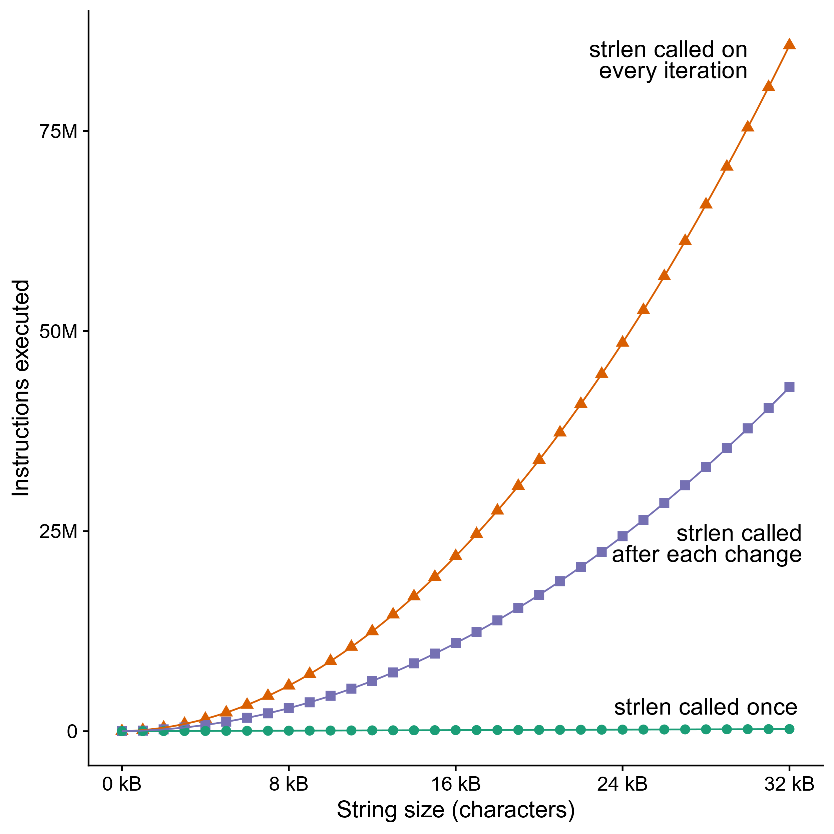
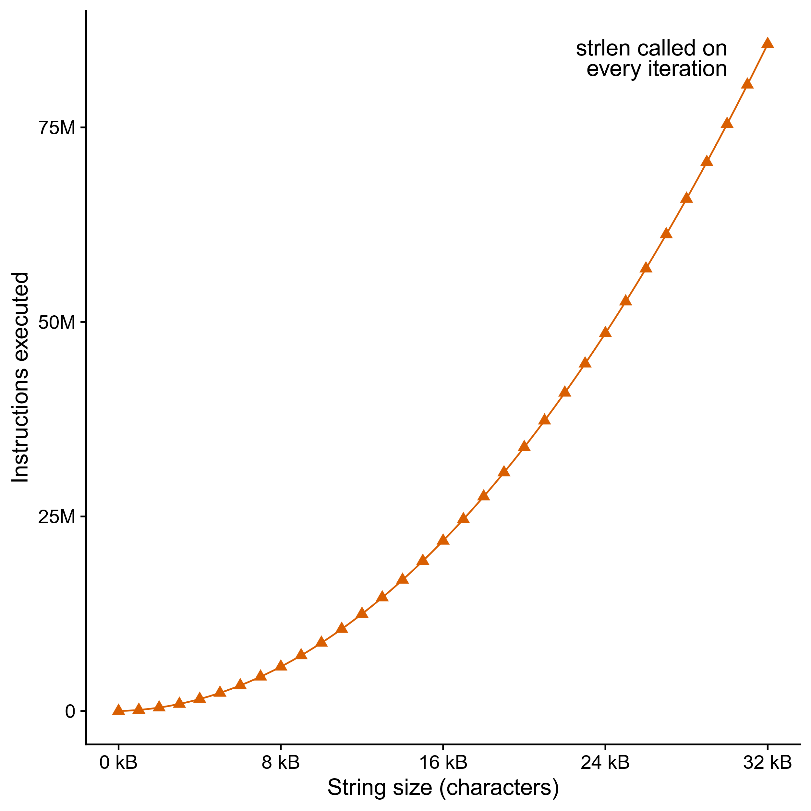
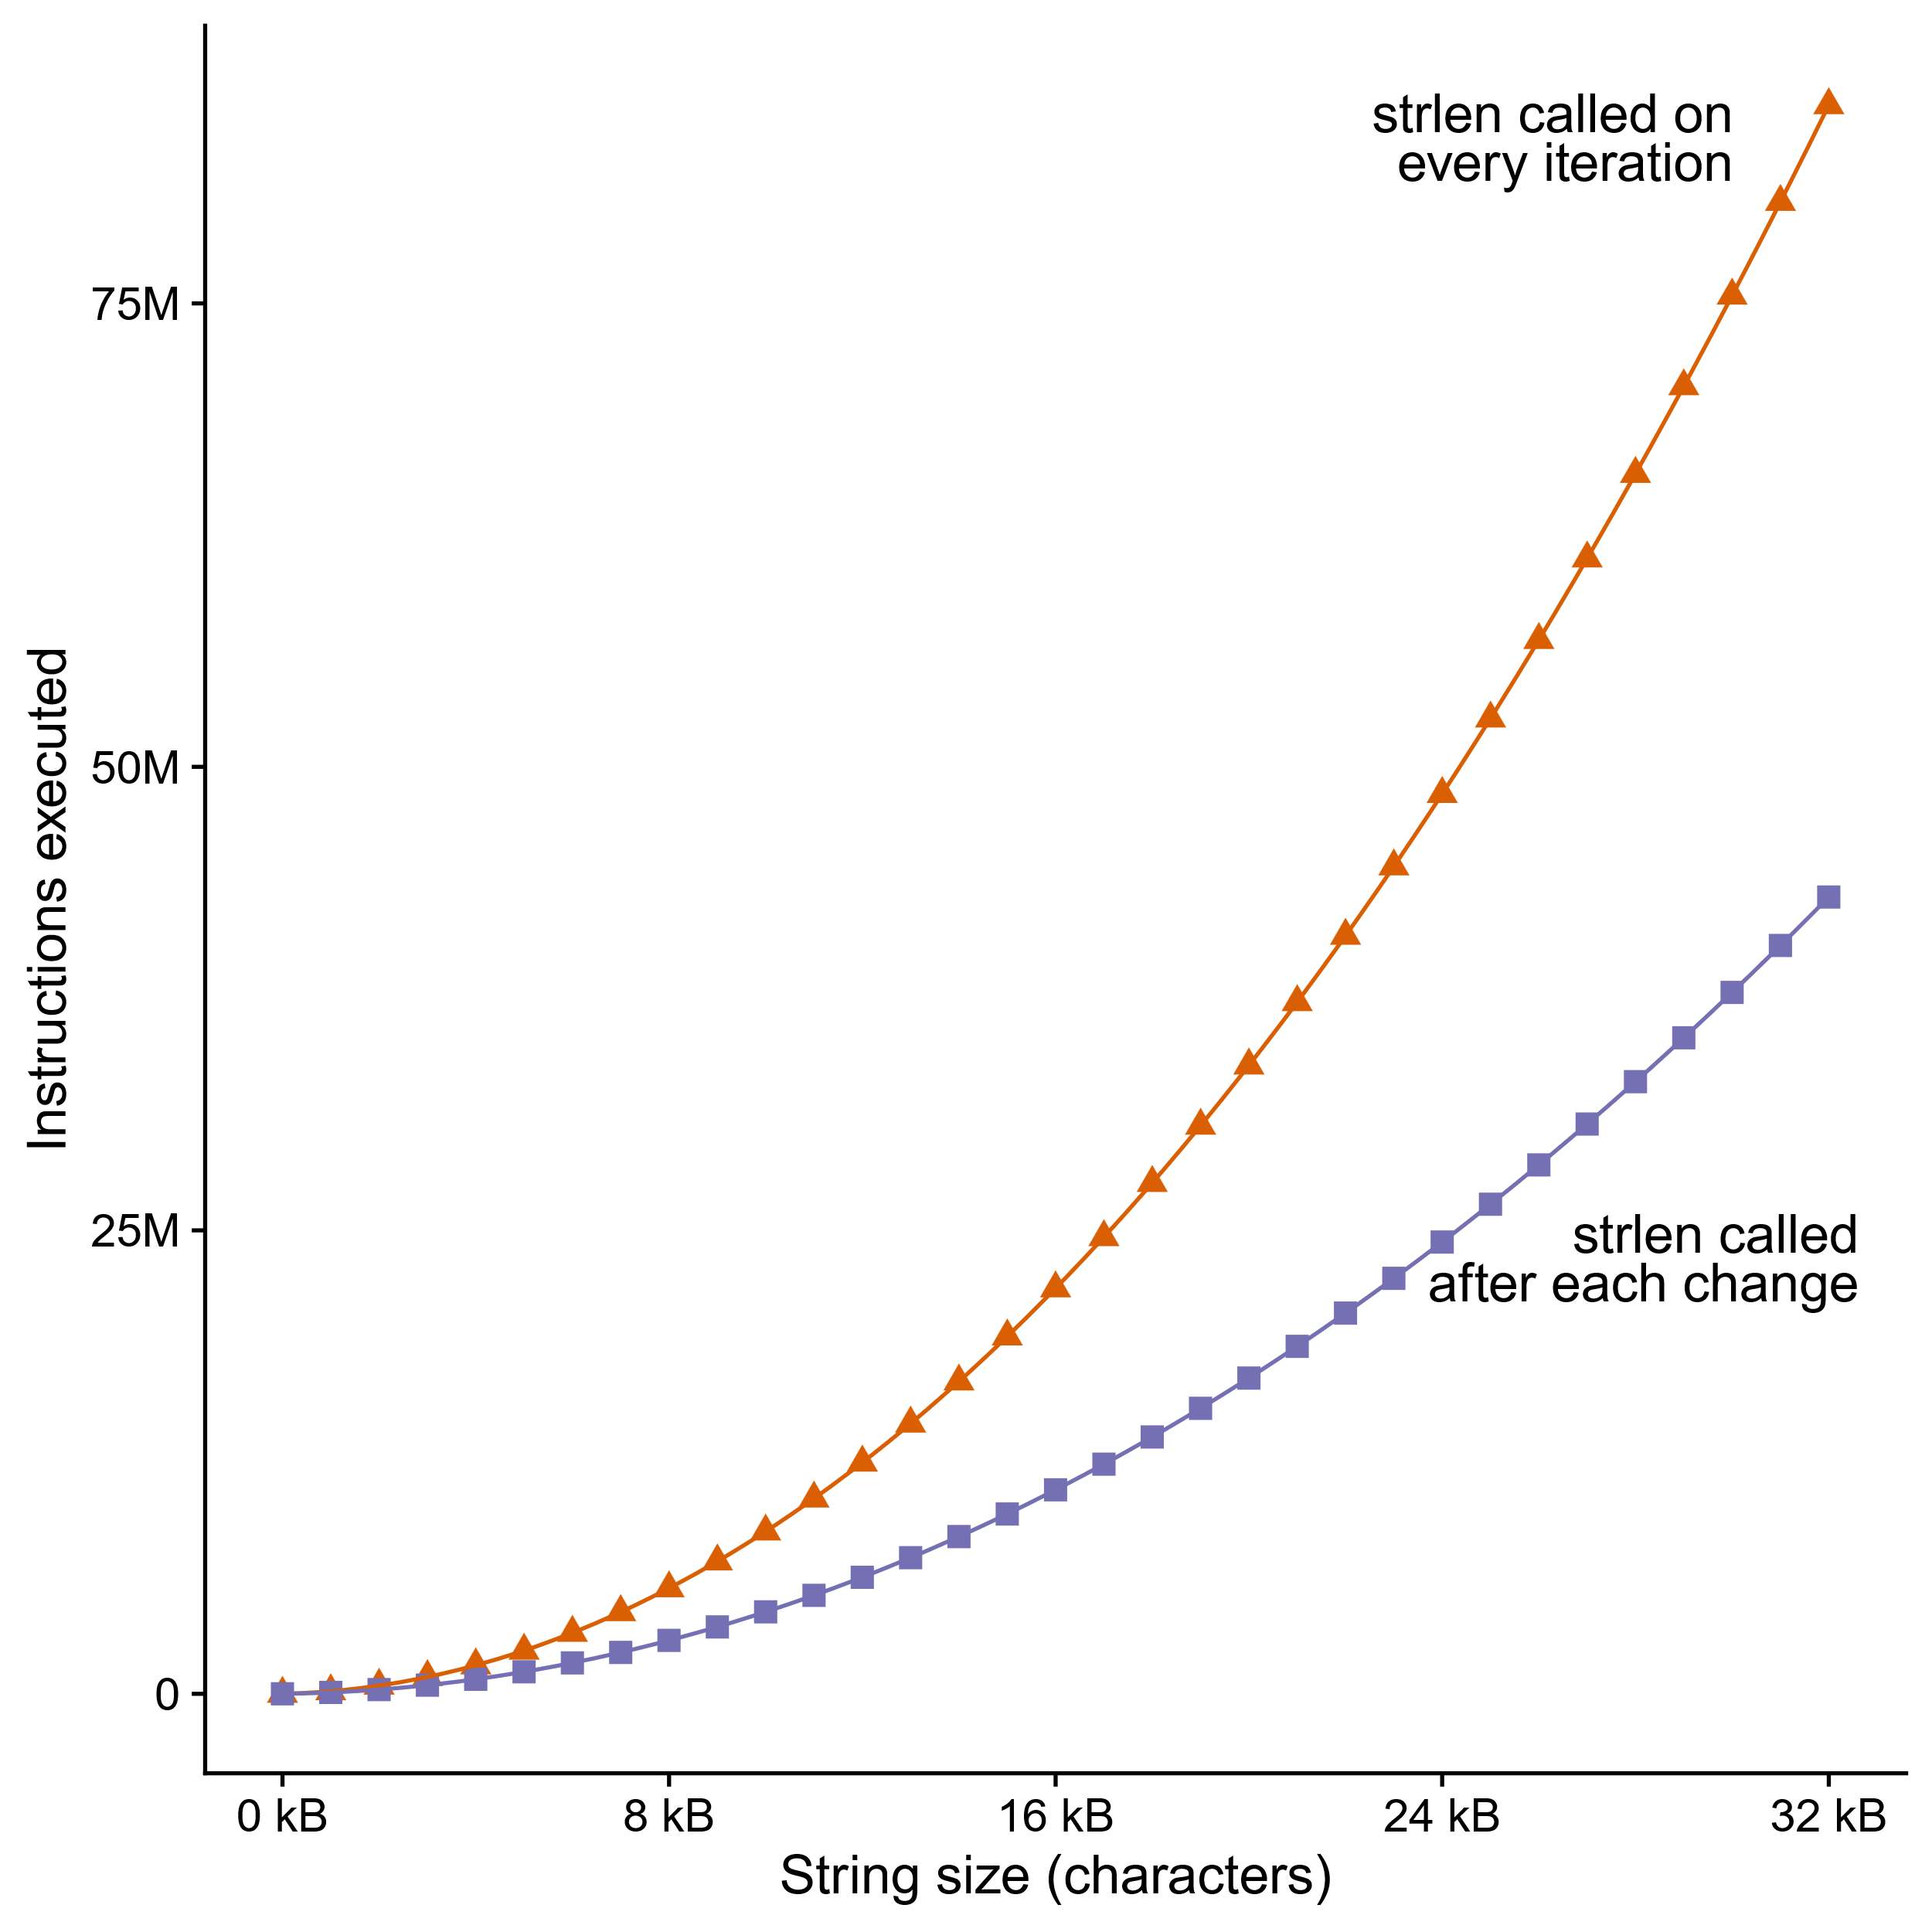
Can’t move function calls out of loops
void lower_quadratic(char *s) {
size_t i;
for (i = 0; i < strlen(s); i++)
if (s[i] >= 'A' && s[i] <= 'Z')
s[i] += 'a' - 'A';}
void lower_still_quadratic(char *s) {
size_t i, n = strlen(s);
for (i = 0; i < n; i++)
if (s[i] >= 'A' && s[i] <= 'Z') {
s[i] += 'a' - 'A';
n = strlen(s);}}
void lower_linear(char *s) {
size_t i, n = strlen(s);
for (i = 0; i < n; i++)
if (s[i] >= 'A' && s[i] <= 'Z')
s[i] += 'a' - 'A';}
Notes:
And because the compiler doesn’t know most of that, if you call strlen in a loop, it has to assume the result could change evey time.
In the function at the top, we have “for (I = 0, I < strlen(s), I++)”, we’re calling strlen, which scans the whole string, for every character in the string, and that’s O(n squared) time complexity. 75 million instructions executed to lowercase 32k of text.
[space] GCC on the sharks does know that strlen is a “pure function”, meaning it doesn’t have any side effects and its return value only depends on its argument and the data pointed to by its argument. That means it can assume strlen will return the same thing on each iteration UNLESS the loop changes the string. So it only calls strlen right after each change. I generated the data for the graph with strings that were exactly 50 percent uppercase, so, the middle function is twice as fast, but it’s still quadratic.
[space] If we manually move the strlen call out of the loop and only call it once, now we get linear time complexity.
[space] This is called “accidentally quadratic” complexity because the programmer probably didn’t intend for lower to be this slow, but it is anyway.
Complexity theorists make a huge deal about the difference between polynomial and exponential time, but for practical purposes,
Quadratic is already too slow.
Even n log n can be too slow – database wranglers spend a lot of time avoiding sorting.

Slide 29
Modern CPU Design
Instruction Control
Fetch
Control
Address
Instruction
Cache
Retirement
Unit
Register
File
Instruction
Decode
Instructions
Operations
Register Updates
Prediction OK?
Execution
Functional
Units
Branch
Arith
Arith
Arith
Load
Store
Operation Results
Addr.
Addr.
Data
Data
Data
Cache
Notes:
To understand the goals of machine-dependent optimizations you have to understand what a modern CPU is like. In the bottom part of the slide are the “functional units” that are actually doing the work. Each is specialized for a type of instruction – such as arithmetic, memory, and branching – and notice there are several arithmetic units, so it can do several arithmetic instructions at the same time. There’s a bus that feeds data from the registers to the functional units, and another bus that takes the data back to the registers, and yet a third bus going from the load and store units out to the data cache.
Meanwhile, at the top of the slide, we have the control circuitry, whose job is to read instructions from memory and dispatch them to appropriate functional units. It will try to keep all of them busy, even if that means executing instructions “out of order” – as soon as all the inputs to an instruction are available, and there’s a free functional unit that can process it, it goes, even if it was later in the machine code than other instructions that are still waiting.
This is just a taste – Professor Railing has an entire course about how these boxes are put together. 418.

Slide 30
Loop Unrolling
Amortize cost of loop condition by duplicating body
Creates opportunities for CSE, code motion, scheduling
Prepares code for SIMDilization
Can hurt performance by increasing code size
Can increase compile time significantly
for (size_t i = 0; i < nelts - 4; i += 4) {
A[i ] = B[i ]*k + C[i ];
A[i+1] = B[i+1]*k + C[i+1];
A[i+2] = B[i+2]*k + C[i+2];
A[i+3] = B[i+3]*k + C[i+3];
}
for (size_t i = 0; i < nelts; i++) {
A[i] = B[i]*k + C[i];
}
When would this change be incorrect?
Notes:
Why would it make the code faster if you duplicate the loop body four times?
The most elemental reason is that it means you execute the loop condition and branch four times less often. That probably doesn’t make a huge difference for this code, but suppose the value of “nelts” is super unpredictable except it’s always a multiple of four – then we just reduced the frequency of branch misprediction stalls by a factor of four.
It also creates opportunities for a bunch of other optimizations, which we’ll look at next.
You do have to watch out for increasing code size, though, like with inlining. And you also have to watch out for running out of registers. If there’s not enough registers to hold all of the variables and intermediates, this probably won’t be faster.
Also, I want to ask: [reveal] When is this change incorrect?
This change is incorrect when the number of elements is not a multiple of 4. Sometimes the compiler can emit code to do the last few array elements separately from the loop, but that takes up even more space.

Slide 31
Scheduling
Rearrange instructions to make it easier for the CPU to keep all functional units busy
For instance, move all the loads to the top of an unrolled loop
Now maybe it’s more obvious why we need lots of registers
for (size_t i = 0; i < nelts - 4; i += 4) {
A[i ] = B[i ]*k + C[i ];
A[i+1] = B[i+1]*k + C[i+1];
A[i+2] = B[i+2]*k + C[i+2];
A[i+3] = B[i+3]*k + C[i+3];
}
for (size_t i = 0; i < nelts - 4; i += 4) {
B0 = B[i]; B1 = B[i+1]; B2 = B[i+2]; B3 = B[i+3];
C0 = C[i]; C1 = C[i+1]; C2 = C[i+2]; C3 = B[i+3];
A[i ] = B0*k + C0;
A[i+1] = B1*k + C1;
A[i+2] = B2*k + C2;
A[i+3] = B3*k + C3;
}
When would this change be incorrect?
Notes:
If we have a lot of work to do within a basic block, maybe it doesn’t have to be done all in a straight line. [reveal] Maybe, for instance, we can take that unrolled loop and move all the memory loads to the beginning, so they can all issue at once and then the math can happen in whatever order the data comes back. The CPU’s control unit might be able to do this itself, but then again it might not, and either way it works better if the compiler helps.
[reveal] When is this change incorrect?
This change is incorrect when A overlaps B or C, so the writes to A change the values being read from B or C. Like with the vector row sums from earlier.

Slide 32
Unrolling/Scheduling are Compiler Optimizations
Modern compilers (like GCC, Clang, and MSVC) are incredibly advanced and handle these optimizations much better than a human can in almost all scenarios.
Compilers also know the underlying microarchitectures better than programmers. All you need to do is use the option
-march = native
-mtune = native
For machines with superscalar and out-of-order execution, programmers struggle with instruction scheduling. If the reorder buffer is empty, they should prioritize latency hiding; if it is full, they should prioritize retirement.

Slide 33
Benchmark Example: Data Type for Vectors
/* data structure for vectors */
typedef struct{
size_t len;
data_t *data;
} vec;
len
0
1
len-1
data
Data Types
Use different declarations for data_t
int
long
float
double
/* retrieve vector element
and store at val */
int get_vec_element
(*vec v, size_t idx, data_t *val)
{
if (idx >= v->len)
return 0;
*val = v->data[idx];
return 1;
}

Slide 34
Benchmark Computation
void combine1(vec_ptr v, data_t *dest)
{
long int i;
*dest = IDENT;
for (i = 0; i < vec_length(v); i++) {
data_t val;
get_vec_element(v, i, &val);
*dest = *dest OP val;
}
}
Compute sum or product of vector elements
Data Types
Use different declarations for data_t
int
long
float
double
Operations
Use different definitions of OP and IDENT
+ / 0
* / 1

Slide 35
Cycles Per Element (CPE)
Convenient way to express performance of program that operates on vectors or lists
Length = n
In our case: CPE = cycles per OP
Cycles = CPE*n + Overhead
CPE is slope of line
psum1
Slope = 9.0
psum2
Slope = 6.0

Slide 36
Benchmark Performance
void combine1(vec_ptr v, data_t *dest)
{
long int i;
*dest = IDENT;
for (i = 0; i < vec_length(v); i++) {
data_t val;
get_vec_element(v, i, &val);
*dest = *dest OP val;
}
}
Compute sum or product of vector elements
Method | Integer |  | Double FP
Operation | Add | Mult | Add | Mult
Combine1 unoptimized | 22.68 | 20.02 | 19.98 | 20.18
Combine1 –O1 | 10.12 | 10.12 | 10.17 | 11.14
Combine1 –O3 | 4.5 | 4.5 | 6 | 7.8
Results in CPE (cycles per element)

Slide 37
Basic Optimizations
void combine4(vec_ptr v, data_t *dest)
{
long i;
long length = vec_length(v);
data_t *d = get_vec_start(v);
data_t t = IDENT;
for (i = 0; i < length; i++)
t = t OP d[i];
*dest = t;
}
Move vec_length out of loop
Avoid bounds check on each cycle
Accumulate in temporary

Slide 38
Effect of Basic Optimizations
void combine4(vec_ptr v, data_t *dest)
{
long i;
long length = vec_length(v);
data_t *d = get_vec_start(v);
data_t t = IDENT;
for (i = 0; i < length; i++)
t = t OP d[i];
*dest = t;
}
Method | Integer |  | Double FP
Operation | Add | Mult | Add | Mult
Combine1 unoptimized | 22.68 | 20.02 | 19.98 | 20.18
Combine1 –O1 | 10.12 | 10.12 | 10.17 | 11.14
Combine1 –O3 | 4.5 | 4.5 | 6 | 7.8
Combine4 | 1.27 | 3.01 | 3.01 | 5.01

Slide 39
Loop Unrolling
void unroll2a_combine(vec_ptr v, data_t *dest)
{
long length = vec_length(v);
long limit = length-1;
data_t *d = get_vec_start(v);
data_t x0 = IDENT;
data_t x1 = IDENT;
long i;
/* Combine 2 elements at a time */
for (i = 0; i < limit; i+=2) {
x0 = x0 OP d[i];
x1 = x1 OP d[i+1];
}
/* Finish any remaining elements */
for (; i < length; i++) {
x0 = x0 OP d[i];
}
*dest = x0 OP x1;
}
Notes:
Loop unrolling saves on the overhead to check bounds and jump. What is the compiled assembly?

Slide 40
Reduction
int a[1000], sum=0;
for (i=0; i<n; i++)
sum += a[i];
Reduction includes sum reduction, product reduction,
Parity, AND, OR, XOR, Max number, Min number.
Scalar Reduction
A[0]
A[1]
A[2]
A[3]
…….
A[n-1]
A[n]
sum
Vector reduction is part of –O2 or –O3 optimizations
128b
Vector Reduction
A[0]
A[1]
A[2]
A[3]
+
A[4]
A[5]
A[6]
A[7]
…….
A[n-3]
A[n-2]
A[n-1]
A[n]
Final step
=
sum0
sum1
sum2
sum3
sum = sum0+sum1+sum2+sum3

Slide 41
Effect of Loop Unrolling
Method | Integer |  | Double FP
Operation | Add | Mult | Add | Mult
Combine1 unoptimized | 22.68 | 20.02 | 19.98 | 20.18
Combine1 –O1 | 10.12 | 10.12 | 10.17 | 11.14
Combine1 –O3 | 4.5 | 4.5 | 6 | 7.8
Combine4 | 1.27 | 3.01 | 3.01 | 5.01
Unroll | 0.81 | 1.51 | 1.51 | 2.51

