Slide 1




The Home Inventory App.

Slide 2
Never again with cella.
Ever find yourself looking for something,
but you can’t seem to find it?

Slide 3

Putting you back in control of your belongings.

Slide 4
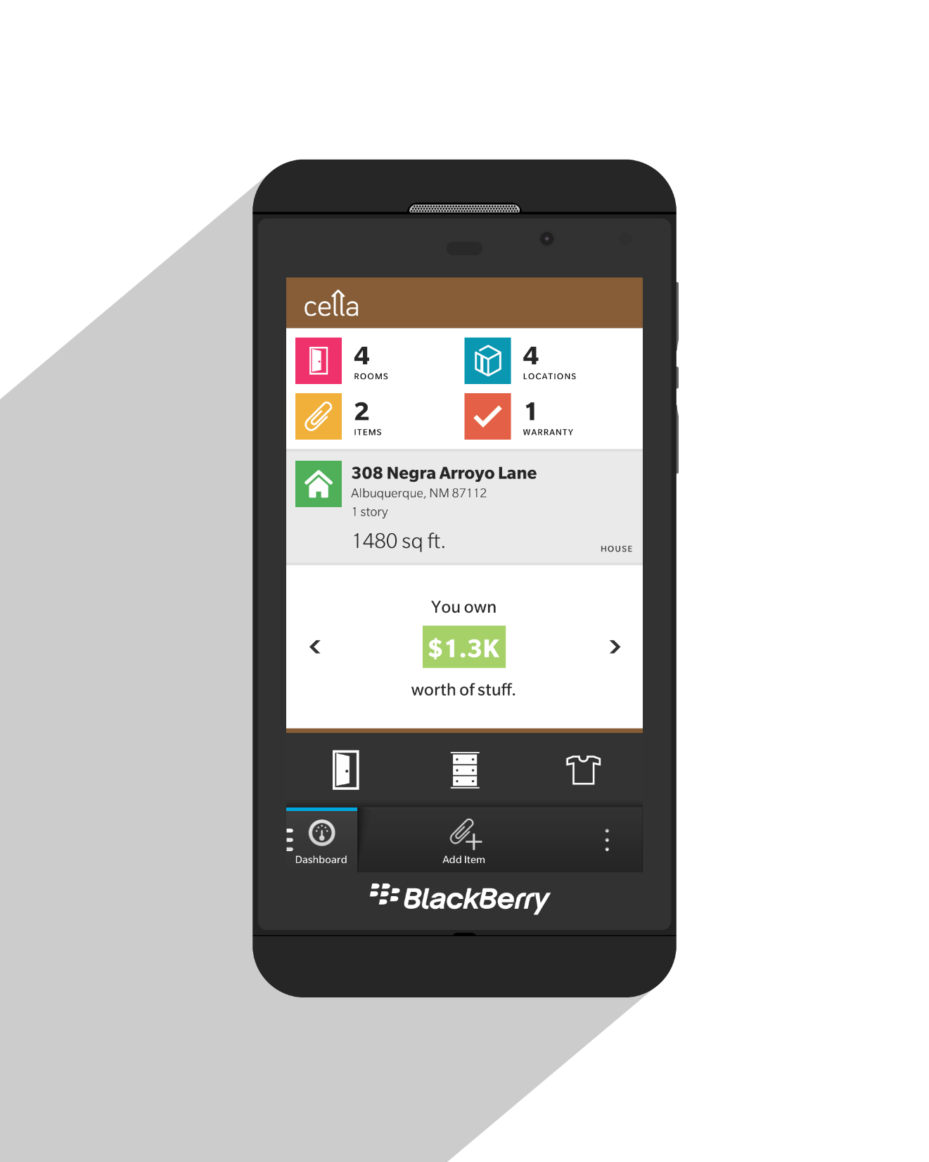
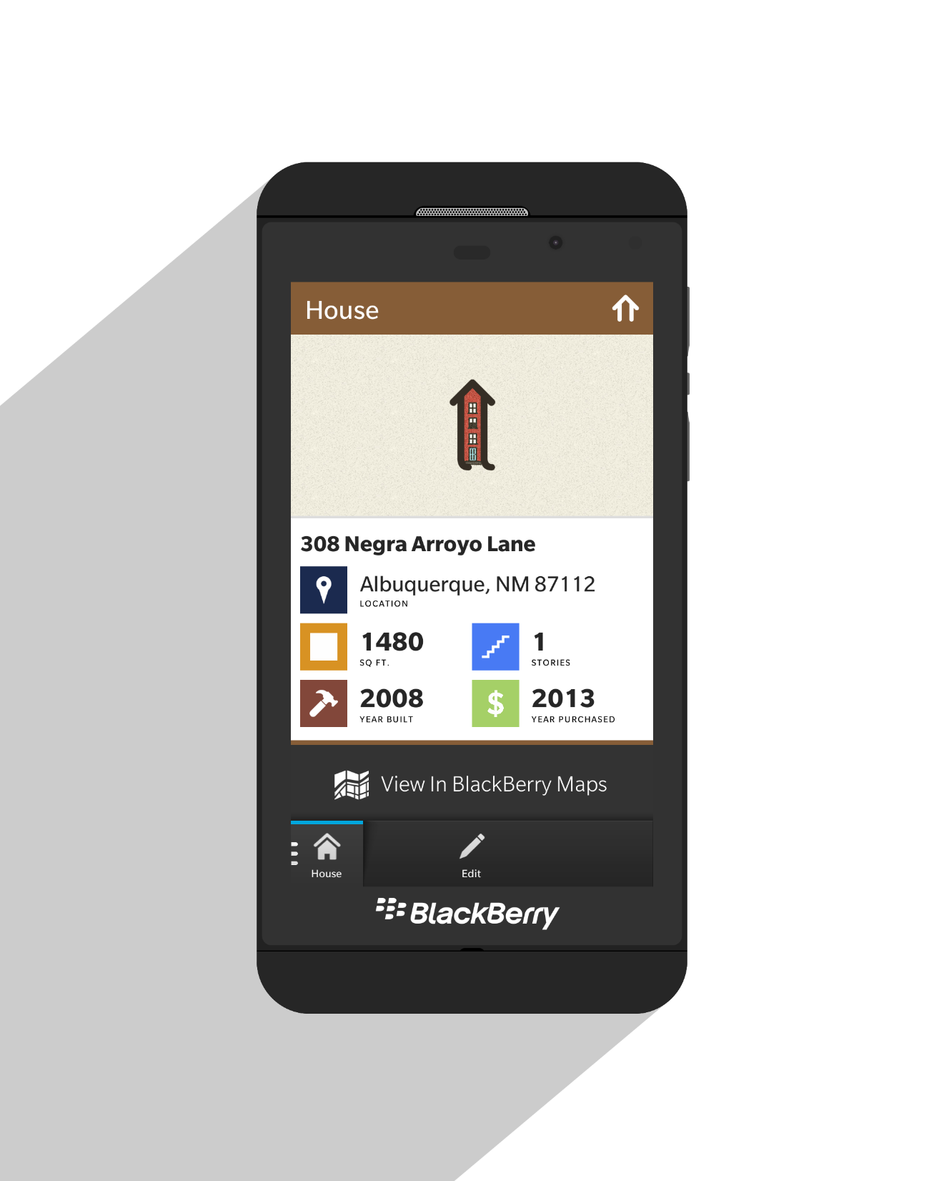
Bring home with you,
wherever you go.
Everything you
need to know at
a single glance.

Slide 5
So here’s how it works…

Slide 6
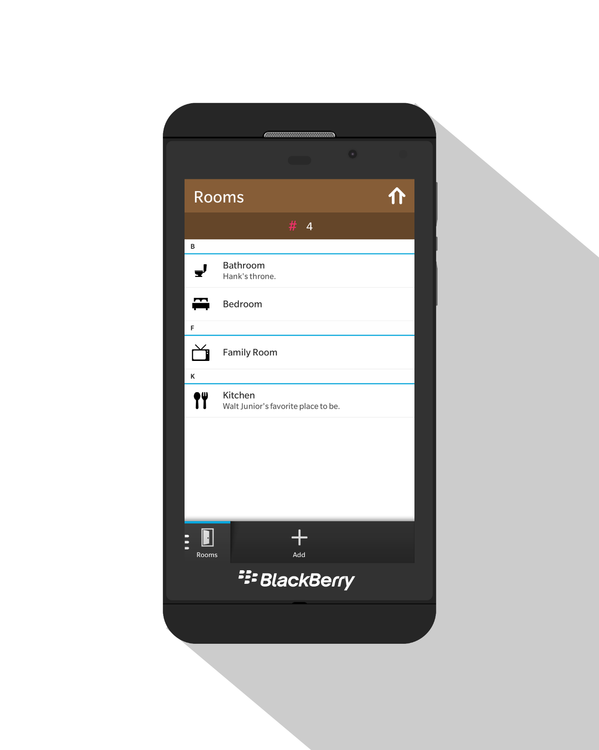
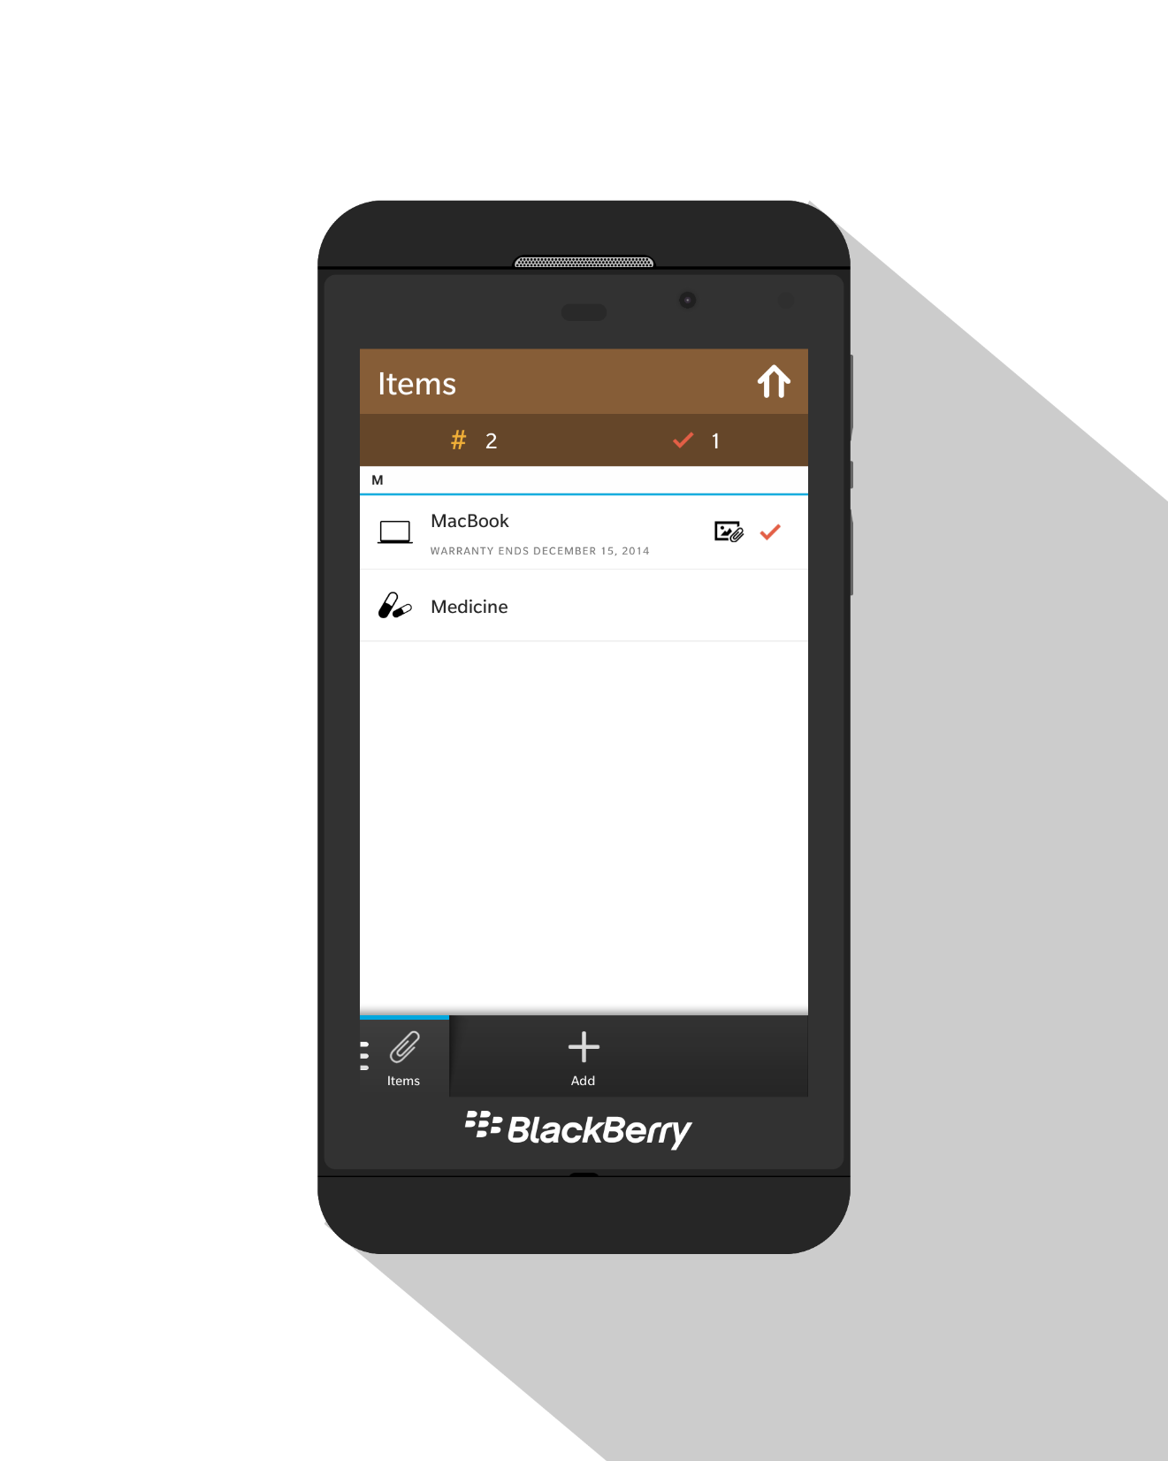
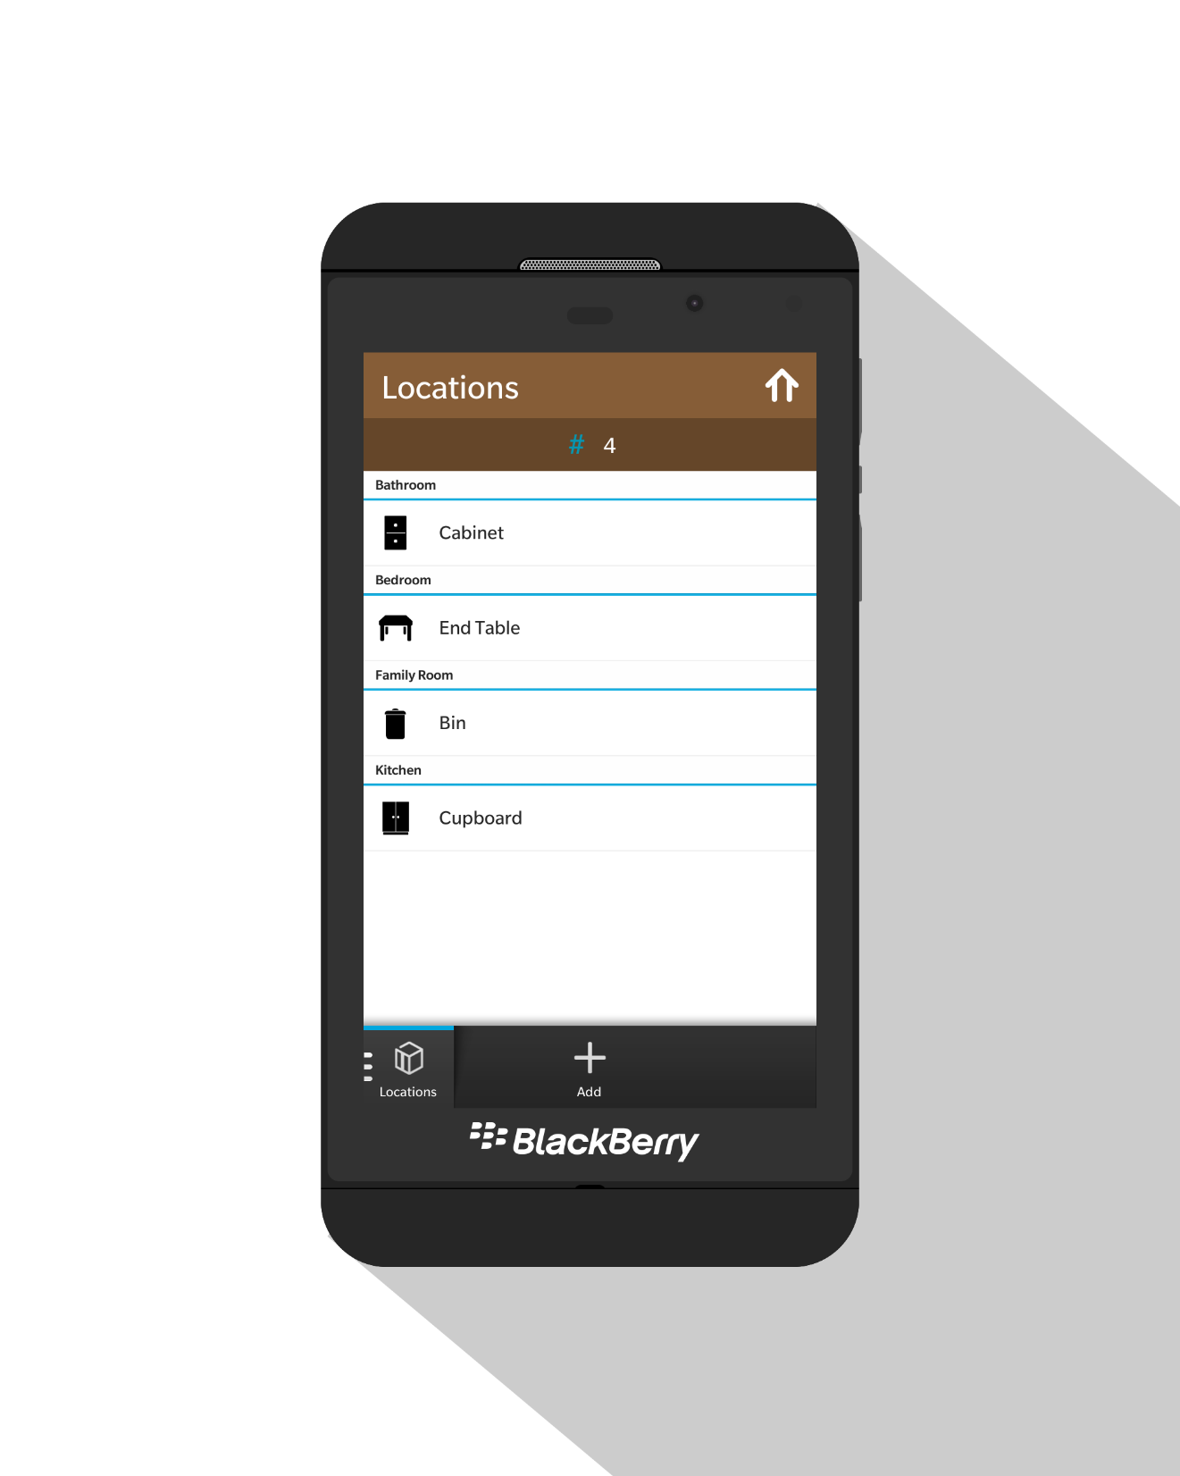
You can add rooms…
locations…
and items!

Slide 7
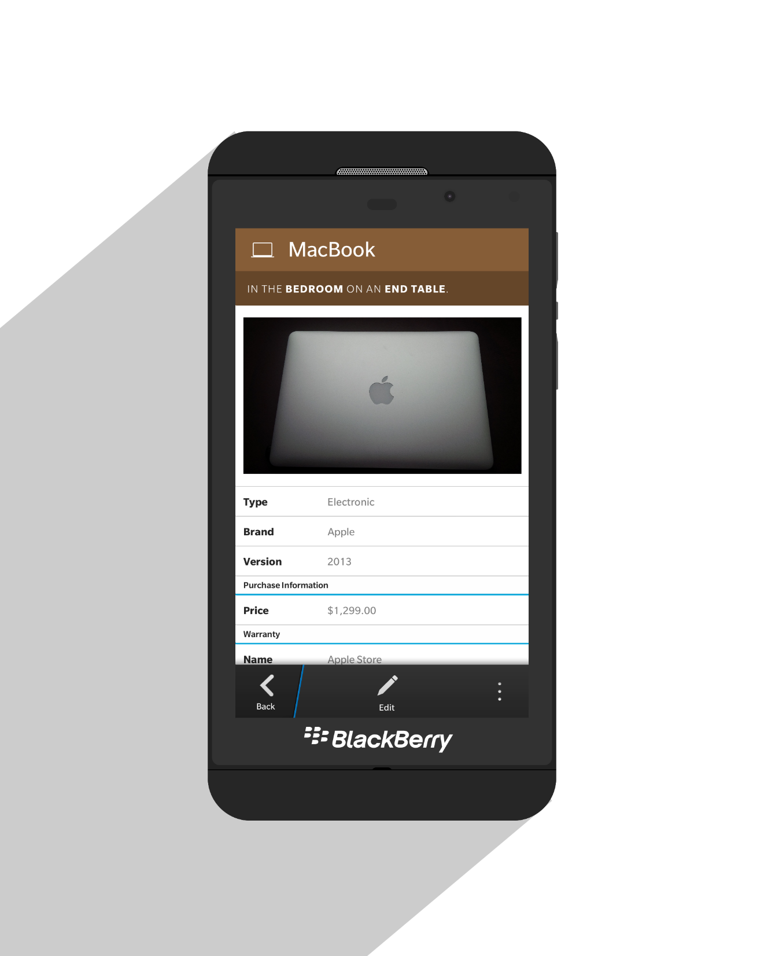
Remember details.
Attach images.
Record purchase info.
Track its warranty.

Slide 8
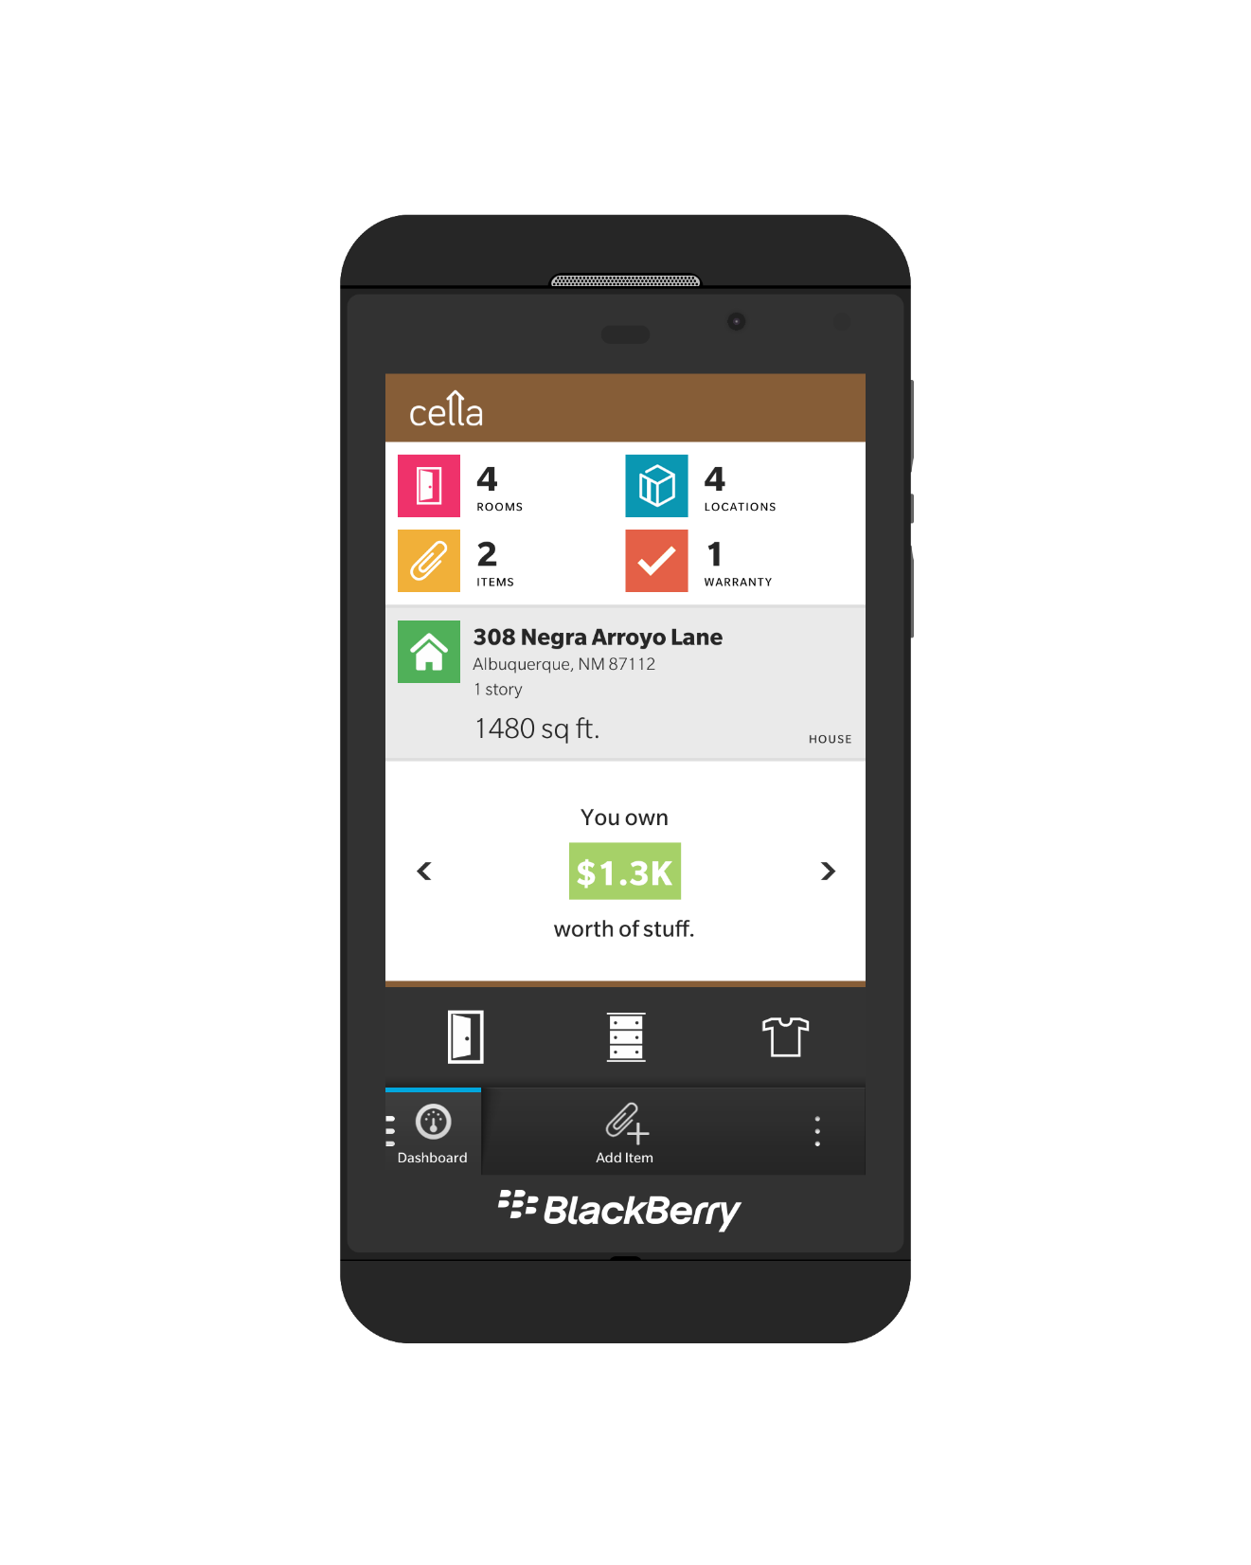
Don’t forget like everybody else.
Be a cell-out.
www.cella.karel.ca
@karelvuong

