Slide 1


Challenges of Managing CoreFX repo
.NET MeetUp in Amsterdam, NL (2017/7/11)
Organized by
Karel Zikmund ( @ziki_cz)

Slide 2
CoreFX repo
https://github.com/dotnet/corefx
Core Framework of .NET Core
BCL (Base class libraries) – 50 namespaces:
System.Collections
System.IO
System.Linq
System.Data
System.Net
System.Reflection
System.Runtime
System.Xml
and more …
Not included:
ASP.NET Core
WCF, EF
Namespaces, which are not part of .NET Core (e.g. UI / System.Xaml)

Slide 3
People behind CoreFX repo
~40 active engineers - https://github.com/dotnet/corefx/graphs/contributors
Ownership/expertise per technology
Beyond .NET Core:
.NET Framework
.NET Native (UWP)
More teams part of end-to-end:
Runtime/JIT, infrastructure, CLI, SDK, project system, NuGet, VS, etc.

Slide 4

How do I fit in?
Engineering manager on CoreFX team
.NET team since 2005
Goals:
Behind the scenes knowledge = better collaboration
Seeking feedback, alternatives, ideas
@karelz
@ziki_cz

Slide 5
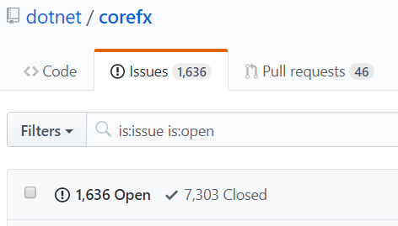
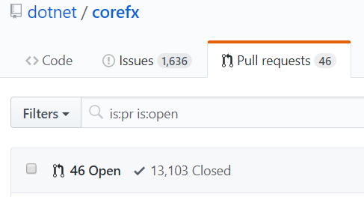
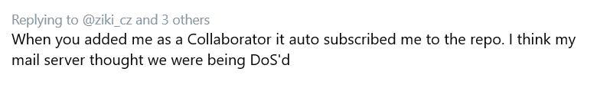
Issues and PRs
Incoming monthly: 500-600 issues, 700 PRs
Notifications: 400-500 per day

Slide 6
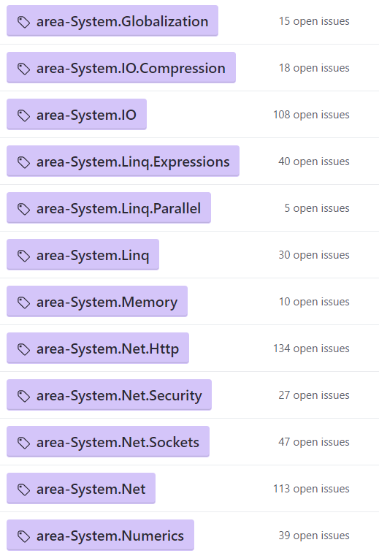
Slicing large repo
Area labels
Tooling – incoming / outgoing
Per area / query
Limitations (no replies, user-configuration, etc.)
Similar problem for community:
New issues/PRs into Twitter feeds @corefxissues

Slide 7
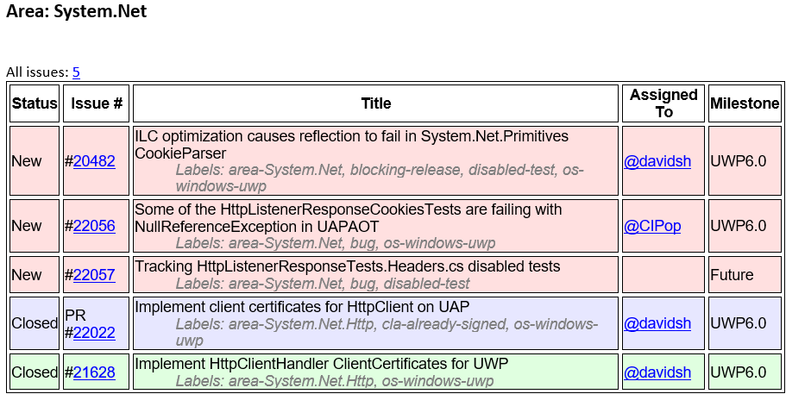
Tooling alerts

Slide 8
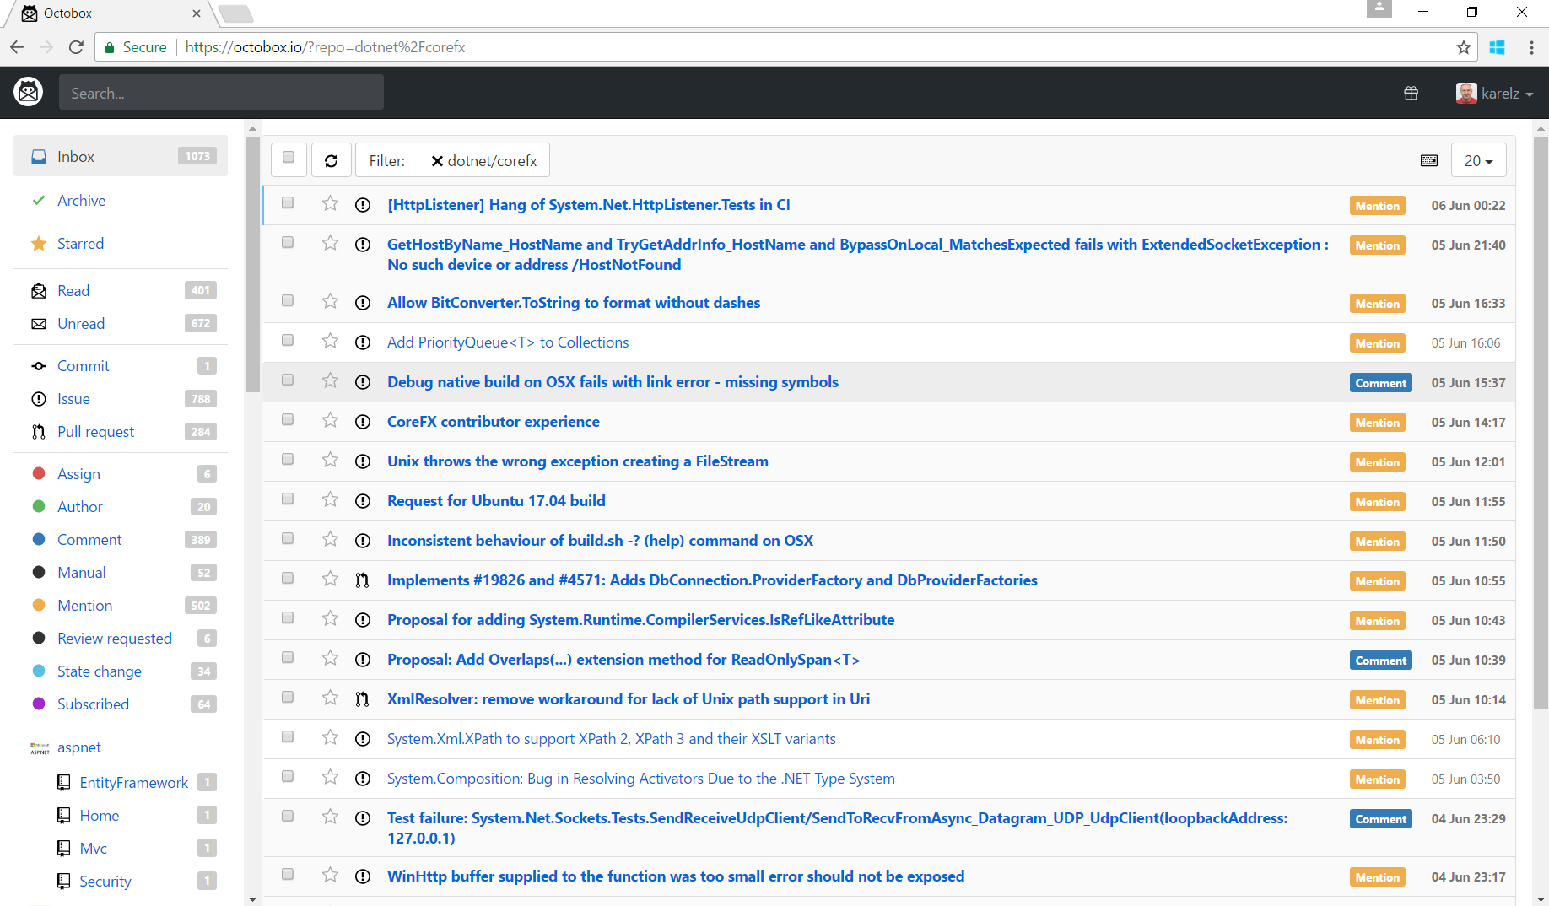
https://octobox.io

Slide 9
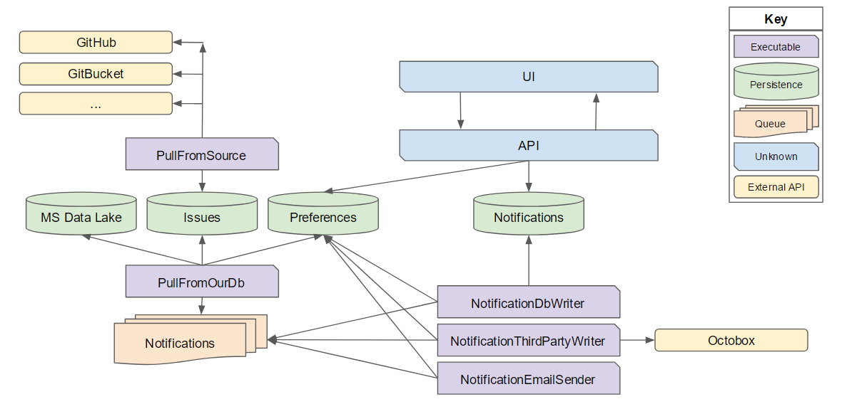
Next gen tooling
https://github.com/karelz/GitHubIssues

Slide 10
Triage rules
One area-* label
Empty Assignee
Use up-for-grabs with next steps & complexity description
Set Milestone as 95% commitment
One issue type label
bug / enhancement / api-needs-work / documentation, etc.
Don't be afraid to say no, or close issues – just explain why and be polite
Don't be afraid to be wrong – just be flexible when new information appears

Slide 11
Adding new APIs
~100 unique APIs in .NET Core now
Dictionary.GetValueOrDefault
Decision tree:
Is it existing BCL type?
Will it be used by CoreFX itself?
Can it live somewhere else? (PowerCollections)
API approval process is slow by design
APIs are forever

Slide 12
Which code change to take?
Performance changes
Performance trade-offs
Code complexity vs. value
Compatibility breaking changes
vs. 1.x or .NET Framework / UWP / Mono
Is the value worth the risk someone will get hurt?
API usage
Obsolete APIs
TreatAsWarnings = breaking change

Slide 13
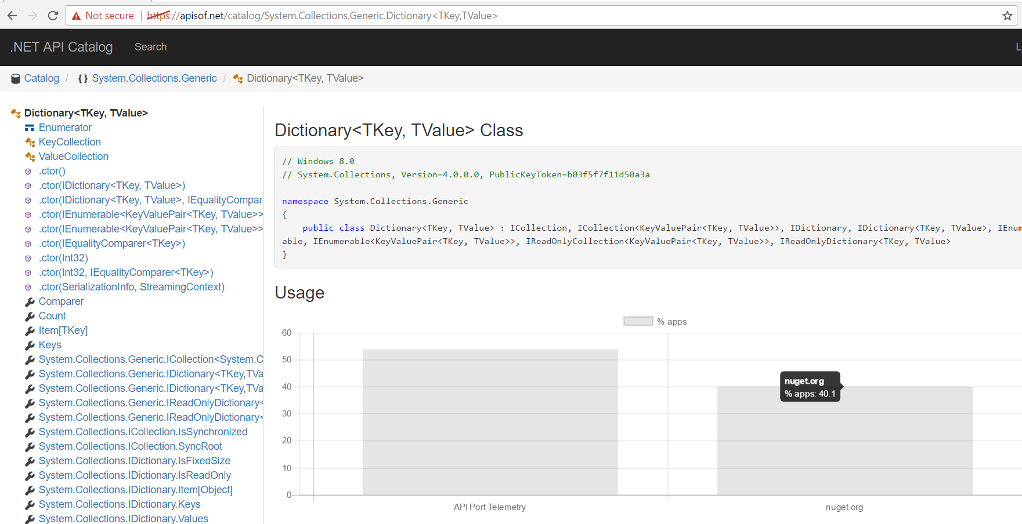
API usage information / telemetry

Slide 14
API Compat tooling – Demo
https://github.com/terrajobst/platform-compat

Slide 15
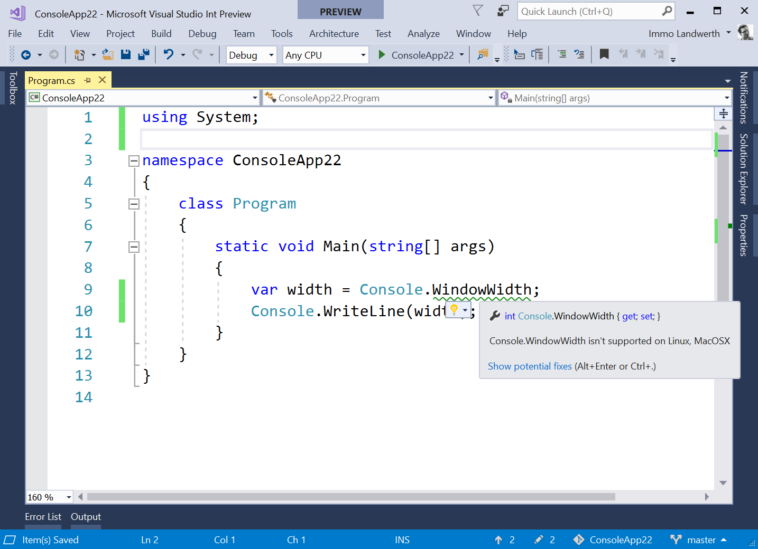
APIs that throw PNSE

Slide 16
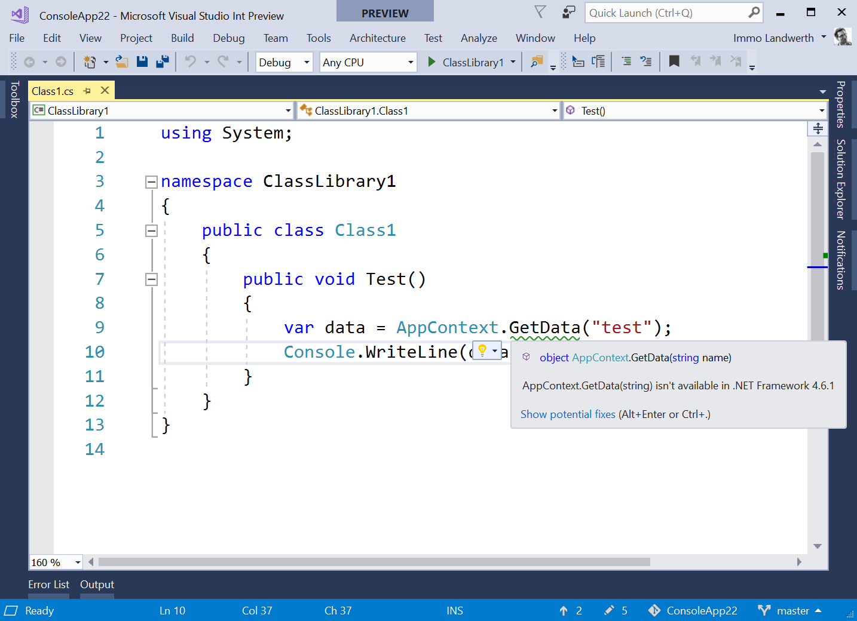
.NET Standard 2.0 APIs
missing from
.NET Framework 4.6.1

Slide 17
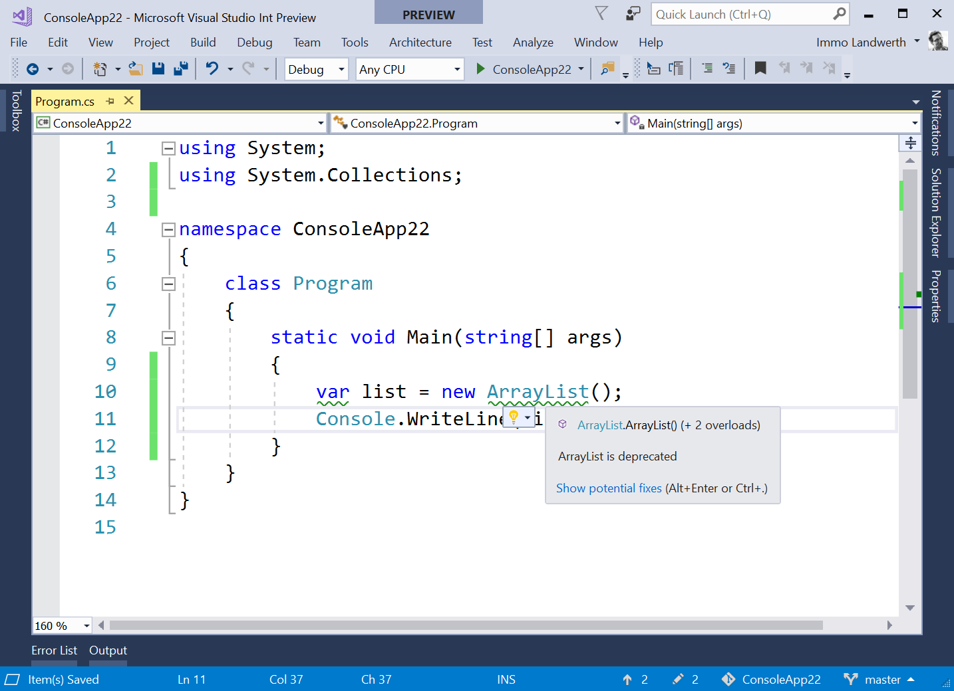
Usage of deprecated APIs

Slide 18
Team Culture changes & challenges
Discussions in the open
Onboarding new contributors (docs, tooling, attitude)
Communication – being polite, welcoming, patient; making it constructive
Unclear language (e.g. ESL = English as Second Language)
Missing/incomplete/complex repro steps
Frustration
Abuse (aggressiveness)
Having your own opinion vs. driving consensus

Slide 19
Involving Contributors & Community
CoreFX Contributors standups - https://github.com/dotnet/corefx-standup
Goals:
Bi-directional discussion
Identify blind spots
1st session on 6/26
Future:
Monthly cadence
Live streaming & recordings, open to everyone
More is coming:
.NET Technology Q&A sessions
Monthly alpha versions for close community
CLR Foundations Talks videos
More ideas: https://karelz.github.io

Slide 20

Thank you
Seeking
Feedback
Alternative / existing solutions
Ideas (incl. above & beyond CoreFX, Microsoft)
Contacts
karelz@microsoft.com
@karelz
@ziki_cz

