Slide 1


.NET Standard
What is it all about?
.NET MeetUp in Amsterdam, NL (2017/7/11)
Organized by
Karel Zikmund ( @ziki_cz)

Slide 2
.NET platforms today
.NET Framework
.NET Core
.NET Native
Xamarin
APP
MODELS
WPF
Win Forms
iOS
ASP.NET Core
Android
UWP
ASP.NET
OS X
BASE
LIBRARIES
.NET Framework BCL
.NET Core BCL
.NET Native BCL
Mono BCL

Slide 3
.NET reusing code – yesterday
Portable Class Libraries (PCLs)
No systematic approach to versioning
Computed intersection profiles
Each PCLs is targeting a specific set of platforms
Not compatible with newer platforms
Hard to understand compatibility relationships
Platform 1
Platform 3
Platform 2
Intersection Profiles

Slide 4
.NET reusing code – tomorrow
.NET Framework
.NET Core
.NET Native
Xamarin
APP
MODELS
WPF
Win Forms
iOS
ASP.NET Core
Android
UWP
ASP.NET
OS X
BASE
LIBRARIES
.NET Standard
.NET Framework BCL
.NET Core BCL
.NET Native BCL
Mono BCL

Slide 5
What is .NET Standard?
.NET Standard is a specification
A set of APIs that all .NET platforms have to implement
.NET Standard versions: 1.0, 1.1, …, 1.6, 2.0*
.NET platforms also version:
.NET Framework:
1.0, 1.1, 2.0, 3.0, 3.5
4.0, 4.5, 4.5.1, 4.5.2, 4.6, 4.6.1, 4.6.2, 4.7
.NET Core: 1.0, 1.1, 2.0*
Newer .NET platforms implement newer .NET Standard versions

Slide 6
Support matrix
https://github.com/dotnet/standard/blob/master/docs/versions.md
.NET Standard | 1.0 | 1.1 | 1.2 | 1.3 | 1.4 | 1.5 | 1.6 | 2.0
.NET Core
.NET Framework
Mono
Xamarin.iOS
Xamarin.Android
.NET Native (UWP)
Windows Phone
Windows Phone Silverlight

Slide 7
Support matrix
https://github.com/dotnet/standard/blob/master/docs/versions.md
.NET Standard | 1.0 | 1.1 | 1.2 | 1.3 | 1.4 | 1.5 | 1.6 | 2.0
.NET Core | 1.0
.NET Framework | 4.5
Mono | 4.6
Xamarin.iOS | 10.0
Xamarin.Android | 7.0
.NET Native (UWP) | 10.0
Windows Phone | 8.1
Windows Phone Silverlight | 8.0

Slide 8
Support matrix
https://github.com/dotnet/standard/blob/master/docs/versions.md
.NET Standard | 1.0 | 1.1 | 1.2 | 1.3 | 1.4 | 1.5 | 1.6 | 2.0
.NET Core | 1.0 |  |  | 1.0
.NET Framework | 4.5 |  |  | 4.6
Mono | 4.6 |  |  | 4.6
Xamarin.iOS | 10.0 |  |  | 10.0
Xamarin.Android | 7.0 |  |  | 7.0
.NET Native (UWP) | 10.0 |  |  | 10.0
Windows Phone | 8.1
Windows Phone Silverlight | 8.0

Slide 9
Support matrix
https://github.com/dotnet/standard/blob/master/docs/versions.md
.NET Standard | 1.0 | 1.1 | 1.2 | 1.3 | 1.4 | 1.5 | 1.6 | 2.0
.NET Core | 1.0 |  |  | 1.0 | 1.0
.NET Framework | 4.5 |  |  | 4.6 | 4.6.1
Mono | 4.6 |  |  | 4.6 | 4.6
Xamarin.iOS | 10.0 |  |  | 10.0 | 10.0
Xamarin.Android | 7.0 |  |  | 7.0 | 7.0
.NET Native (UWP) | 10.0 |  |  | 10.0 | 10.0
Windows Phone | 8.1
Windows Phone Silverlight | 8.0

Slide 10
Support matrix
https://github.com/dotnet/standard/blob/master/docs/versions.md
.NET Standard | 1.0 | 1.1 | 1.2 | 1.3 | 1.4 | 1.5 | 1.6 | 2.0
.NET Core | 1.0 |  |  | 1.0 | 1.0 |  | 1.0
.NET Framework | 4.5 |  |  | 4.6 | 4.6.1 |  | 4.6.1
Mono | 4.6 |  |  | 4.6 | 4.6 |  | 4.6
Xamarin.iOS | 10.0 |  |  | 10.0 | 10.0 |  | 10.0
Xamarin.Android | 7.0 |  |  | 7.0 | 7.0 |  | 7.0
.NET Native (UWP) | 10.0 |  |  | 10.0 | 10.0 |  | vNext
Windows Phone | 8.1
Windows Phone Silverlight | 8.0

Slide 11
Support matrix
https://github.com/dotnet/standard/blob/master/docs/versions.md
.NET Standard | 1.0 | 1.1 | 1.2 | 1.3 | 1.4 | 1.5 | 1.6 | 2.0
.NET Core | 1.0 | 1.0 | 1.0 | 1.0 | 1.0 | 1.0 | 1.0 | 2.0
.NET Framework
Mono
Xamarin.iOS
Xamarin.Android
.NET Native (UWP)
Windows Phone
Windows Phone Silverlight

Slide 12
Support matrix
https://github.com/dotnet/standard/blob/master/docs/versions.md
.NET Standard | 1.0 | 1.1 | 1.2 | 1.3 | 1.4 | 1.5 | 1.6 | 2.0
.NET Core | 1.0 | 1.0 | 1.0 | 1.0 | 1.0 | 1.0 | 1.0 | 2.0
.NET Framework | 4.5 | 4.5 | 4.5.1 | 4.6 | 4.6.1 | 4.6.1 | 4.6.1 | 4.6.1
Mono
Xamarin.iOS
Xamarin.Android
.NET Native (UWP)
Windows Phone
Windows Phone Silverlight

Slide 13
Support matrix
https://github.com/dotnet/standard/blob/master/docs/versions.md
.NET Standard | 1.0 | 1.1 | 1.2 | 1.3 | 1.4 | 1.5 | 1.6 | 2.0
.NET Core | 1.0 | 1.0 | 1.0 | 1.0 | 1.0 | 1.0 | 1.0 | 2.0
.NET Framework | 4.5 | 4.5 | 4.5.1 | 4.6 | 4.6.1 | 4.6.1 | 4.6.1 | 4.6.1
Mono | 4.6 | 4.6 | 4.6 | 4.6 | 4.6 | 4.6 | 4.6 | vNext
Xamarin.iOS | 10.0 | 10.0 | 10.0 | 10.0 | 10.0 | 10.0 | 10.0 | vNext
Xamarin.Android | 7.0 | 7.0 | 7.0 | 7.0 | 7.0 | 7.0 | 7.0 | vNext
.NET Native (UWP) | 10.0 | 10.0 | 10.0 | 10.0 | 10.0 | vNext | vNext | vNext
Windows Phone | 8.1 | 8.1 | 8.1
Windows Phone Silverlight | 8.0

Slide 14
Remember HTML and HTML5?
http://www.webdevout.net/browser-support
HTML version | 2.0 | 3.2 | 4.0 | 5 | 5.1 | Notes
Internet Explorer
Chrome
Firefox
Safari
Opera
Edge

Slide 15
Remember HTML and HTML5?
http://www.webdevout.net/browser-support
HTML version | 2.0 | 3.2 | 4.0 | 5 | 5.1 | Notes
Internet Explorer |  |  |  | 10 |  | IE11 also supports HTML5
Chrome |  |  |  | 30 |  | Latest Chrome 58 also supports HTML5
Firefox |  |  |  | 30 |  | Latest Firefox 53 also supports HTML5
Safari |  |  |  | 8.0 |  | Latest Safari 10.2 also supports HTML5
Opera |  |  |  | 12.10 |  | Latest Opera 45 also supports HTML5
Edge |  |  |  | 12 |  | Edge 12-15 all support latest HTML5

Slide 16
Remember HTML and HTML5?
http://www.webdevout.net/browser-support
HTML version | 2.0 | 3.2 | 4.0 | 5 | 5.1 | Notes
Internet Explorer | ? | ? | 6 | 10 | Future? | IE11 also supports HTML5 IE9 supports parts of HTML5 IE7 & IE8 also support HTML 4.0
Chrome
Firefox
Safari
Opera
Edge

Slide 17
Remember HTML and HTML5?
http://www.webdevout.net/browser-support
HTML version | 2.0 | 3.2 | 4.0 | 5 | 5.1 | Notes
Internet Explorer | ? | ? | 6 | 10 | Future? | IE11 also supports HTML5 IE9 supports parts of HTML5 IE7 & IE8 also support HTML 4.0
Chrome | ? | ? | ? | 30 | Future? | Latest Chrome 58 also supports HTML5
Firefox | ? | ? | 2 | 30 | Future? | Latest Firefox 53 also supports HTML5
Safari | ? | ? | ? | 8.0 | Future? | Latest Safari 10.2 also supports HTML5
Opera | ? | ? | 9 | 12.10 | Future? | Latest Opera 45 also supports HTML5
Edge | 12 | 12 | 12 | 12 | Future? | Edge 12-15 all support latest HTML5

Slide 18
.NET Standard 2.0
Has much bigger API surface
Extended to cover intersection between .NET Framework and Xamarin
.NET Core 2.0 implements .NET Standard 2.0 (makes it bigger)
+20K
More APIs than
.NET Standard 1.x
Can reference .NET Framework libraries
Compat shim allows referencing existing .NET Framework code – without recompilation
Limited to libs that use APIs that are available for .NET Standard
~70%
of NuGet packages
are API compatible

Slide 19
Versioning of .NET Standard
Additive APIs
Higher versions have all APIs from previous versions.
2.0
1.3
Version | # of APIs | Growth %
1.0 | 7,949
1.1 | 10,239 | +29%
1.2 | 10.285 | +0%
1.3 | 13,122 | +28%
1.4 | 13,140 | +0%
1.5 | 13,355 | +2%
1.6 | 13,501 | +1%
2.0 | 32,638 | +142%
1.1
1.0

Slide 20
Which .NET Standard?
Supporting lower version of NS = more platforms support it
Supporting higher version of NS = more APIs you can use
Advice for Libraries:
Target lowest version of .NET Standard you can get away with
Advice for Applications:
Don’t target .NET Standard, it is for libraries
For cross-platform use .NET Core (server/console apps) or Xamarin (UI apps)

Slide 21
Which .NET Standard?
.NET Portability Analyzer
https://github.com/Microsoft/dotnet-apiport
Check APIs used by your project
Check APIs used by your binaries
Command line / VS extension
Outputs: HTML, XLSX, Json

Slide 22
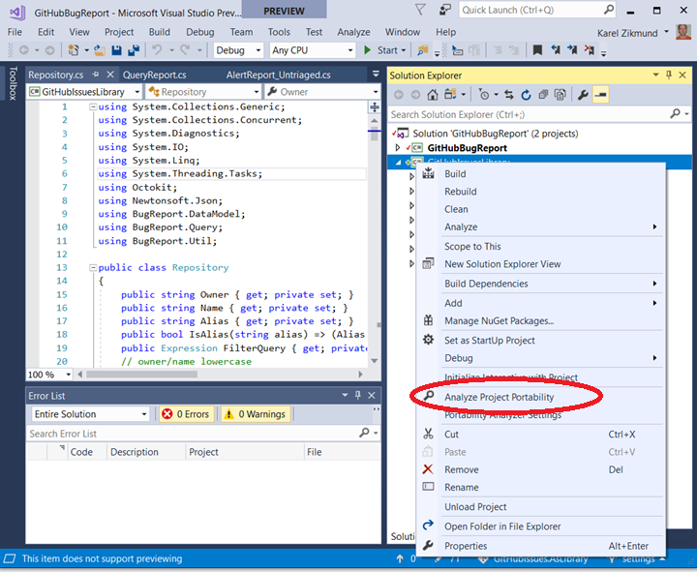
.NET Portability Analyzer demo

Slide 23
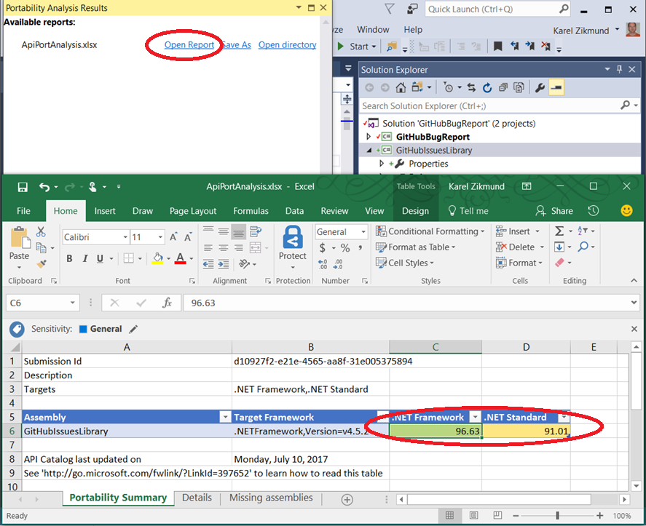

Slide 24
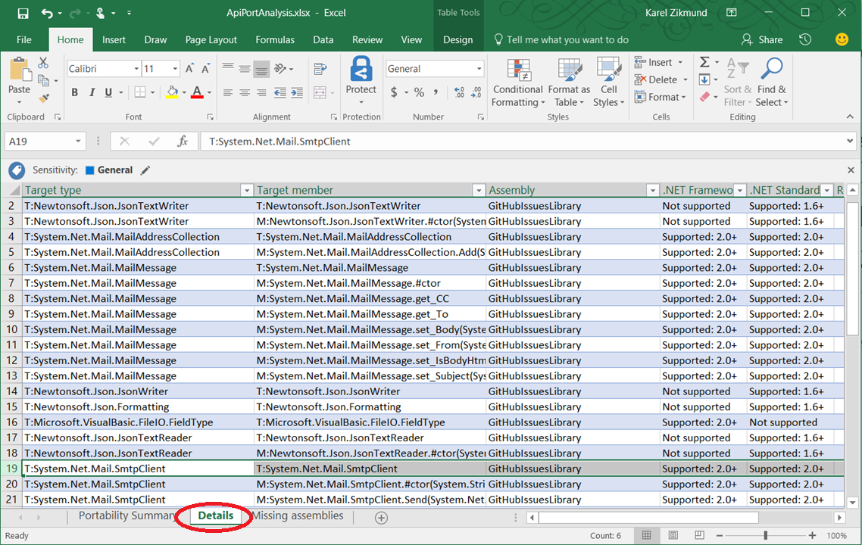

Slide 25
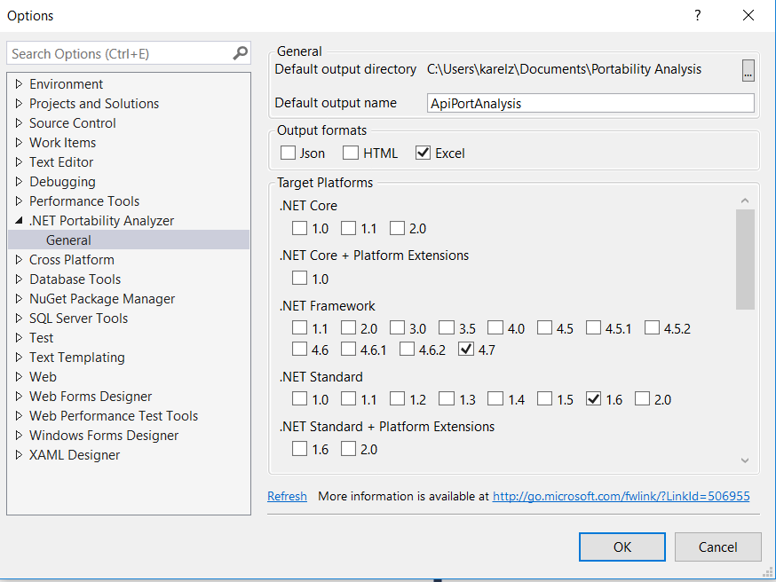

Slide 26
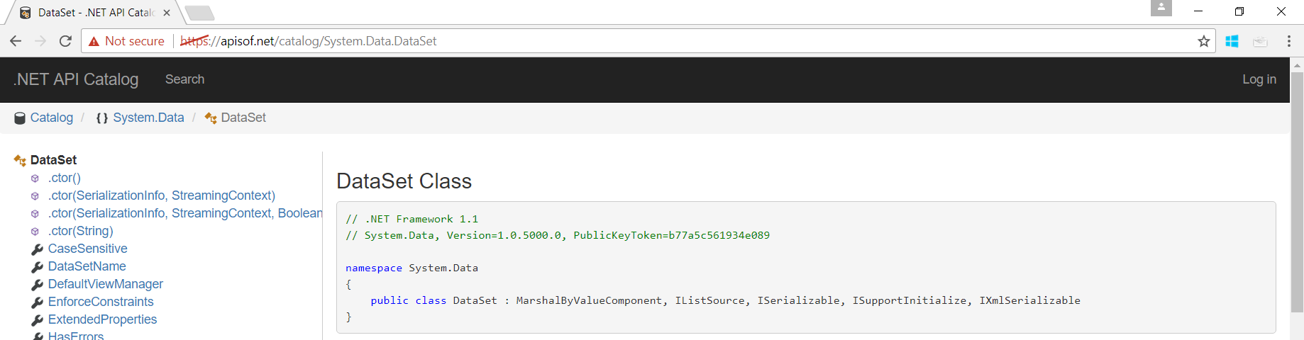
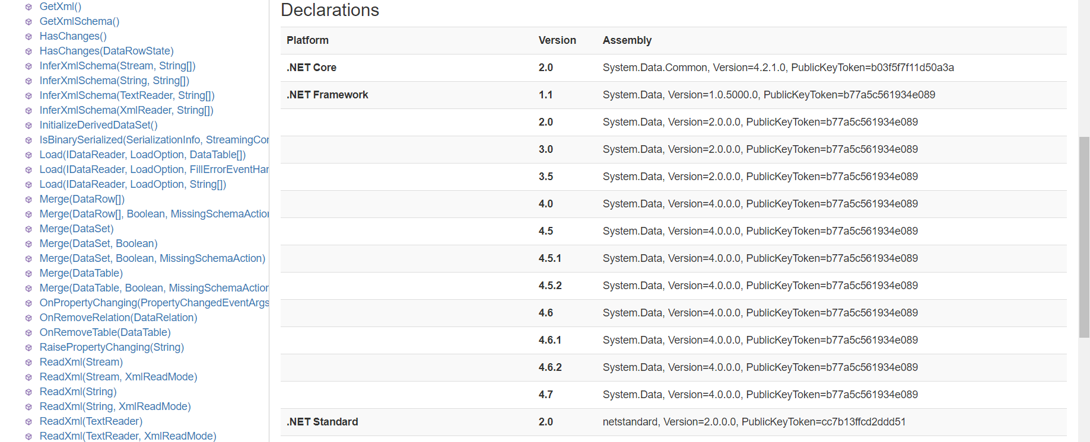
Which .NET Standard? https://apisof.net

Slide 27
.NET platforms – recap
.NET Framework 4.6.1 – implements NS2.0
Windows only, machine-wide install (highly compatible)
Scenarios: All, incl. server, client/UI (WPF, WinForms), etc.
Xamarin – will implement NS2.0 very soon
Scenarios: UI apps for cross-platform (iOS, Android, UWP)
.NET Native 2.0 (UWP 6.0) – will implement NS2.0 (Q4 2017)
Scenarios: UWP (UI) apps only (Win10)
.NET Core 2.0 – will implement NS2.0 very soon (Q3 2017)
Cross-platform (Windows, Linux, OS X)
Scenarios: Server and console apps (no client/UI apps)

Slide 28



.NET Core
https://www.microsoft.com/net/core/platform - 6 key values
Cross-platform
You can create .NET Core apps that run on Windows, Linux and macOS.
Unified
Leverage the unified .NET Standard library to target all platforms with the same code and use the same languages and tools to reuse your skills.
Fast
High performance server runtime for Windows Server and Linux makes .NET a top performing web framework on TechEmpower benchmarks. That means applications provide better response times and require less compute power.
Performance Improvements in .NET Core
Performance Improvements in RyuJIT in .NET Core and .NET Framework

Slide 29



.NET Core (cont.)
https://www.microsoft.com/net/core/platform
Lightweight
No impact deployment and a modular development model where you only take dependencies on the minimal set of packages you need.
Modern
Multiple language support with C#, VB, F# and modern constructs like generics, Language Integrated Query (LINQ), async support and more.
Open Source
Runtime, libraries, compiler, languages and tools are all open source on GitHub where contributions are accepted, tested and fully supported.

Slide 30
The End
Author: Karel Zikmund ( @ziki_cz)
Slides: https://karelz.github.io
Special thanks to Immo Landwerth ( @terrajobst)
Based on Immo’s .NET Standard slides for .NET Fringe 2017 conference

