Slide 1
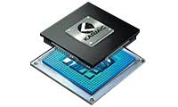
Karmic embedded pvt ltd Presentation on Windows keyboard shortcuts
By:
D.V.Sudha Manasa

Slide 2


Slide 3

What are they?
Keyboard shortcuts are alternate ways to do something that you would ordinarily use the mouse for.
One or more keys can be used together for a specific function.

Slide 4
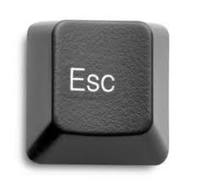
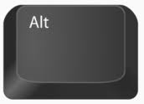
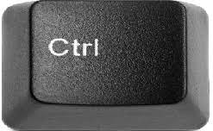

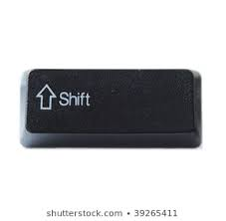
Keys you will use more

Slide 5




Useful shortcuts
Copy selected
to paste selected
To save files or changes u did in files
To access all previously copied data Clipboard settings should be enabled
: to see things copied in clipboard (clipboard settings should be enabled )

Slide 6




continuation….
: To find
: To selelct all
: to redo
: to undo

Slide 7

continuation….
: refreshes and re-downloads the web pages and cached files
+ shift + esc
: to get task manager
+ alt + delete
: allows u to open task
manager but has an
extra step
+ shift + n
: To create new folder

Slide 8





continuation….
: to bookmark a page
: to get .com while entering urls
: to get windows search
: to restore closed tabs

Slide 9

continuation….
: to open new tab
: to close current tab
+ tab
: to switch between tabs in browser
: used to switch tasks and it shows some extra stuff like some recently used files,virtual desktop
+ tab

Slide 10





continuation….
: to open new virtual desktop
: to close current desktop
: to switch between virtual desktops

Slide 11
continuation….
: to minimize all windows
and shows desktop
+ Position number of
application on taskbar
: to open the application on taskbar
+ shift +
: to copy a screenshot to clipboard
: to save screenshot to computers>pictures>
screenshots
+ prtscr

Slide 12



continuation….
+ “ ; ”
: to bring emoji panel
: to bring up run box
: to change windows to projection mode
: to get settings menu

Slide 13

continuation…
Alt + f4
: used to close current active window
Alt + tab
: commonly used task switcher
: to toggle full screen mode in browsers
Right_click on taskbar
+ d and u
: to cascade and uncascade all open windows
Right_click on taskbar
+ e and u
: to stack and unstack all open windows

Slide 14


continuation…
Mouse + shake : to minimize all windows but one on which u clicked
: to rename files (click on file and press f2 )
: to lock the system

Slide 15
reference
https://www.youtube.com/watch?v=RQaTIS85VKE
https://www.braintek.com/infographics/windows-10-keyboard-shortcut-cheat-sheet/

Slide 16


