Slide 1

Anna
24 years old, student of nutritional science
"I like to have dinner with my girls in town. We all pay attention to our food, so we avoid fast food restaurants."
About Anna:
Anna likes to go to the Apiano with her girls on different occasions. The fresh preparation of the food is particularly important to her, as a balanced and healthy meal is important to her and her friends. They also appreciate the constant high quality of Apiano. Anna visits the Apiano especially in the evening before they go out in town, that's why they rarely have time pressure and enjoy the open atmosphere in the restaurant. After dinner they also like to sit for a coffee.
Problems & Challenges:
Orders at the individual counters take different lengths of time
Difficulties finding a suitable table for large groups
Sometimes some ingredients are already used up in the evening, which limits the choice.
Feedback via the website possible
Needs & Goals:
Constant, high quality food
Eating together in a group
Relaxed feel-good ambience to ring in the evening

Slide 2
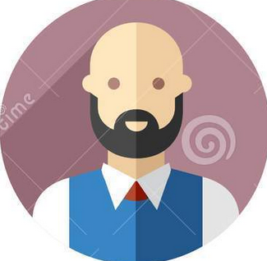
Bernd
47 years old, employee in a car showroom
"During my lunch break, I usually eat out in town. It's important to eat healthy food that doesn't lie like a stone in my stomach".
About Bernd:
Bernd likes to go to the Apiano during his lunch break because there is no canteen at his company. Since his lunch break is limited in time, it has to go like clockwork when ordering. Nevertheless, he doesn't want to go to a fast food restaurant, as the unhealthy food is heavy in his stomach in the afternoon. He appreciates the high quality of the food in the Apiano and the relaxed atmosphere. If he has enough time, he likes to have a coffee afterwards before going back to work. Even if it is a self-service restaurant, he appreciates the friendly atmosphere.
Problems & Challenges:
Time pressure when ordering and preparing food, because lunch break is limited in time
Staff often stressed and annoyed during rush hour
Food should be appealing and deliciously prepared
Feedback only possible with media discontinuity
Needs & Goals:
Constant, high quality food
Fast preparation, for a stress-free meal
Friendly staff
Enough time in the back to relax and have a cup of coffee.

