Slide 1
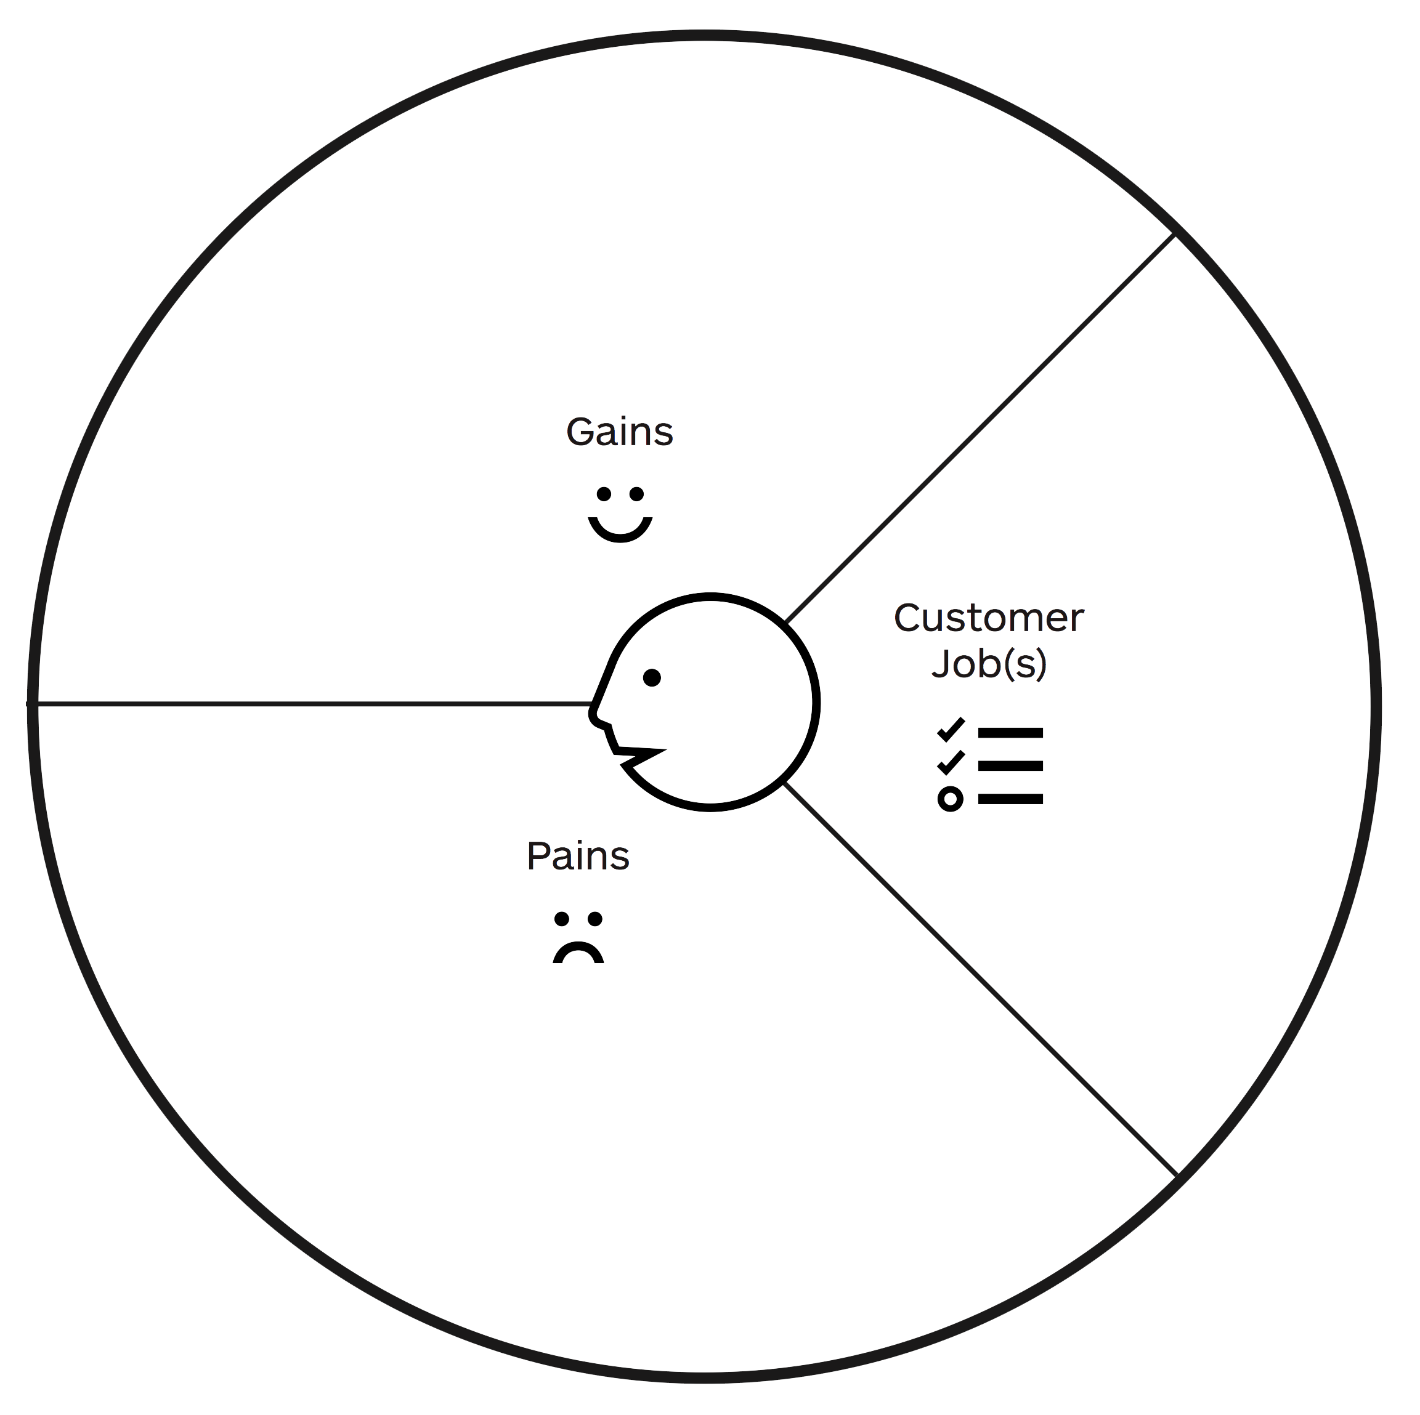
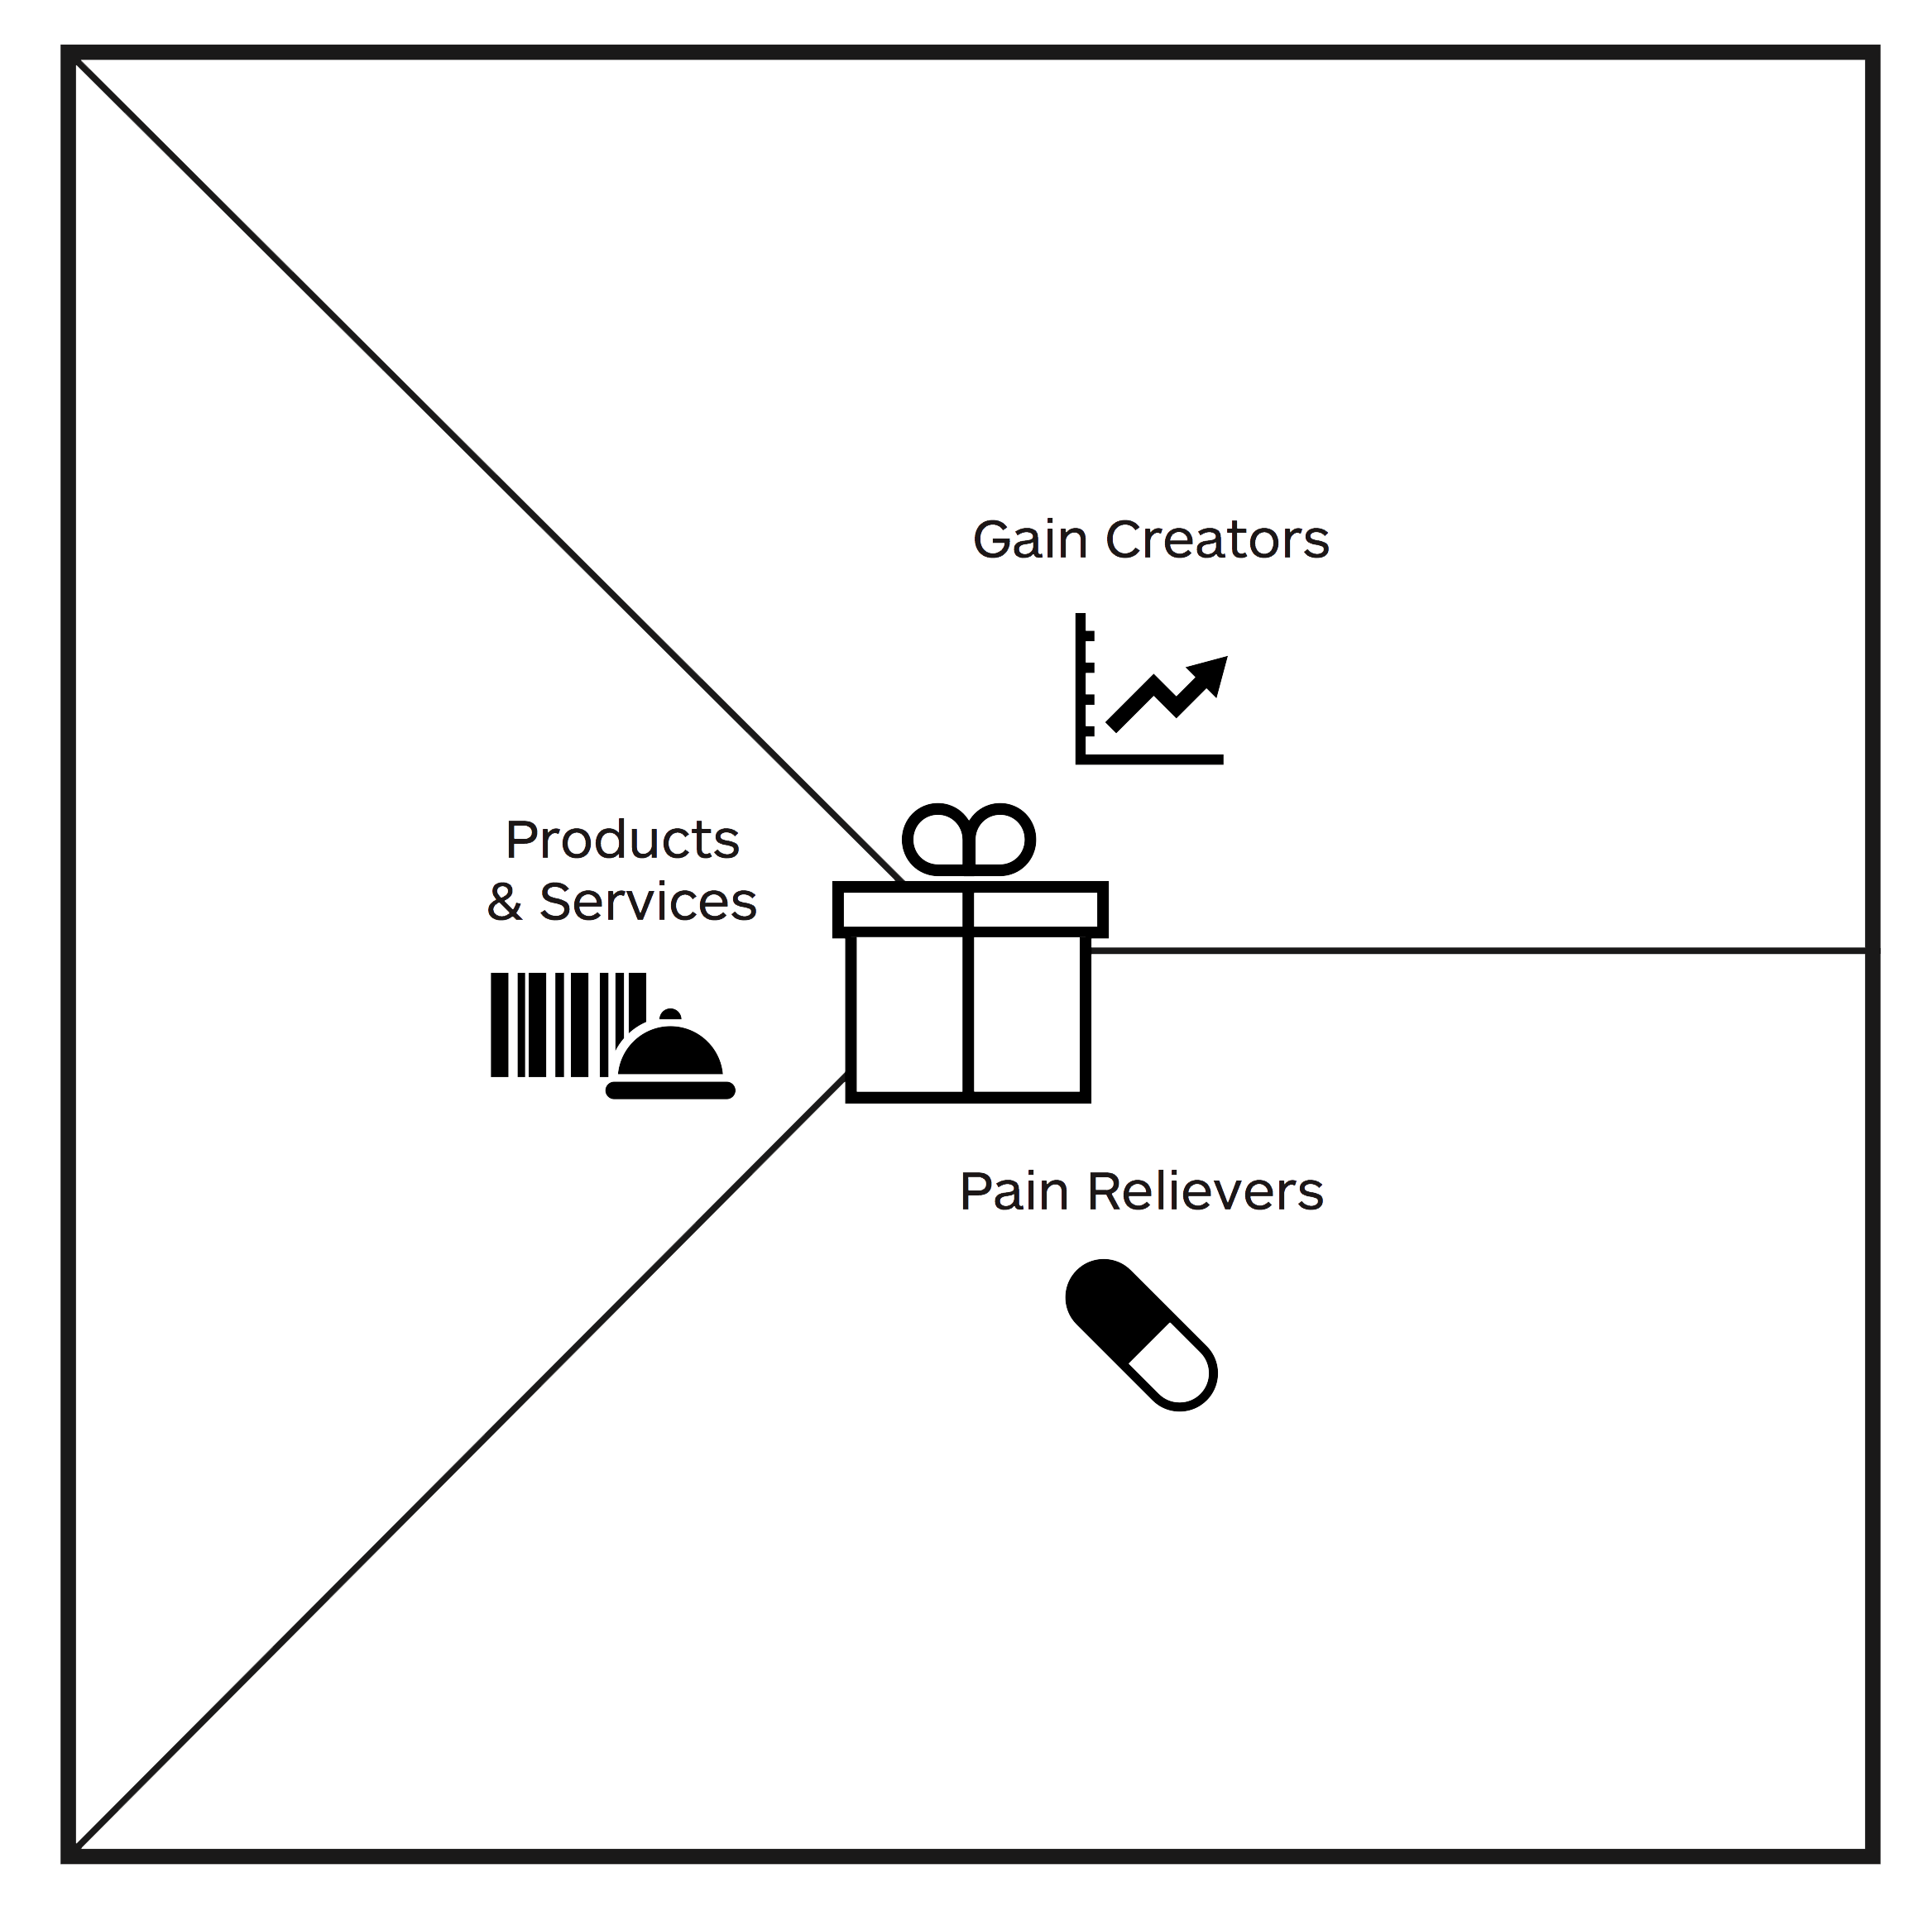
Bernd, 47 employee, in a car showroom
Have an alternative to a cantine
Strengthen the experience of quality and service
IoT supportet service
Open ktichen gives trust in hiqh quality
“Fast food“ in high quality
No reservation needed
New service experience
Have healty and fresh food
Sliding stars for rating waiting time at the food counter
Eat with a good consience
Feels customer oriented
Fresh food preparation
Embadded feedback system in the real world for individual rating
Want to have lunch without time pressure
Smiley box for raiting overall satisfaction at the cash desk
Waiting time at rush hours
Should be able to work after lunch
Enjoy a coffee after meal
Individual feedback data enables actions for better customer experience
No additional effort for the customer to give feedback
Sometimes staff is stress and less friendly
Feedback opportunity takes additional effort

