Slide 1

DATA ANALYTICS LEARNCAMP
MINI PROJECT III
KAREN WAMBUI

Slide 2
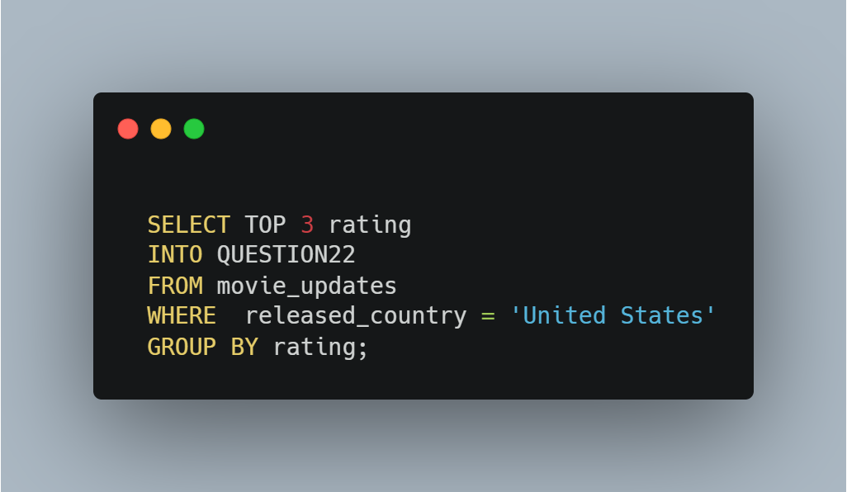
1.What are the top 3 ratings for movies released in the United States?
CODE SNIPPET
CHARTS

Slide 3
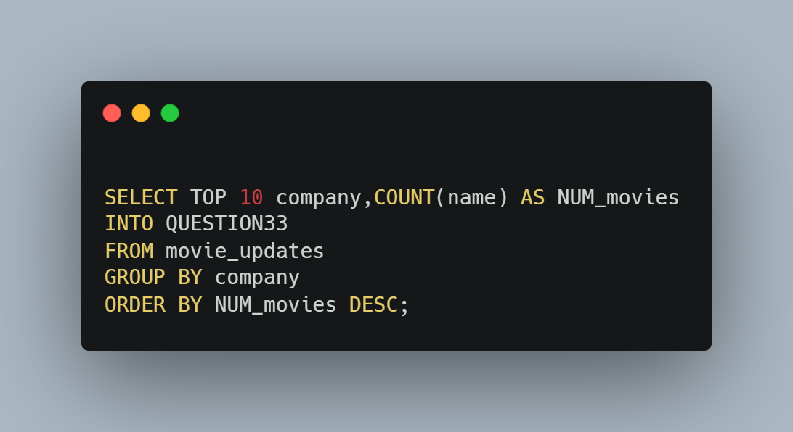
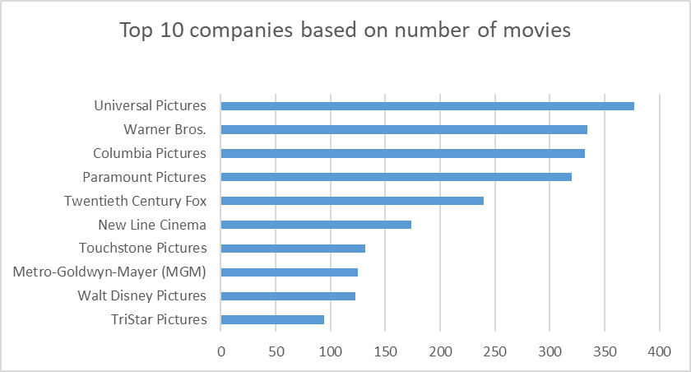
2.What are the top 10 companies based on number of movies?
CODE SNIPPET
CHARTS

Slide 4
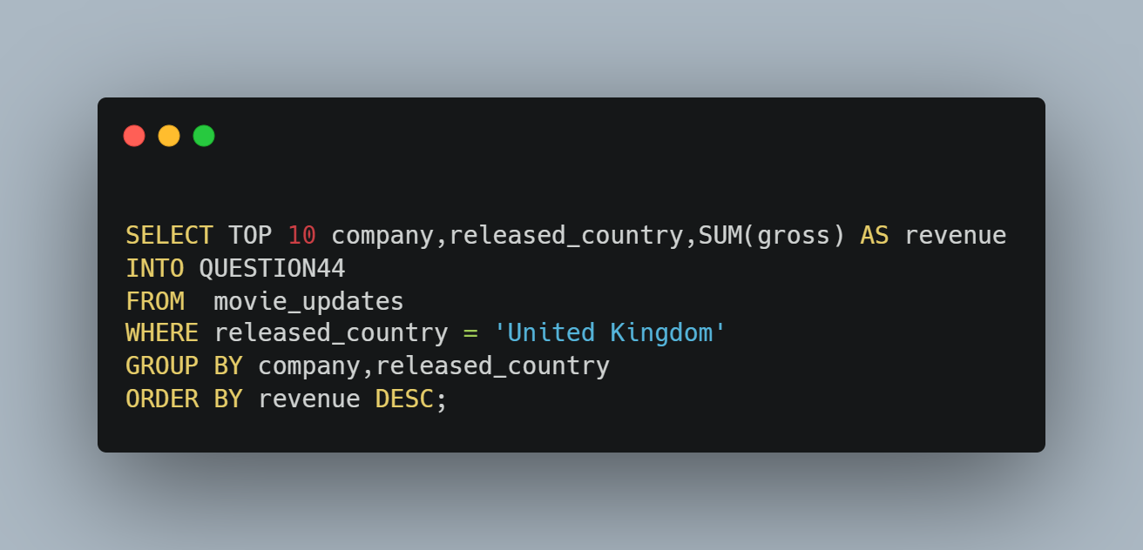
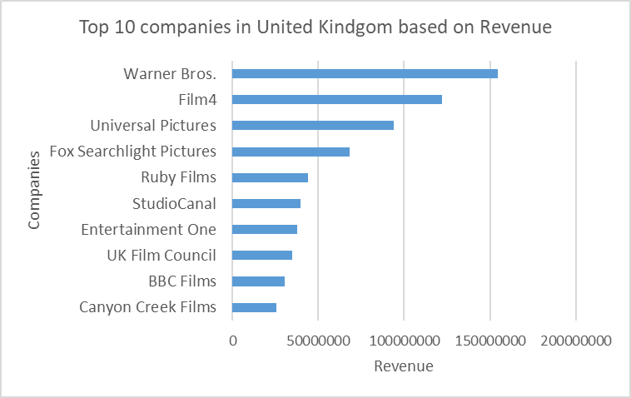
3.What are the top 10 companies in the United Kingdom based on movie revenue(released country)?
CODE SNIPPET
CHARTS

Slide 5
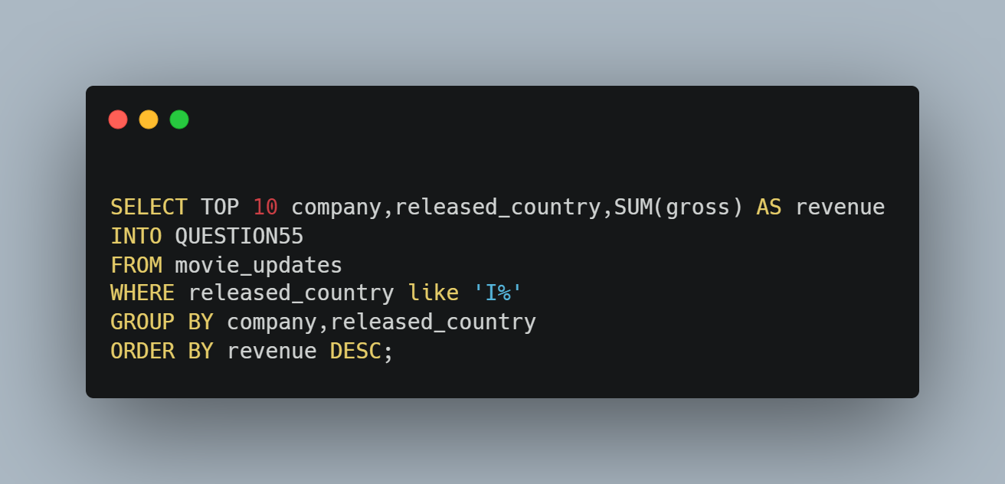
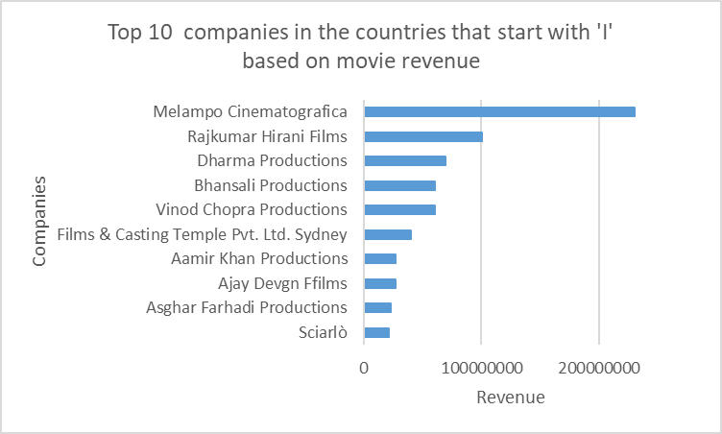
4.Top 10 companies in countries that start with ‘i’ based on movie revenue?
CODE SNIPPET
CHARTS

Slide 6
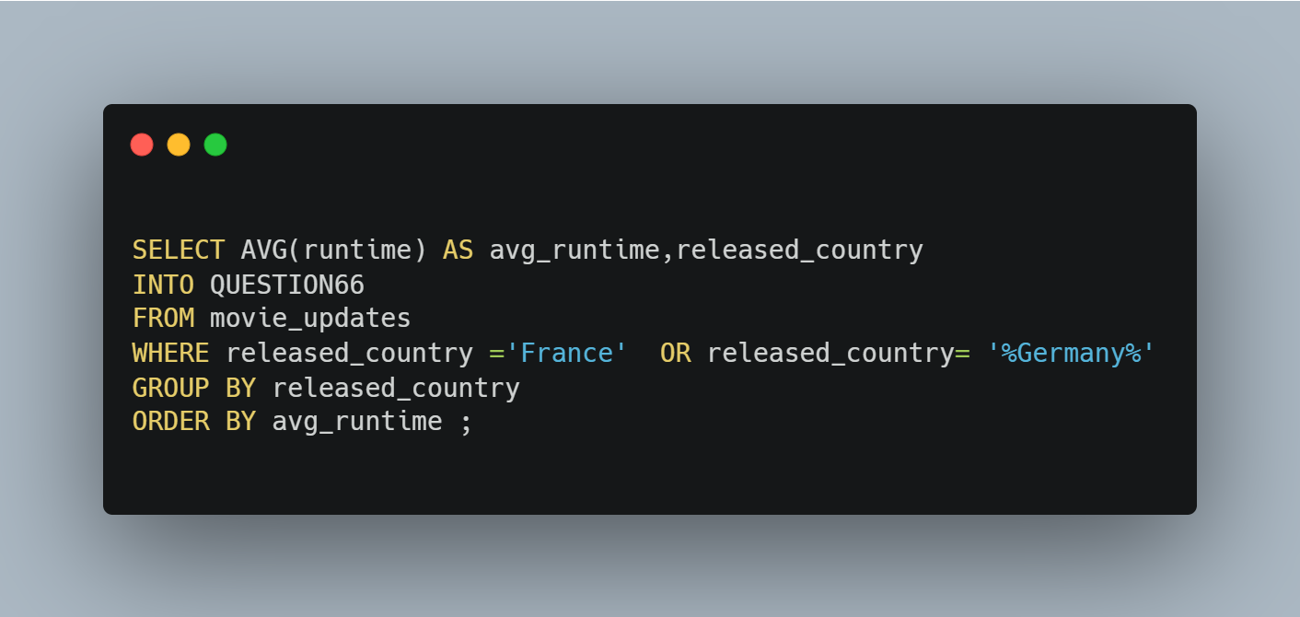
5.Average Movie time for movies in France and any country that contains Germany?
CODE SNIPPET
CHARTS

Slide 7
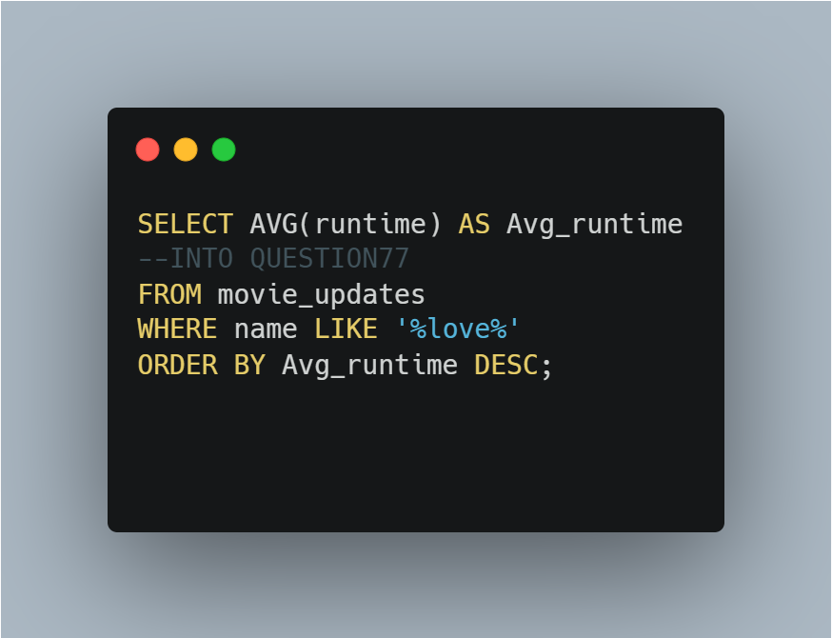
7.Average movie time for movies with the title that contains ‘love’?
Avg _runtime
106
CODE SNIPPET
CHARTS

Slide 8
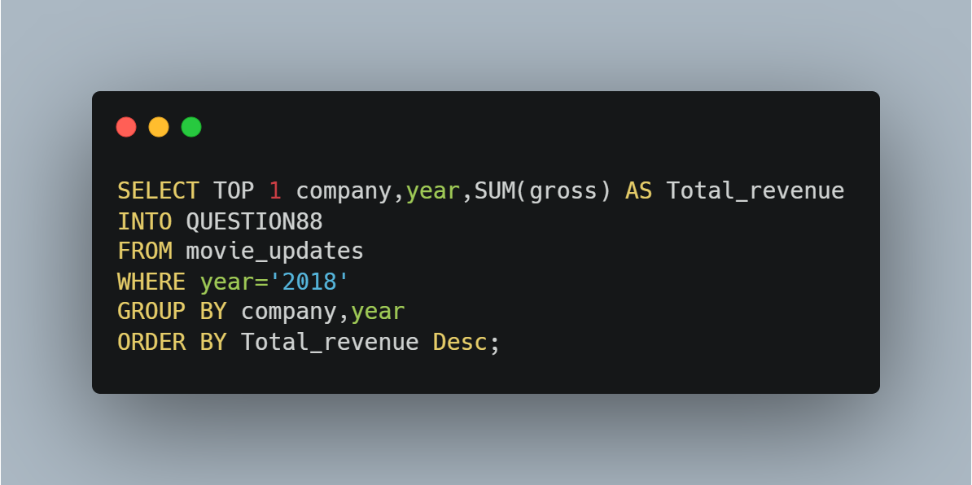
7.Which company generated the most revenue? How much did they make in 2018
CODE SNIPPET
CHARTS

Slide 9
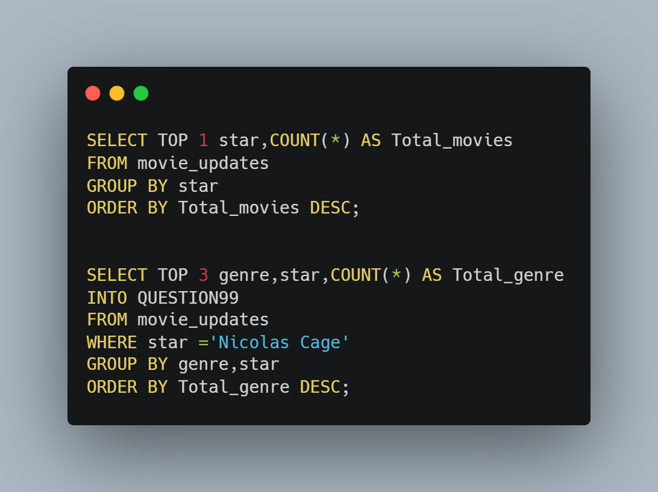
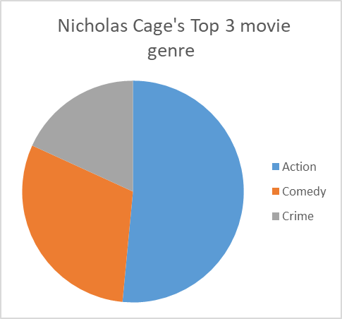
8.Which star has been featured the most in most movies? What are the top 3 movie genre he/she has acted in?
CODE SNIPPET
CHARTS

Slide 10
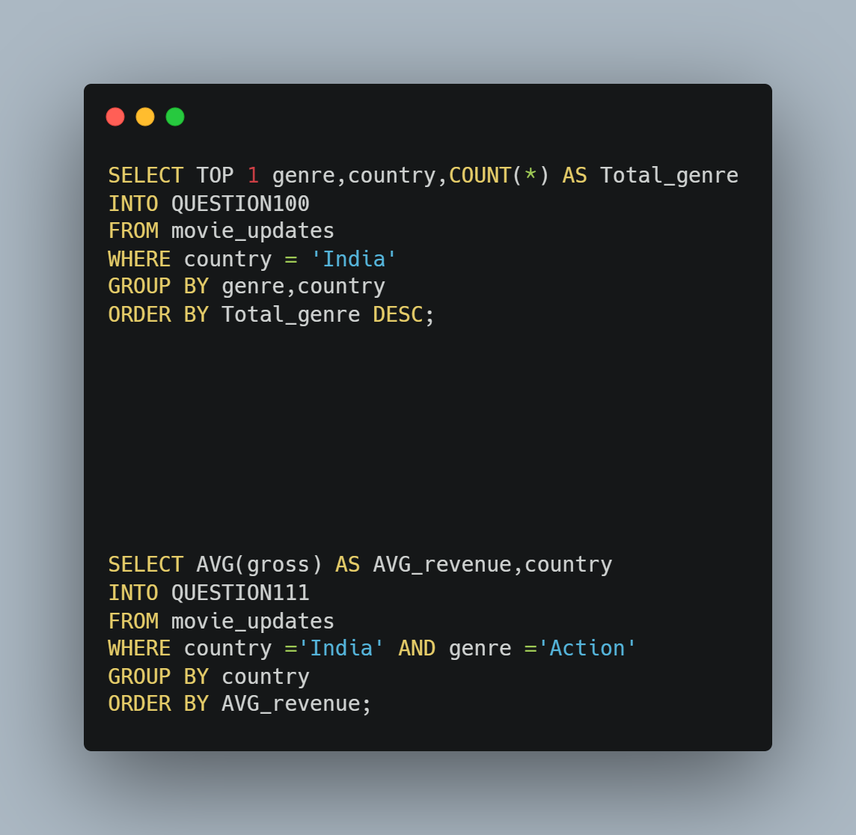
9.Which movie genre is most popular in India? What is the average revenue generated for this movie genre in India?
CODE SNIPPET
CHARTS

Slide 11
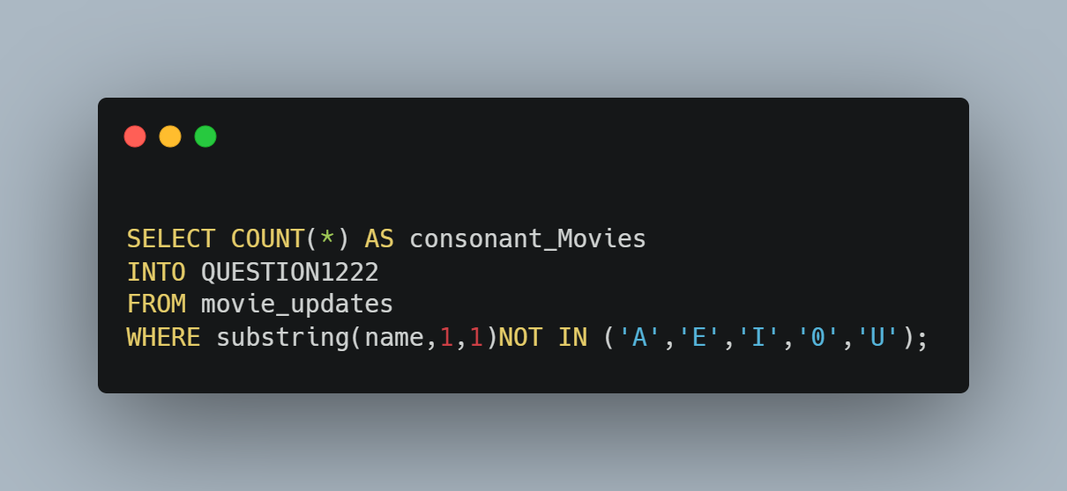
10.How many movies start with consonant letter?
CODE SNIPPET
CHARTS

Slide 12
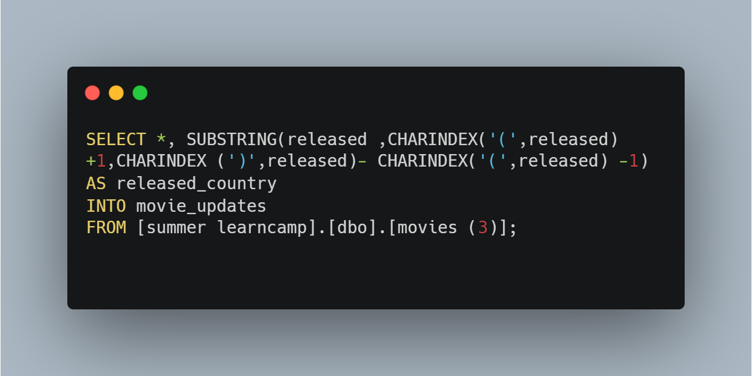
11.Code to extract released country from released column
CODE SNIPPET
CHARTS

