Slide 1

Healthcare Analytics for Doctor Visits
[Karen Acharya]
AICTE STU ID : STU6a66eedfe85331785130719
TECHNO INDIA UNIVERSITY

Slide 2

Problem statement :
To analyze doctor-visit patterns and understand healthcare utilization among individuals in the dataset.
To examine how age, gender, income, illness, and health status relate to doctor visits.
To investigate the association between insurance coverage, reduced activity, chronic conditions, and healthcare utilization.
To identify meaningful patterns and relationships using statistical analysis and data visualization techniques.

Slide 3
Project Description :
The Project focuses on analyzing healthcare utilization patterns using Python and a dataset containing information about individuals' doctor visits, demographic characteristics, income, illness, health status, and insurance coverage.
The project uses Python libraries such as Pandas, Matplotlib, and Seaborn for data cleaning, exploratory data analysis, statistical summaries, and visualization. It examines the relationships between doctor visits and factors such as age, gender, illness levels, income, insurance categories, reduced activity, and chronic conditions.
Various charts, including histograms, bar plots, box plots, and correlation heatmaps, are used to explore patterns and relationships within the dataset. The analysis aims to identify factors associated with healthcare utilization and present findings in a clear, understandable format. This project demonstrates how data analytics can support better understanding of healthcare-seeking behavior while recognizing that observed associations do not necessarily establish causation.

Slide 4

Who are the End users?
🧑 Local People / Patients
Benefiting from better understanding of healthcare needs and improved healthcare planning.
🩺 Healthcare Professionals
Understanding doctor-visit patterns and factors associated with healthcare utilization.
🏥 Hospitals and Healthcare Administrators
Planning healthcare services and allocating resources according to patient needs.
🏛️ Government and Public Health Departments
Supporting public health planning and healthcare policy development.
📊 Healthcare Analysts / Researchers
Studying relationships between demographic factors, health conditions, insurance, and doctor visits.
🛡️ Health Insurance Providers
Analyzing healthcare utilization patterns to support insurance planning, risk assessment, and policy development.

Slide 5

Technology Used :
Python :
Pandas- Data loading, cleaning and grouping
NumPy- Numerical operations
Matplotlib- Data visualization
Seaborn- Statistical charts
SciPy- ANOVA statistical test
Platform :
Google Colab / Jupyter Notebook & Github Reposit Hosting

Slide 6
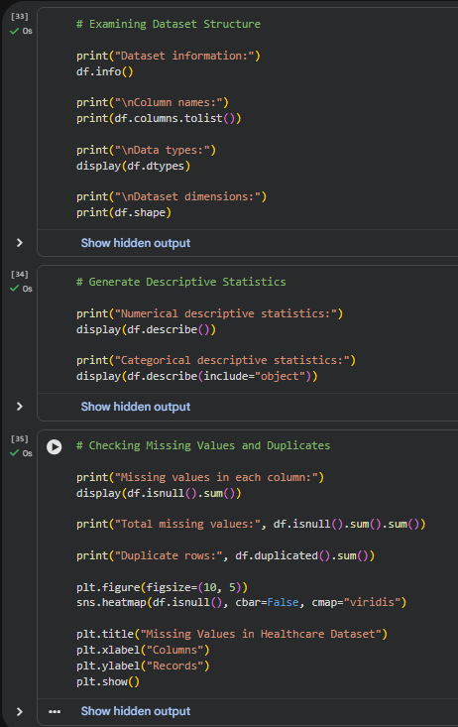
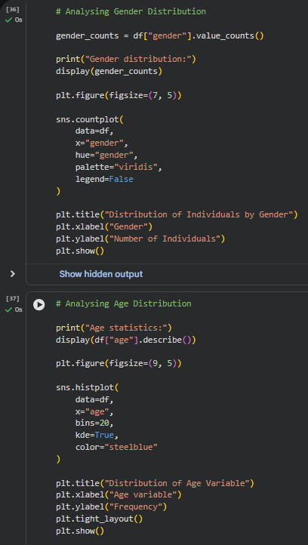
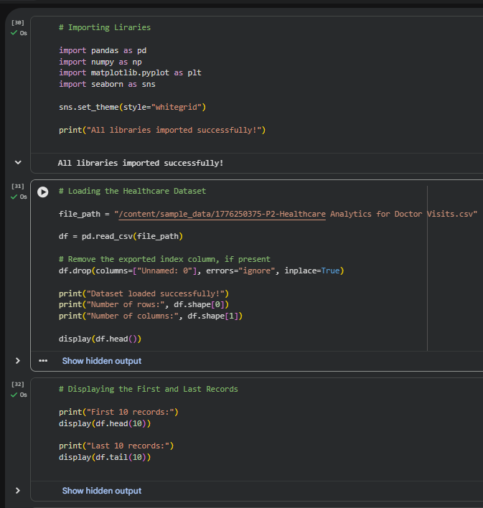
RESULTS :

Slide 7
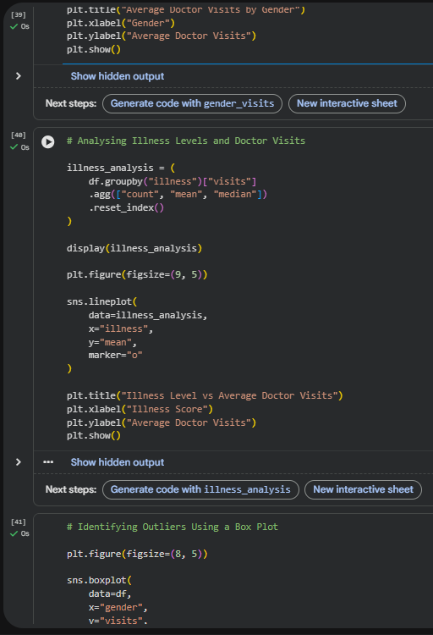
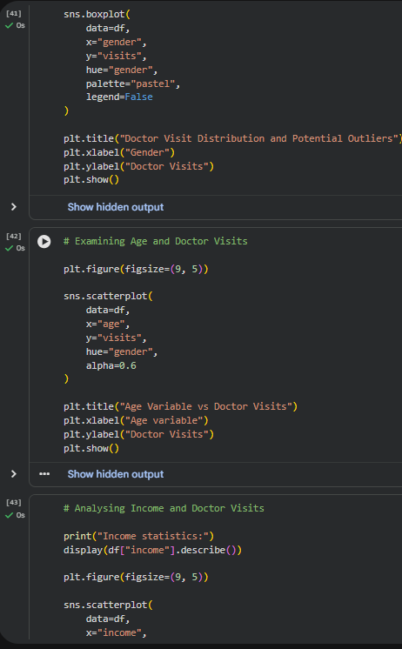
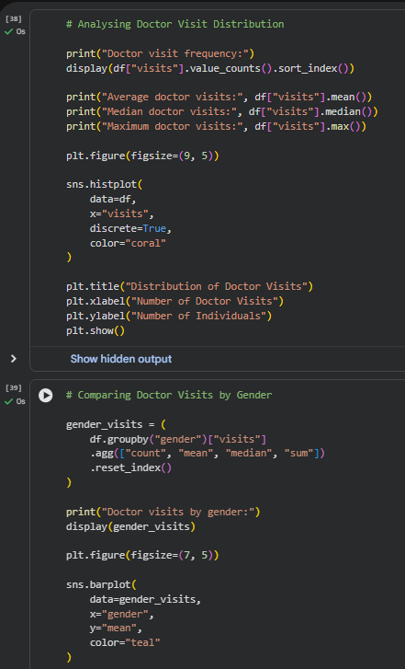
RESULTS :

Slide 8
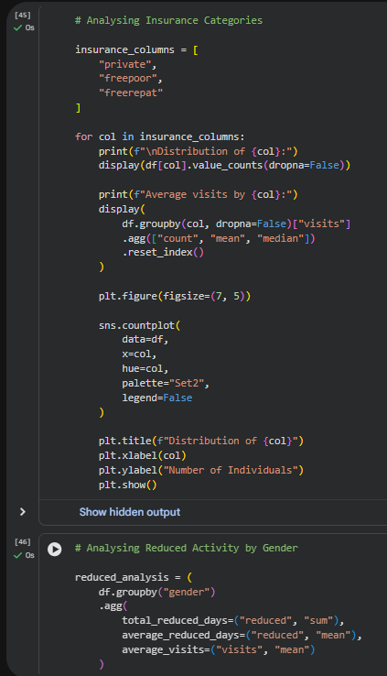
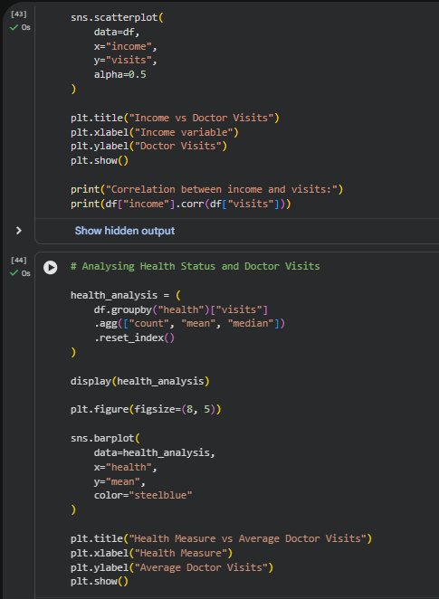
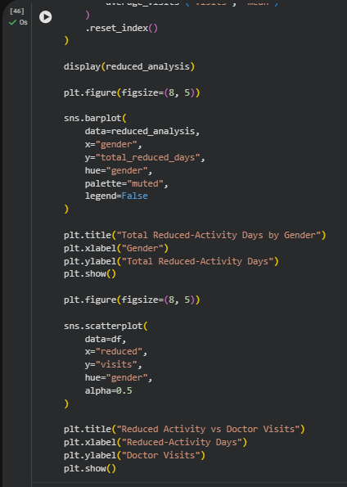
RESULTS :

Slide 9
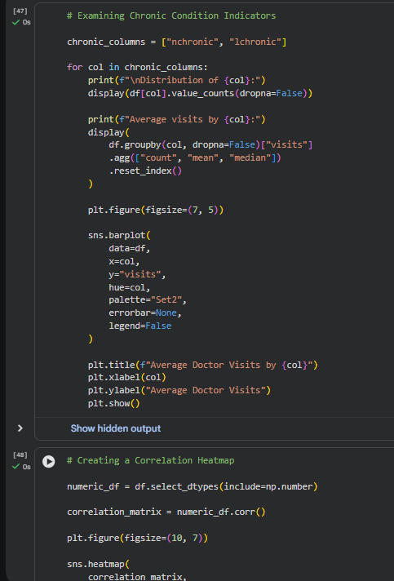
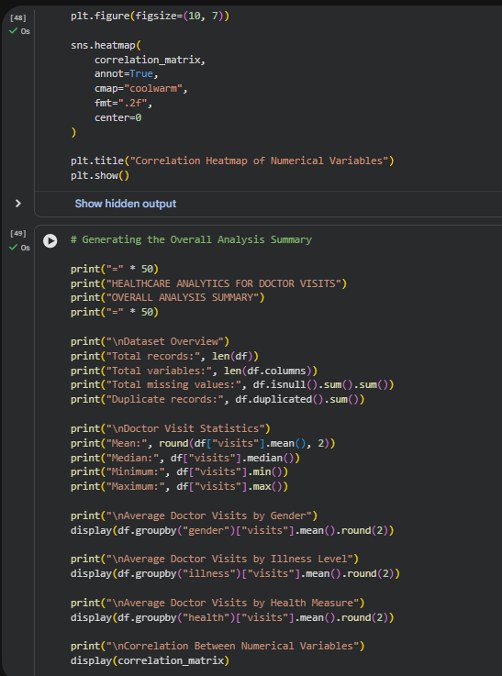
RESULTS :

Slide 10
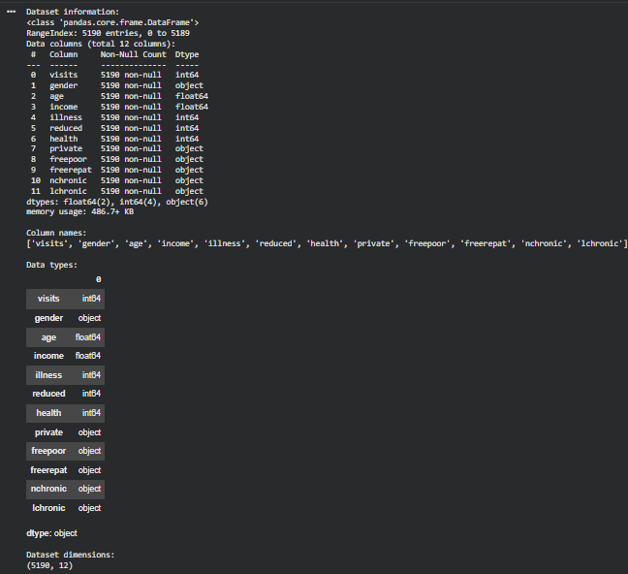
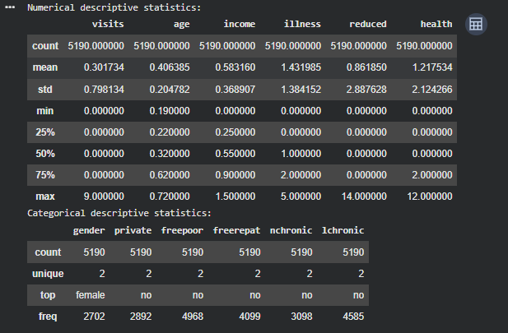
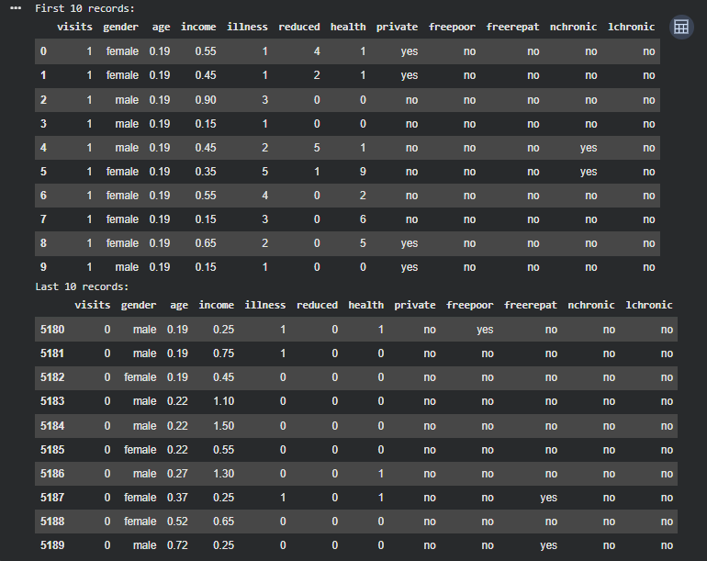
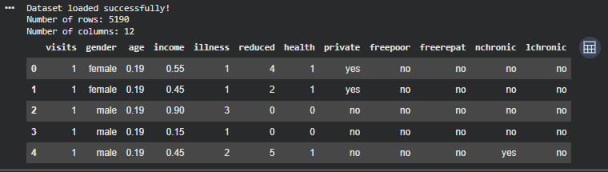
RESULTS :

Slide 11
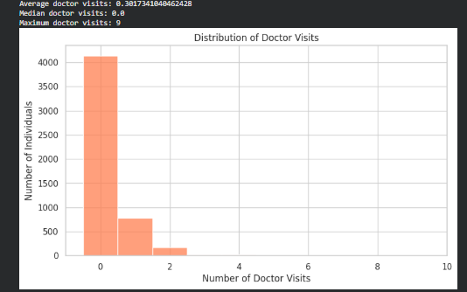
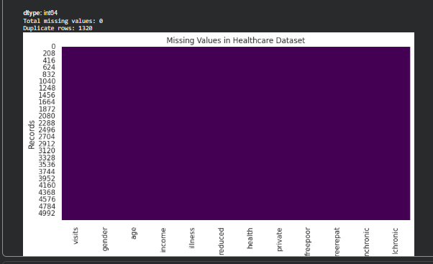
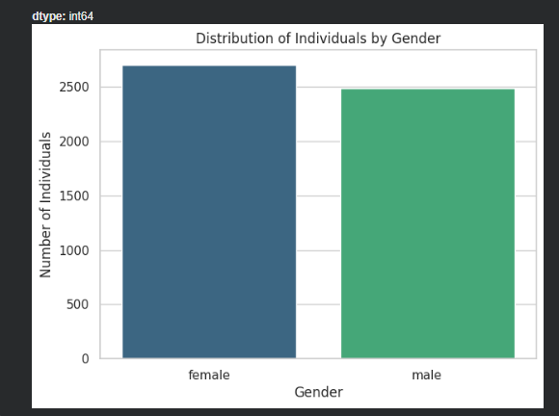
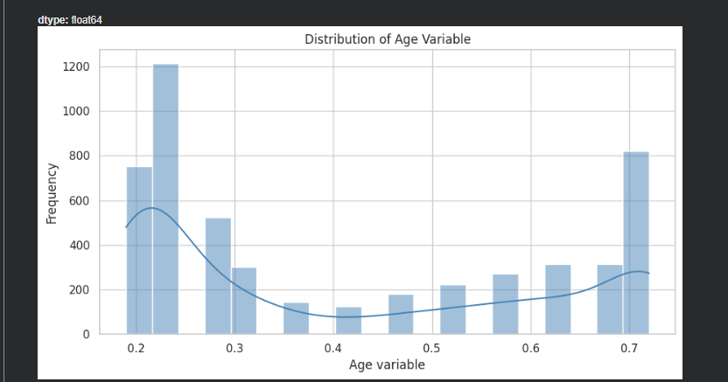
RESULTS :

Slide 12
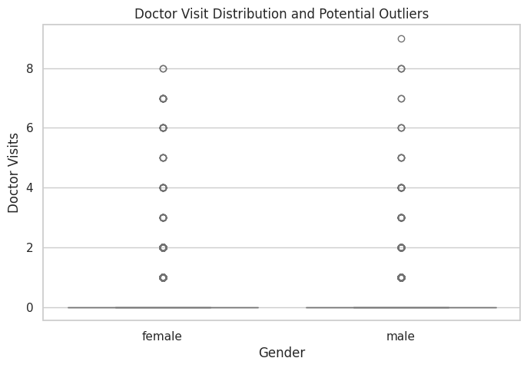
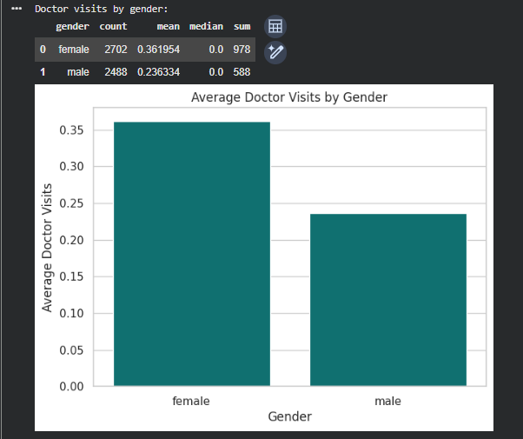
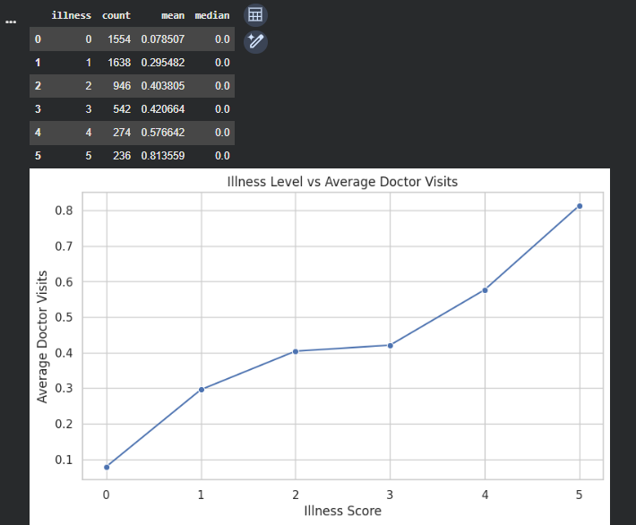
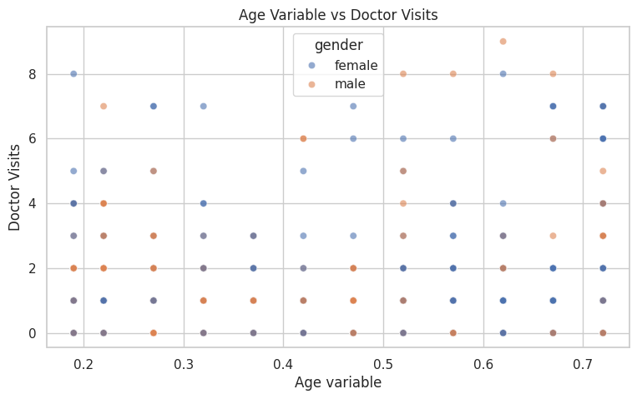
RESULTS :

Slide 13
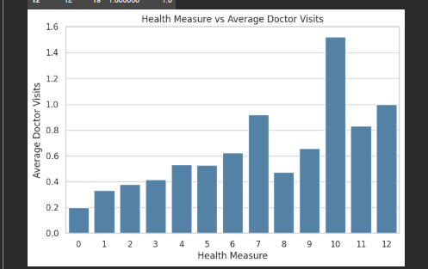
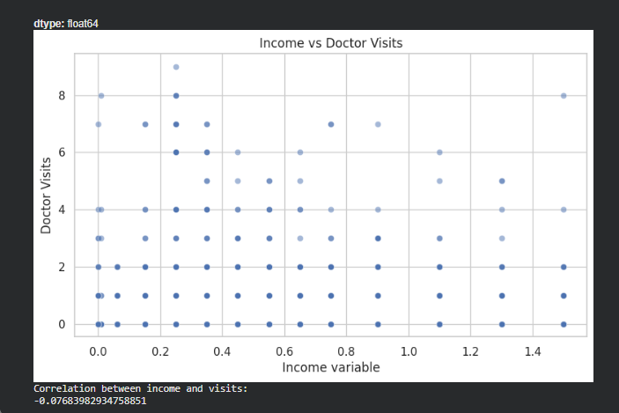
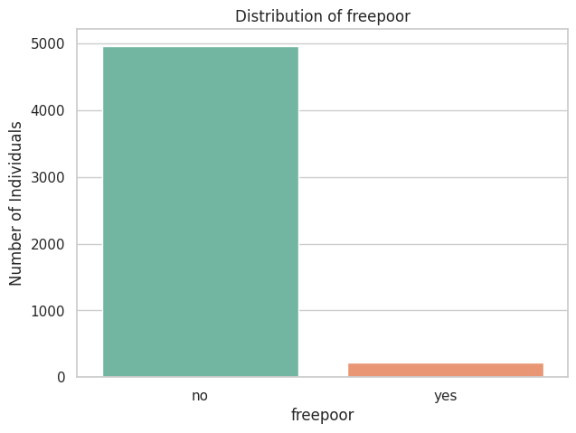
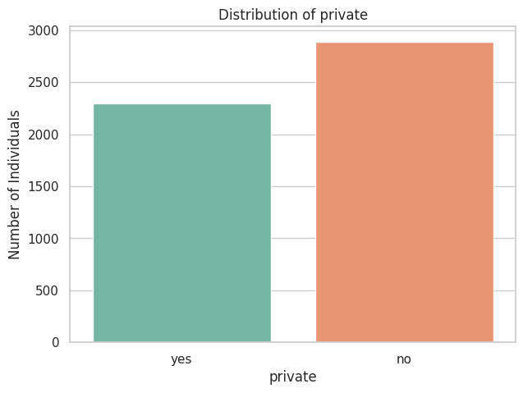
RESULTS :

Slide 14
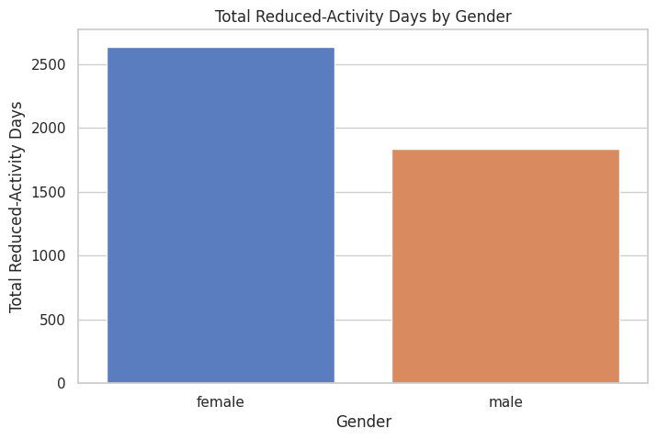
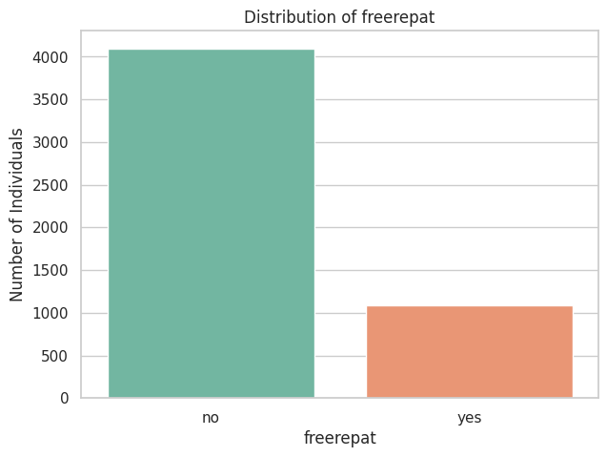
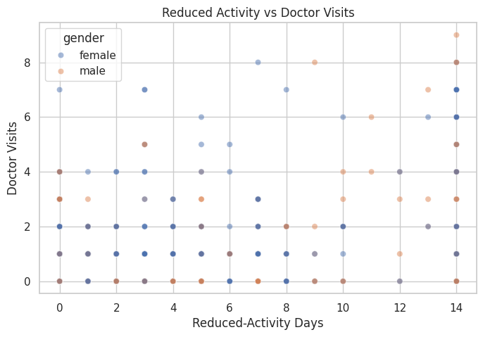
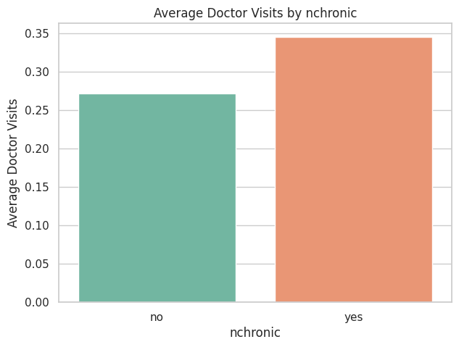
RESULTS :

Slide 15
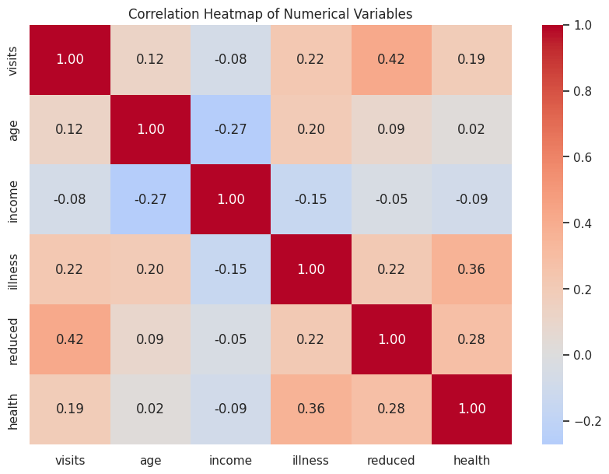
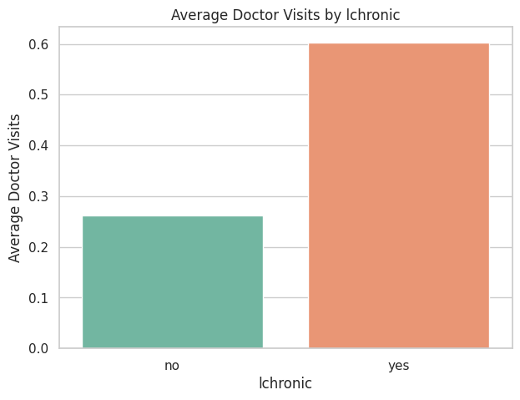
RESULTS :

Slide 16
GitHub Link :
https://github.com/karenacharya24-boop/Healthcare_Analytics_for_Doctor_Visits.git

Slide 17
Thank you
[Karen Acharya]
AICTE STU ID : STU6a66eedfe85331785130719
Email: karenacharya24@gmail.com
Mobile No.: 8697355268
Github Link: https://github.com/karenacharya24-boop/Healthcare_Analytics_for_Doctor_Visits.git
.
.

