Slide 1

Seasonal Agriculture Performance Analysis
[Karen Acharya]
AICTE STU ID : STU6a66eedfe85331785130719

Slide 2

Problem statement :
Agricultural performance is dependent upon seasonal environmental conditions, farming practices, resources and market conditions.
Agricultural performance may vary across Kharif, Rabi and Zaid seasons. Raw agricultural data does not clearly show these seasonal variations.
This project analyses this dataset in order to identify patterns, trends, relationships and variations in agricultural performance.
This analysis would aid in forming evidence based agricultural planning decisions.

Slide 3
Project Description :
This project uses data analytics to study the impact of different seasons on farming through data visualization tools. It includes the study of crop output and profit for a given season, precipitation, air conditions, soil quality, irrigation, water usage, and other related activities in the farm sector. The study evaluates the Kharif, Rabi and Zaid seasons and tries to understand the anomalies in the farming patterns, insights, and relationships through statistical analysis and interpretations. The recommendations are supported with statistical and graphical plots along with correlation analysis and ANOVA
Goal: Understanding how agricultural performance vary across seasons and identify factors and patterns that can support better seasonal agricultural planning.

Slide 4

Who are the End users?
👨‍🌾 Farmers Understanding the seasonal crops and resource performance.
🌾 Agricultural Planners Supporting seasonal planning and resource allocation.
🏛️ Government & Agricultural Departments Understanding regional and seasonal agricultural patterns.
📊 Agricultural Analysts / Researchers Studying the relationships between environmental conditions and agricultural outcomes.
💼 Agribusiness Stakeholders Understanding production, cost, revenue, profit and various patterns.

Slide 5

Technology Used :
Python :
Pandas- Data loading, cleaning and grouping
NumPy- Numerical operations
Matplotlib- Data visualization
Seaborn- Statistical charts
SciPy- ANOVA statistical test
Platform :
Google Colab / Jupyter Notebook & Github Reposit Hosting

Slide 6
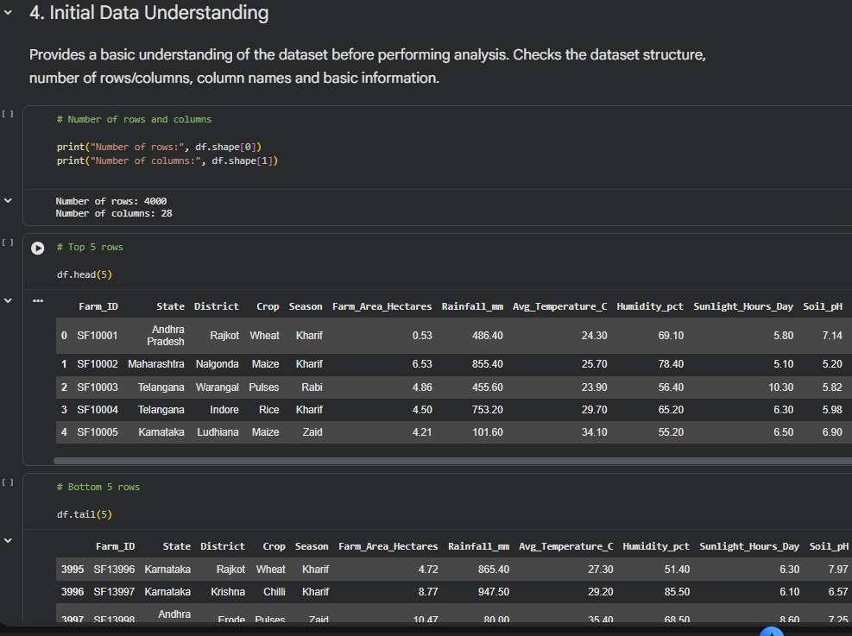
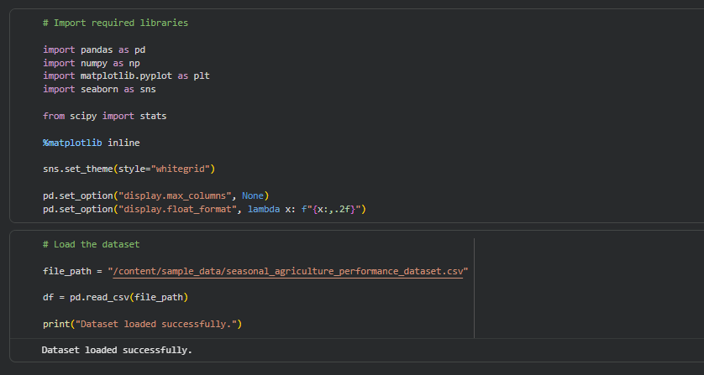
RESULTS :

Slide 7
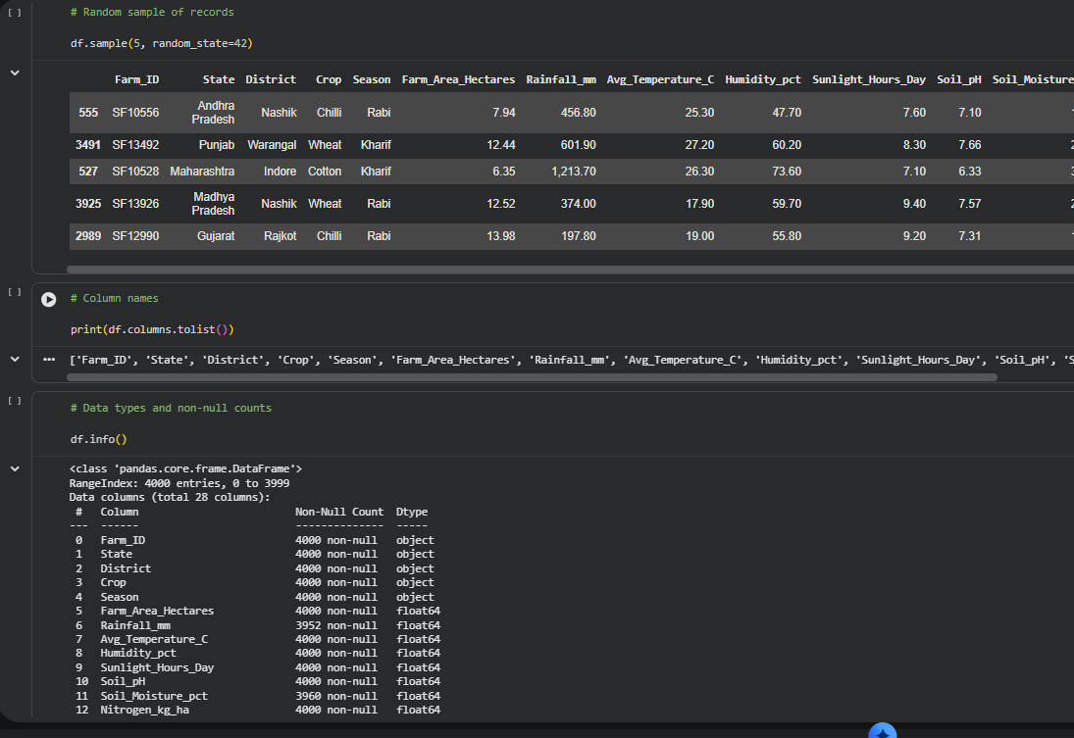
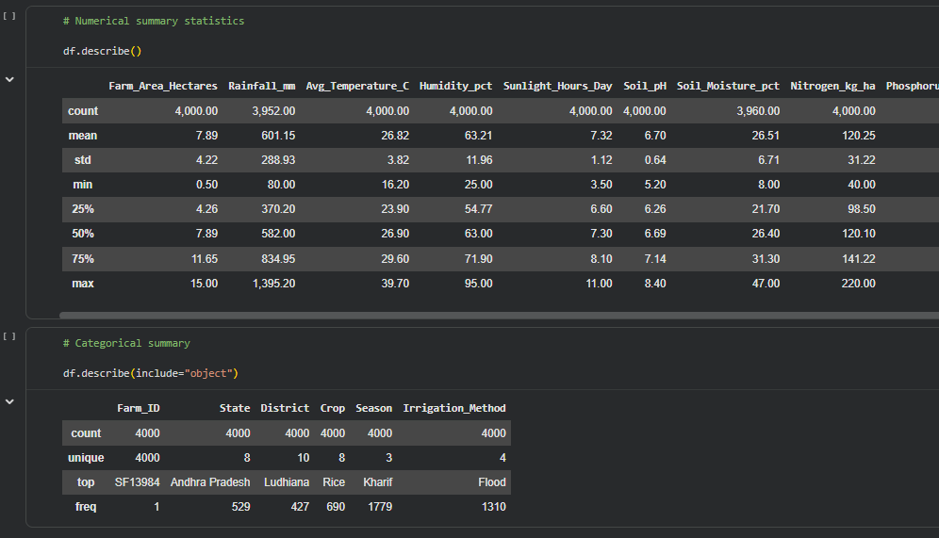
RESULTS :

Slide 8
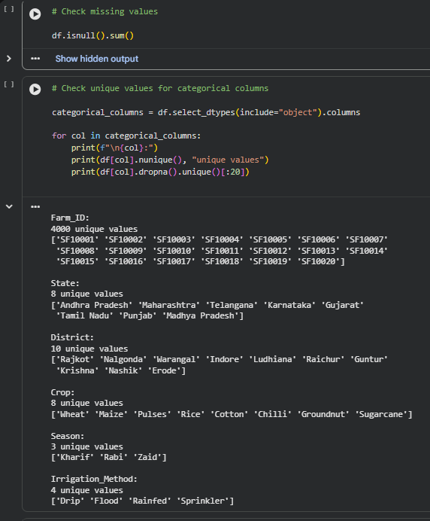
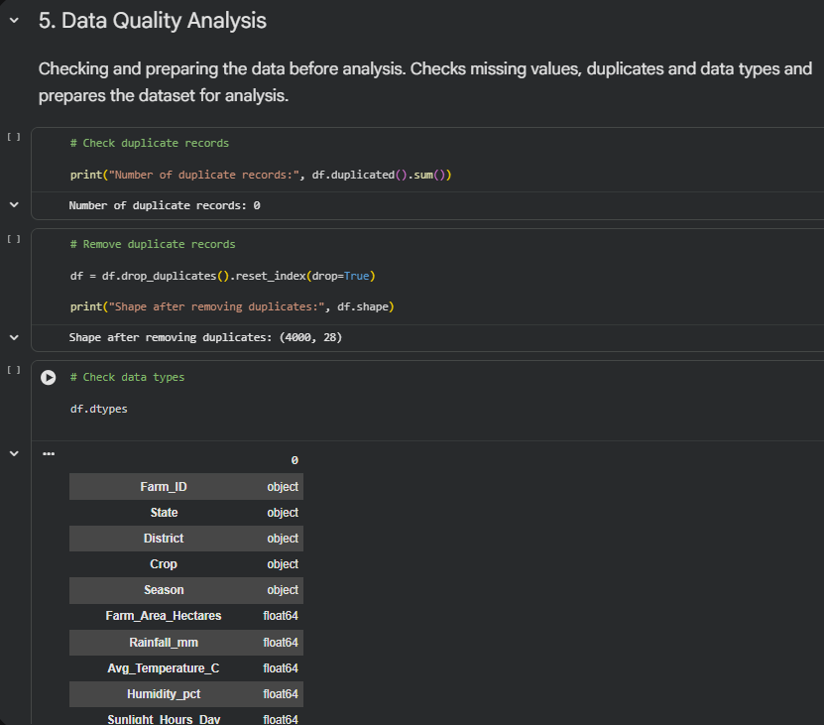
RESULTS :

Slide 9
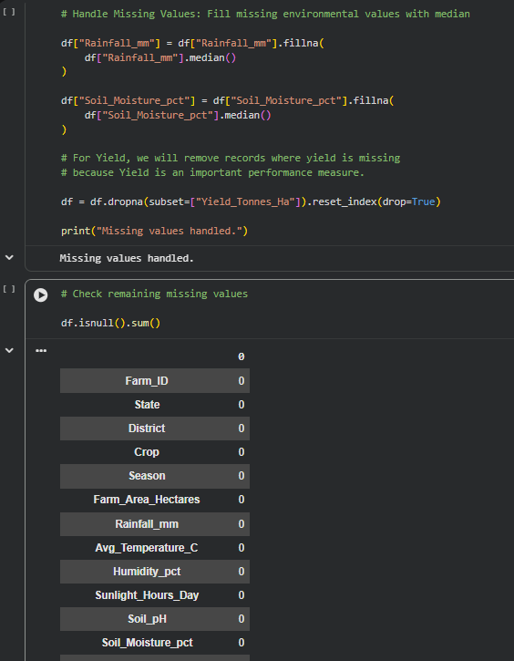
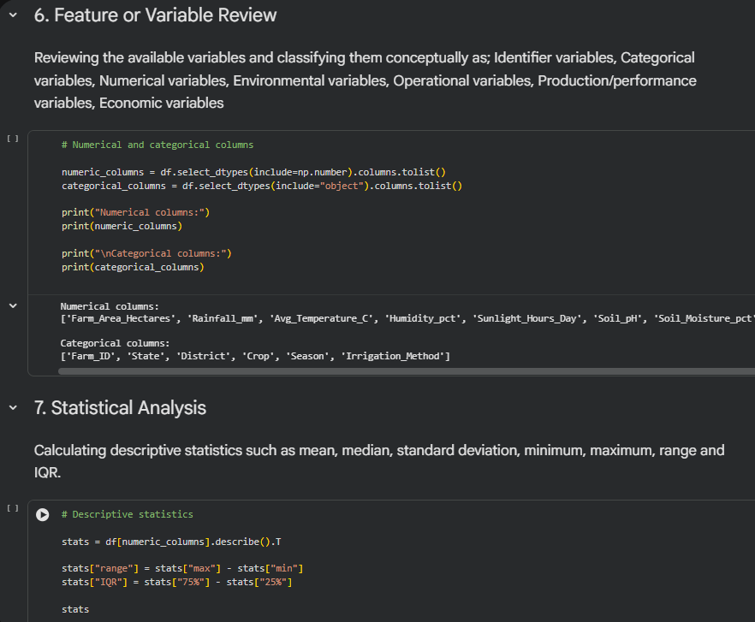
RESULTS :

Slide 10
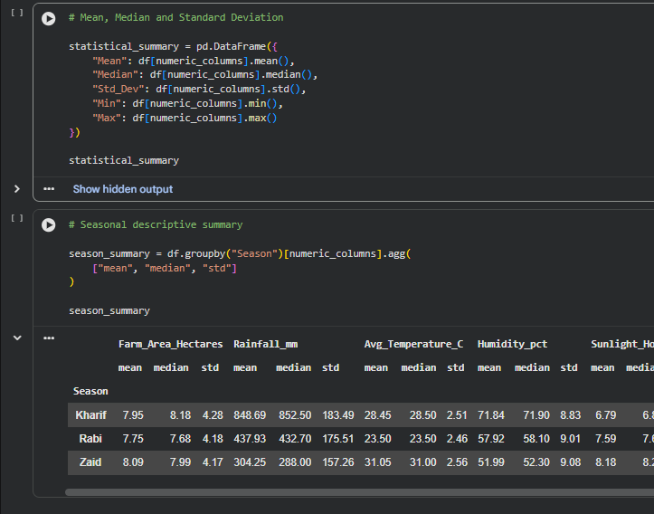
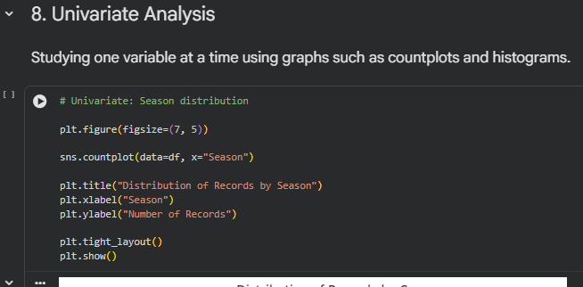
RESULTS :

Slide 11
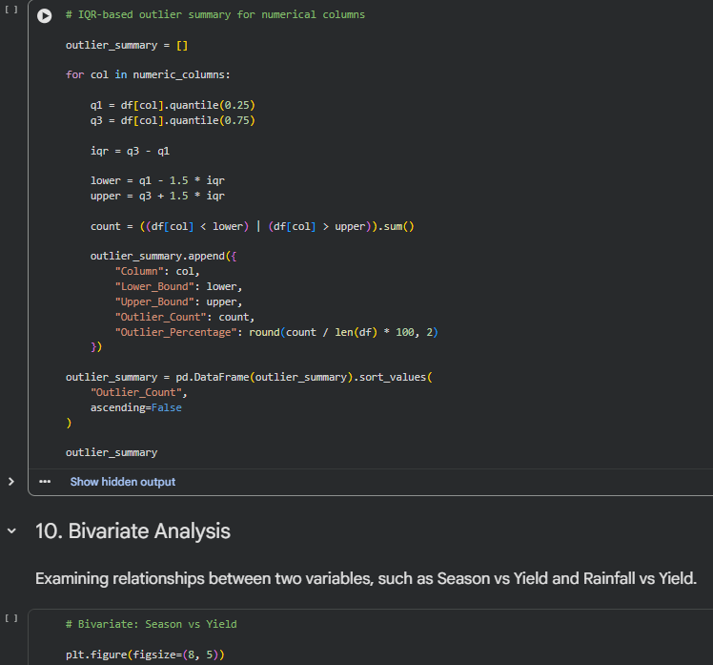
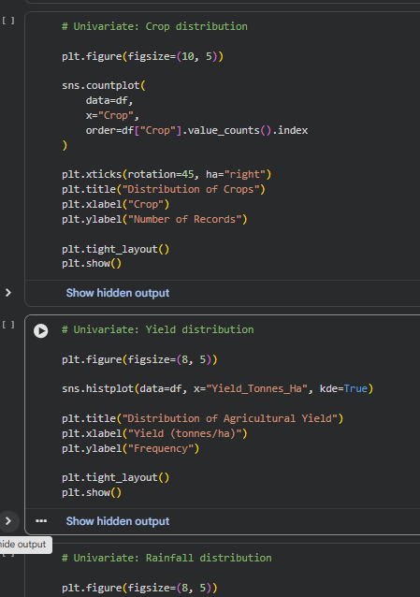
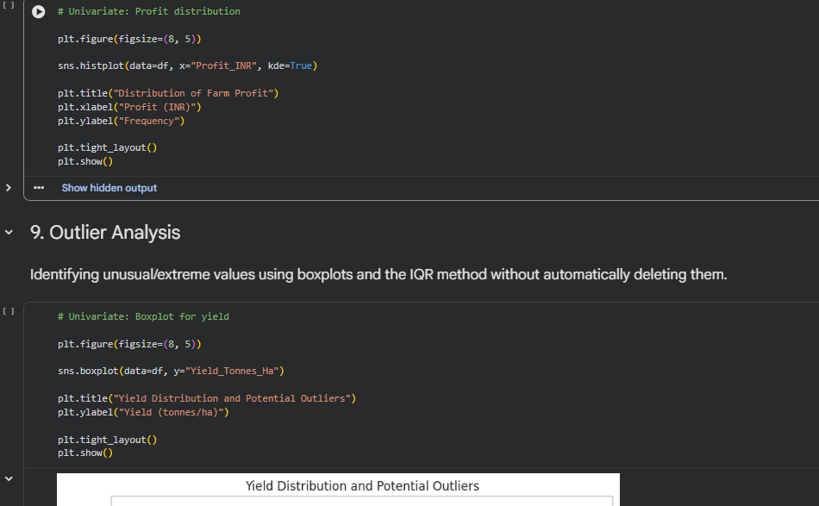
RESULTS :

Slide 12
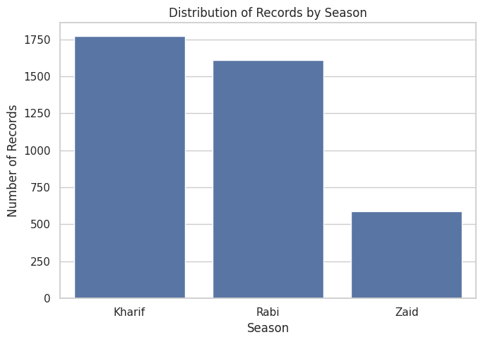
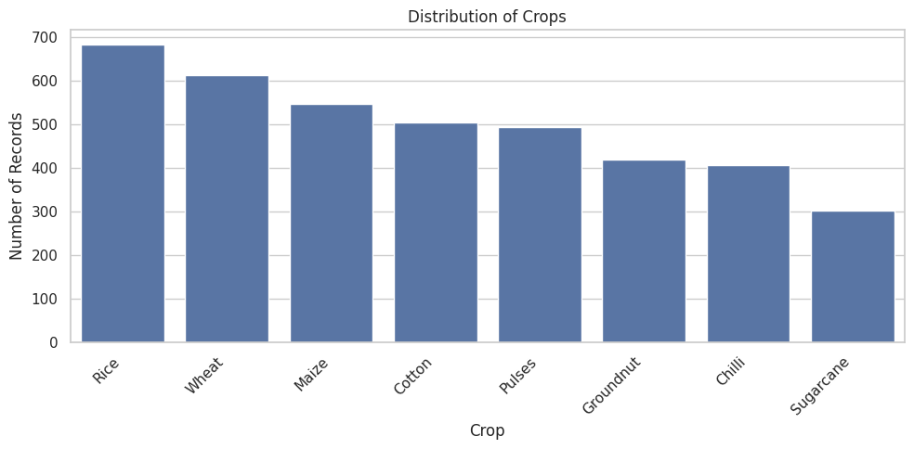
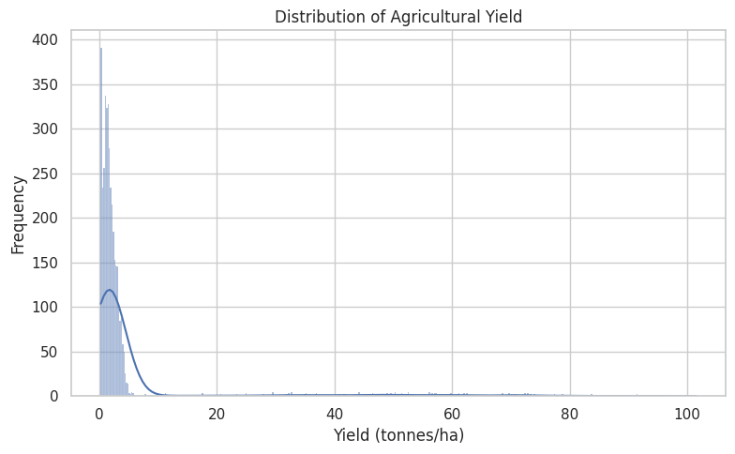
RESULTS :

Slide 13
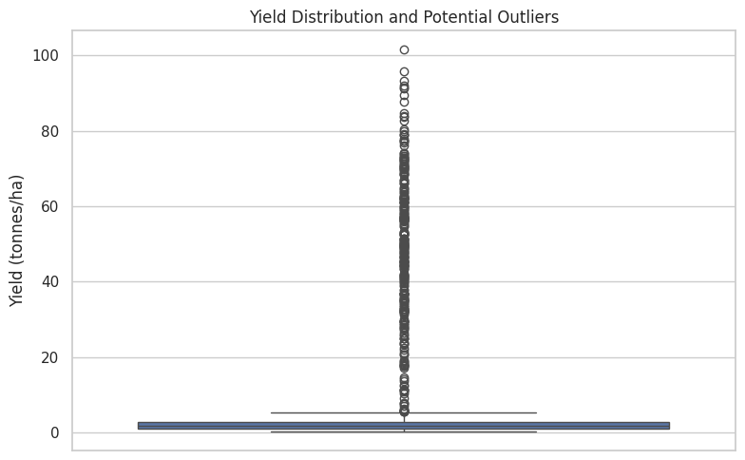
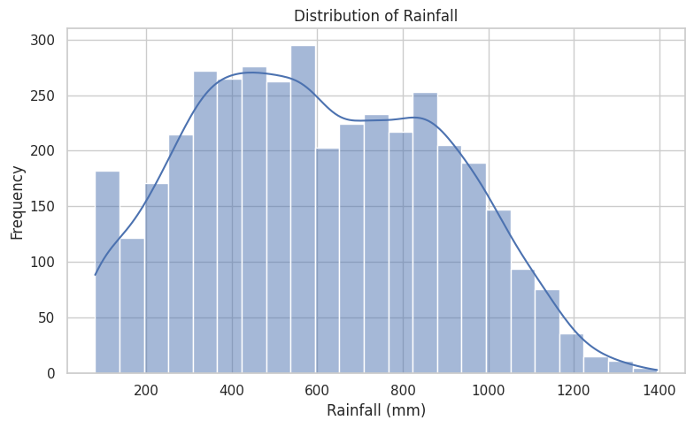
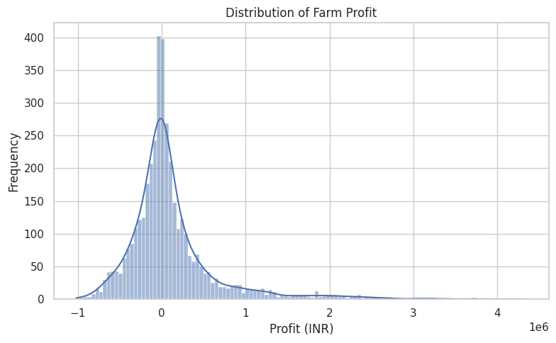
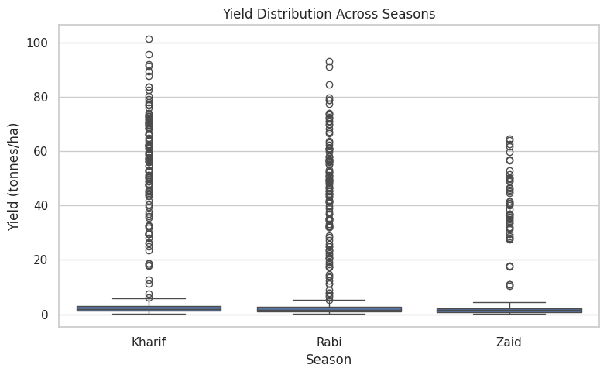
RESULTS :

Slide 14
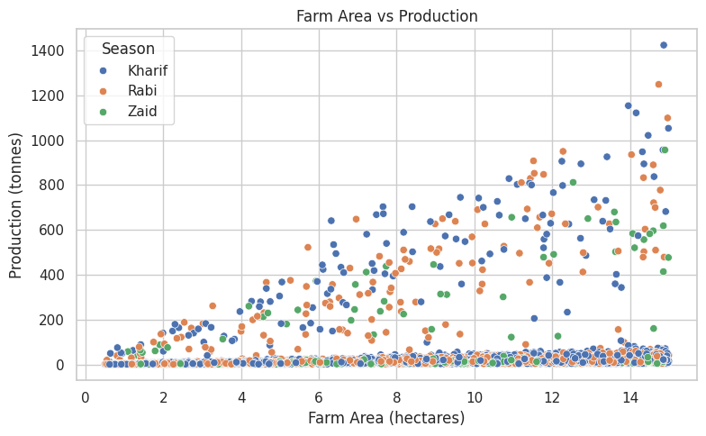
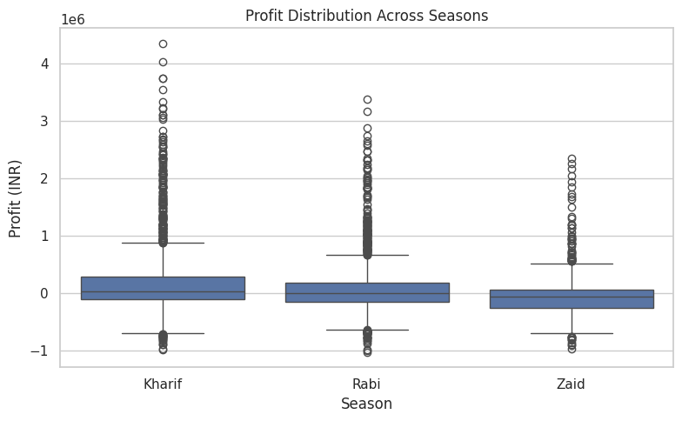
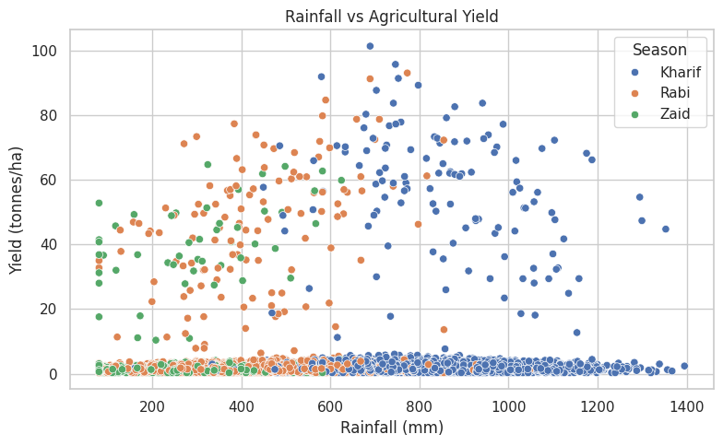
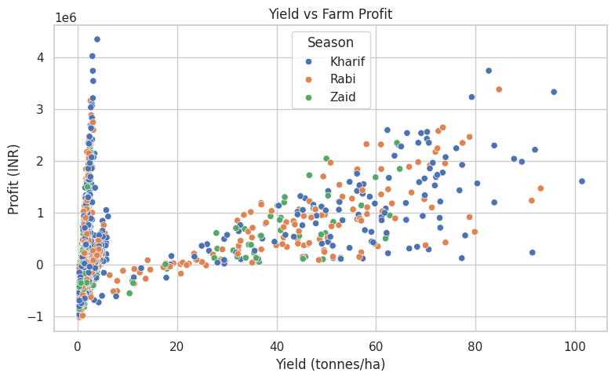
RESULTS :

Slide 15
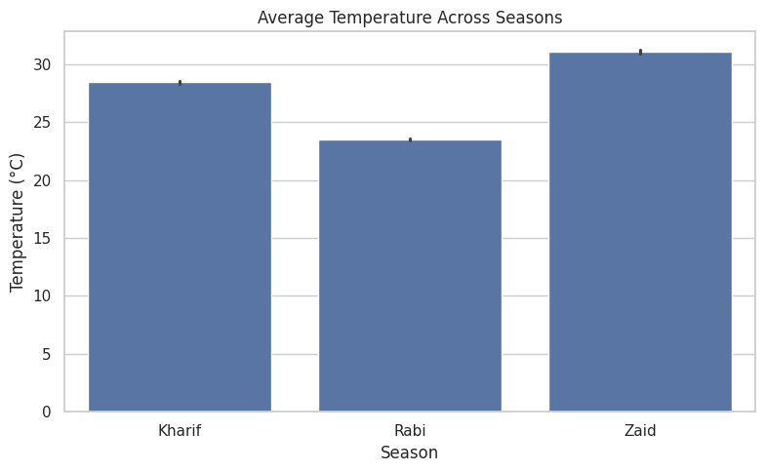
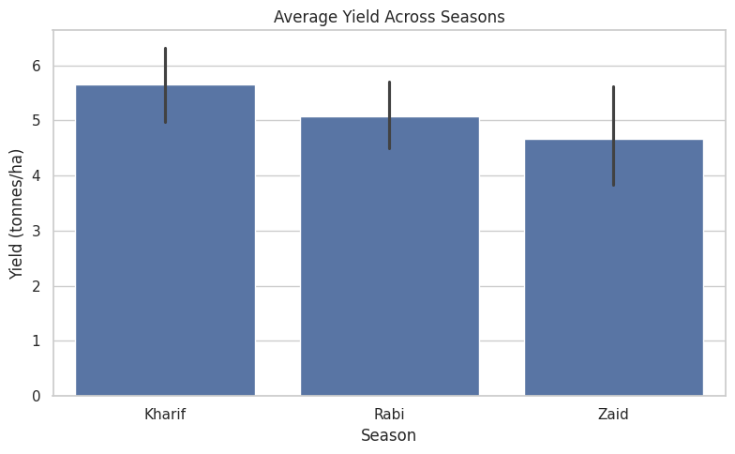
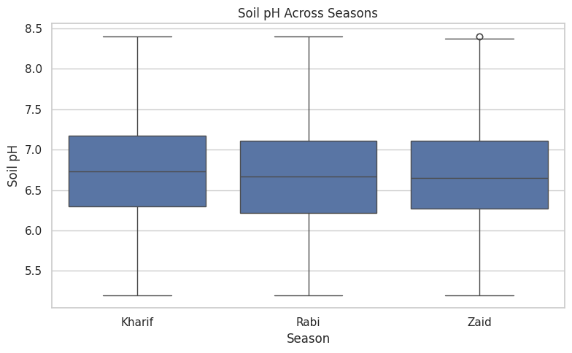
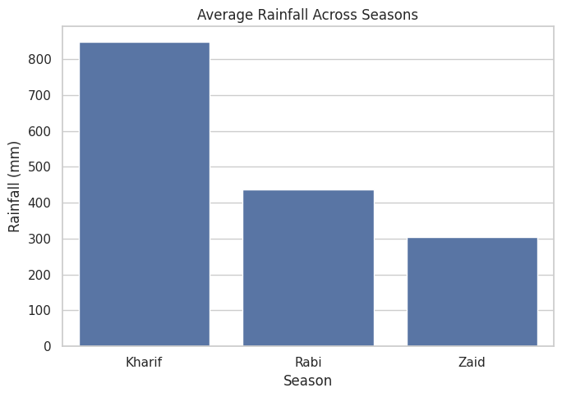
RESULTS :

Slide 16
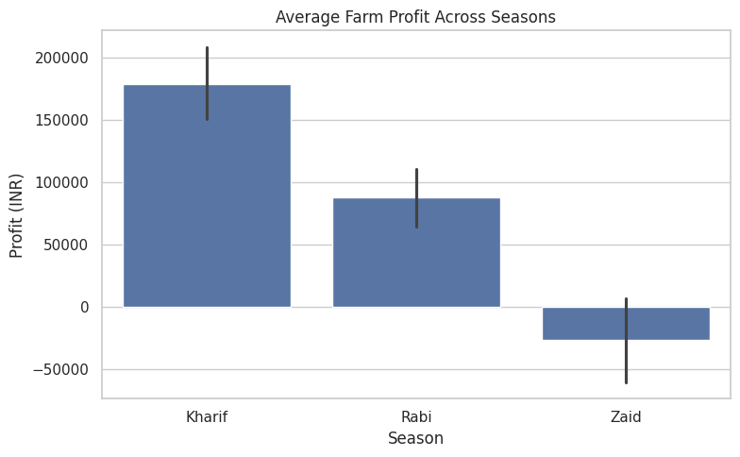
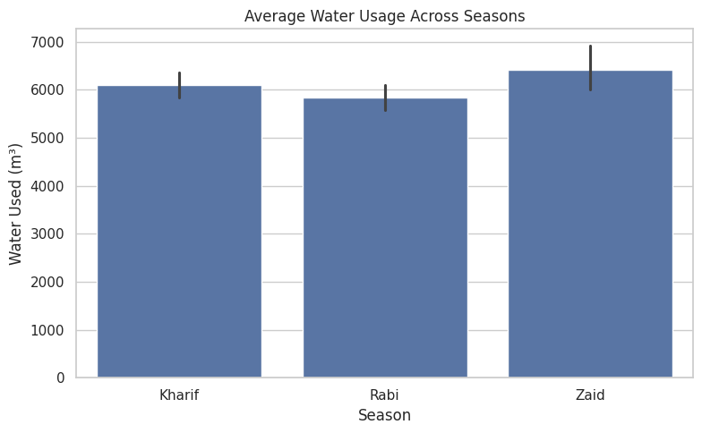
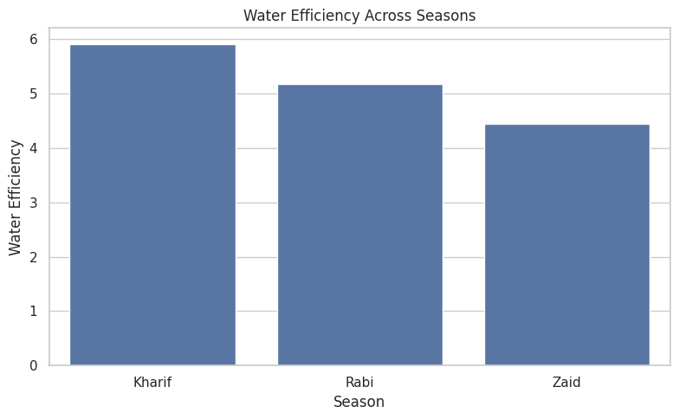
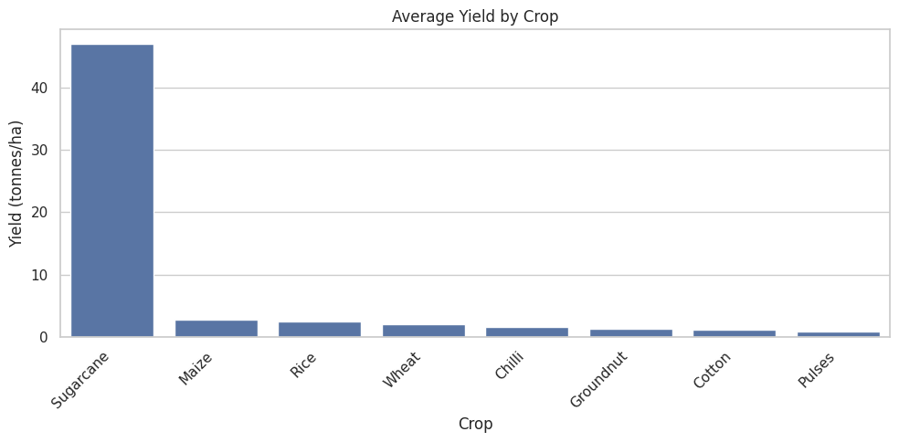
RESULTS :

Slide 17
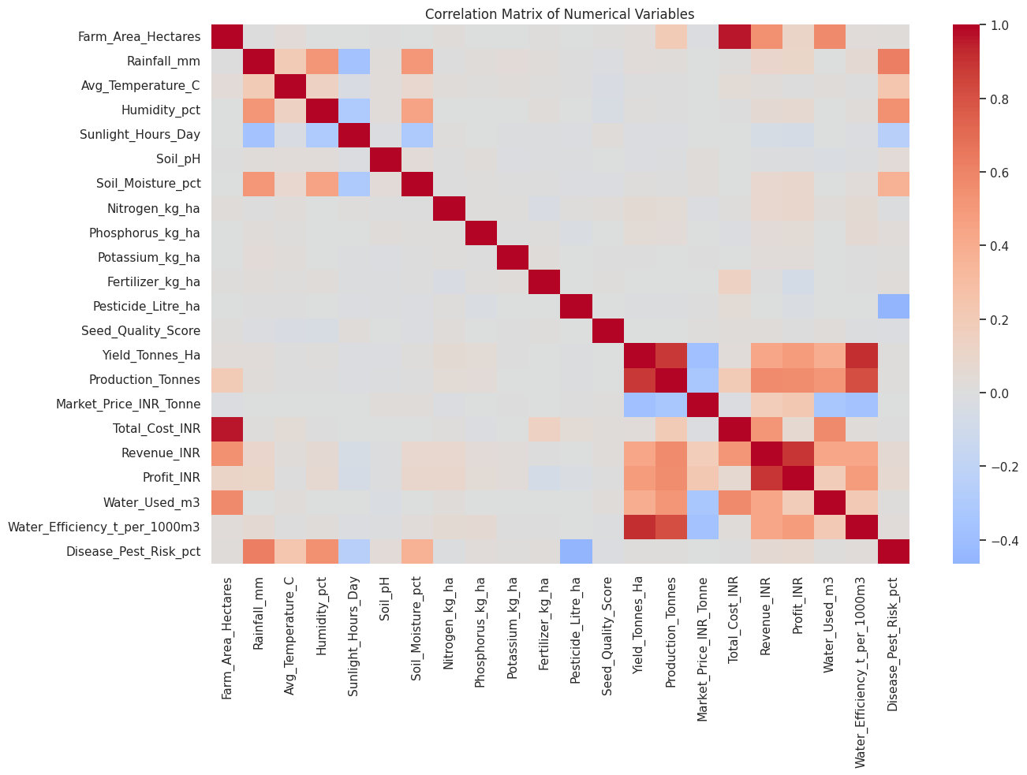
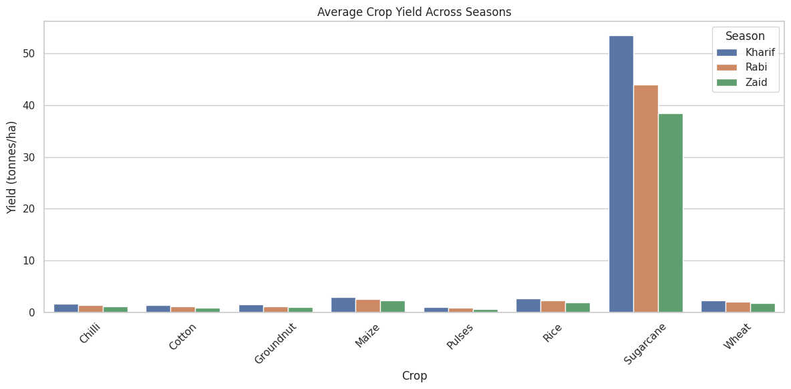
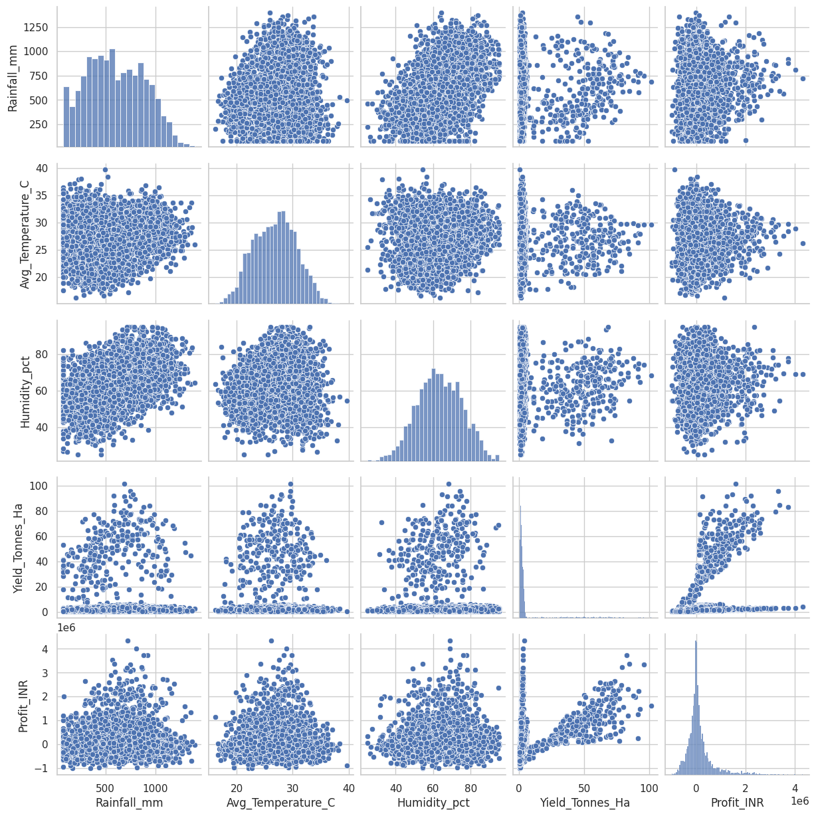
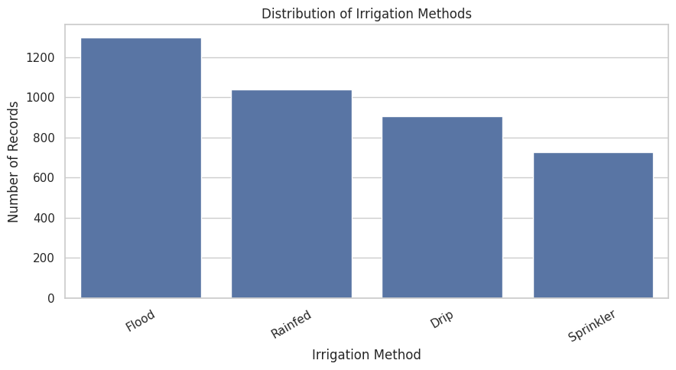
RESULTS :

Slide 18
Future scope :
We can expand the dataset by adding data from coming years and various regions.
We can even perform a detailed analysis at the state and district level to spot regional patterns.
We can further study the impact of weather and environmental conditions on crop yield, in greater detail.
We can further Analyse resource efficiency, especially how water and fertilizer are used.
We can extend the analysis to include forecasting of crop yield and profits.
We can develop a interactive dashboard so that farmers and agricultural planners can use the findings easily and efficiently.
Future analysis can combine datasets, regional information and predictive techniques to support better seasonal agricultural planning.

Slide 19
GitHub Link :
https://github.com/karenacharya24-boop/Karen_Acharya_VOIS_Major_Project.git

Slide 20

VOIS Course completion certificate - Course name- Data Visualization

Slide 21
Thank you
[Karen Acharya]
AICTE STU ID : STU6a66eedfe85331785130719
Email: karenacharya24@gmail.com
Mobile No.: 8697355268
Github Link: https://github.com/karenacharya24-boop/Karen_Acharya_VOIS_Major_Project.git
.
.

