Slide 1
Investigating
flight delays at Newark Airport
Karen Gibson
CodeClan Final Data Project
May 2023
Notes:
Test

Slide 2
Project Brief
Investigate the effect of weather on domestic departure delays at
Newark airport, specifically:
the impact of weather conditions on departure delays
the types of weather conditions that cause departure delays
Further investigation:
other factors that cause departure delays
how Newark compares to other airports servicing New York city
Notes:
Read slide plus –
The data was provided by the airport and some data was sourced externally from the meteo stat website
Data ethics have been considered. The data is suitable for analysis as it does not contain any passenger information or any other information that could lead to bias.

Slide 3
Data
The following datasets have been used:
flights – information on departures from Newark (EWR), JFK (JFK) and LaGuardia (LGA) for 2017
weather – hourly weather conditions for each airport York throughout 2017
additional weather – further daily weather information from meteostat
airlines – information on the carrier airlines
planes – information on the model specifications and manufacturing data
Data ethics:
8 data risk zones have been considered
no personalised passenger data

Slide 4
Weather related factors
Data exploration of weather factors:
Wind direction (degrees)
Wind speed (mph)
Visibility (miles)
Precipitation (inches)*
Daily average temperature (°C)*
Snow (mm)*
* Externally sourced data from: https://meteostat.net/en/station/72502?t=2017-01-01/2017-12-31
Notes:
The weather factors that our data looks at are: read slide
For this presentation we will look closer at the impact on flight departures based on visibility levels and also the average daily temperature.

Slide 5
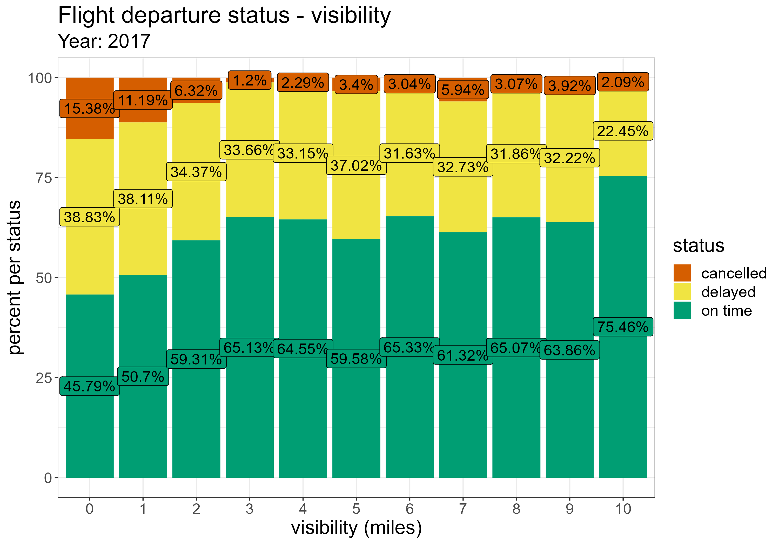
Newark: impact of visibility
Cancellations more likely when visibility at 0 to 1 miles
Highest percentage of delays also at visibility level from 0 to 1
Delays more steady throughout, with cancellation rates being impacted more with the lowest visibility
Notes:
This graph shows…
Perhaps unsurprisingly, we see that departure cancellations are at the highest when visibility is lowest. *refer to graph*
There is less of a fluctuation in delays, but we do still see a pattern of more delays with less visibility. *refer to graph*

Slide 6
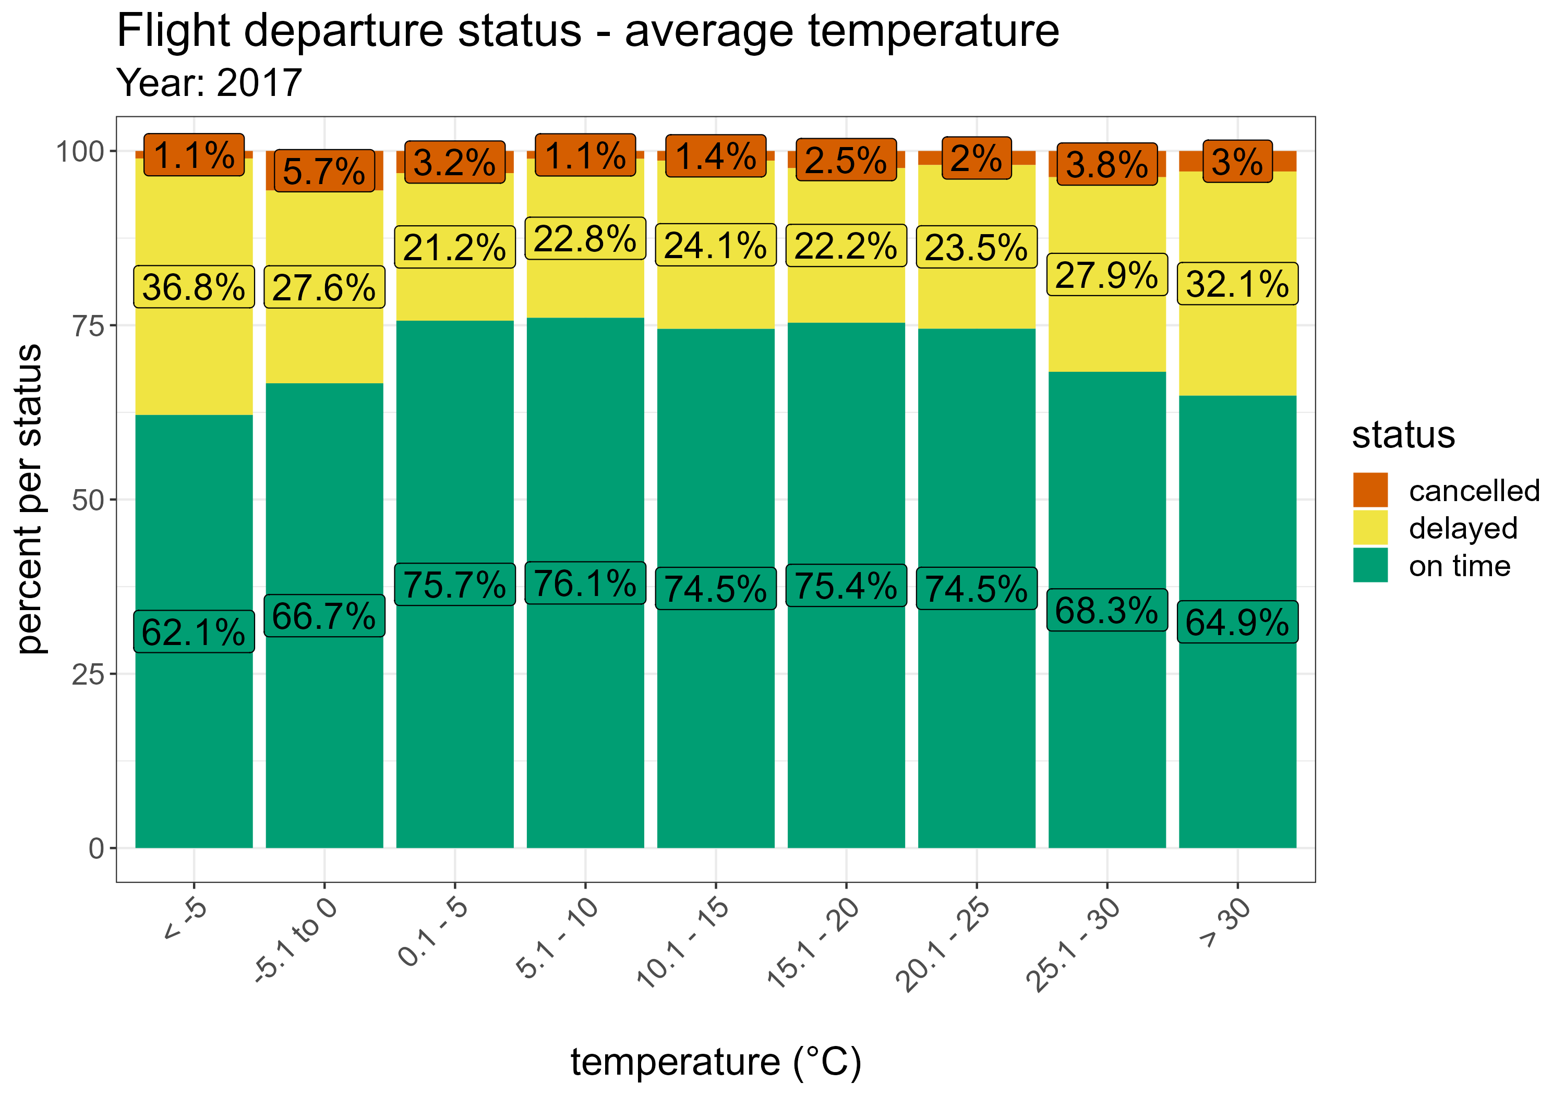
Newark: impact of temperature
Average of 75% flights depart on time within temperature range 0.1°C - 25°C
More flight delays when temperature at 0°C or below and 25.1°C or above
Lower temperature correlates with likelihood of snow
Higher temperatures correlate with months where airport has highest number of scheduled departures
Notes:
This graph shows…
We see a nice average spread of around 75% of flights departing on time when the temperature ranges from 0.1 to 25 degrees.
Above and below these temperatures we see a fluctuation in our scheduled flights.
We know from exploration of our that snow has an impact on flight delays, and snow will occur at the colder tempartures so this could be part of the story here.
We also know, and will explore more later, that the airport is busier in the warmer months of the year and that a busier airport sees more delays. This could explain the drop in on time flights in the higher temperature bands.

Slide 7
Other factors
Data exploration of other factors:
Departure month
Departure weekday
Departure time (hour)
Carrier (domestic departure airline)
Type of plane
Engine (type of)
Notes:
For this presentation we will delve a bit deeper in to the pattern of delays and cancellations by carrier (or airline)

Slide 8
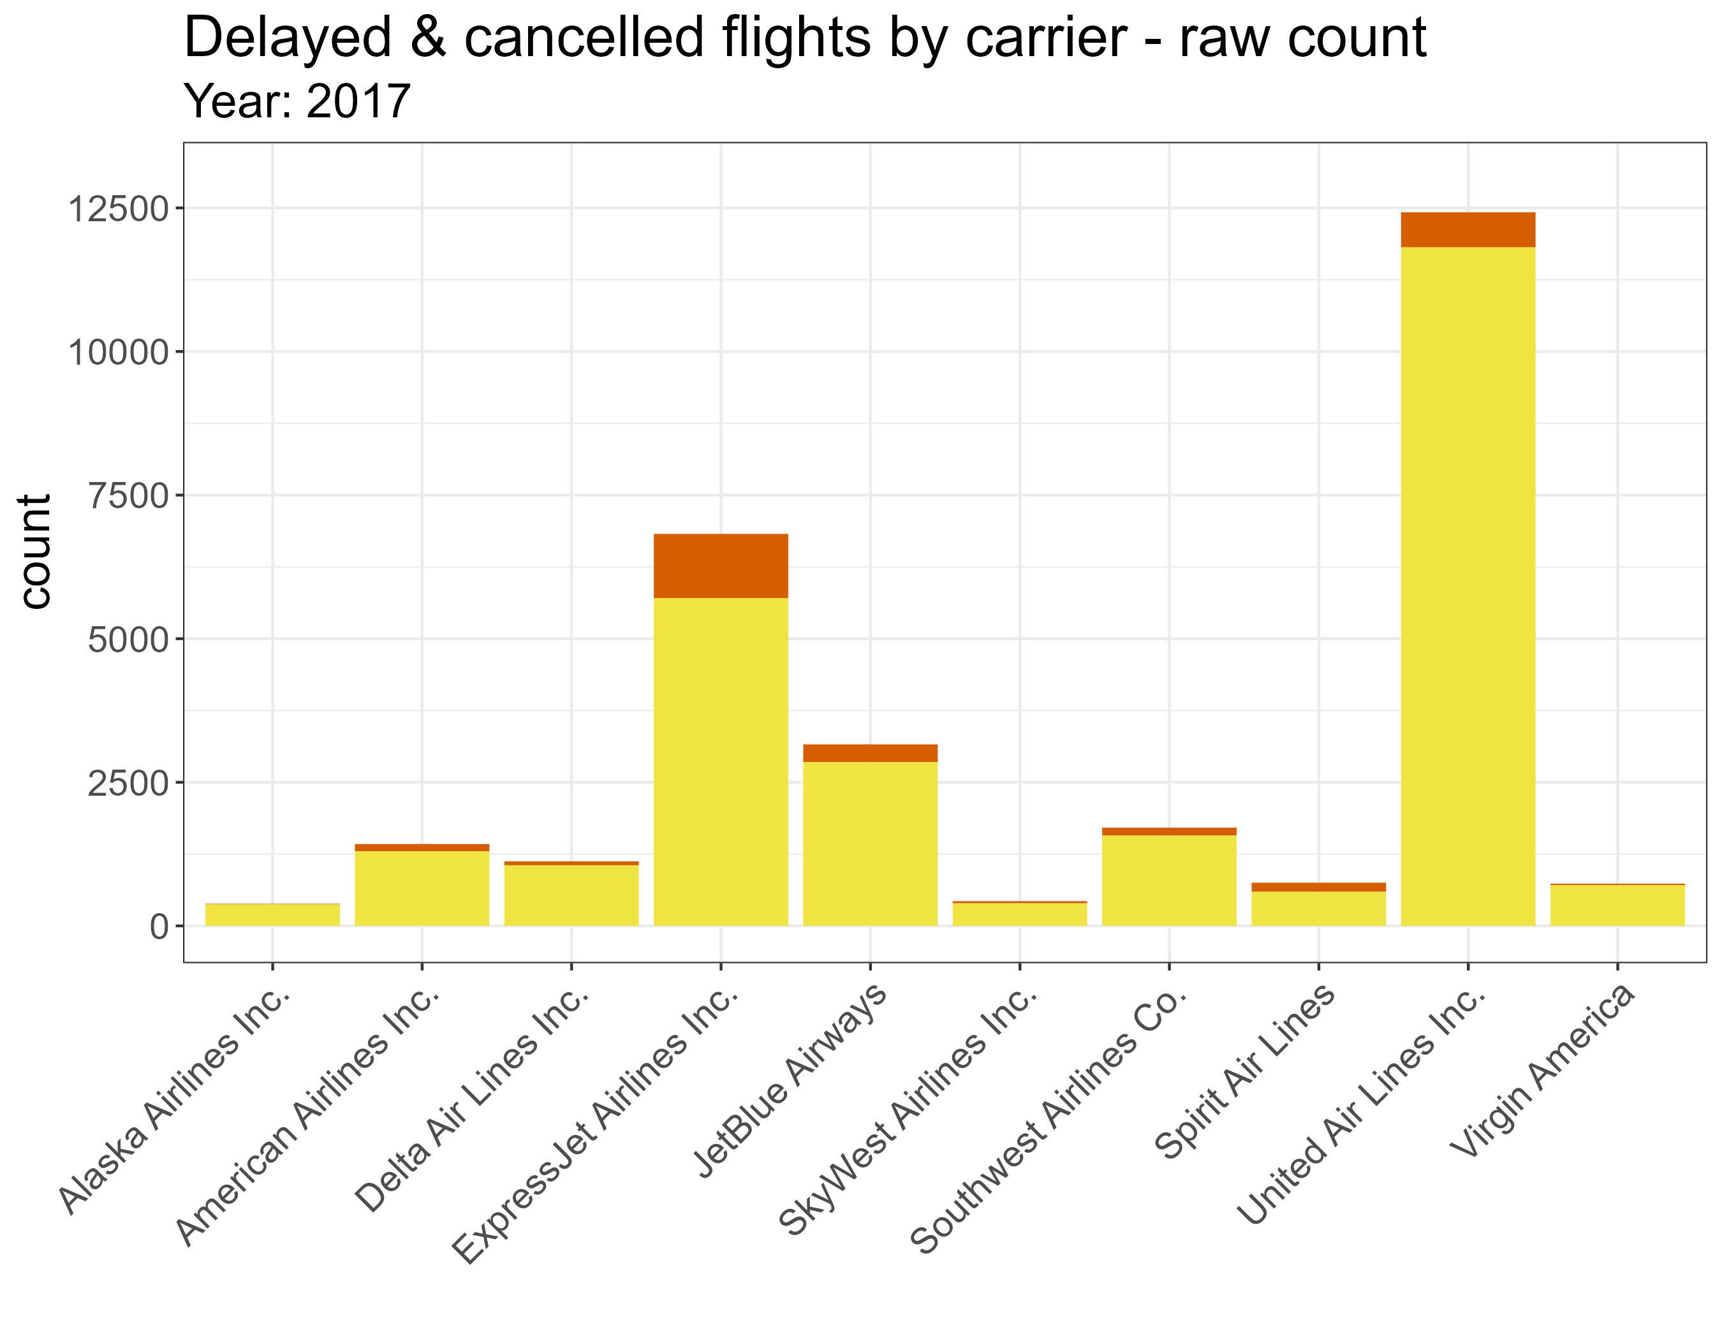
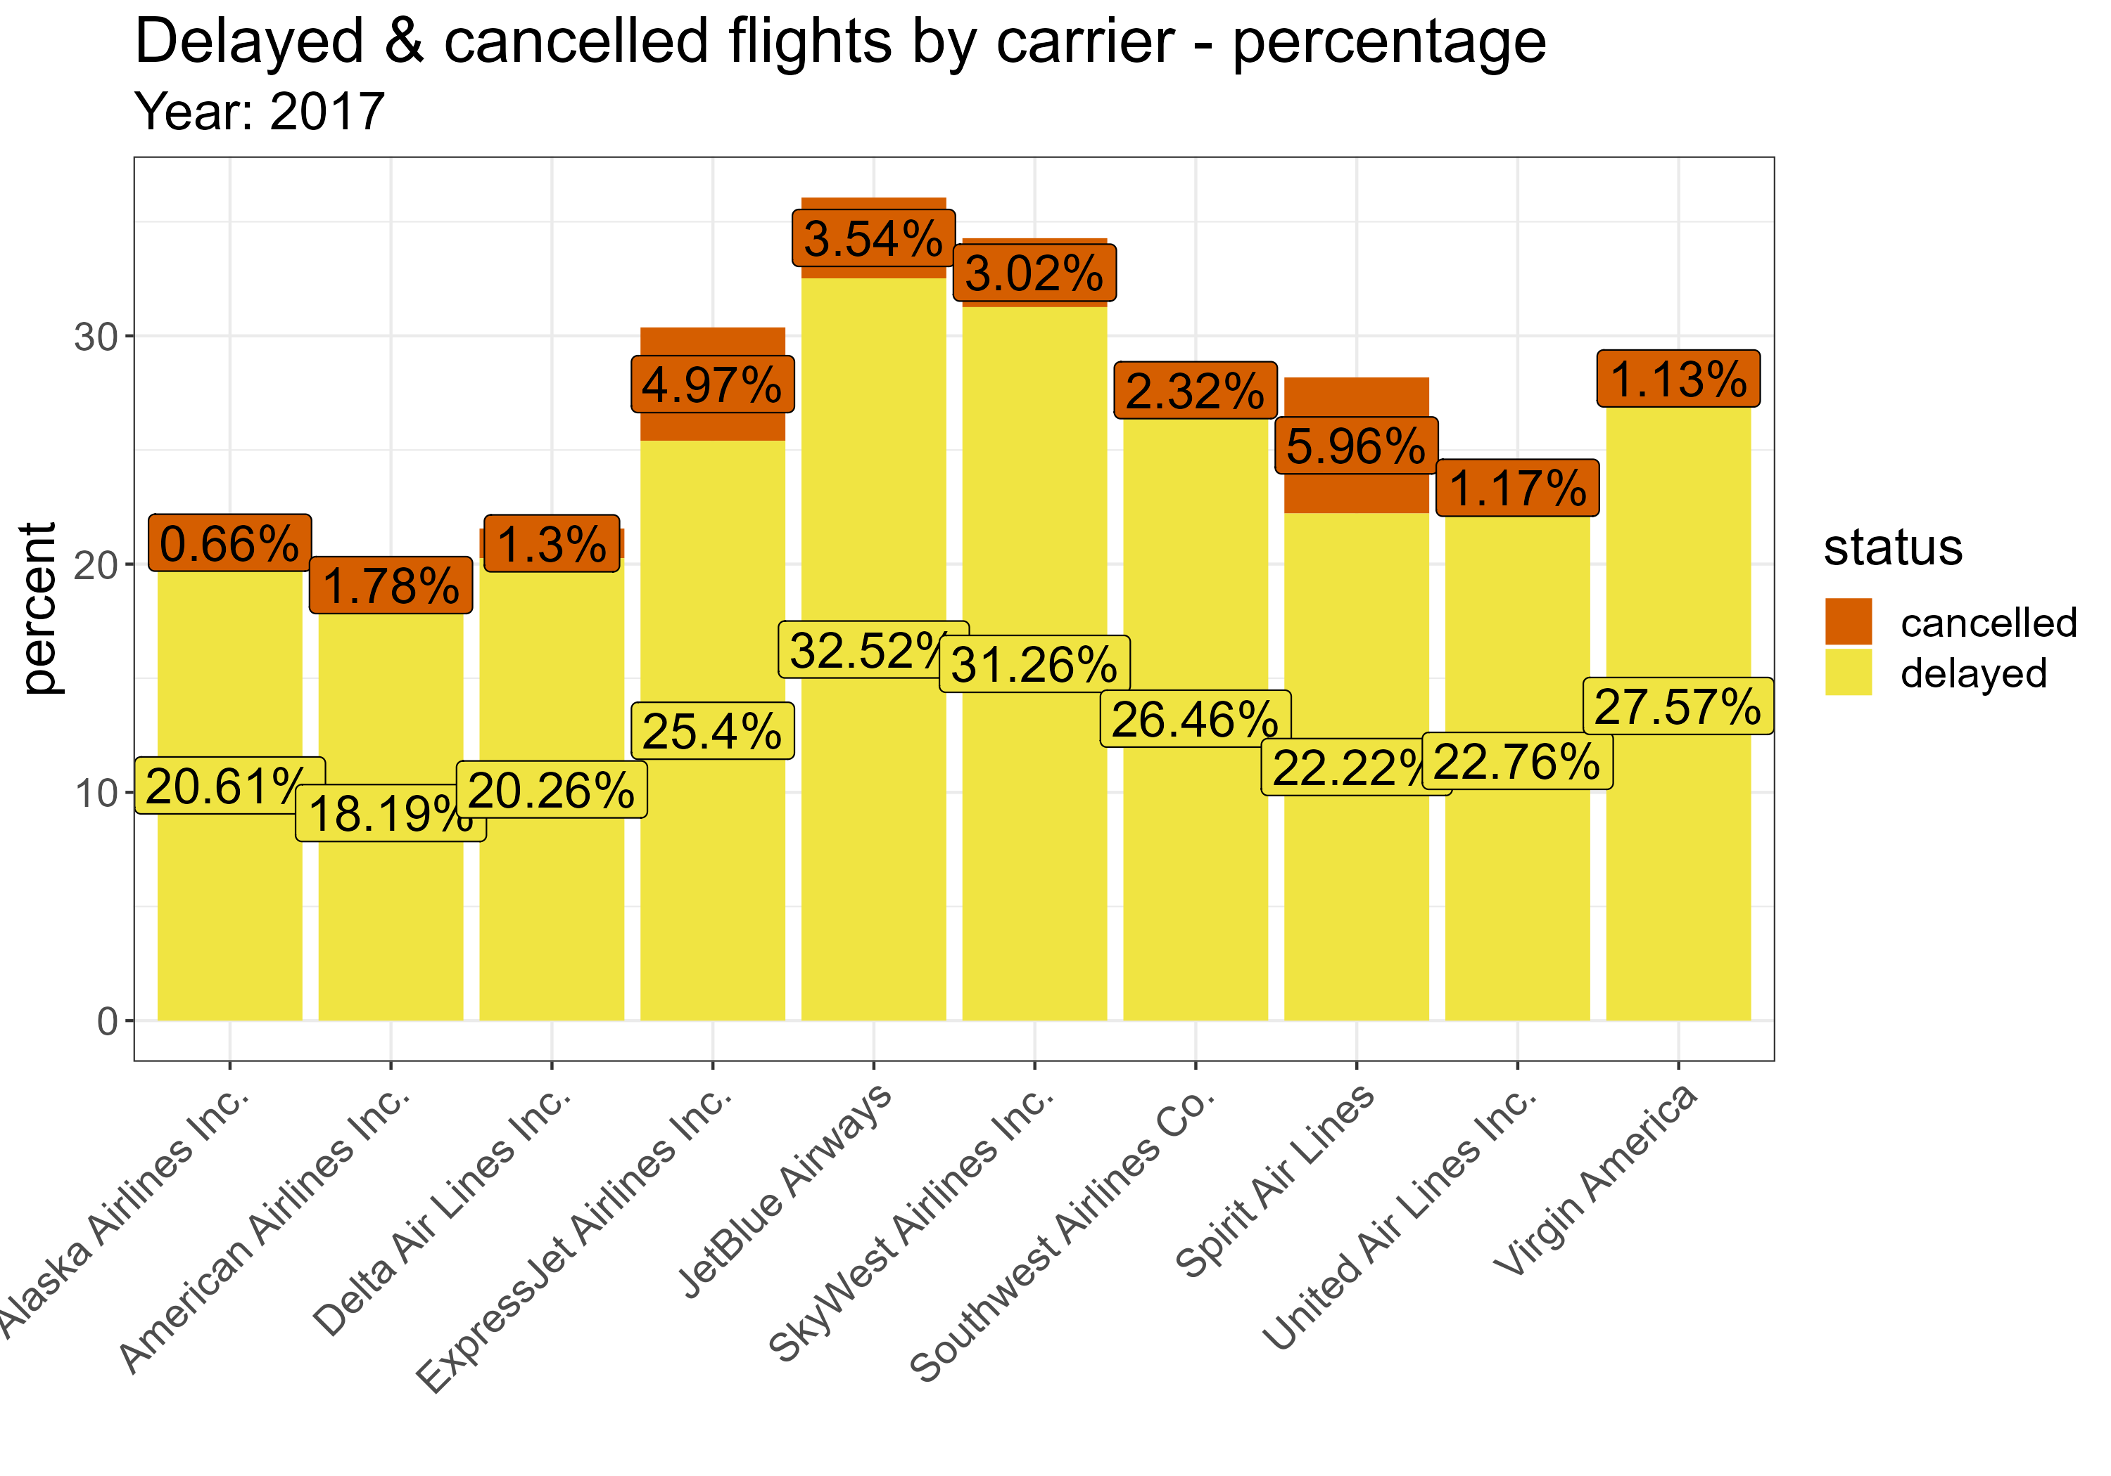
Newark: delays by carrier
United, ExpressJet & JetBlue have highest number of departure disruption
Spirit Air highest percentage of departure cancellations
JetBlue, SkyWest & ExpressJet highest percentage of flights delayed and cancelled (combined)
Notes:
When we look at the raw count of our carrier data, which is the graph on the left, we see that United have the highest number of delays by a large margin.
However, if we look at the percentage of delays and cancellations by carrier, the graph on the right, we see a different narrative. With a more even proportional spread. SpiritAir have the highest percentage of cancellations, with 5.96%.
We see the top 3 offenders in terms of delays and cancellations combined are JetBlue (36%), SkyWest (34%) and ExpressJet (30%)

Slide 9
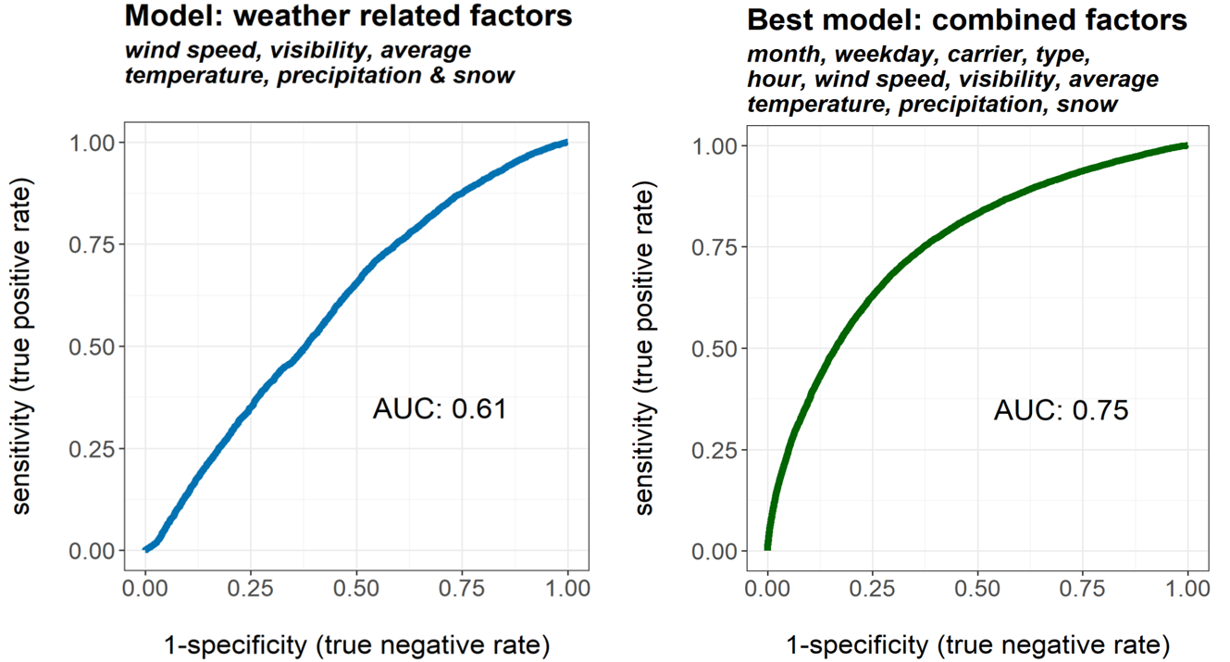
Newark: predicting delayed or cancelled flights
Weather related factors alone do not provide a reliable model
More complex model with variety of factors proves the most reliable - predicting around 75% of flight delays or cancellations
Notes:
Regression models have been built and tested in order to explore in more detail the recipe of factors that influence delays and cancellations for domestic departure flights
The graph on the left shows a model that includes weather conditions only. What we are looking for here is a high AUC, which stands for “area under the curve” number. Our weather AUC of 0.61 tells us that we can correctly predict around 61% of on time, delayed or cancelled flights when we know the wind speed, visibility, average temperature, precipitation and snow measurement.
However, if we add further factors to our model, namely month, weekday, carrier, type of plane and hour alongside the prementioned weather conditions, we find a more accurate model give us a reliable response 75% of the time. This leads to the conclusion that the reason for departure delays and cancellations is more complex than looking at weather factors alone

Slide 10
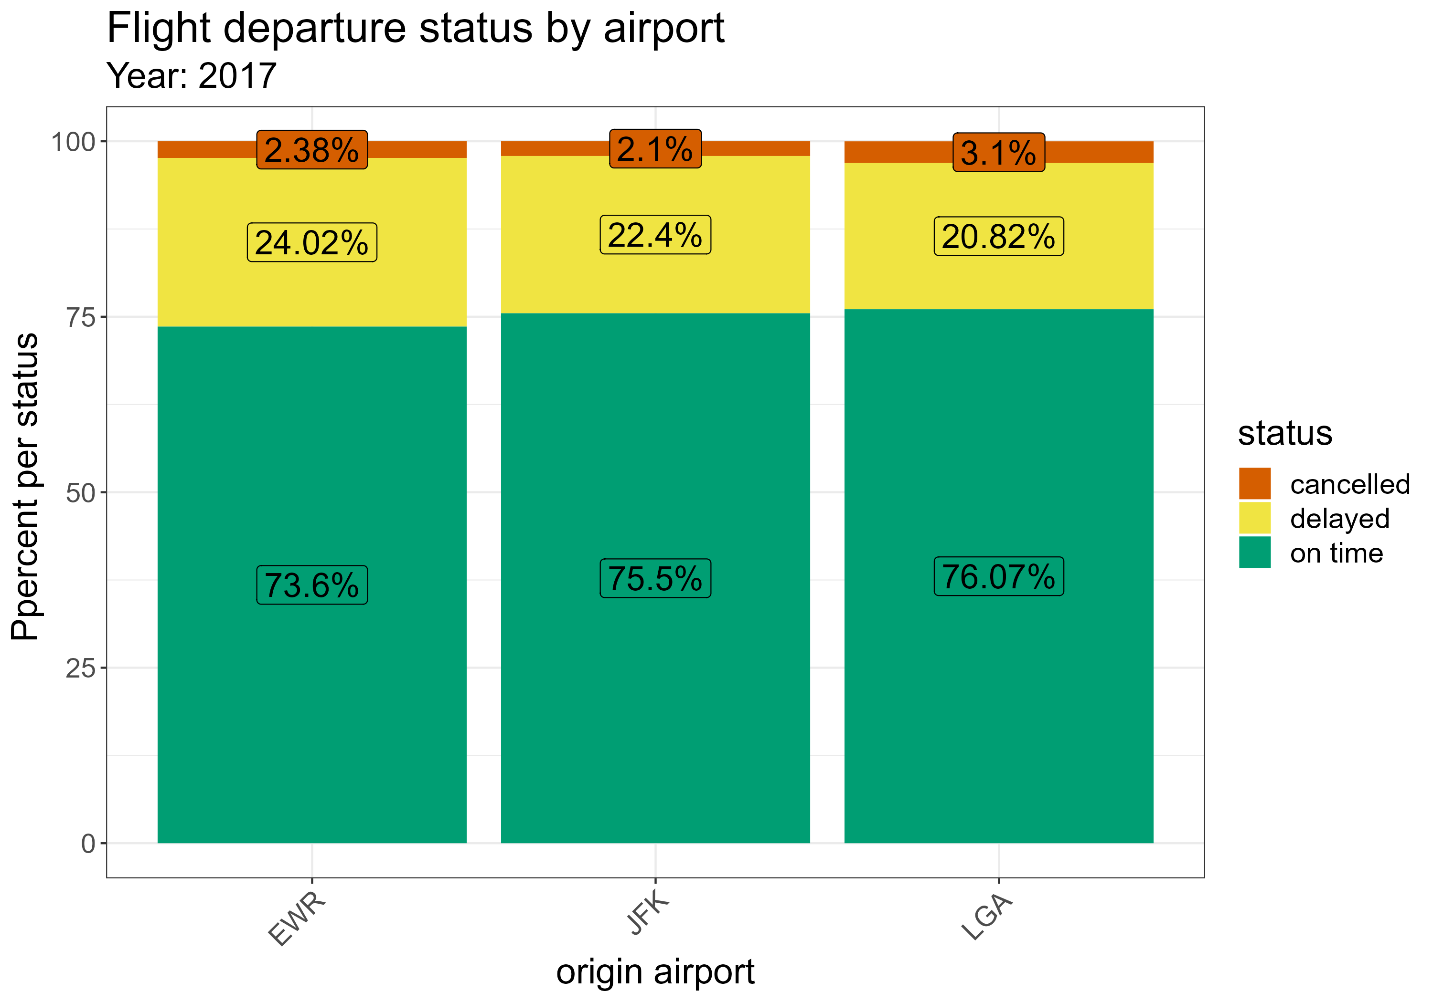
Flight status across NYC serving airports
Newark slightly underperforming with on time flights and higher number of delays, but fewer cancellations than LaGuardia
Roughly similar distribution of on time, delayed and cancelled flights across all 3 airports
Notes:
As part of the brief I also explored the departure status at JFK and LaGuardia airports.
This graph shows the percentage of on time, delayed and cancelled scheduled domestic departures for all three airports across 2017.
We see that Newark is slightly underperforming with on time flights, and a higher number of delays than the other two airports. However, LaGuardia does see more cancelled flights.
Overall, we can say that Newark is performing competitively but there is room for improvement.

Slide 11
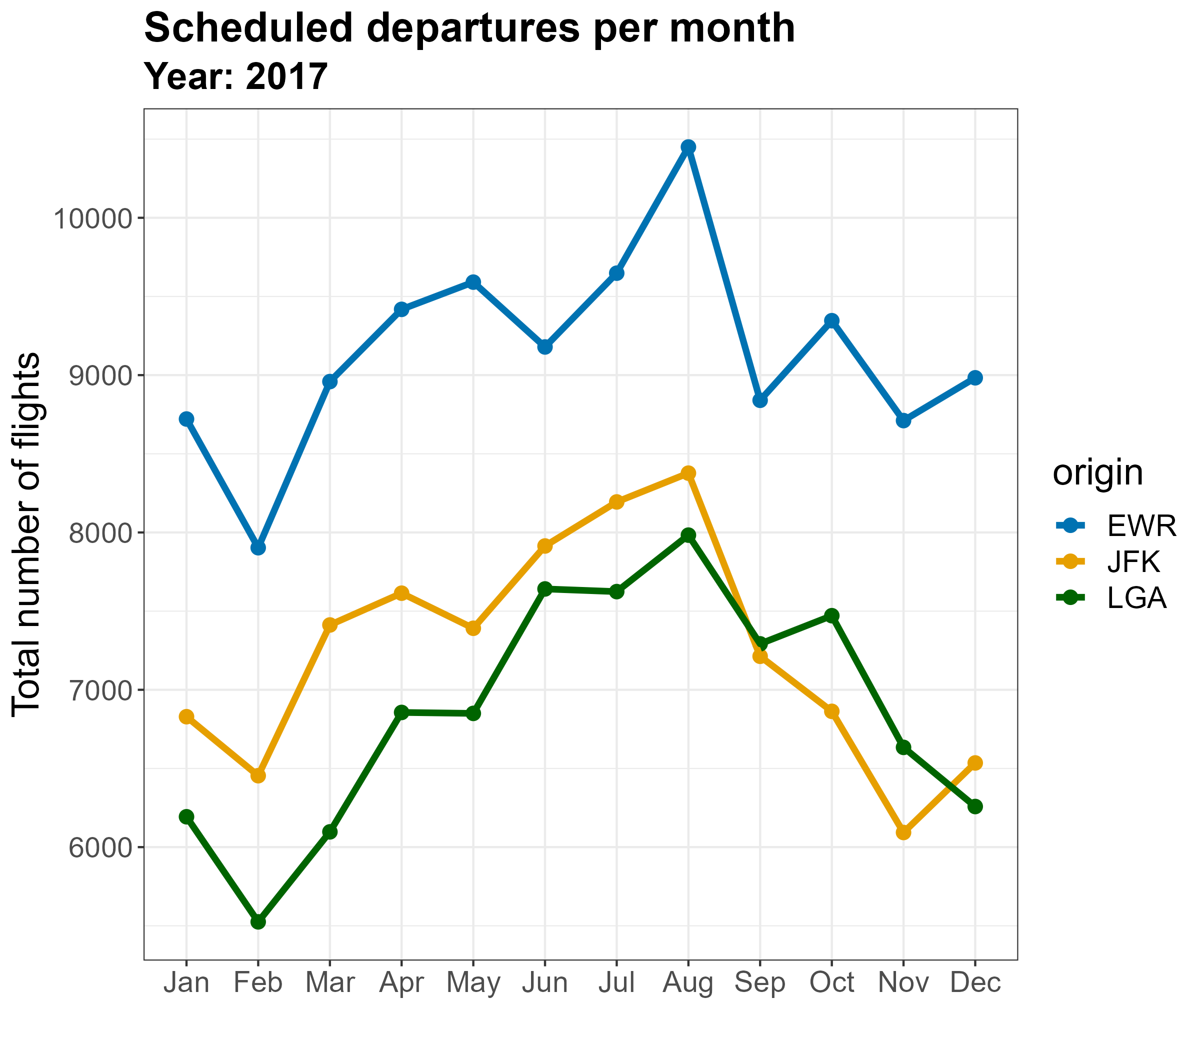
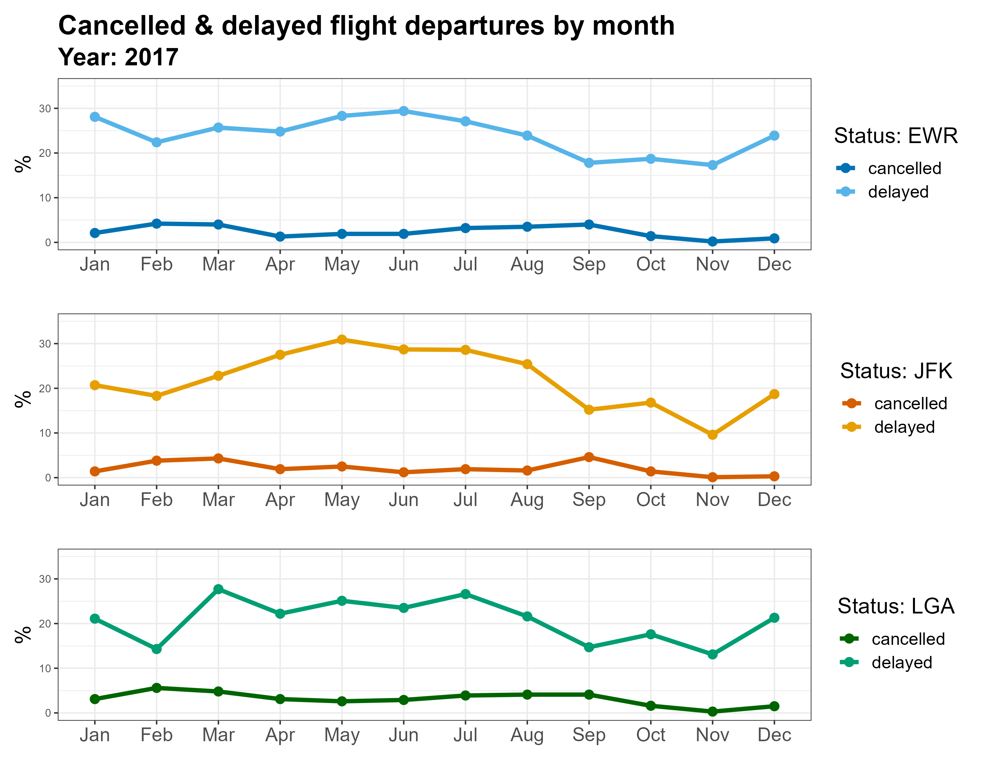
Monthly analysis
Notes:
Continuing to look at performance across the three airports, the graph on the left shows the count of scheduled domestic departures for all three airports throughout each month of 2017.
We see that Newark (identified by the blue line) has a higher number of domestic departures than the other two airports.
Breaking this information down to show the percentage of delayed and cancelled flights across each month of the year, we see fairly similar trends across the board. As mentioned earlier, we see an increase of busy-ness at each airport in the summer months, when the average temperature is higher.
Our data does show some anomalies, for example we see that June is a quiet summer month for Newark, yet it is the month with the higher number of delays. This may be worth further exploration.

Slide 12
Conclusions and recommendations
Weather factors are not the full picture
Technologies to assist planes with in certain whether conditions will help
Other factors to consider:
- balancing out flight schedules more evenly where possible
- investigate specific carrier issues
Further research:
- what causes delays at peak periods? (airport staffing levels, air traffic congestion, etc.)
- conversations with carriers that experience higher % of delays
Notes:
Weather factors can be considered as part of the reason for flight delays or cancellation but there is a bigger picture with varying factors to consider
May wish to consider technologies to assist planes in low visibility and when there is more than 50mm snow
Other factors to consider include the day and month of departures as these are typically indicative of busy-ness:
consider balancing out flight schedules more evenly where possible
further research needed to ascertain the specific causes of delays at busier times
Conversations with carriers who experience higher percentage of delays and cancellation needed to understand the specific issues the company/planes experience

