Slide 1
Investigating
flight delays at Newark Airport
Karen Gibson
CodeClan Final Data Project
May 2023

Slide 2
Project Brief
Investigate the effect of weather on departure delays at
Newark airport, specifically:
the impact of weather conditions on departure delays
the types of weather conditions that cause departure delays
Further investigation:
other factors that cause departure delays
how Newark compares to other airports servicing New York city

Slide 3
Data
The following datasets have been used:
flights – information on departures from Newark (EWR), JFK (JFK) and LaGuardia (LGA) for 2017
weather – hourly weather conditions for each airport York throughout 2017
airlines – information on the carrier airlines
planes – information on the model specifications and manufacturing data
Data ethics:
8 data risk zones have been considered
no personalised passenger data
no data that could lead to bias or any other negative or discriminatory factors

Slide 4
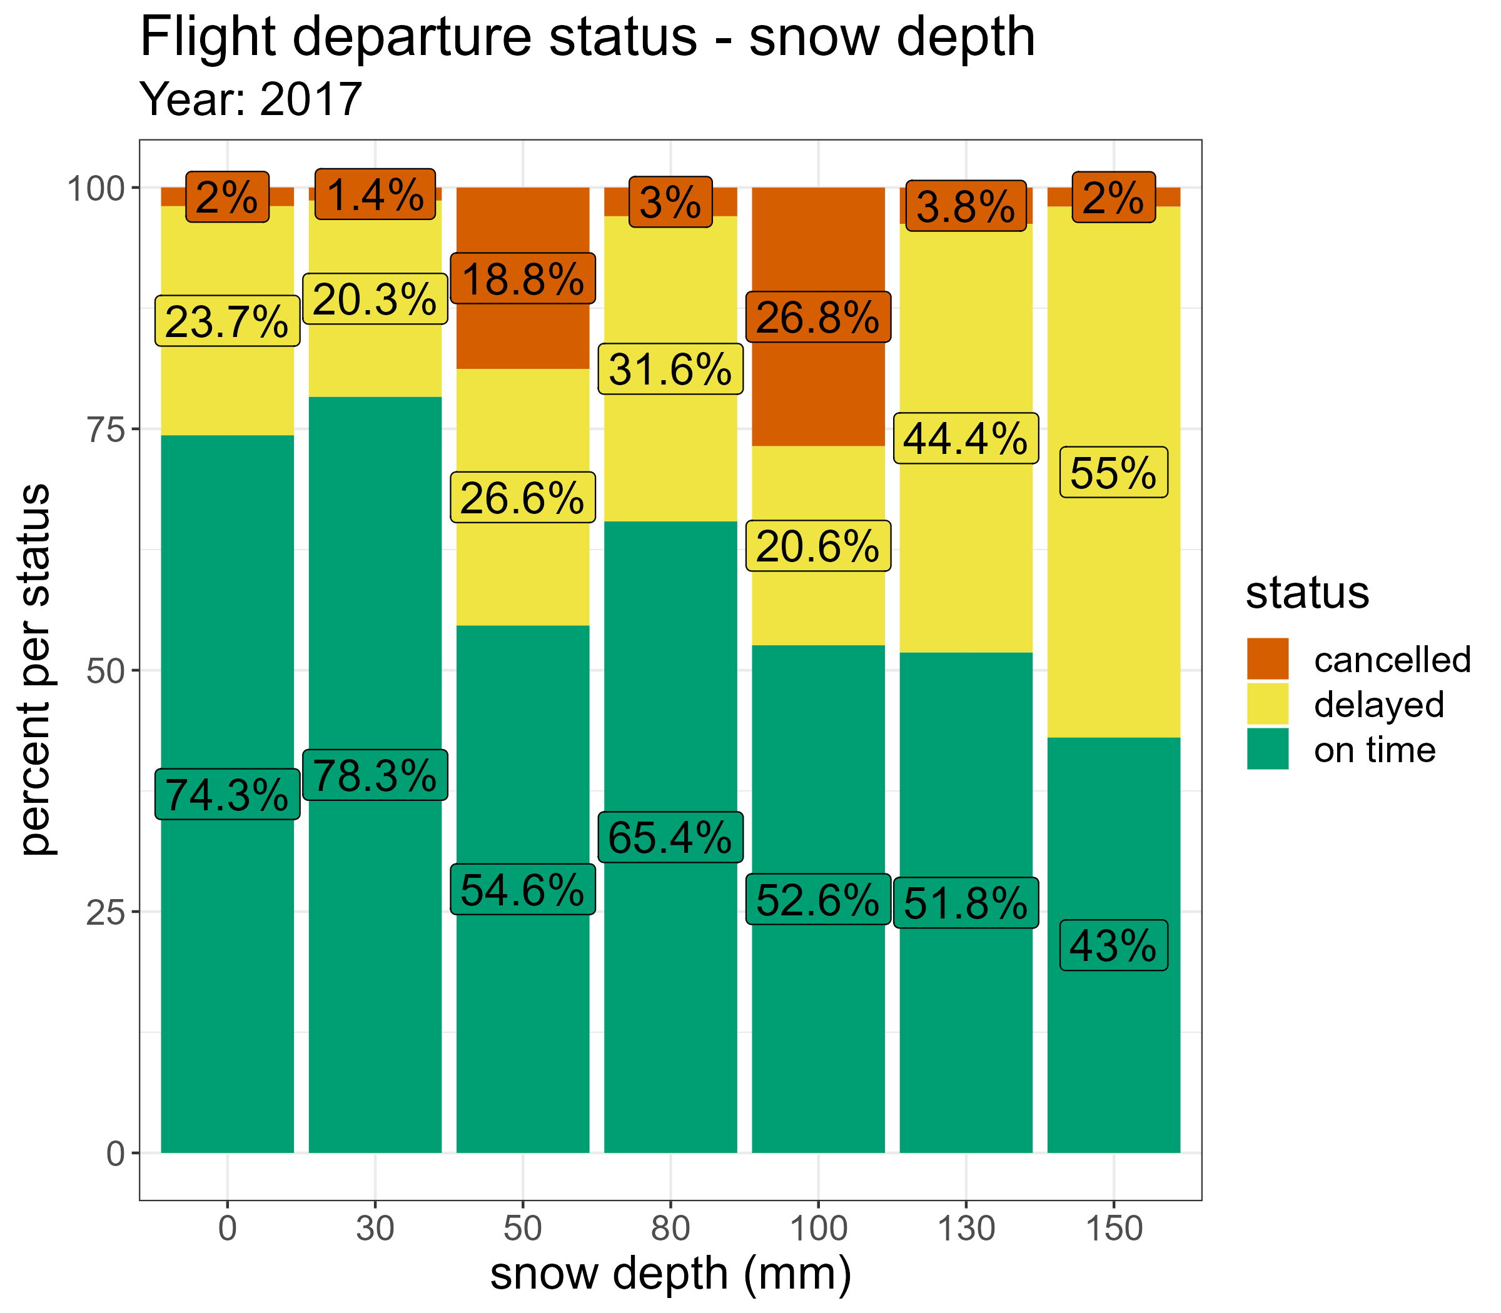
Newark: flight status and weather
Departure flights impacted when snowfall hits 50mm
Higher snowfall leads to higher chance of flight delays or cancellations

Slide 5
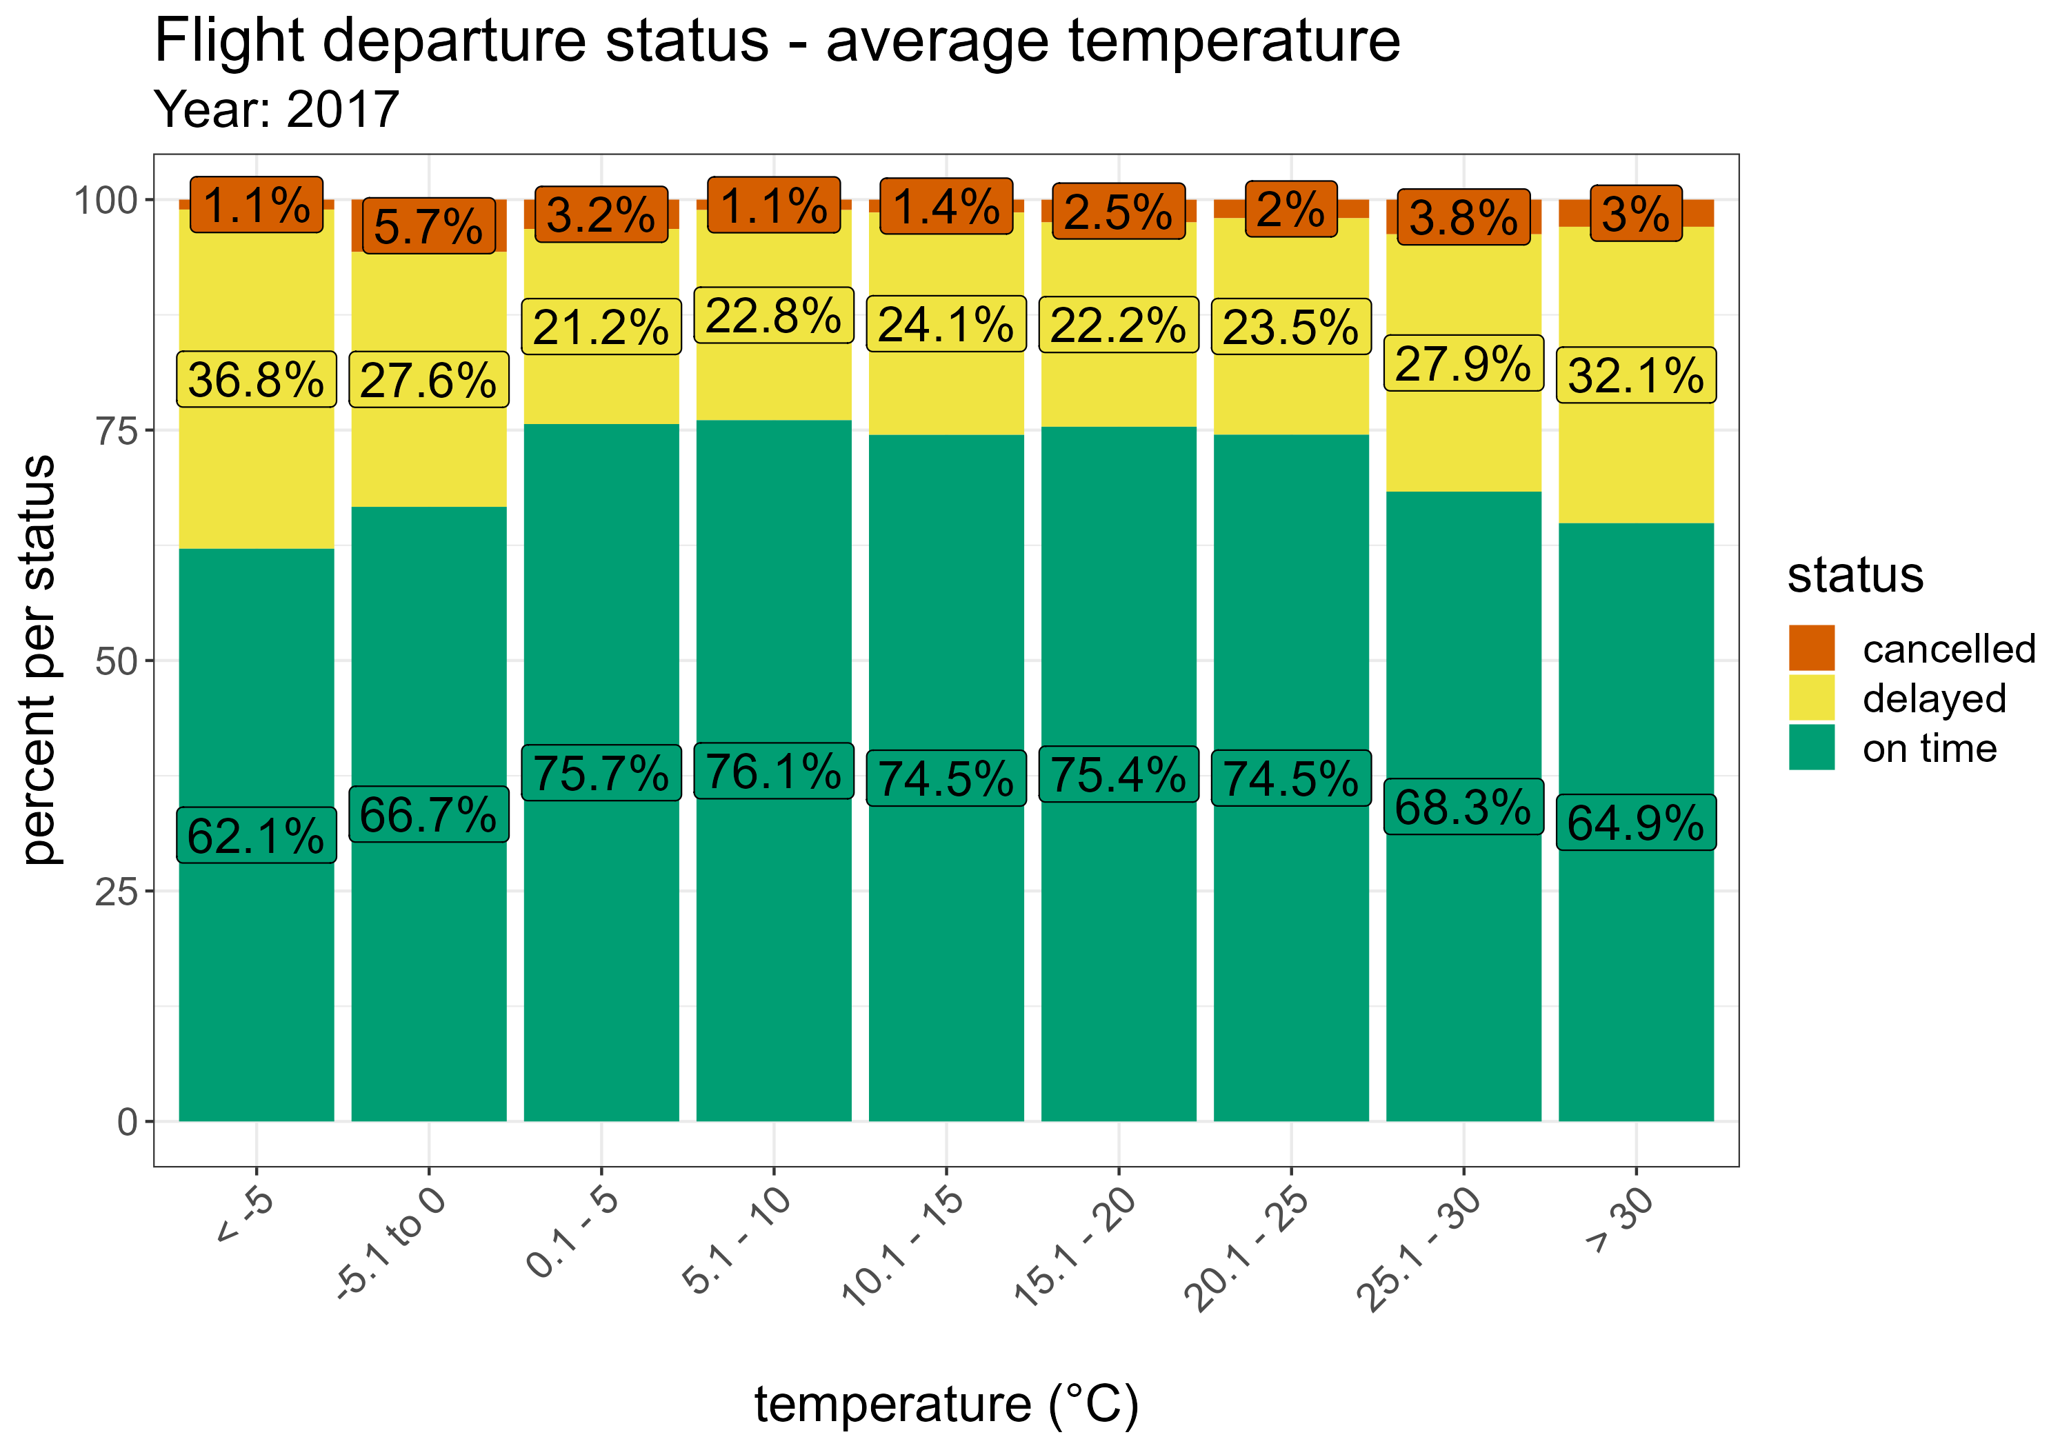
Newark: flight status and weather
Average of around 75% flights depart on time within temperature range 0.1°C - 25°C
More flight delays when temperature at 0°C or below and 25.1°C or above
Lower temperature correlates with likelihood of snow
Higher temperatures correlate with months where airport has highest number of scheduled departures

Slide 6
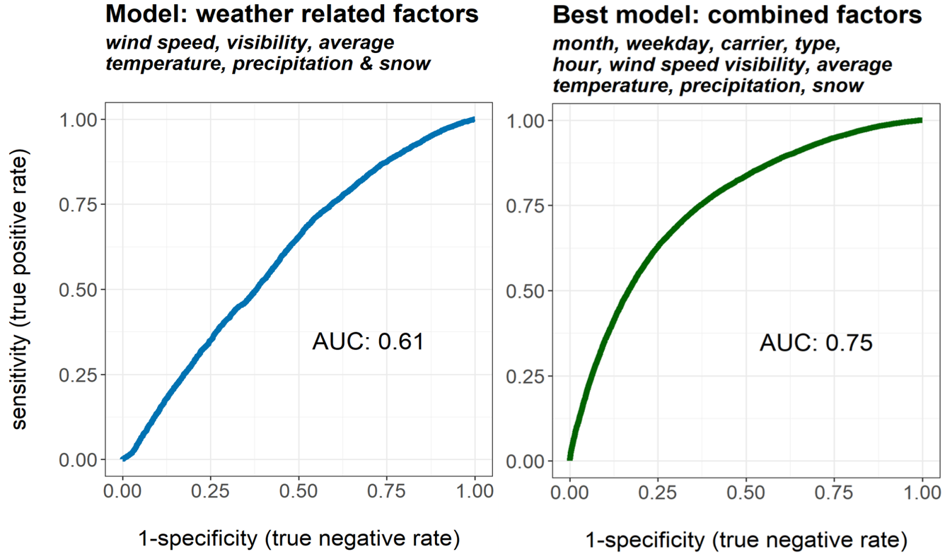
Newark: predicting delayed or cancelled flights

Slide 7
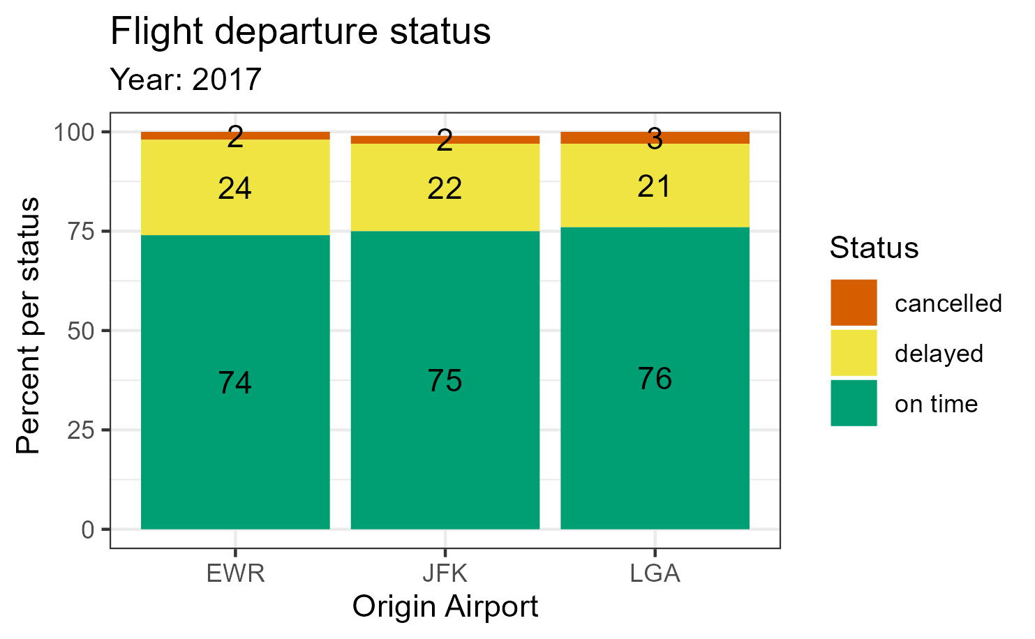
Flight status by origin airport
Newark slightly underperforming with on time flights and higher number of delays, but fewer cancellations than LaGuardia
Roughly similar distribution of on time, delayed and cancelled flights across all 3 airports

Slide 8
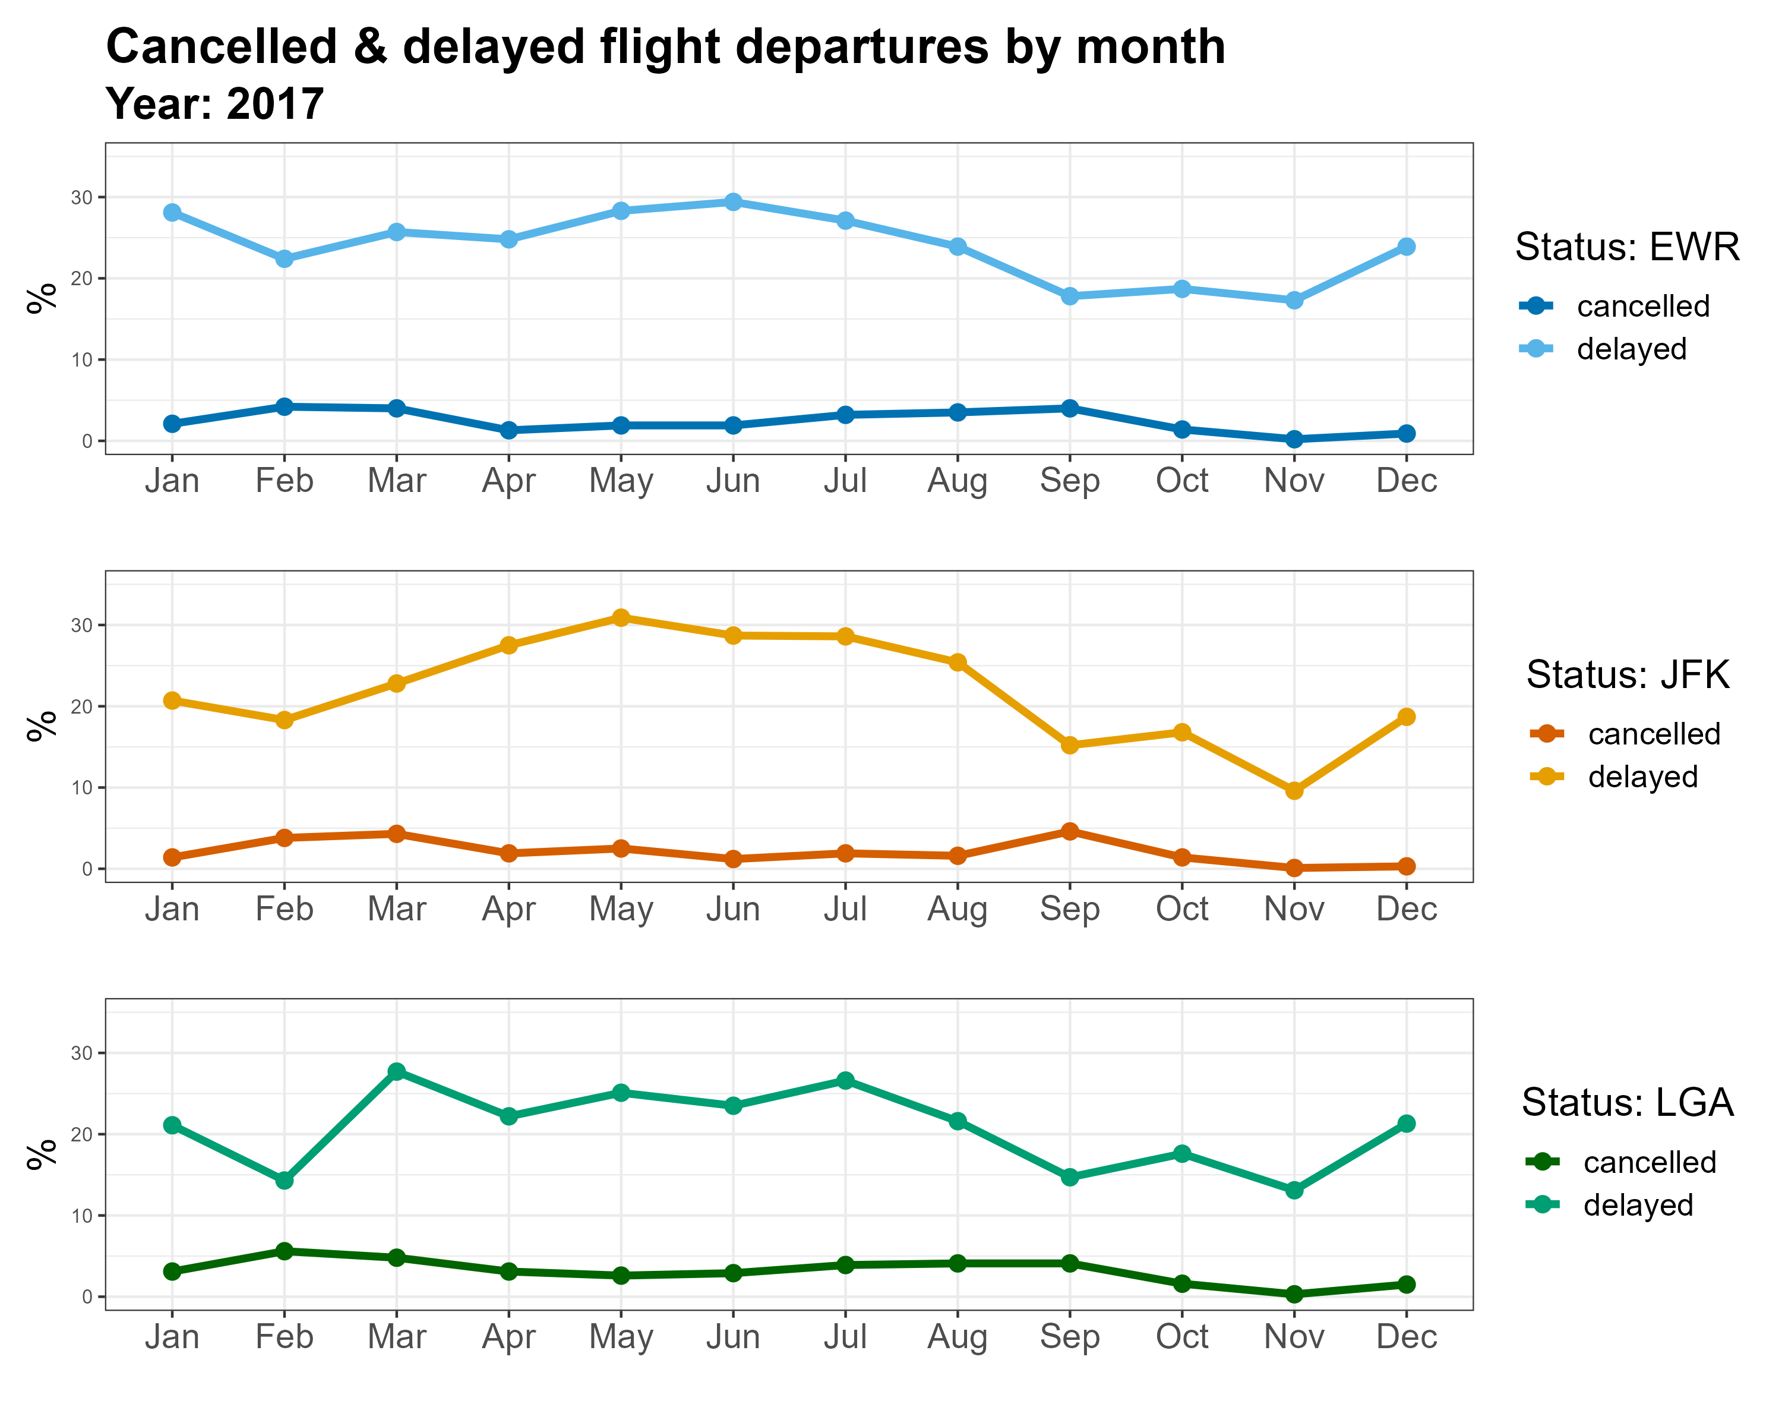
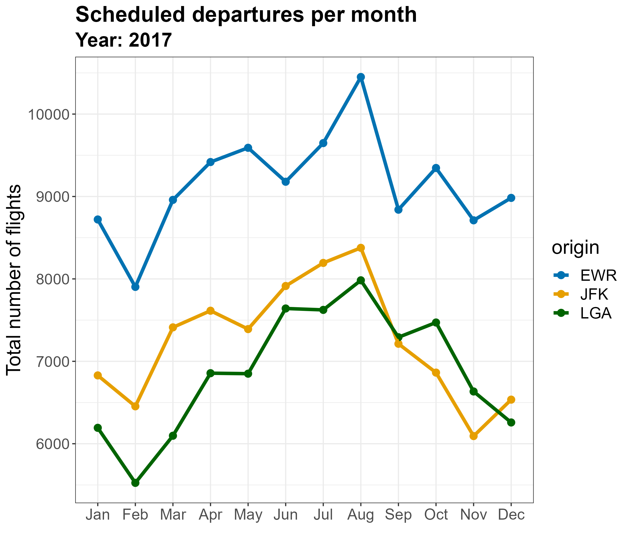
Monthly analysis

