Slide 1
Gold Price Prediction
Capstone project
Presented by:
Karen Huang
Bank Associate/
Data Scientist

Slide 2
Bio
Master of Profession Accounting / Bachelor of International Trade
Working experience in banking/financial markets and taxation
Join IOD Data Science course since Feb. 2022 (6 months)
No programming background
Transformable skills: computer, problem solving, communication, stakeholder management skill and strategic thinking
To achieve business goals by making decision with information
data vs information
increasing accuracy on data analysis to make better decision

Slide 3
Project Context
Commodity market
Gold price prediction
Buyer of gold wishes price down and seller of gold wishes price up
Previous works:
gold-price-prediction-dataset – Kaggle
gold-price-prediction-with-pca-and-regression – Kaggle
gold-price-prediction-with-visualisation-0-99-r2 - Kaggle

Slide 4
Define
Business aspects
Gold price goes up or down?
Data science aspects
Dataset: FINAL_USO.csv - Kaggle
80 columns (features) and 1718 rows
Target variable (y) = Adjusted Close
Features (X) = High, Low, Open and Volume
Stakeholder | Business value
Government | Stable currency value, economic sanction
Exchangers | Speculation and arbitrage
Jewelers | Stable price
Traders | Speculation and arbitrage

Slide 5
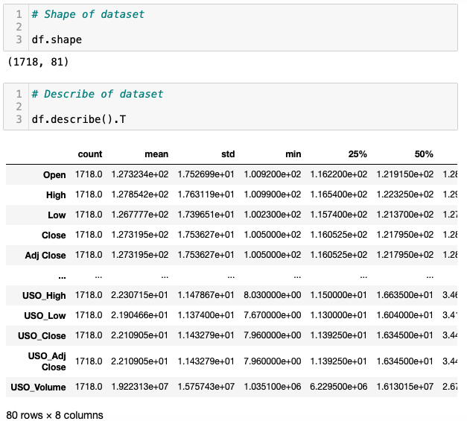
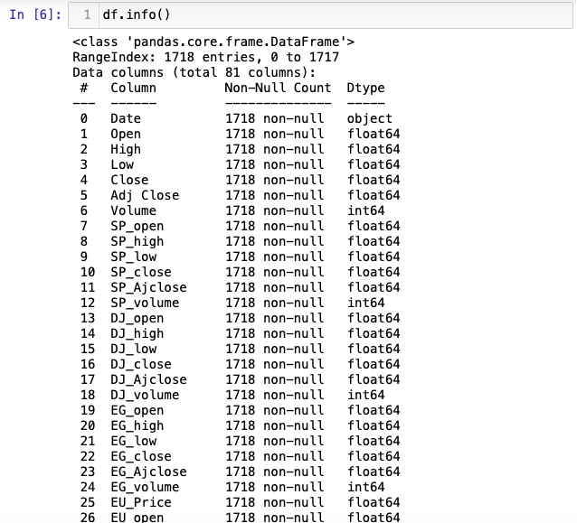
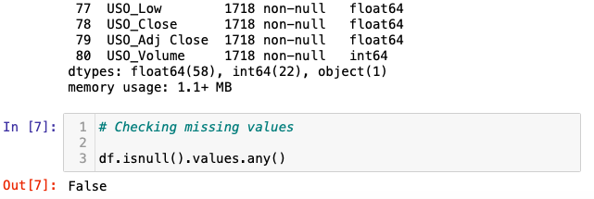
Data exploration, analysis and visualization

Slide 6
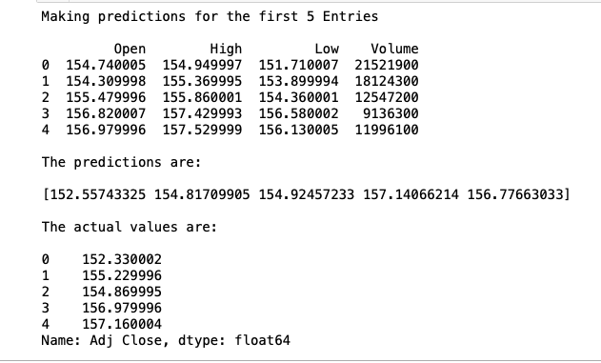
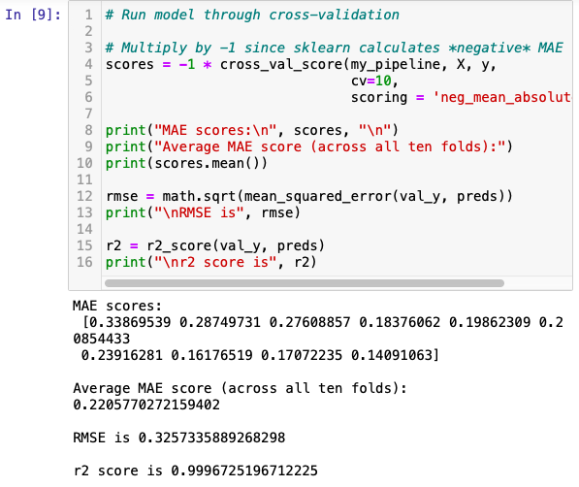
Linear Regression & Cross Validation

Slide 7
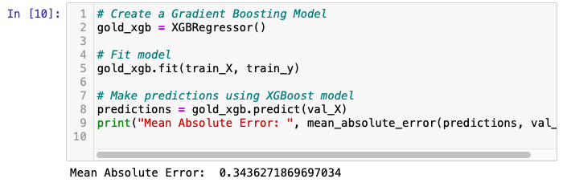
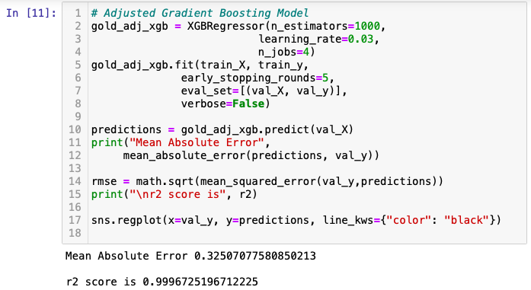
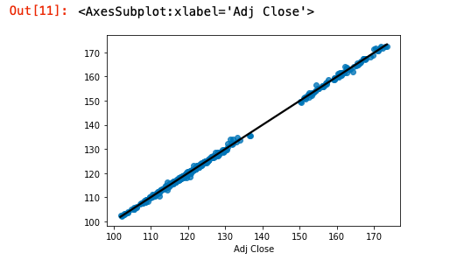
XGBoost

Slide 8
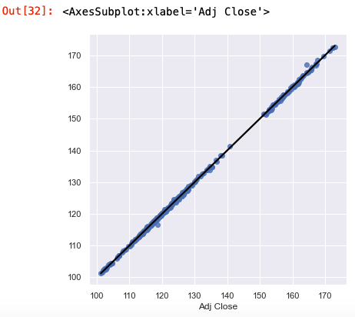
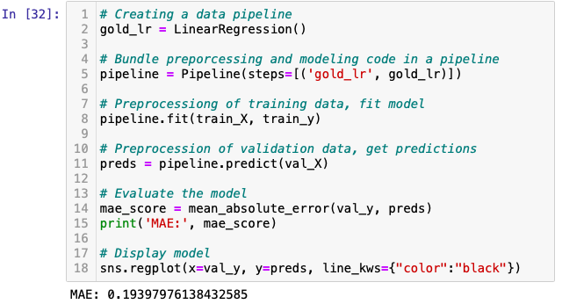
Data Pipeline

Slide 9
Applying data science in gold price prediction
1.2
1.1
Context
Commodity Markets
Central banks
Jewelers
Traders
1
8
2
Predict gold price
7
Business answer
3
6
Data answer
Data question
4
9
5
Data Science process
Data
Solution
Ask a question
Explore data
Model and validate
Communicate
Implement

Slide 10
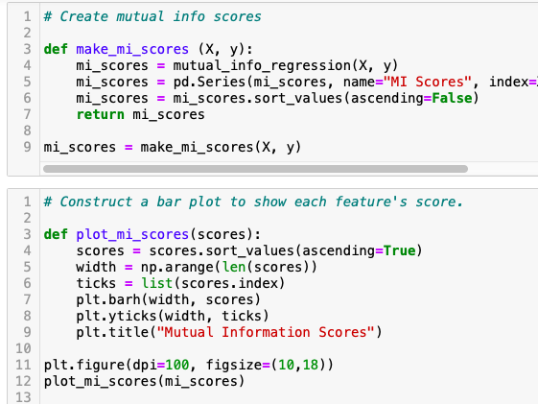
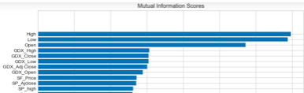
Feature Engineering

Slide 11
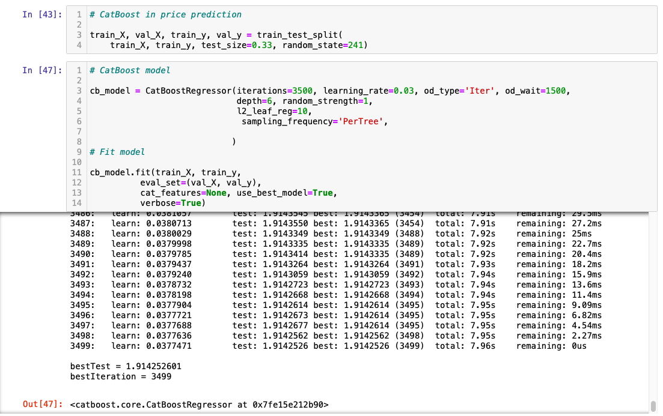
CatBoost

Slide 12
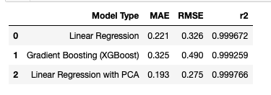
Summary, conclusions and next steps
Three features are highly corelated with adjusted close price
Adding more features doesn’t improve significantly

