Slide 1
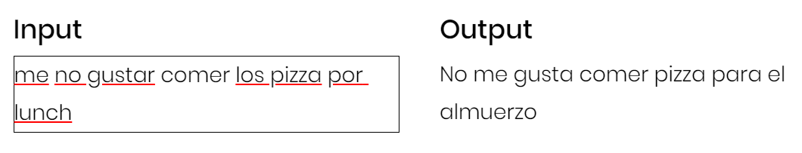
Karenina IO
Write better in English, Spanish, French, German, Italian, Chinese, Japanese & more!

Slide 2
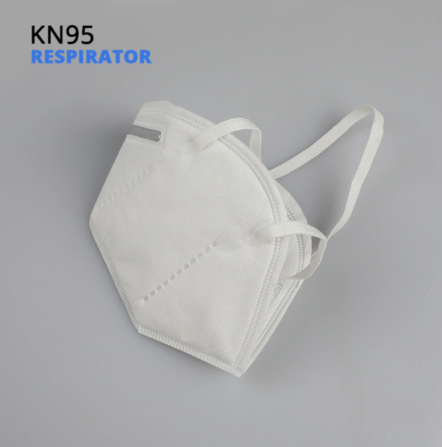

Slide 3
