Slide 1
Activity – Activities (Explicit)
An application to illustrate the activity life cycle
This application consists of two activities that call each other
Activities are referenced explicitly by naming their Java class objects
If an activity is called, then it is pushed onto the stack to become the main activity
Exiting main activity results in that acitivity being popped off the stack.
Each activity has its own lifecycle and Android will call callbacks at the appropriate moments
LoggingAcitivty: a helper class to demonstrate activity lifecycle:
Overrides the activity lifecycle methods and logs appropriate messages.

Slide 2
The app has two activities:
BlueActivity
Main activity
An intent has to be constructed to call YellowActivity
On press of button the YellowActivity will be called
YellowActivity
BlueActivity is pushed into the background
Pressing a button returns to BlueActivity
A call to finish() ends the current activity and returns to the previous one on the activity stack
Leaving YellowActivity – returns to BlueActivity
onActivityResult() of BlueActivity will be called
A return value in the form of an Intent can be returned
Back button has to be handled by overriding onBackPressed()

Slide 3
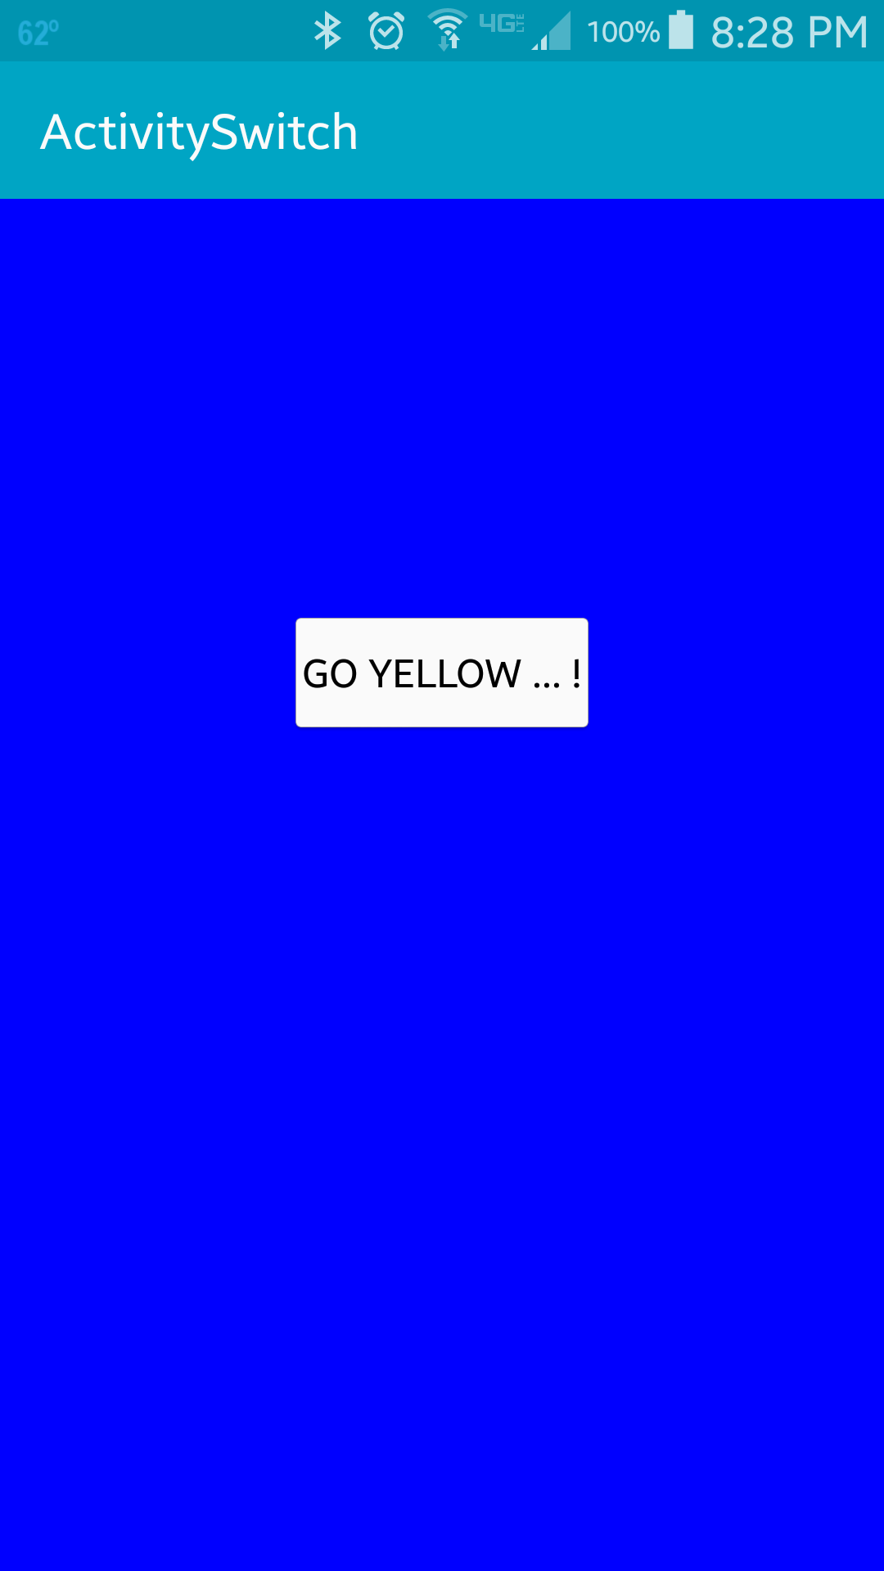
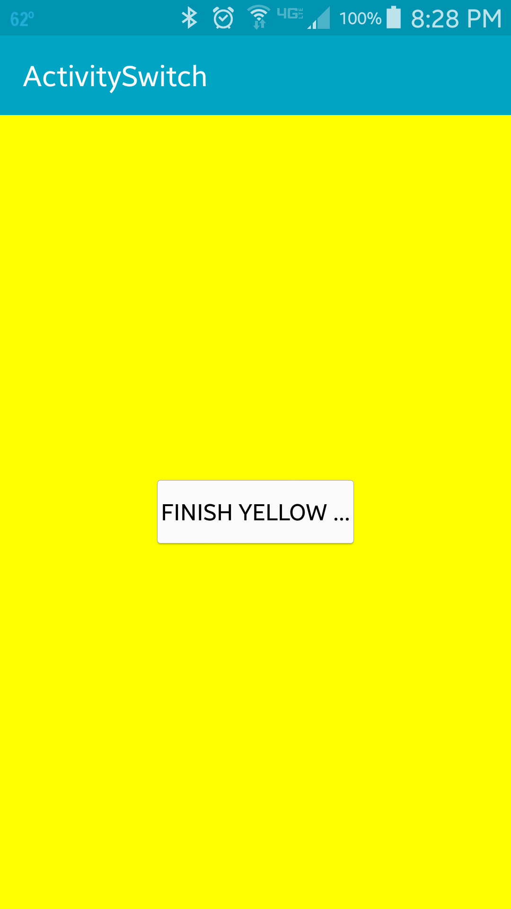
On click of button in BlueActivity, the YellowActivity will be pushed on the Stack
On click of button in YellowActivity, YellowActivity will be popped out of the stack and returned back to BlueActivity.

Slide 4
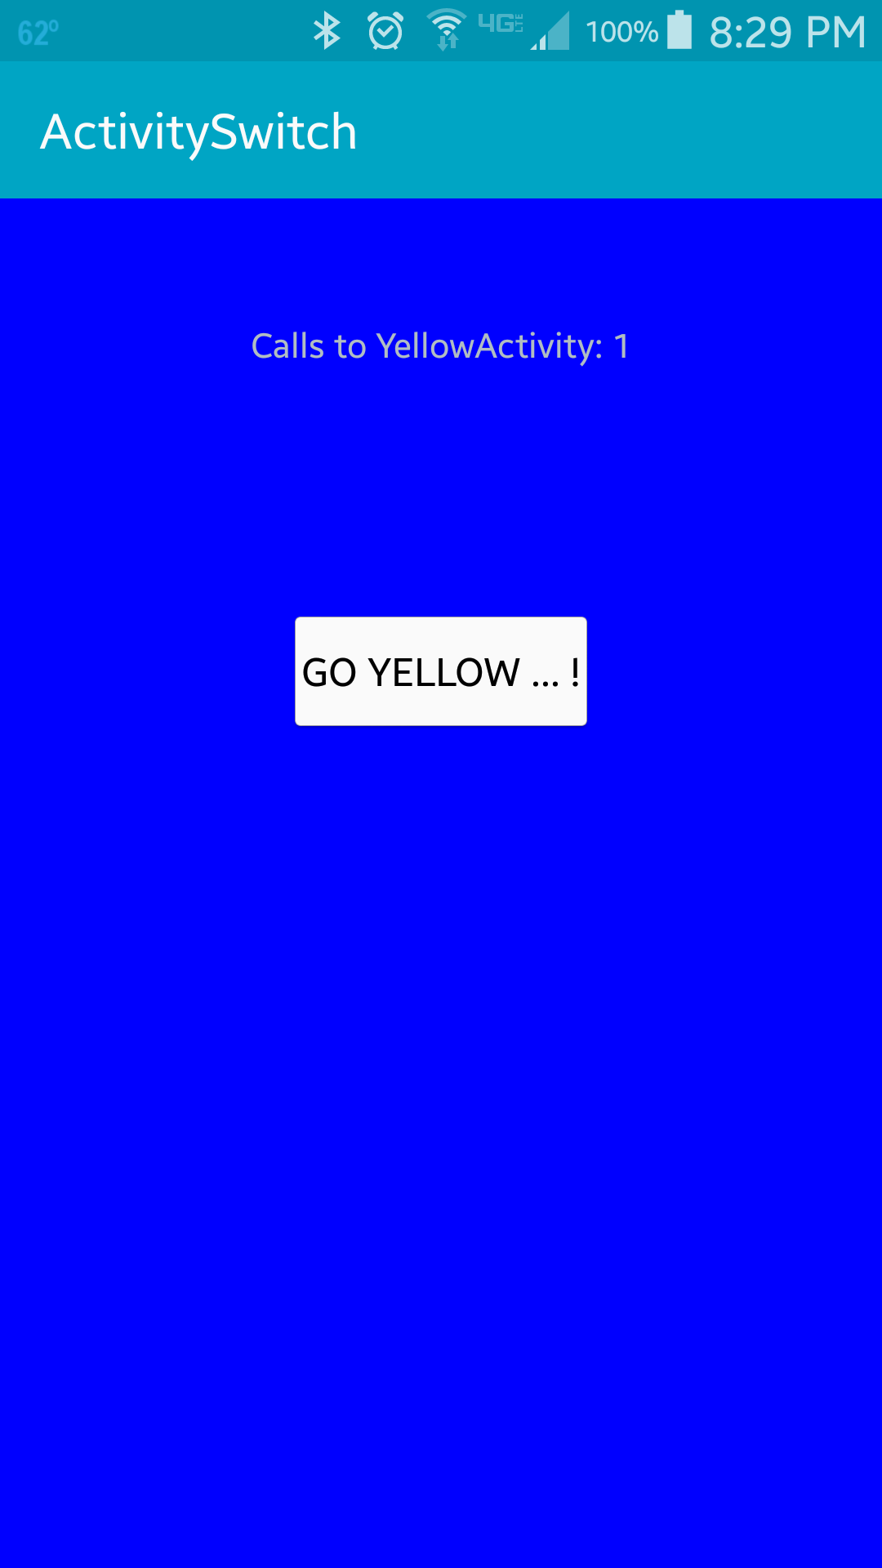

The YellowActivity keeps track of the number of times the activity was called. This is returned to the blue activity in the form of an Intent which is displayed in the TextView of the BlueActivity.

Slide 5
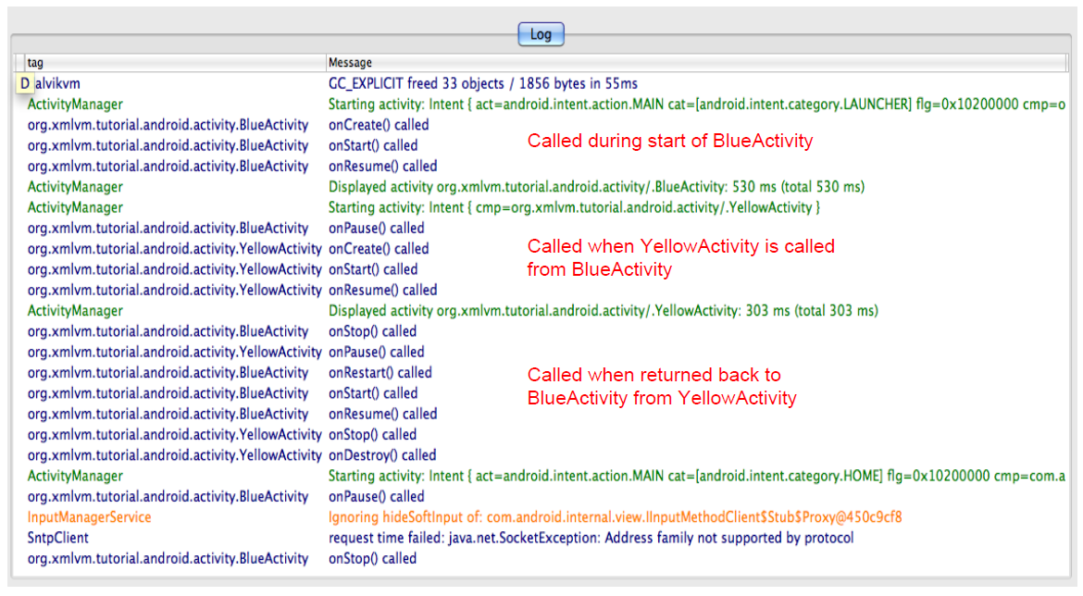
When running this application, the logging output can be observed (using DDMS) to understand the activity lifecycle methods that are invoked by Android.

Slide 6
References
Activity
Activity lifecycle
Intent

Slide 7
Exercise
Add a GreenActivity that can be reached via a button from the YellowActivity. No data needs to be passed between the YellowActivity and the GreenActivity.

