Slide 1
Android - Alerts
App shows three different kinds of alerts: AlertDialog, Toast and Snackbar
AlertDialog:
Modal dialog that can have one or more buttons.
Users have to explicitly acknowledge by pressing one of the buttons.
Toast:
Short text message that is displayed for a few seconds.
Toasts are automatically removed
Snackbar
Short text message that can be displayed for a few seconds or indefinitely.
Snackbars are automatically removed unless LENGTH_INDEFINTIE is used.
If LENGTH_INDEFINTIE is used, snackbars must be removed by an Action
Unlike Toasts, Snackbars can have Actions

Slide 2
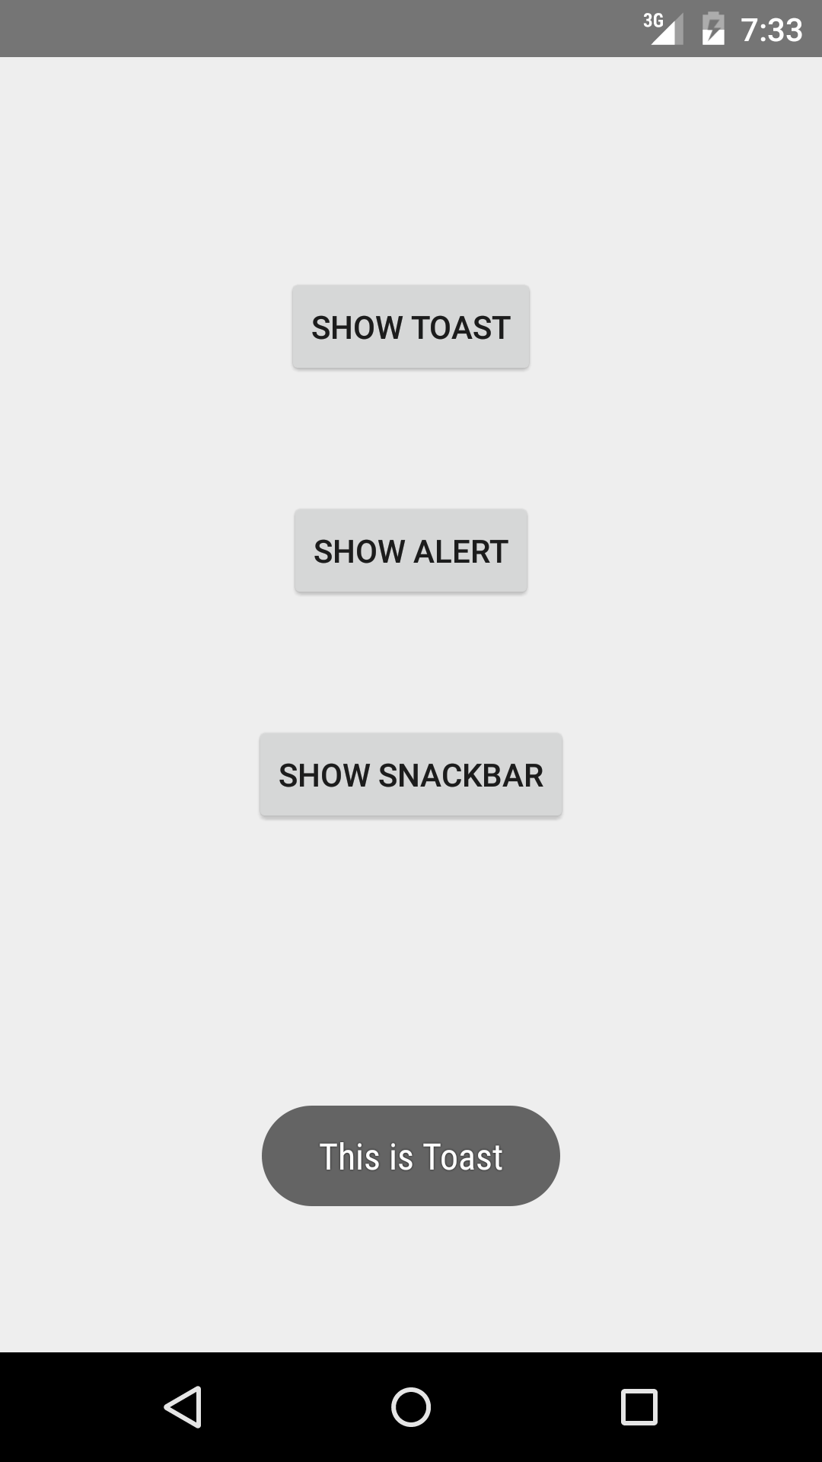
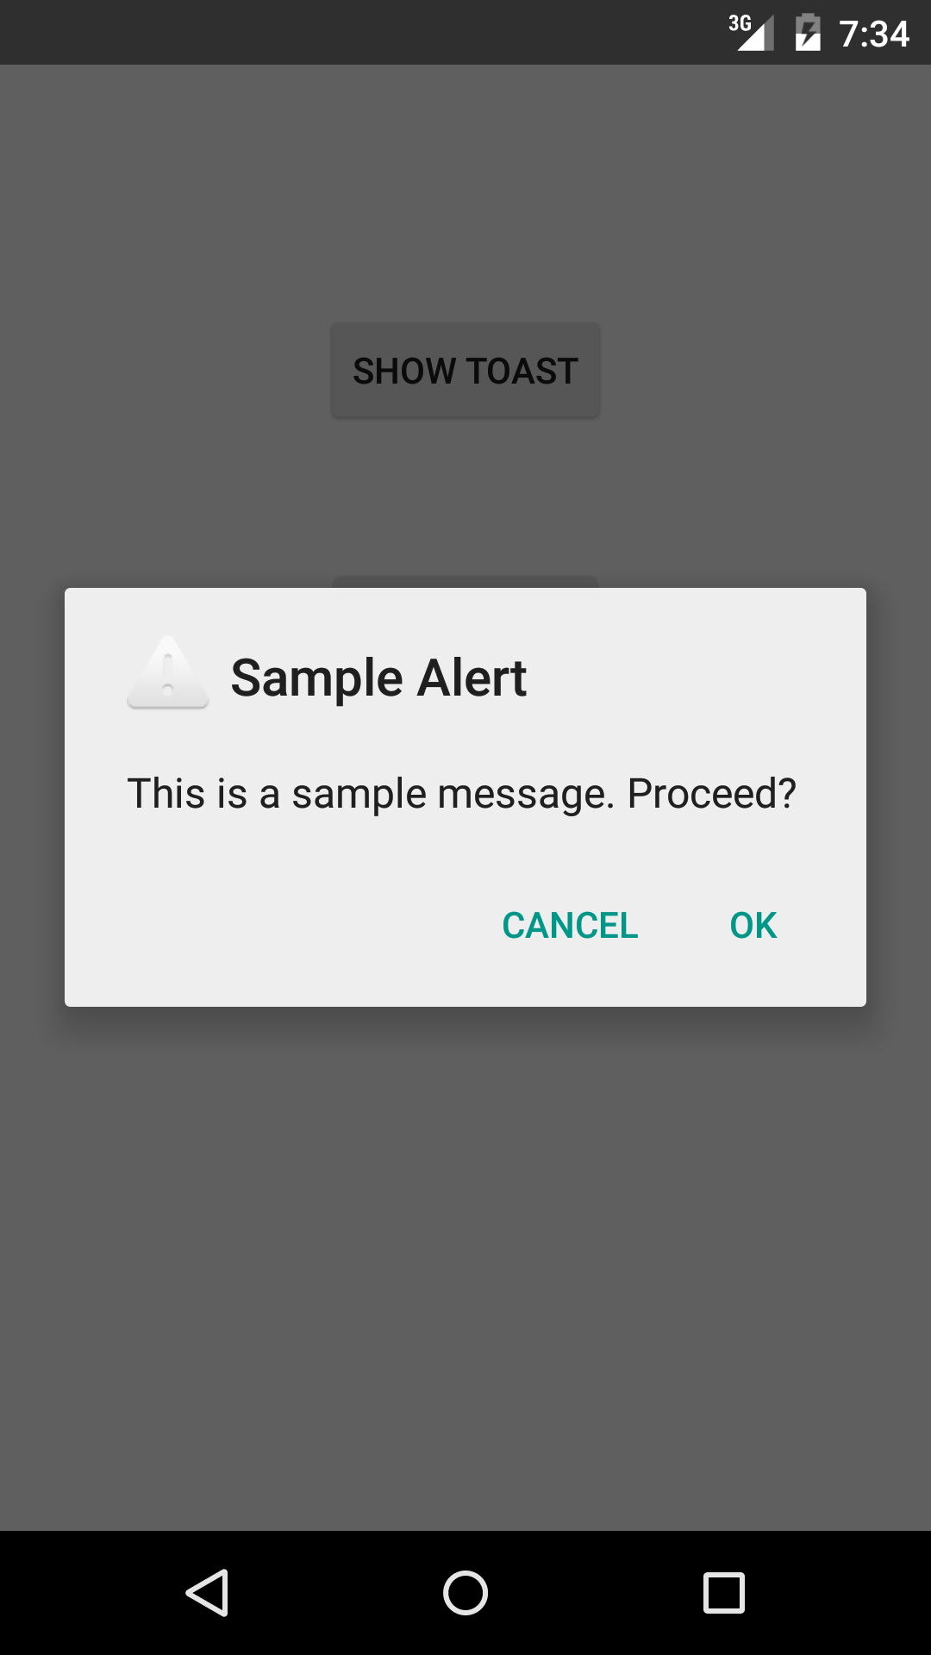
Toast
AlertDialog

Slide 3
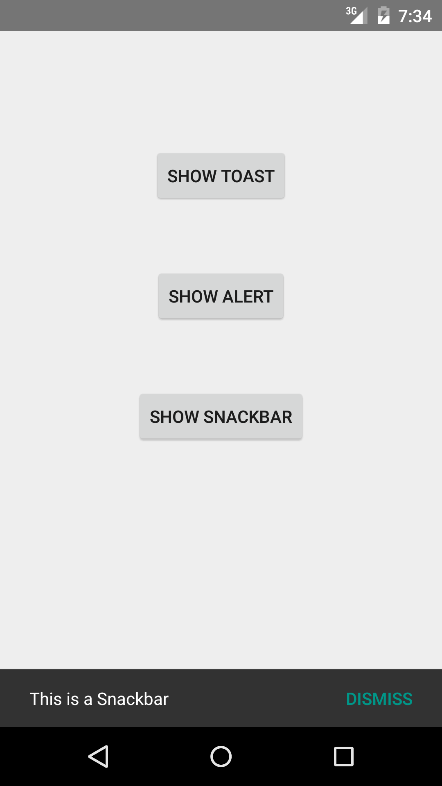
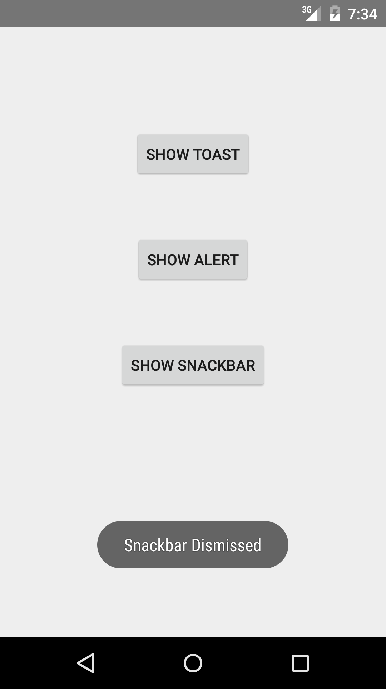
Snackbar
Snackbar Dismissed

Slide 4
References
Toasts
Dialogs
Snackbar
Snackbar And Toast Material Design

Slide 5
Exercise
Add a third button with the title “Reject” to the AlertDialog

