Slide 1
Android - AsyncTask
This tutorial shows the usage of AsyncTask that greatly simplifies background processing.
AsyncTask should be used for operations that run several seconds and therefore cannot be performed on the UI thread.
It offers several callbacks that are either called on the UI thread or a background thread. The callbacks are called in a certain sequence to allow for proper handling of UI updates.

Slide 2
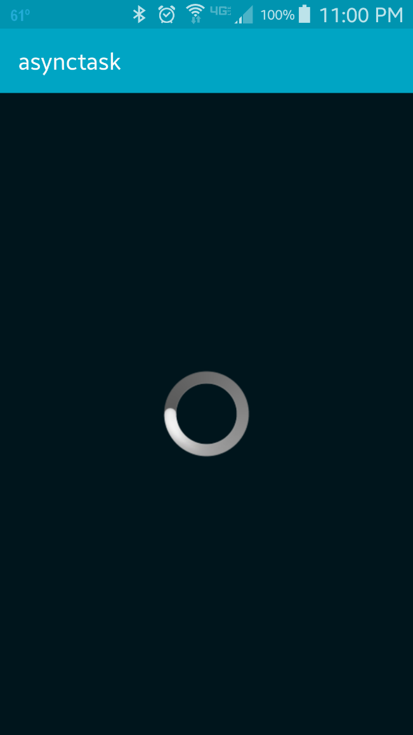
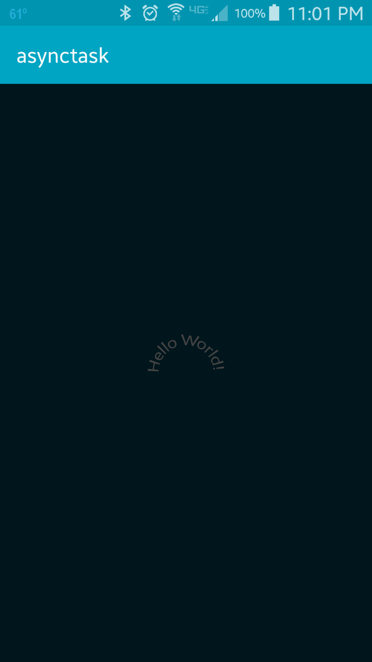
~ 5 seconds later

Slide 3
References
Asysnc Task
Process and threads

Slide 4
Exercise
Change the type of the ProgressBar to be horizontal (by adding <ProgressBar style="@android:style/Widget.ProgressBar.Horizontal" ... /> to the layout definition. Next change the second parameter of the AsyncTask (that is currently Void) to Integer and change the implementation such that every 500 ms the ProgressBar is updated by 5%.

