Slide 1
Android – Navigation Drawer
Navigation Drawer is one of the ways users can navigate through an Android application
The Drawer can be opened by either swiping from the left to the right, starting from the left edge of the screen or by tapping the hamburger( 3-bar icon) icon in the upper left corner of the screen.
This icon only shows up if it is explicitly added by the developer.
Hamburger icon can be added by configuring an ActionBarDrawerToggle and adding it to your DrawerLayout via setDrawerListener()

Slide 2
Android – Navigation Drawer
activity_main.xml contains the layout for the App.
Its root view is <DrawerLayout> from the support library.
A child view of <DrawerLayout> is <NavigationView>
<NavigationView>’s width works best when set to “wrap_conetent”
In Android Studio you will notice that the drawer itself is off the screen to the left.
If you want the Drawer to slide in from the right set: android:layout_gravity to “end”. Sliding from the left use “start”.
Items in the Drawer can be set either pragmatically via a ListView or declaratively via an xml resource file in the res/menu directory
Menu Item click events are handled by configuring a NavigationView.OnNavigationItemSelectedListener

Slide 3
Android – Navigation Drawer
Menu items declared in res/menu folder can be added to NavigationView via app:menu=“@menu/resource_name.xml”
A header layout can also be defined. This will live right above the menu items.
navdraw_header.xml defines the layout for the navigation drawer.
Added with app:headerLayout=“@layout/navdraw_header” in NavigationView.

Slide 4

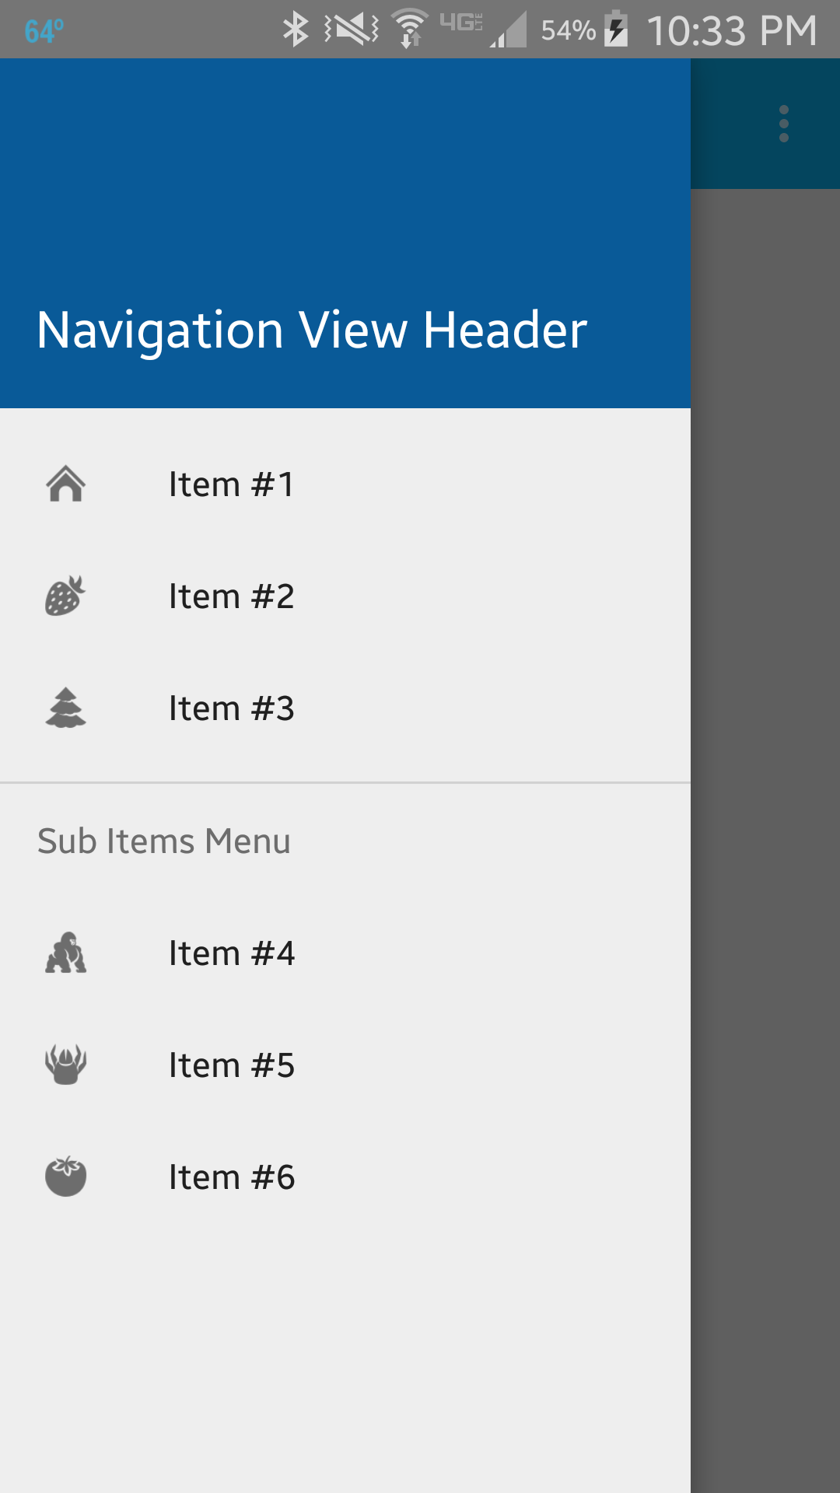
Tap the 3-bar icon or swipe from left to right, starting from the left side of the screen to open navigation Drawer
Swipe from right to left to close the navigation drawer. Or click on a Menu item

Slide 5
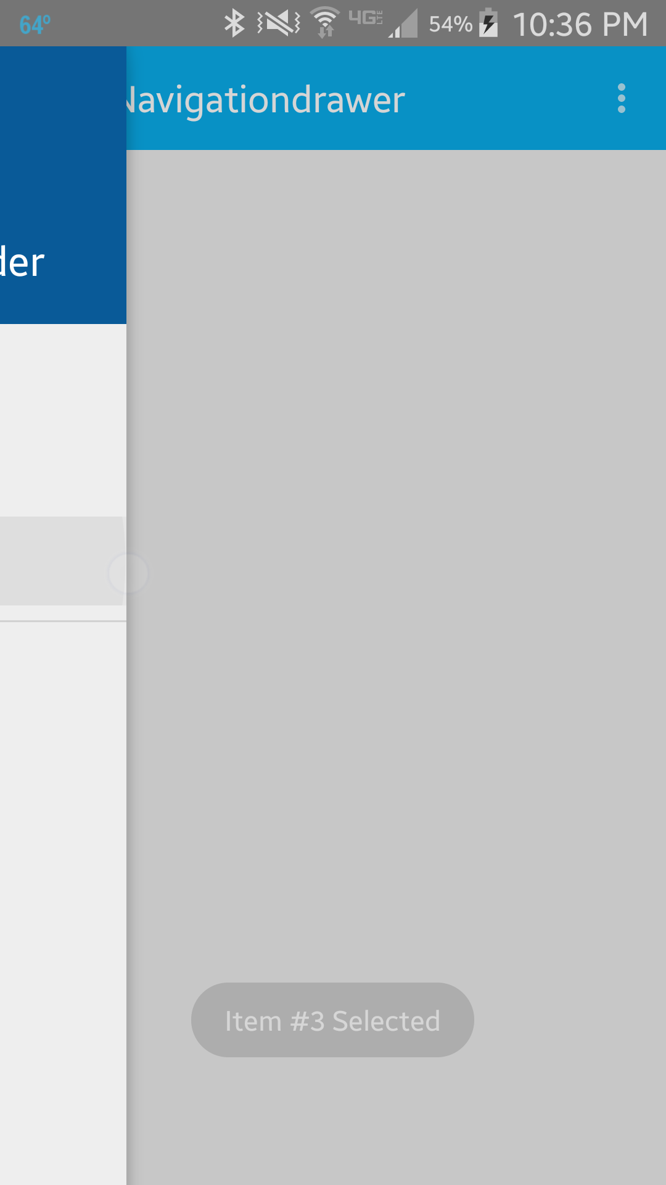
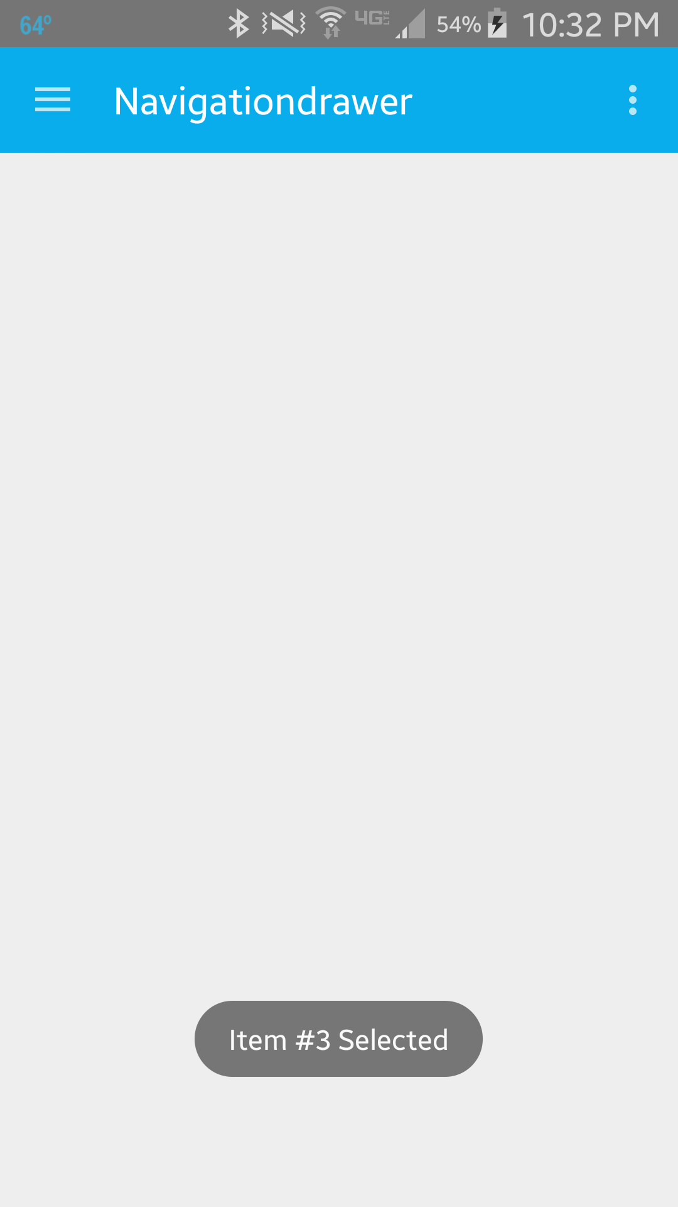
Navigation drawer closing after swipe or when an item is selected. In this case, an item is selected.
A Toast is shown telling the user which item he or she has selected.

Slide 6
References
Android Design Guide
NavigationView
DrawerLayout
ActionBarDrawerToggle
AppCompatActivity
Toolbar
Toast
Toast Class
Menus

Slide 7
Exercise
Currently the Navigation Drawer when opened covers the Toolbar. Modify the acitivity_main.xml so that when the Navigation Drawer is opened, it does not cover the Toolbar.

