Slide 1
Android - Drawing
Application to demonstrate simple drawing primitives
An Activity can override onDraw()
Invoked every time the view of the activity needs to be re-drawn
should not be called directly
An instance of anonymous class with base class android.view.View is created
onDraw() method is overridden
Canvas object is used for drawing operations
Paint object used to aggregate settings such as anti-aliasing, color for drawing operations
Drawable object - used to represent PNG file

Slide 2
Paint.setColor()
Used to set drawing color
Color is specified as (Alpha, Red, Green, Blue) tuple whose values must be between 0-255
Canvas.drawRect()
Used to draw rectangle
Canvas.drawCircle()
Used to draw circle
getResources().getDrawable()
Used to load a PNG file which is referenced in the R-class
Drawable.setBounds()
Used to set the drawing bounds

Slide 3
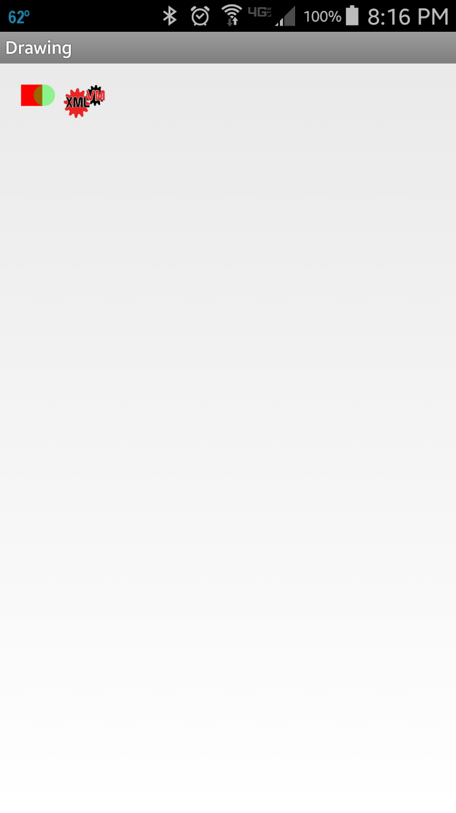
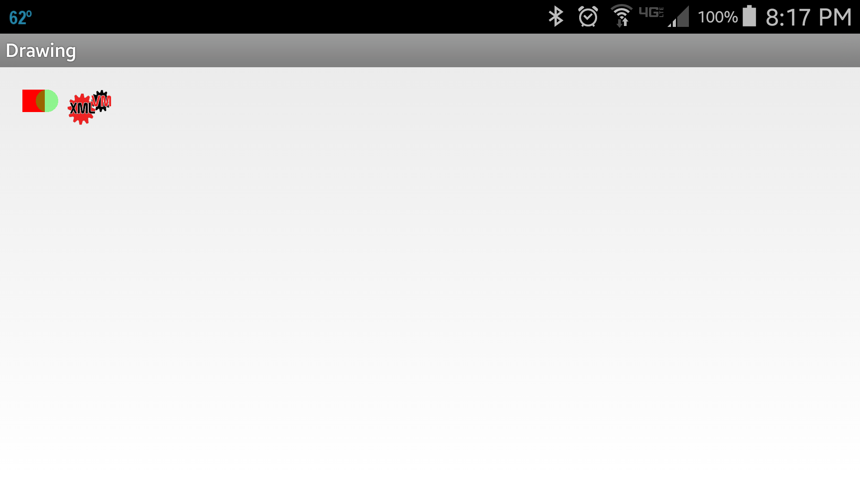
A rectangle, circle is drawn at the co-ordinates specified
A PNG file is also rendered on the canvas

Slide 4
References
View
Canvas
Paint
Drawable
Graphics

Slide 5
Exercise
Change the application so that the circle no longer is transparent.
Also change the Z-ordering of the rectangle and the circle, so that the rectangle is drawn above the circle.

