Slide 1
Android – Layout (relative)
Shows use of RelativeLayout for portrait and landscape mode
Displays five buttons – stretched to make use of width and height of the display for landscape and portrait
Only one layout resource is used:
Res/layout/mian.xml
RelativeLayout – arranged its children relative to each other based on given rules
Layout parameters of children – buttons are specific to layout container – RelativeLayout

Slide 2
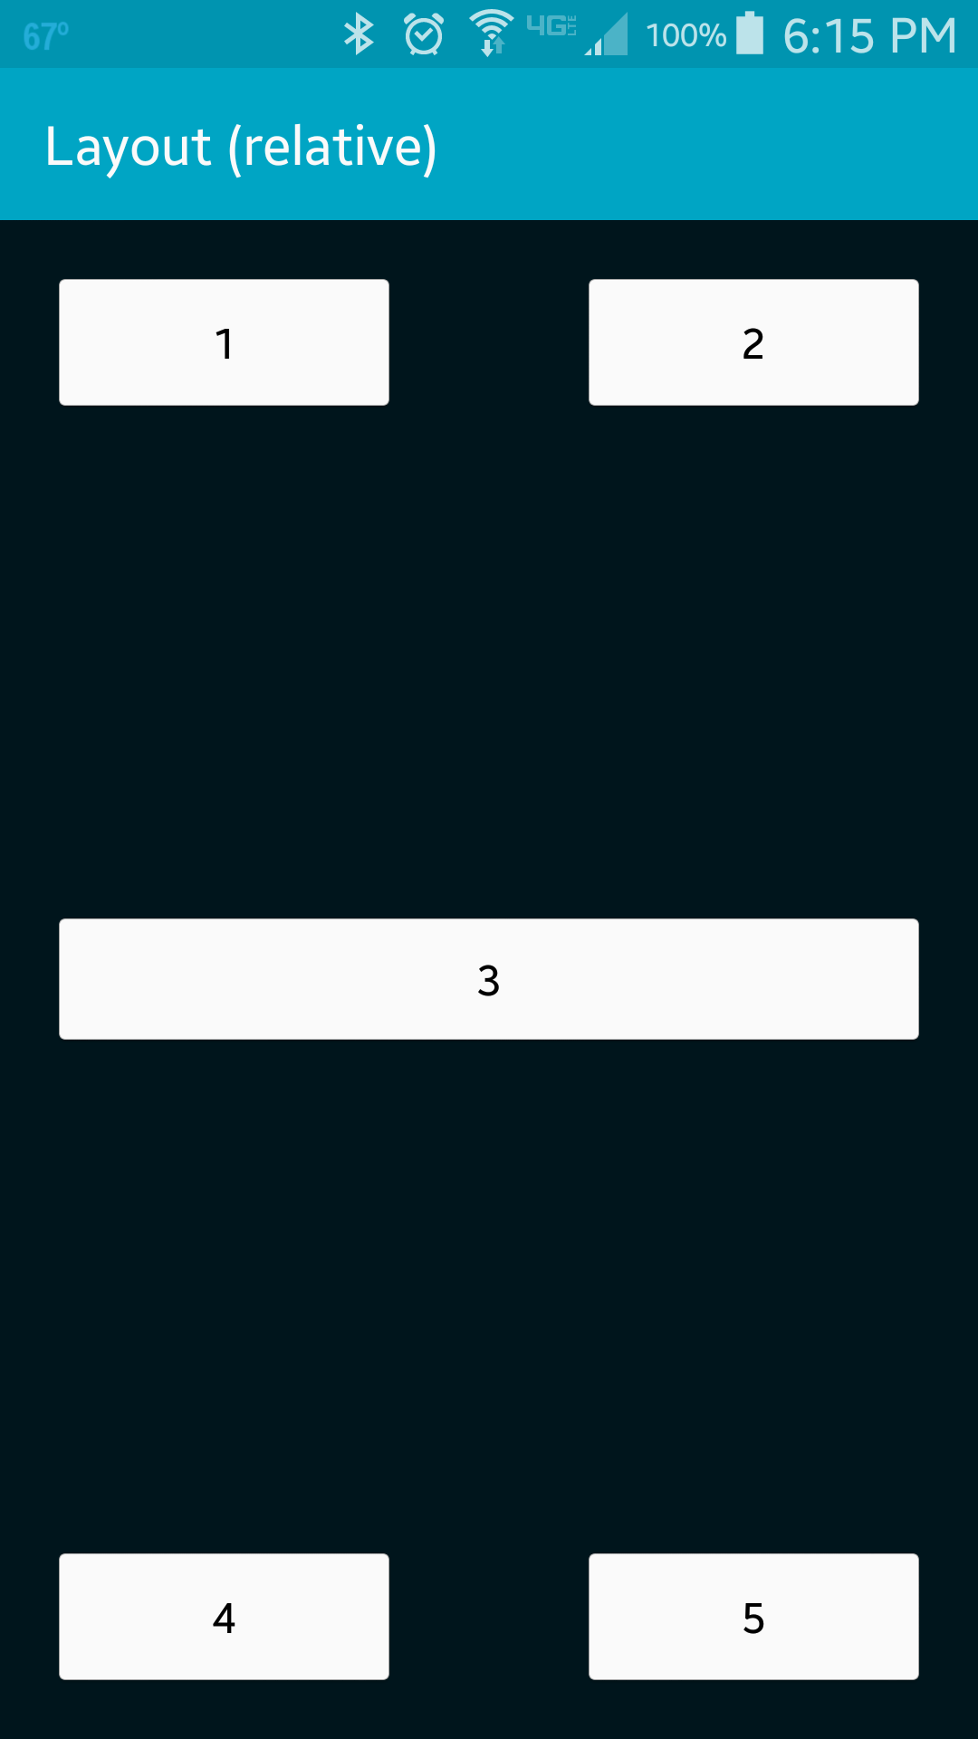
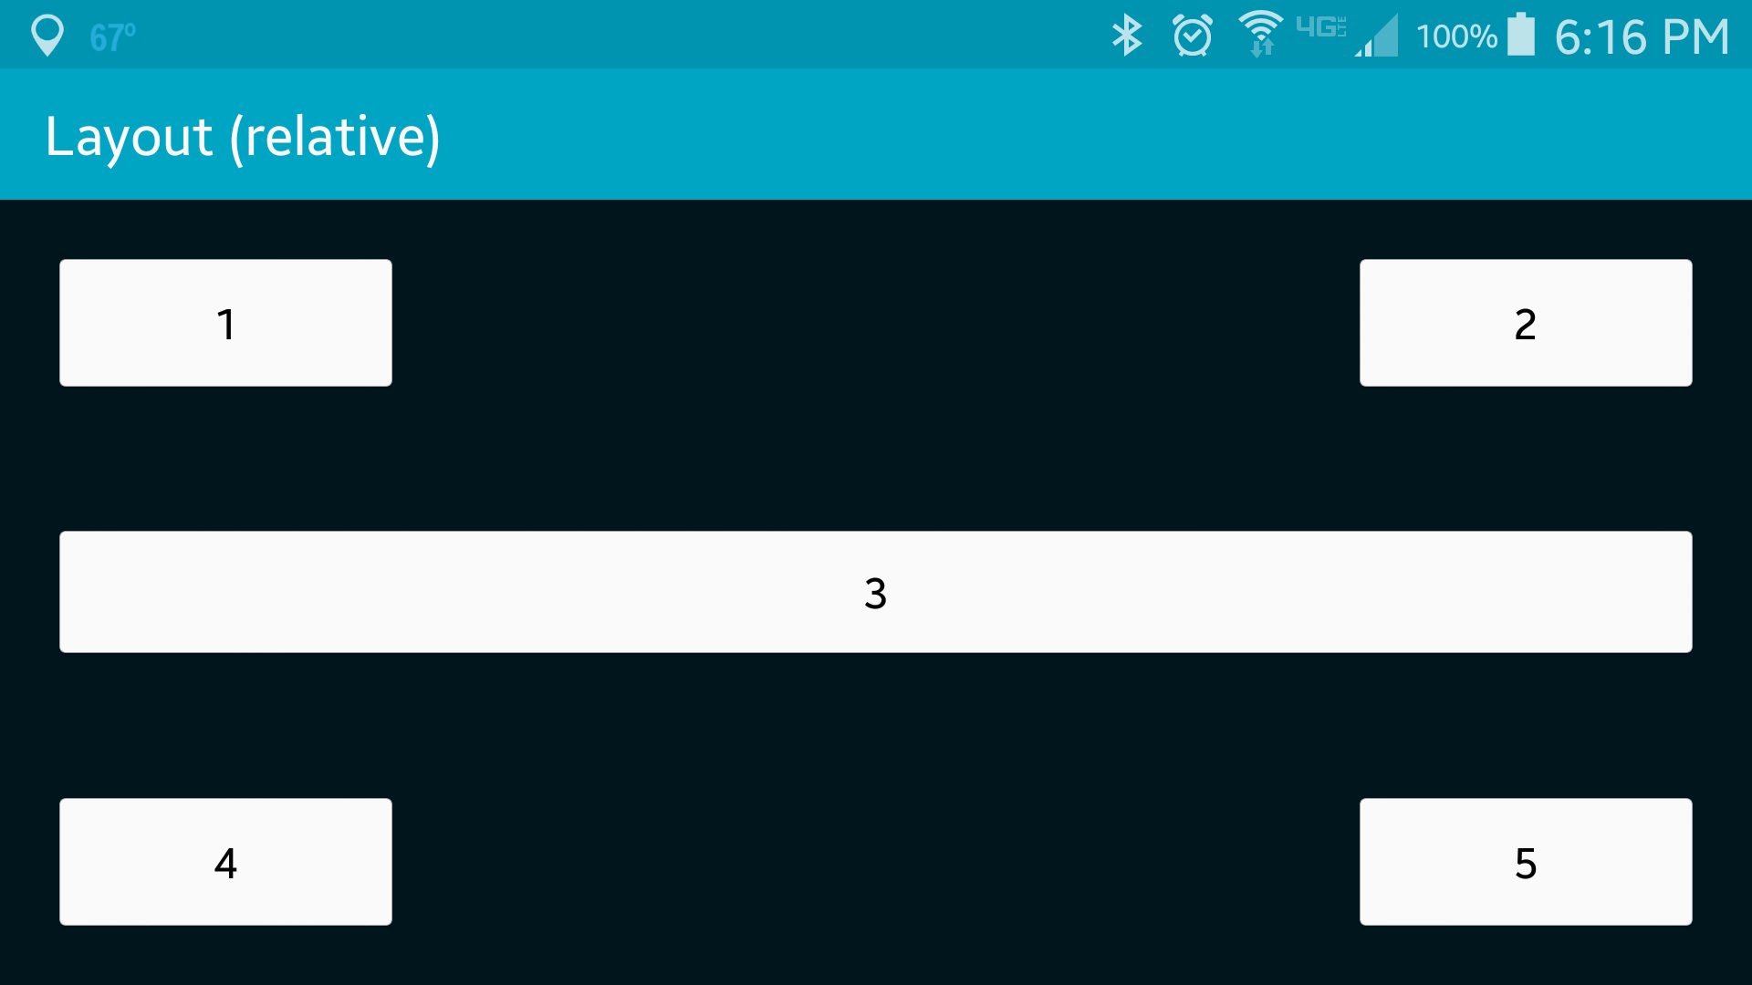
The buttons are stretched to make use of width and height of the display
The buttons are placed relative to each other

Slide 3
References
Layout Objects
RelativeLayout
RelativeLayout.LayoutParams

Slide 4
Exercise
Remove button “2” from the application and change the properties of button “1” so that this button will be stretched along the width of the screen (similar to button “3”)

