Slide 1
Android - Map
This application is uses Google API to display map of San Francisco
Google API offers MapFragment to show a map within a fragment
Every application that uses Google Maps API has to
Register with Google
Obtain a Map API Key
Include the key in a meta-data section of AndroidManifest.xml
GoogleMap
Provides access to the Google Maps API to manipulate and work with Google Maps data
CameraUpdate
Used to manipulate certain aspects of a GoogleMap (e.g., zoom level, or center of the map in terms of longitude/latitude)

Slide 2
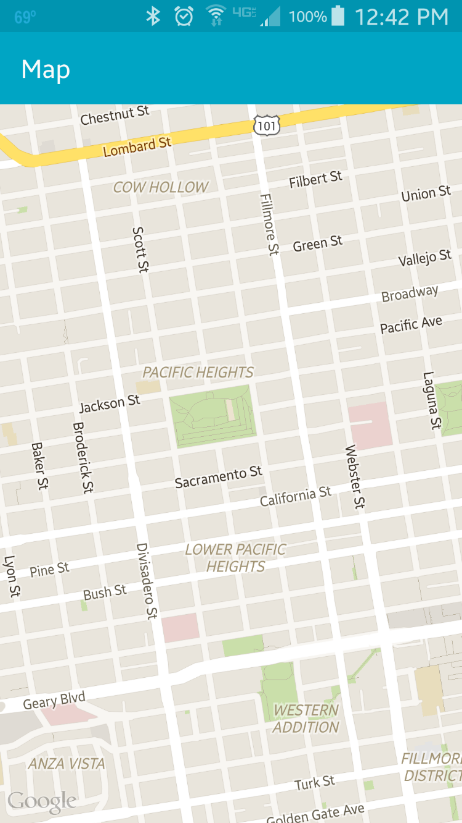
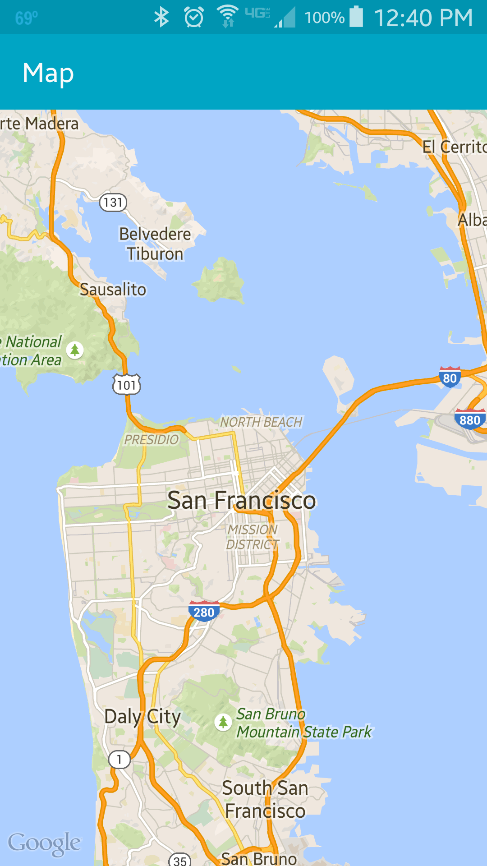

Slide 3
References
Google Maps API overview
Google Developer console
MapFragment
GoogleMap
CameraUpdate

Slide 4
Exercise
Change the hardcoded longitude/latitude coordinates so that the map shows downtown Manhattan in New York City.
Also show a marker at those coordinates
(hint: https://developers.google.com/maps/documentation/android/marker)

