Slide 1
Android - List
Application demonstrates a list of items. Android used to do this via classes ListActivity and ListView. The recommended way is now via RecyclerView.
RecyclerView better separates between the data model of a list and the way it is rendered.
A RecyclerView depends on an Adapter that manages the data model of the list.
The Adapter populates so-called ViewHandler instances that represent individual list items.
A ViewHandler instance keeps references to Views of a custom layout that defines the look of an item.
RecyclerView manages animations when items are inserted or deleted.

Slide 2
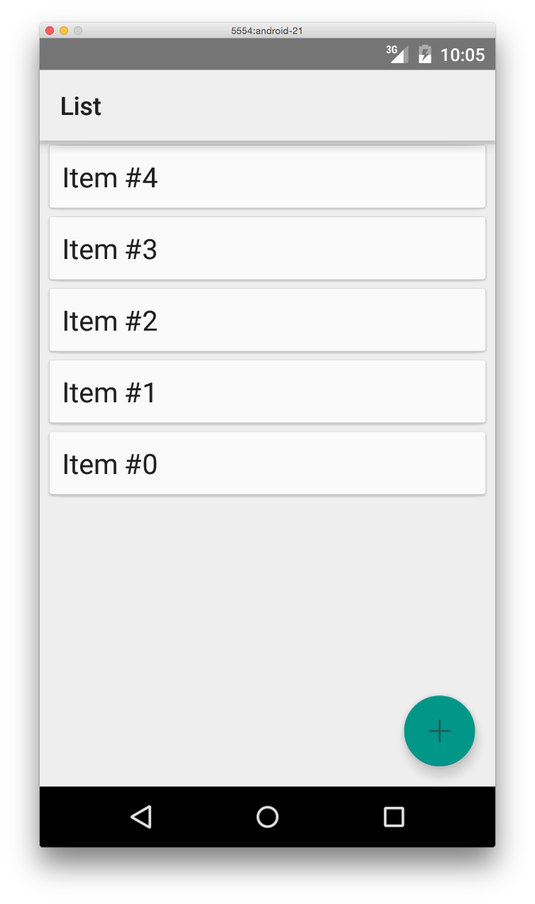
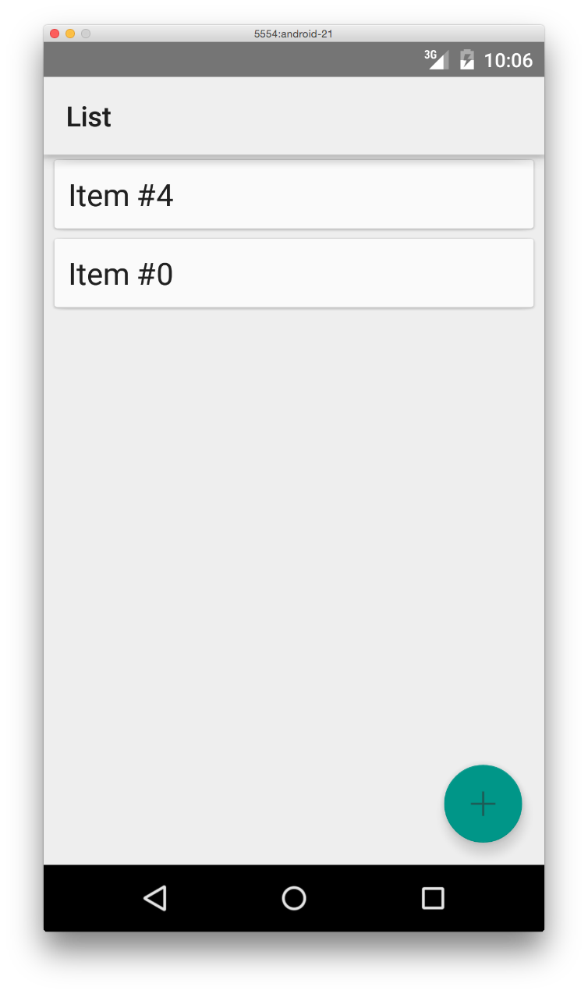
An item is rendered in a CardView. Pressing the “+” button will add a new item at the beginning of the list.
Clicking on an item will delete that item (without further confirmation). Note the animations as items are inserted and deleted.

Slide 3
References
Creating Lists and Cards
RecyclerView
RecyclerView.Adapter
CardView

Slide 4
Exercise
Add more complex content in the CardView as defined in file list_item.xml by merging it with the “AsyncTask” tutorial on this site.

