Slide 1
Android - TabLayout
TabLayout is a way to switch between important views.
TabLayout bar is a collection TabLayout.Tab instances.
Creating a tab is done with the newTab() function.
After a tab is created its text and icon can be set.
To have a scrolling TabLayout, TabLayout.MODE_SCROLLABLE can be passed to setTabMode
In order to detect tab selections, a TabLayout.OnTabSelectedListener must be attached to the TabLayout bar.

Slide 2
Android - TabLayout
When implementing TabLayout.OnTabSelectedListener three functions will be overridden.
onTabSelected
OnTabReselected
OntabUnSelected
Care should be taken when implementing onTabSelected and onTabUnSelected. Both these functions are called when changing tabs.
This is demonstrated via Log.d function calls. Application tag is TabLayout.
When a Tab is selected a Toast is shown displaying which Tab is selected.

Slide 3
Android – TabLayout - Toolbar
In res/layout/toolbar.xml the layout of a Toolbar is defined.
Since the release of Material Design, a Toolbar can be seen as a generalization of the Action bar.
An Action bar is now a special kind of toolbar
Toolbar is now apart of your view hierarchy
It is no longer tied to an Activity’s color scheme
Can be placed anywhere
Is highly customizable
When using the Toolbar from the support library, your MainActivity should extend AppCompatActivity
The Application theme also needs to set to Theme.AppCompat.NoActionBar
Theme.AppCompat.Light.NoActionBar can be used if app should have Light theme (what’s used in tutorial).

Slide 4
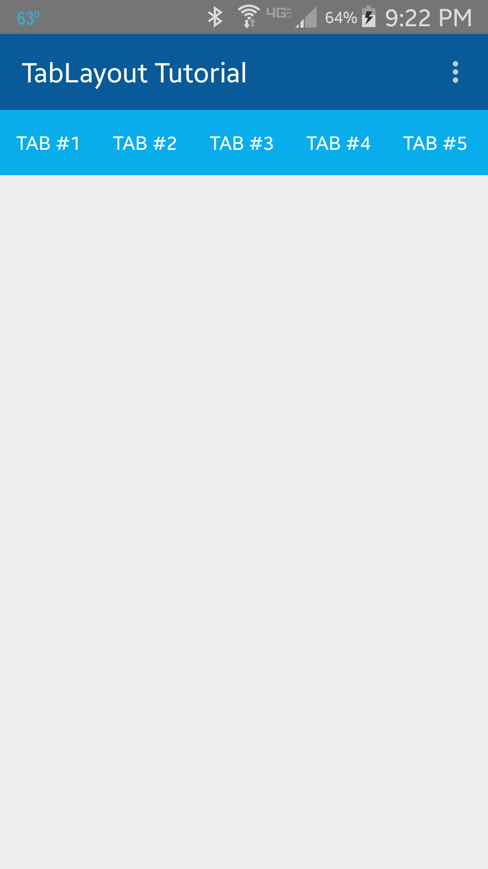
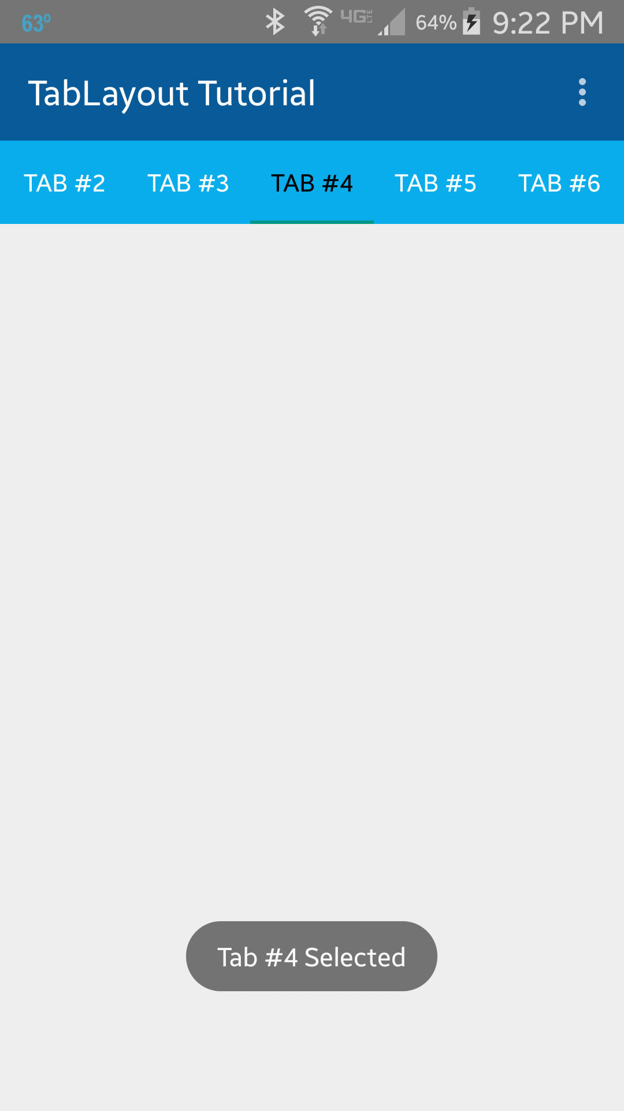
Initial TabLayout showing 5 of the 8 tabs.
When selecting tab 4, a Toast is shown recognizing the tab selection.

Slide 5


When selecting tab #4, when tabs 1-5 are shown, the tab bar is auto-scrolled one tab,
When selecting tab #5, when tabs 1-5 are shown, the tab bar is auto-scrolled two tabs.

Slide 6
References
TabLayout
Toolbar
TabLayout.OnTabSelectedListener

Slide 7
Exercise

