Slide 1
Android - Notification
A notification is a message you can display to the user outside of your application’s UI.
There are two areas to view notifications: Notification area and notification drawer. Both of these areas are system controlled.
Notifications will first appear as an icon in the notification area
Details of the notification can be seen by opening the notification drawer and clicking on a specific notification.
The following application will trigger a notification after 5 seconds when “Trigger Notification” button is clicked.
The notification will appear in the notification area on the top of the screen.

Slide 2
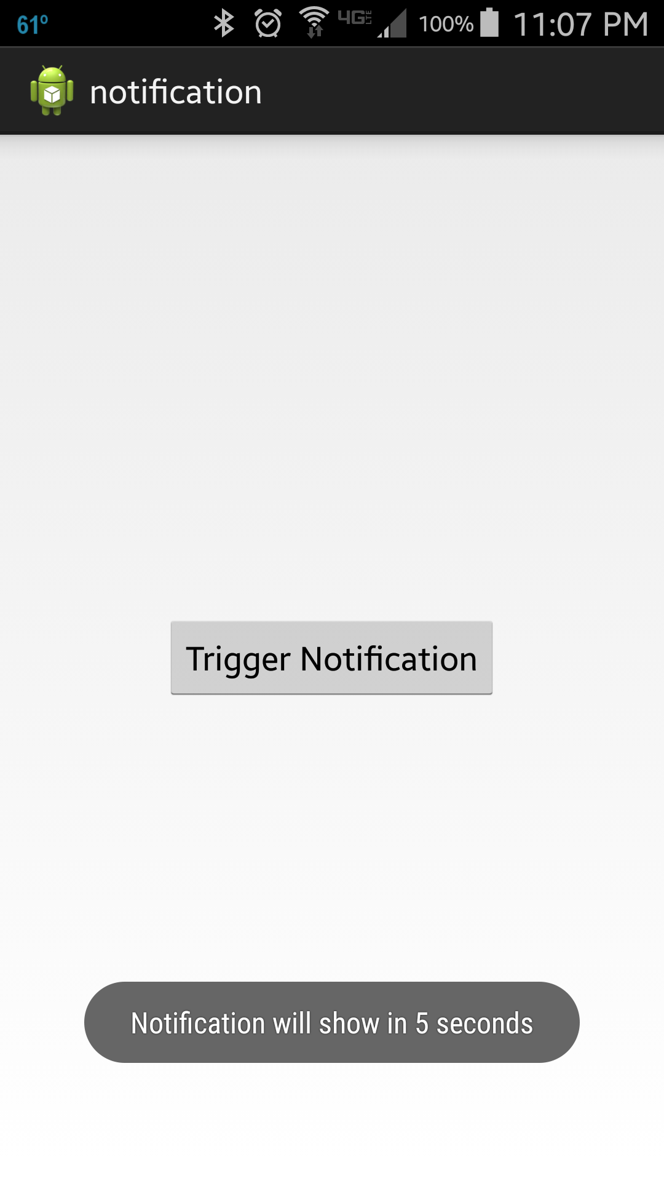
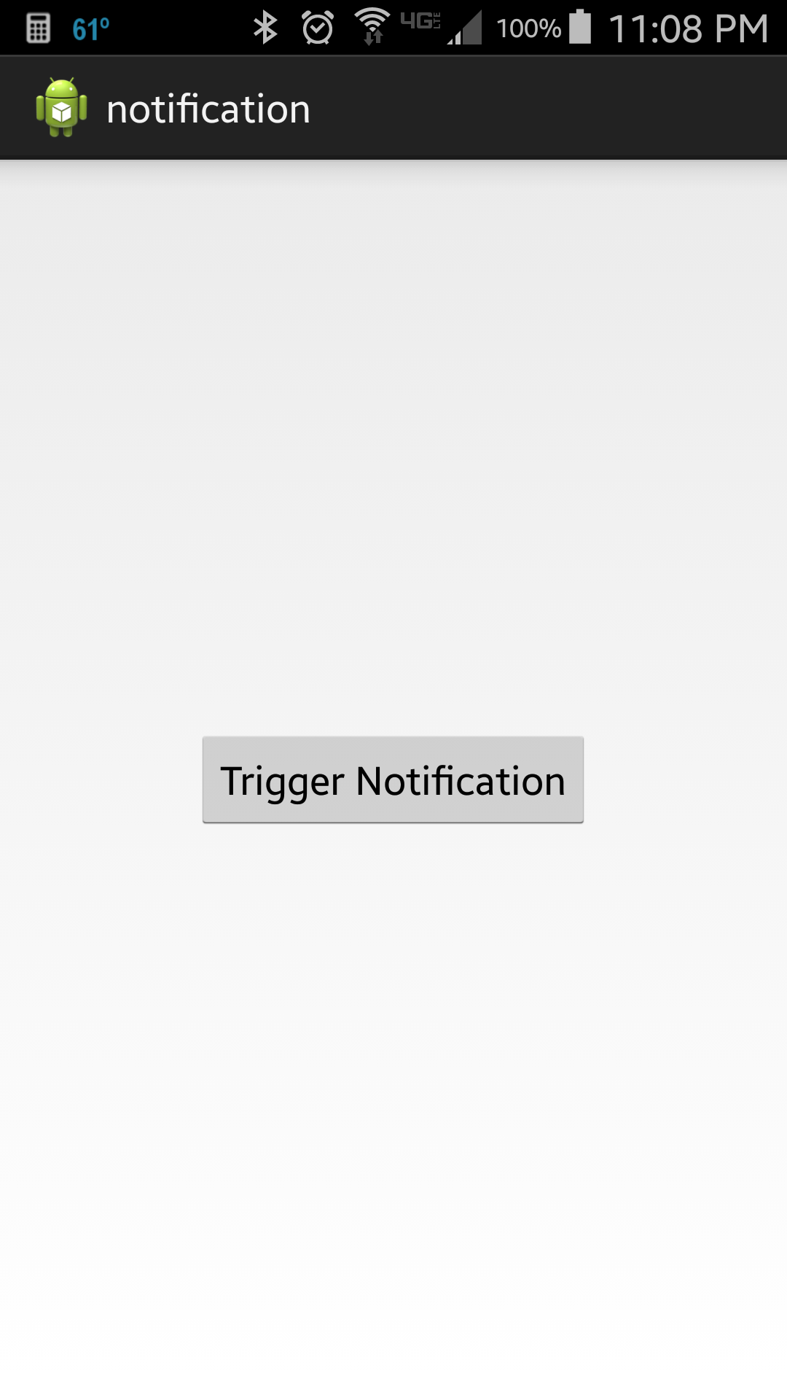
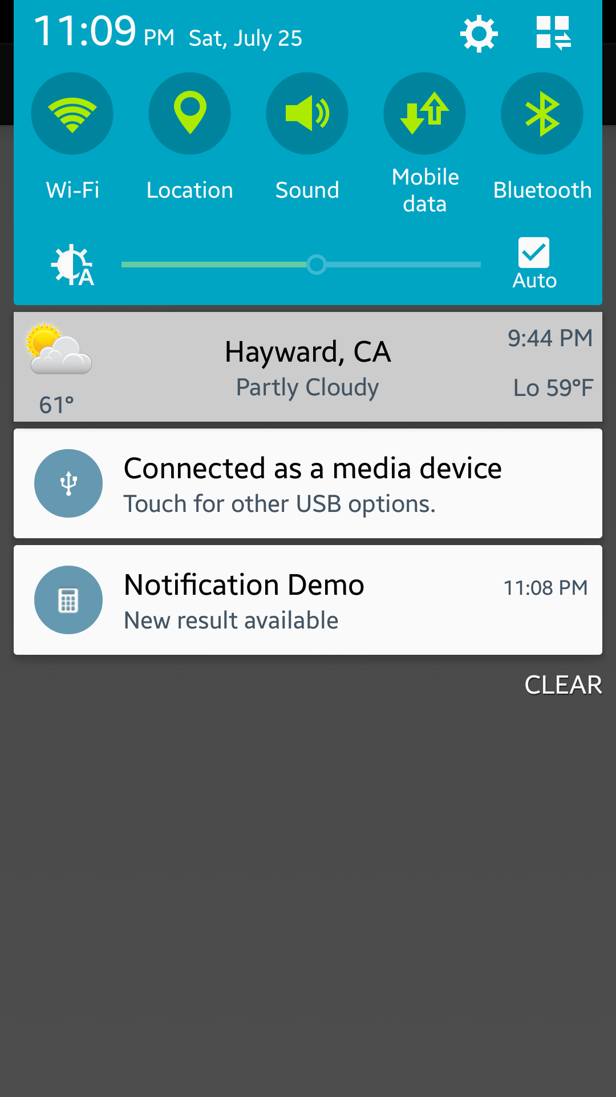

Slide 3
References
Notification
PendingIntent
TaskStackBuilder
Guide on Notifications

Slide 4
Exercise
The tutorial uses a ‘normal view’ for the notification. Change the application such that it uses the ‘big picture style’ showing a bitmap in the notification.

