Slide 1
Android – SayHello (decl)
Allows user to enter a name and a greeting message is displayed with the name when user presses a button
Makes use of layout resource described in res/layout/main.xml
Widgets - TextView and EditText referenced are located using their resource ID defined in R-class
R-class is generated from information contained in layout file
OnClickListener is set via layout resource
findViewById()
Used to locate the widgets with appropriate ID
Returns an instance of android.view.View hence downcast to proper type is required

Slide 2
Button widget defines click listener via XML attribute 'onClick' in layout resource
It has value of the method that has to be invoked which is declared in the context that created the Button
The method's signature must have:
void return type
one input argument of type android.view.View
In layout resource - LinearLayout aligns the three widgets:
EditText
TextView
Button
Each is assigned a resource ID vid XML attribute 'id'

Slide 3
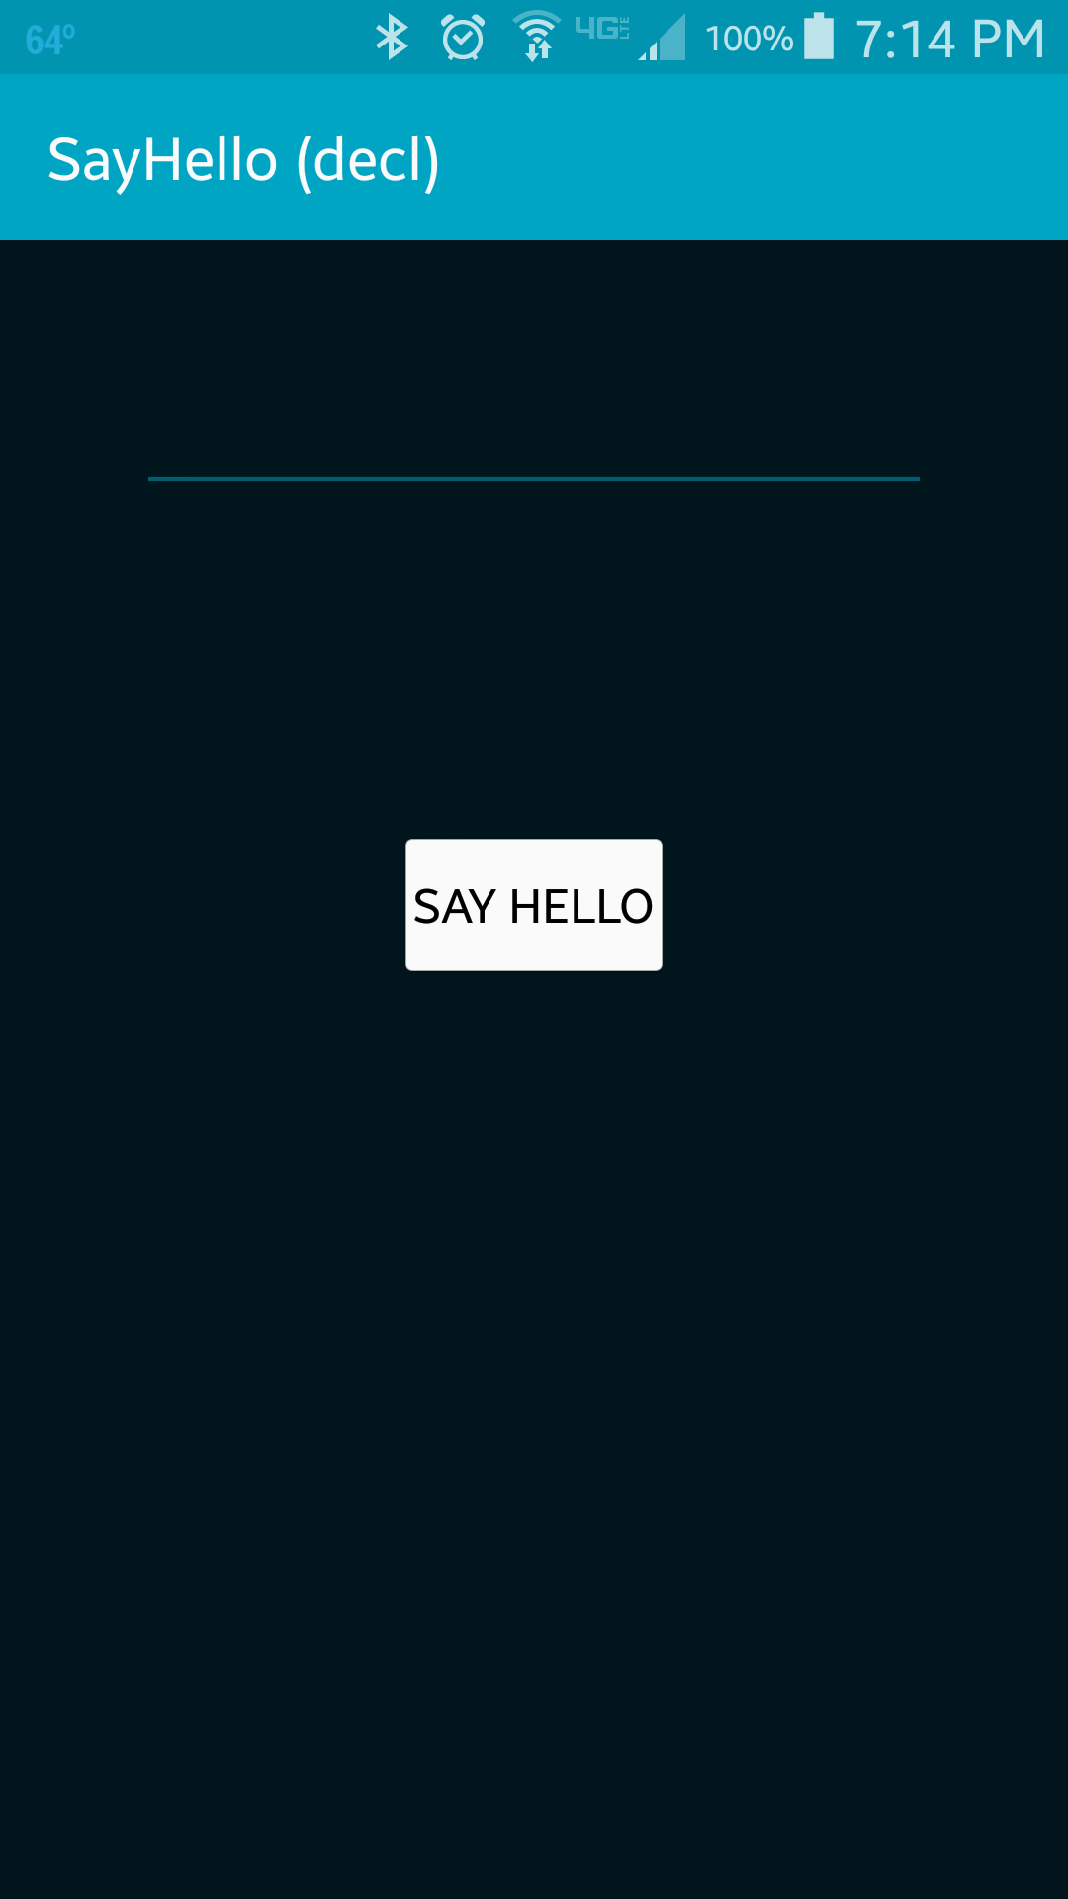
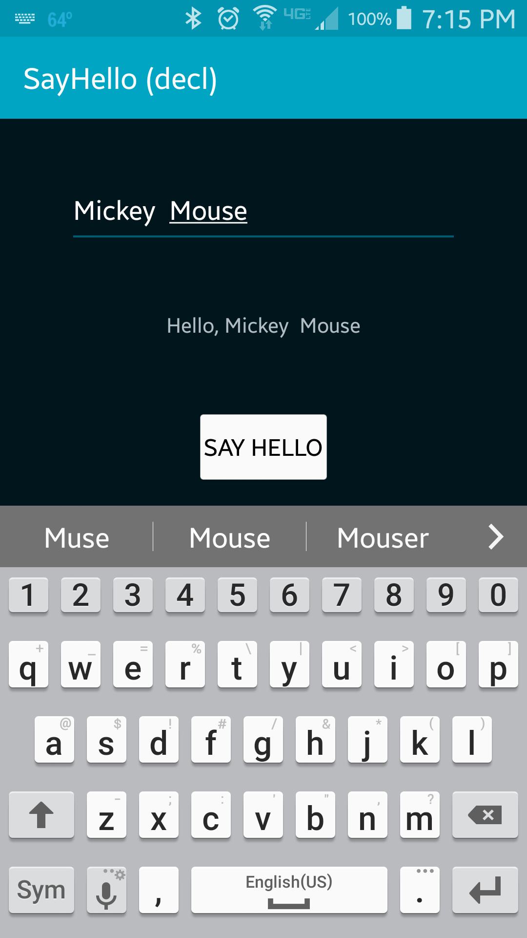
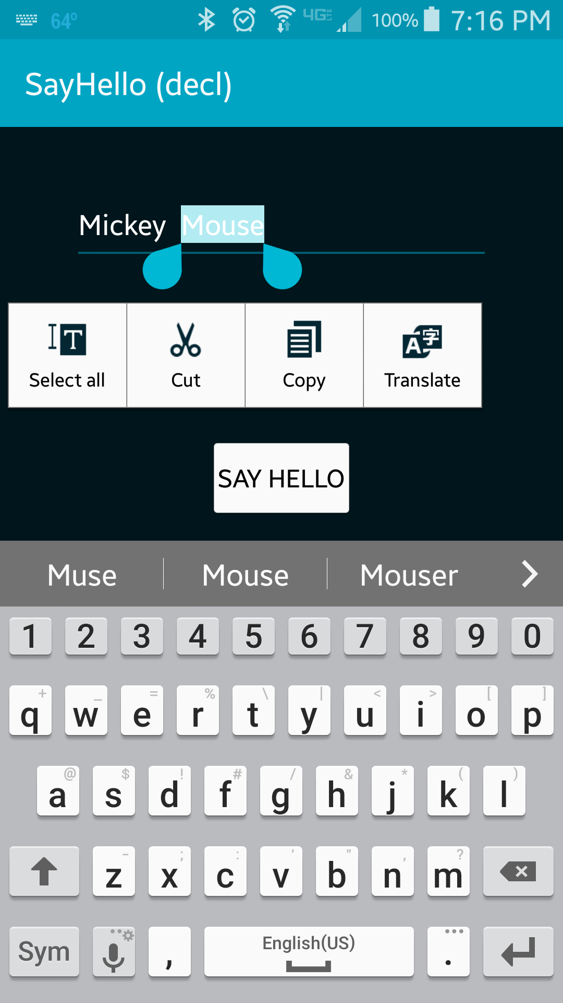
User enters the name in the EditText and presses the Button
Greeting message with the name is displayed in the TextView

Slide 4
References
TextView
EditText
R.id
View

Slide 5
Exercise
Add a second button below the “Say Hello” button. The label for the second button should read “Ask” and when clicked, should echo “How are you, XXX?” to the label (overwriting any previous message), where XXX is the name the user entered.

