Slide 1
Android - Accelerometer
Demonstrates how to access accelerometer in Android devices
(x,y,z) values of accelerometer are shown in TextViews on main screen
Main activity implements the interface android.hardware.SensorEventListener
Therefore requires overriding :
onAccuracyChanged()
Called whenever the accuracy of the sensor has changed (not applicable for the accelerometer sensor)
onSensorChanged()
This method will be called whenever there are sensor events

Slide 2
getSystemService(SENSOR_SERVICE)
Used to retrieve SensorManager to access the sensors
SensorManager.getDefaultSensor(Sensor.TYPE_ACCELEROMETER)
Used to retrieve the default Sensor for the accelerometer.
SensorManager.registerListener()
used to register the activity as the listener for accelerometer events
SensorEvent object contains 'values' - an array which has (x,y,z) values

Slide 3
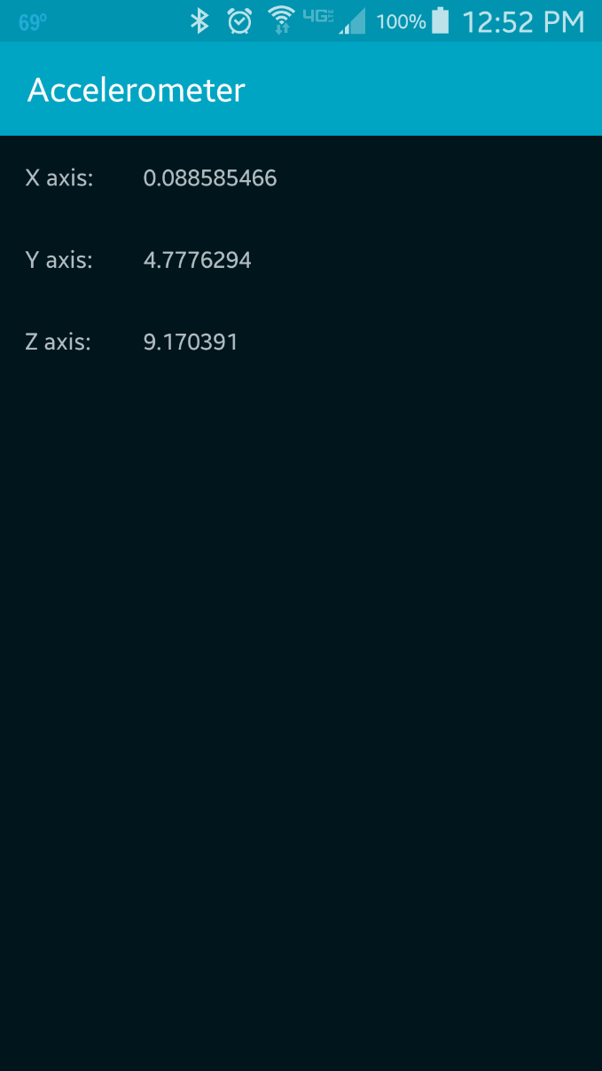

Slide 4
References
SensorEvent
SensorEventListener
SensorManager
Sensor

Slide 5
Exercise
Add a label to the application that displays “Device in horizontal position” whenever the device is held horizontally, i.e., the screen of the device faces up and the device is held parallel to the ground.
(Hint: think of a condition that the (x, y, z) acceleration values must satisfy for this condition to be true. Use a threshold to cancel out noise).

