Slide 1
Android - Camera
tutorial/android/sensor/camera
Application to demonstrate the use of camera in android.
A SurfaceView is created for the camera preview.
SurfaceHolder.Callback is used to get notifications about the changes in the surface.
surfaceCreated()
called immediately after the surface is first created
surfaceChanged()
when there are any structural changes to the surface
surfaceDestroyed()
called just before the surface is being destroyed
The CAMERA permissions should be declared in the AndroidManifest.xml file to access the camera device.
<uses-feature> element is used to declare the features of the camera that will be used by the application.

Slide 2
An instance of camera is obtained using open()
Default Camera.Parameters can be obtained and modified using getParameters() and setParameters()
setPreviewDisplay() sets the surface required for the camera preview.
A fully initialized SurfaceHolder must be passed to this method.
startPreview() updates the preview surface
setPreviewDisplay() must be called before calling startPreview()
Preview should be started before taking a picture

Slide 3
When image is captured using the button, the takePicture() is called which initiates a series of Callbacks for image capture.
A shutter callback occurs close to the moment of image capture.This callback can be used to play shutter sound
A raw callback occurs when raw image data is available.
A jpeg callback occurs when compressed image is available.
Image data that is available after image capture is supplied using the callback interface PictureCallback via onPictureTaken()
A null can be passed when a callback is not required.
Since camera is a shared resource it is good practice to release the resource when not using it.

Slide 4
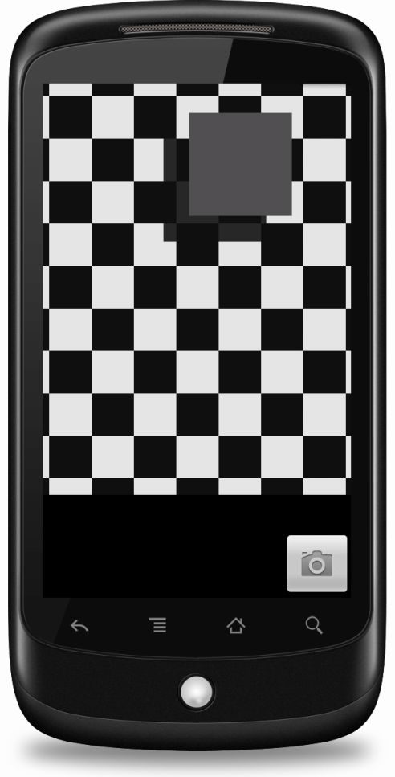
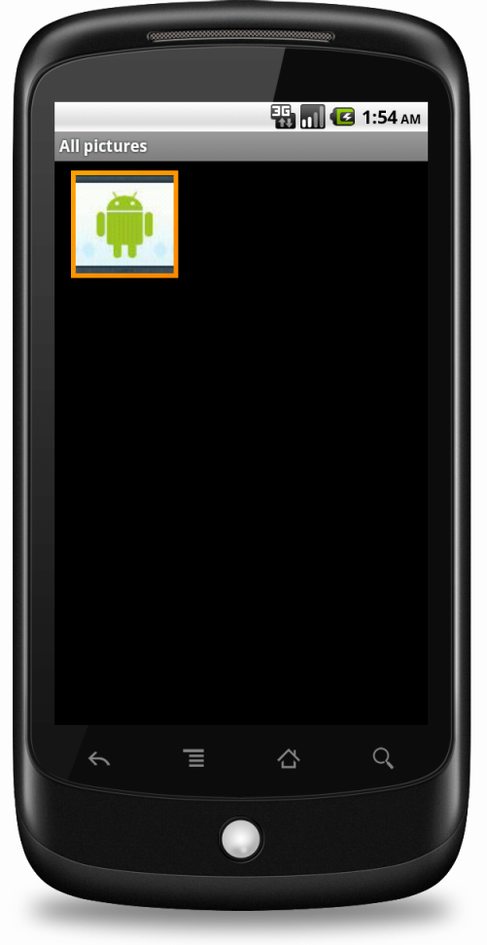
Below screenshots demonstrate how the camera application is rendered on an emulator.
Once the button is clicked, you can verify the captured image (which is typically an android icon on an emulator) by browsing to the gallery.

Slide 5
References
Camera
Camera Parameters
SurfaceHolder
SurfaceView
SurfaceHolder Callback
ShutterCallback
PictureCallback

Slide 6
Exercise
Change the application such that the picture is taken with the front camera instead of the back camera (assume that the device supports both front and back camera).

