Slide 1
Android - NFC Reader
Used for short-range wireless communication.
Typically requires a distance of 4cm or less to start a connection.
Allows the exchange of small amounts of data between either:
an nfc-enabled Android device and a NFC tag
Two nfc-enabled Android Devices
Three modes of Operation:
Reader/Writer Mode
P2P(Peer-2-Peer) Mode
Card emulation mode

Slide 2
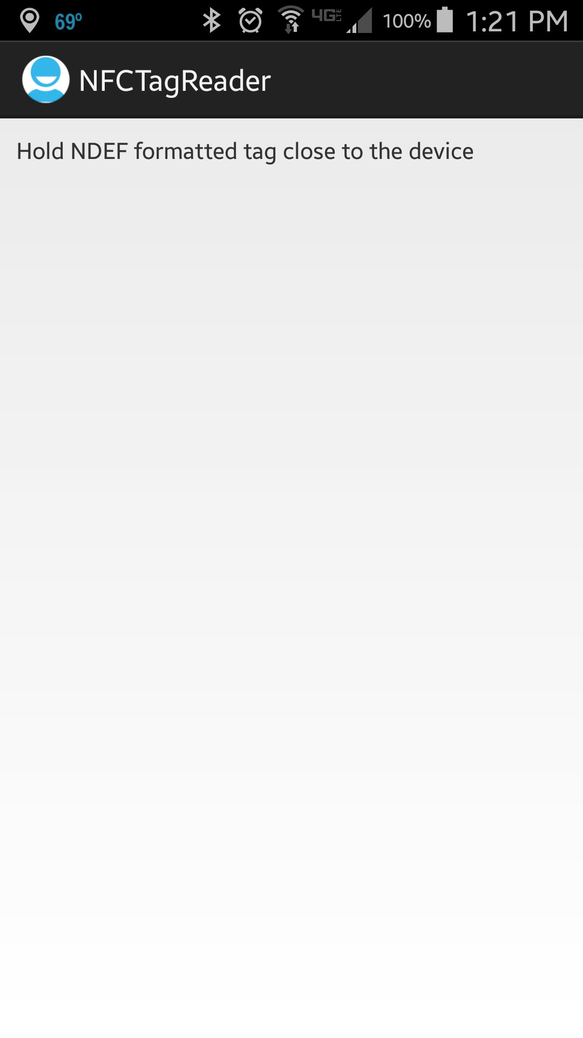
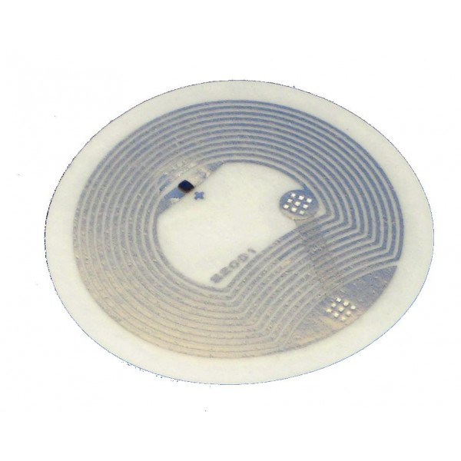
Example of a NFC Tag

Slide 3
References
Near Field Communication
NFC Tag class
Tag Info App
Tag Writer App

Slide 4
Exercise
Nothing to do!

