Slide 1
Android – Service(Bound)
An Android Service is an application component that can perform long running operations.
By default, a service runs in the context of the UI thread. I.e., requires a thread to be created for background operations.
A bound service performs a long running operation on behalf of a client. At the end of the operation the result is returned back to the client.
A bound service exists as long as there is a client bound to it.
A client can access a service running in a different process.
A bound service is derived from class Service and needs to override method onBind(). The latter returns a Binder object that the client uses to interact with the service.
The client calls bindService() to bind to a service. This requires a ServiceConnection object that is used to detect when the asynchronous connect to the service succeeded.
A service needs to be declared in AndroidManifest.xml using the <service> tag.

Slide 2
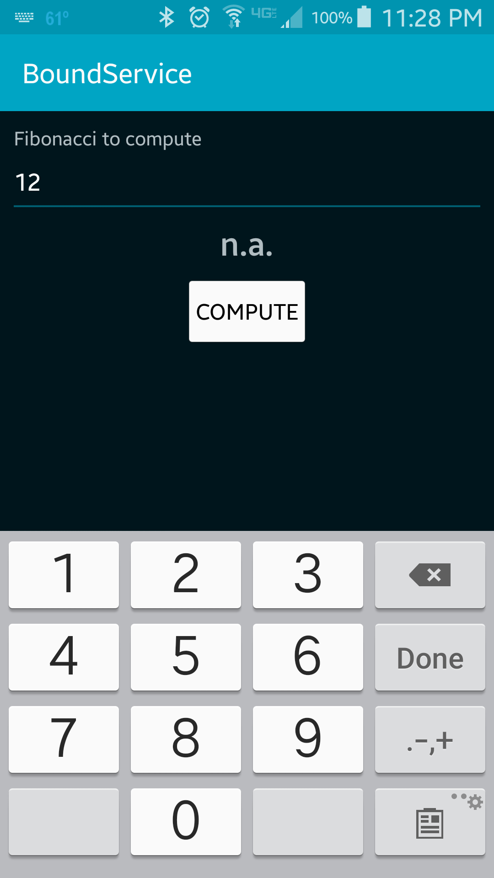

Step 1: Enter value and press the "Compute" button.
Step 2: After 5 seconds the result will be displayed.

Slide 3
Reference
General overview of Android Services
Details of Bound Services
android.app.Service
android.os.Binder
android.content.ServiceConnection

Slide 4
Exercise
The current implementation will destroy the FibonacciService when FibonacciActivity is destroyed. Convert FibonacciService such that it also overrides onStartCommand() for a started service. This service is a hybrid because it is both a started as well as a bound service. Hint: look at the exercise for a started service and combine it with the bounded service.

