Slide 1
CAPSTONE
26 May 2024

Slide 2
TOPICS FROM THE PICKS
01
02
03
MODEL EVALUATION & VALIDATION
MACHINE LEARNING
NATURAL LANGUAGE PROCESSING (NLP)

Slide 3
MODEL EVALUATION & VALIDATION
Target Audience
Insurance and adjusting companies
Any Problem
Success Metric
Finding out the bad seed
Saving time and eventually resource
Insurance Claim Fraud
Data Source
Reasonable Project
Kaggle
Yes
Potential Challenges
Complications of polices

Slide 4
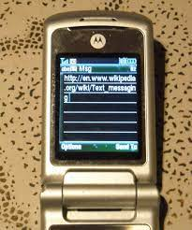
MACHINE LEARNING SMS Spam Collection
Problem?
Who cares?
Build prediction model identify spam SMS
Everyone
Success Metrics?
Data from?
Obstacles?
Minimize phishing links
UC Irvine
Different format of SMS links
Reasonable project

Slide 5

Natural Language Processing (NLP)
Fake or Real News Online
Problem
WHO
Success Metrics
Data Source
Obstacle
Online news media
Does it really help?
Kaggle, the usual.
Ethical Considerations
Yes, reasonable project.

Slide 6

Questions?

