Slide 1
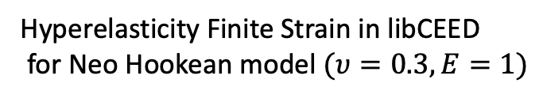
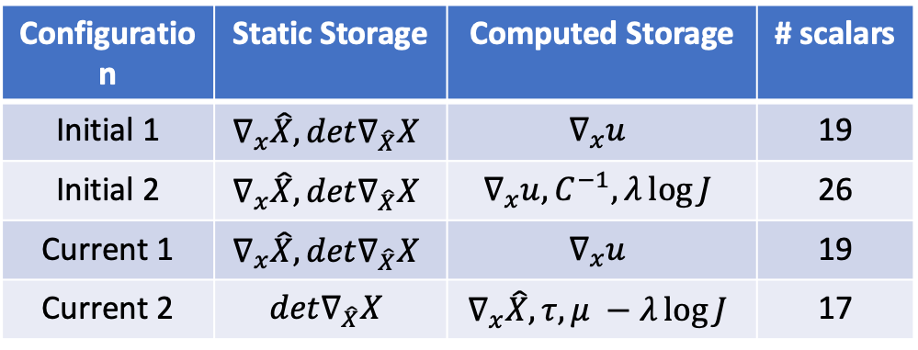
Efficient and performance portable matrix-free p-multigrid solvers for solid mechanics
Initial 1
Current 1
Hyperelasticity Finite Strain in libCEED
for Neo Hookean model $(υ=0.3,E=1)$
Configuration | Static Storage | Computed Storage | # scalars
Initial 1 | $$∇_{x}\hat{X},det∇_{\hat{X}}X$$ | $$∇_{x}u$$ | 19
Initial 2 | $$∇_{x}\hat{X},det∇_{\hat{X}}X$$ | $$∇_{x}u,C^{−1},λ\log{J}$$ | 26
Current 1 | $$∇_{x}\hat{X},det∇_{\hat{X}}X$$ | $$∇_{x}u$$ | 19
Current 2 | $$det∇_{\hat{X}}X$$ | $$∇_{x}\hat{X},τ, μ −λ\log{J}$$ | 17
Initial 2
Current 2
PSAAP III ASC PI Meeting
Center for micromorphic multiphysics porous and particulate materials simulations
within exascale computing workflows Multi-disciplinary Simulation Center (MSC)
Notes:
This slide is for flash talk

