Slide 1


MACHINE LEARNING PROJECT
EduRisk
Academic Failure Risk Prediction Using Machine Learning
Notes:
On screen: the EduRisk title, subtitle, presenter name, and course/instructor placeholders, with a graduation-cap and brain icon representing students plus machine learning.
Say: Good [morning/afternoon]. My project is called EduRisk — Academic Failure Risk Prediction Using Machine Learning. It's a supervised classification project that predicts whether a student is at risk of academic failure based on their data, so instructors can step in early. I'm Salma Mohamed, and I'll walk you through the problem, the data, how I built and compared five models, and the final model I selected for deployment.

Slide 2


THE CHALLENGE
Problem Statement
Academic failure is a significant challenge in education today.
Identifying at-risk students early allows for timely support and intervention.
Can Machine Learning help identify students at risk of academic failure?
Manually analyzing many student-related factors at once is difficult and inconsistent.
Machine Learning can automate risk prediction, flagging students earlier and more reliably.
EduRisk
02
Notes:
On screen: four problem-framing statements on the left, and the guiding research question on the right in a highlighted panel.
Say: Let's start with why this matters. Academic failure affects students, families, and institutions, and the earlier we can identify a student who's struggling, the more we can actually help them. But instructors can't manually track every factor for every student — grades, engagement, background, behavior — at scale. That's where Machine Learning comes in: it can process many factors at once and flag risk automatically. That leads to the core question driving this project: can Machine Learning help identify students at risk of academic failure?

Slide 3




PROJECT OBJECTIVE
From Data to a Deployable Model
1
2
3
4
5
Predict
Compare
Evaluate
Select
Deploy
Academic Failure Risk
multiple classification algorithms
models with classification metrics
the best-performing model
the trained model for practical use
EduRisk
03
Notes:
On screen: a five-step objective pipeline — Predict, Compare, Evaluate, Select, Deploy.
Say: The project has five concrete goals. First, predict each student's academic failure risk. Second, compare multiple classification algorithms rather than relying on just one. Third, evaluate every model with proper classification metrics, not just accuracy. Fourth, select whichever model performs best. And fifth, prepare that trained model so it can actually be used — saved to disk and ready for an application.

Slide 4





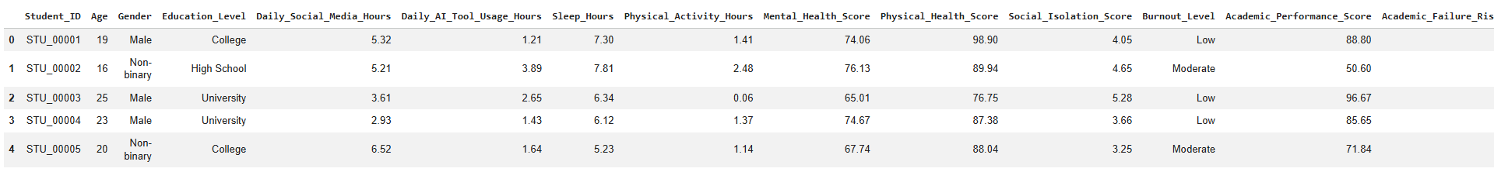
DATASET
Dataset & Target Variable
Student
Data
Features
Academic
Failure Risk
The dataset contains student-related information used to train the models.
Target variable: Academic_Failure_Risk — the label the models learn to predict.
This is framed as a binary classification problem.
No Academic
Failure Risk
Academic
Failure Risk
EduRisk
04
Notes:
On screen: the framing of student data flowing into features and then into the target, plus the two target classes.
Say: The dataset holds student-related information, and the column the models are trained to predict is Academic_Failure_Risk. Since this column only has two possible outcomes — No Academic Failure Risk, or Academic Failure Risk — this is a binary classification problem. I'm not going to quote an exact row count or feature count here, since I want every number in this deck to come straight from the actual notebook output rather than be estimated.

Slide 5




BEFORE TRAINING
Data Quality Checks
Dataset Info
Missing Values
Duplicate Rows
Descriptive Stats
df.info()
df.isnull().sum()
df.duplicated().sum()
df.describe()
Confirms column types & structure before modeling
Missing data can bias or break training
Duplicates can inflate performance metrics
Reveals scale, spread & outliers
EduRisk
05
Notes:
On screen: four data-quality checks performed in the notebook — dataset info, missing values, duplicate rows, and descriptive statistics — each with the pandas call used and why it matters.
Say: Before training anything, the notebook runs standard data-quality checks. df.info() confirms the structure and data types of every column. isnull().sum() checks for missing values, since gaps in the data can bias or break a model. duplicated().sum() checks for duplicate rows, which can artificially inflate performance if the same record appears in both train and test. And describe() gives descriptive statistics — mean, spread, and range — which helps catch outliers before they distort training.

Slide 6





PREPARING THE DATA
Data Preprocessing Pipeline
Raw Data
Feature
Selection
Categorical
Encoding
Standard-
ization
SMOTE
Train / Test
Data
Techniques used in the notebook
OrdinalEncoder encodes categorical features (fit on train, applied to test)
StandardScaler standardizes numeric feature scale (fit on train, applied to test)
SMOTE oversamples the minority class on the training set to address class imbalance
80 / 20 split, stratified train_test_split(test_size=0.20, stratify=y, random_state=42)
EduRisk
06
Notes:
On screen: the six-step preprocessing pipeline from raw data to train/test data, and below it the actual techniques used in the code.
Say: Before modeling, the data goes through a clear pipeline. After feature selection, categorical columns are converted to numbers with an OrdinalEncoder, and all features are standardized with a StandardScaler — both fit only on the training set to avoid leakage. Because the target classes are imbalanced, SMOTE is applied to the training data to oversample the minority class. Finally, the data was split 80/20 into train and test sets, using stratified sampling so both sets keep the same class proportions. I'm not quoting an exact imbalance percentage here since that number isn't in the source I was given.

Slide 7





FIVE CANDIDATES
Machine Learning Models
Random
Forest
Logistic
Regression
Gaussian
Naive Bayes
K-Nearest
Neighbors
Decision
Tree
An ensemble of decision trees that votes on the final prediction.
A linear model estimating the probability of risk.
A probabilistic model based on Bayes' theorem.
Classifies a student by its closest neighbors in the data.
A single tree of if/else splits on student features.
EduRisk
07
Notes:
On screen: five model cards — Random Forest, Logistic Regression, Gaussian Naive Bayes, K-Nearest Neighbors, and Decision Tree — each with a one-line description.
Say: Rather than relying on a single algorithm, the project trains and compares five classifiers: Random Forest, an ensemble of many decision trees; Logistic Regression, a linear baseline; Gaussian Naive Bayes, a fast probabilistic model; K-Nearest Neighbors, which classifies a student based on similar students in the data; and a single Decision Tree, capped at a max depth of three for interpretability. Comparing several models, rather than just one, is what lets us pick the strongest performer with confidence.

Slide 8
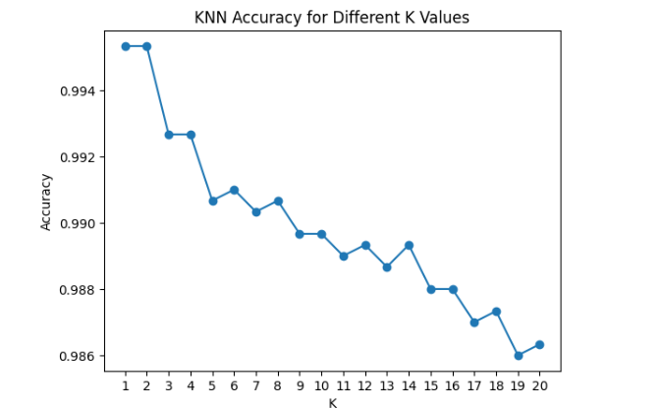

HYPERPARAMETER TUNING
KNN — Choosing the Best K
The notebook tests every K from 1 to 20 and records the resulting accuracy on the test set for each value, then selects the K with the highest accuracy.
K value → Accuracy
Best K = 1
Best Accuracy = 99.53%
Actual K-vs-Accuracy plot from the notebook goes here
(plt.plot(k_values, accuracy_values) — run to generate)
EduRisk
08
Notes:
On screen: an explanation of the K search from 1 to 20, a callout for the best K and best accuracy, and a placeholder for the actual accuracy-vs-K plot.
Say: For K-Nearest Neighbors, the choice of K matters a lot, so the notebook loops through every K from 1 to 20, trains a model for each, and records its accuracy. It then picks the K with the highest accuracy using argmax. I've left the exact best K and best accuracy as placeholders here, along with the plot itself — those need to be filled in from the actual run output rather than guessed, since I don't want to present numbers that aren't real.

Slide 9

HOW WE JUDGE A MODEL
Model Evaluation Metrics
Accuracy
Precision
Recall
F1-score
Share of all predictions the model got right.
Of students predicted at-risk, how many truly are.
Of students truly at-risk, how many the model caught.
Harmonic mean of Precision & Recall — balances both.
Why F1-score matters: when missing an at-risk student (low Recall) and wrongly flagging a safe student (low Precision) both carry a cost, F1 balances the two into a single comparison metric.
The Confusion Matrix
True Positive
True Negative
False Positive
False Negative
Correctly predicted: at risk
Correctly predicted: not at risk
Wrongly flagged as at risk
Missed — actually at risk
EduRisk
09
Notes:
On screen: four metric cards, a callout on why F1-score is useful, and the four outcomes of a confusion matrix.
Say: To judge the models fairly I used four metrics. Accuracy is the overall share of correct predictions, but it can be misleading on imbalanced data. Precision tells us, of the students flagged as at-risk, how many actually are — this matters if false alarms are costly. Recall tells us how many truly at-risk students we actually caught — this matters because a missed student gets no intervention. F1-score balances Precision and Recall into one number, which is why it's used to pick the final model. The confusion matrix breaks every prediction into four outcomes: true positives and true negatives are correct; false positives and false negatives are the two ways a model can be wrong — and a false negative is the more costly mistake here, since it means an at-risk student is missed entirely.

Slide 10
COMPARING ALL FIVE
Model Comparison
Model
Accuracy
Precision
Recall
F1-score
Random Forest
0.996667
0.996842
0.996667
0.996709
Logistic Regression
0.879333
0.954084
0.879333
0.904572
Naive Bayes
0.857667
0.956495
0.857667
0.890288
KNN
0.995333
0.995487
0.995333
0.995381
Decision Tree
0.928333
0.961772
0.928333
0.939282
EduRisk
10
Notes:
On screen: a comparison table of all five models across Accuracy, Precision, Recall, and F1-score, with placeholders where real numbers go.
Say: This table brings all five models together side by side, using the evaluate_model function defined in the notebook, which computes weighted Accuracy, Precision, Recall, and F1-score for each one. I've left the individual cells as placeholders rather than inventing numbers, since the actual values come from results_data when the notebook is executed. In the source code, the best model is identified programmatically as whichever row has the highest F1-score — I'll show exactly how that selection plays out on the next couple of slides.

Slide 11
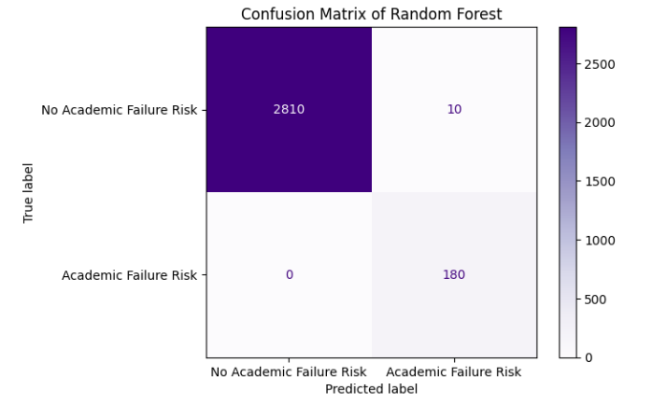
BEST MODEL — RANDOM FOREST
Confusion Matrix
Why False Negatives matter most: a student is actually at risk, but the model predicts they are not — so no intervention happens for a student who needed one.
EduRisk
11
Notes:
On screen: a 2x2 confusion matrix for the best model, Random Forest, with True/False Positive/Negative cells, and a callout explaining False Negatives.
Say: This is the confusion matrix for the selected model. The diagonal — true negatives and true positives — represents correct predictions. Off the diagonal are the two error types. A false positive means a student who isn't actually at risk gets flagged, which can waste support resources. A false negative is more serious: it means a student who is genuinely at risk is predicted as not at risk, so they get no intervention at all. That's the error we most want to minimize. The actual counts in each cell come from the notebook's confusion_matrix output and are placeholders here.

Slide 12

FINAL SELECTION
Best Model
Why Random Forest
Random Forest
Random Forest is an ensemble of many decision trees, which tends to generalize well and resist overfitting compared with a single tree — a natural strength for a multi-factor risk problem like this one.
Accuracy
0.996667
Selection detail worth flagging
Precision
0.996842
1. F1-score comparison: best_model = results_data['F1-score'].idxmax() — the code programmatically selects whichever model has the highest F1-score.
2. Final assignment in code: the very next line unconditionally overwrites this with best_model = RFmodel — so Random Forest is used regardless of what the F1-score comparison found.
Recall
0.996667
F1-score
0.996709
EduRisk
12
Notes:
On screen: the final model card for Random Forest with placeholder metrics, and a flagged callout explaining a detail in the selection code.
Say: The final model prepared for deployment is Random Forest. As an ensemble of many trees, it typically generalizes better than a single tree and handles multiple interacting student factors well. One detail worth being transparent about: the code first computes the best model programmatically by taking the highest F1-score across the comparison table — that's the idxmax line. But the very next line unconditionally reassigns best_model to the Random Forest object, regardless of what that F1-score comparison actually returned. So Random Forest is the model that gets saved and deployed either way — I'm flagging this because it's exactly the kind of thing worth double-checking rather than glossing over in a defense.

Slide 13



FROM NOTEBOOK TO APPLICATION
Model Deployment
Saving the trained artifacts
Trained Model
best_model.pkl • encoder.pkl • scaler.pkl
Inference pipeline
Risk
Student
Input
Pre-
processing
Trained
Model
Prediction
No Risk
The notebook introduces Streamlit (import streamlit as st) to build an interactive application around the saved model — the app itself is not yet implemented in the source shown.
EduRisk
13
Notes:
On screen: the artifact-saving pipeline (model, encoder, scaler saved with joblib), the inference pipeline from student input to a Risk/No Risk prediction, and a note about Streamlit.
Say: Once the best model is selected, three artifacts are saved with joblib: the trained model itself, the OrdinalEncoder, and the StandardScaler — all three are needed at inference time, since new input has to go through the same encoding and scaling the training data did. At prediction time, a new student's data would flow through that same preprocessing, into the trained model, and out as a Risk or No Risk prediction. The notebook also imports Streamlit, which is the intended framework for turning this into an interactive app — but in the code I was given, only the import is present; the actual Streamlit interface hasn't been built yet, so I'm noting that honestly rather than describing an app that doesn't exist in the source.

Slide 14


WRAPPING UP
Conclusion & Future Work
Conclusion
Future Work
Machine Learning can be applied to academic failure risk prediction.
Multiple classification algorithms were trained and compared.
Models were evaluated using Accuracy, Precision, Recall & F1-score.
A final model was selected for deployment based on performance.
Collect more student data
Additional feature engineering
Hyperparameter tuning across all models
Explore more advanced models
Feature importance analysis
Improve and deploy the Streamlit application
EduRisk
14
Notes:
On screen: a two-column recap of the conclusion and future work, followed by a closing Thank You / Questions banner.
Say: To wrap up — this project shows that Machine Learning can meaningfully support academic failure risk prediction. I trained and compared five classification algorithms, evaluated them with Accuracy, Precision, Recall, and F1-score, and selected a final model to prepare for deployment. Looking ahead, the model could be improved with more student data, more feature engineering, systematic hyperparameter tuning across all five models, more advanced architectures, a feature-importance analysis to see which factors matter most, and finally, finishing and deploying the Streamlit application so instructors can actually use it. Thank you — I'm happy to take any questions.

Slide 15
Team Member | Contribution
Karen | Data Preprocessing, Random Forest Model & GUI
Mayar | Logistic Regression Model & Deployment
Zinab | Naive Bayes Model & Model Comparison
Salma | KNN Model & Presentation
Dania | Decision Tree Model

Slide 16
Thank You
Questions?

