Slide 1
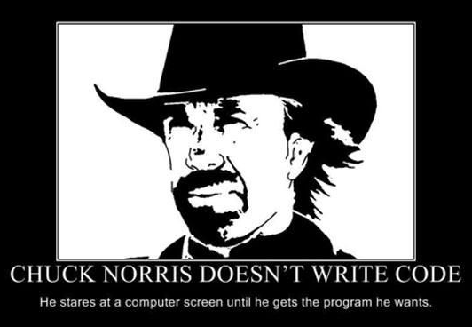

Slide 2
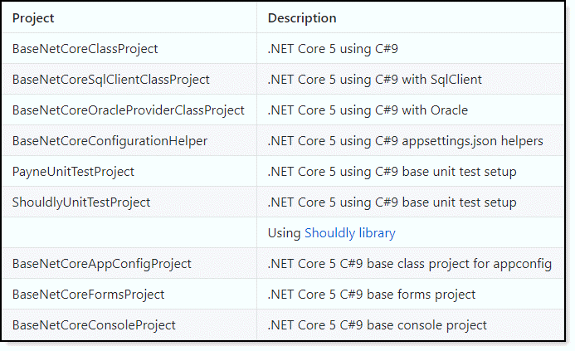
Project templates
Project templates will be installed which get you coding faster

Slide 3
User templates
C:\Users\paynek\Documents\Visual Studio 2019\Templates\ProjectTemplates

Slide 4


Slide 5
GitHub accounts (should be setup by now)
https://github.com/join
Signing up for a new GitHub account

Slide 6
Visual Studio ecosystem languages vs Cold Fusion
Cold Fusion is rapid application development and more
VS is structured development and in some case rapid application development

Slide 7

Microsoft Visual Studio
Microsoft Visual Studio - incredibly powerful and just about no limits
Visual Code can be used in tangent with VS
Most database operations can be done in VS while others in SSMS or Toad
Source control for GitHub is built in to VS
Powerful debugging tools; lacking in some areas in community edition
NuGet integration

Slide 8
Visual Studio setting
Walk through
Text Editor setting
All languages
Basic
C#
HTML
JavaScript
JSON
Markdown

Slide 9
Visual Studio setting
Walk through
Debugging
One of the most powerful and at the same time unused feature in Visual Studio. For today we will explore setting only
We will spend one or more hours in future classes
Notes:
https://tinyurl.com/9y9jfnky

Slide 10
Visual Studio setting IntelliTrace
You can spend less time debugging your application when you use IntelliTrace to record and trace your code's execution history. You can find bugs easily because IntelliTrace lets you:
Record specific events
Examine related code, data that appears in the Locals window during debugger events, and function call information
Debug errors that are hard to reproduce or that happen in deployment

Slide 11
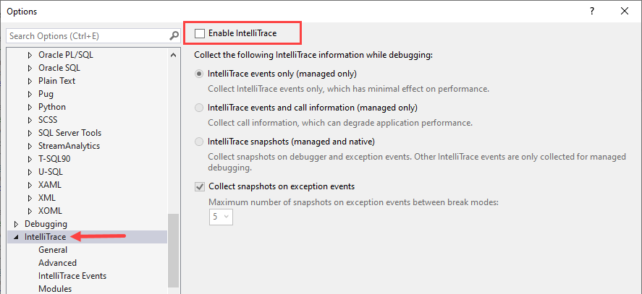
Visual Studio setting IntelliTrace
Be careful, will slow debugging but worth it

Slide 12
Setting default project location
Using a base folder for all Visual Studio 2019 code is recommended
If moving to a new version Visual Studio we create a new base folder
C:\OED\Dotnetland\VS2019
C:\OED\Dotnetland\VS2021
Code may not run outside of C:\OED
All developers keep code in the same location, no guessing where code resides

Slide 13
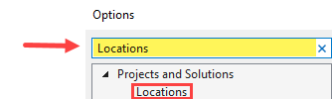
Setting default project location
Open Visual Studio
Select Tools menu
Select Options menu item
Type Locations in the input
Click Locations

Slide 14
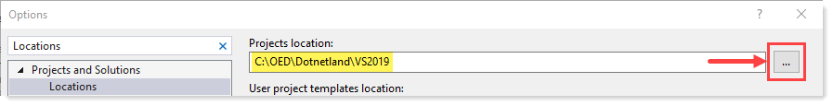
Setting default project location
In Windows Explorer
Create the following folder C:\OED\Dotnetland\VS2019
Use the button to select the folder above, press OK.

Slide 15

Visual Studio extensions
Allow third party to integrate into the IDE for additional functionality.
Some are free while others are paid-for.
After trying specific ones you can’t do without them like
Resharper and EF Power Tools
PostSharp – for beginners is “out there” while not for a season coder
For me, taking Resharper away is like telling a crack addict they must come clean. Yet it can be done.

Slide 16
Live share
https://visualstudio.microsoft.com/services/live-share/
Use real-time collaboration for pairing, code reviews, technical interviews, bootcamps and more
With Live Share, versatility is the name of the game. Gone are the days of using multiple tools for collaboration and context switching. Live Share not only works for multiple use-cases, but also has an extensibility model that allows you to add your own customization to it.
Have not used this in OED yet, may have permission issues
DOR developers uses Live share

Slide 17
Live share
Many possibilities
Mentoring
Get hands on remote user’s Visual Studio

Slide 18
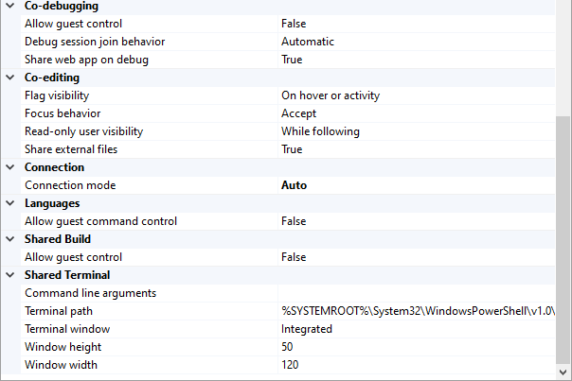
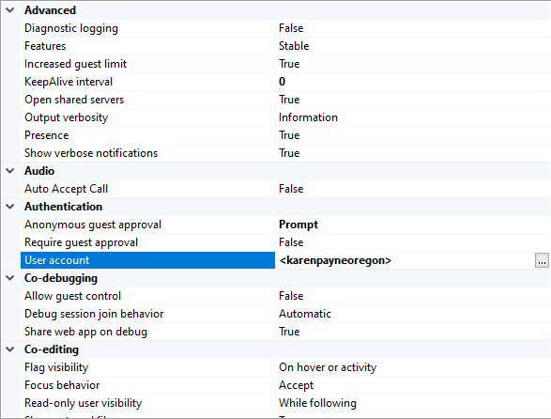
Live share setting

Slide 19

FYI
There will be things seen that I do you can’t without ReSharper
ReSharper
Lays on top of the IDE engine
Additionally has menus for other actions
Enhances coding standards and provides recommends which are configurable
For those who will be coding in Visual Studio often no matter what level you are this is a must have extensions

Slide 20
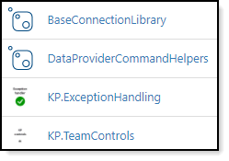
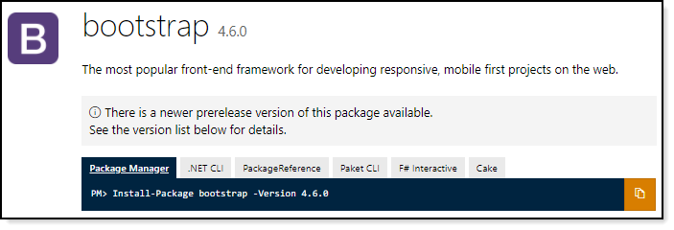

NuGet packages
NuGet is a package manager designed to enable developers to share reusable code. It is a software-plus-service solution whose client app is free and open-source.
Provided code which is not built into the .NET Framework
One reason, Microsoft .NET Core is designed to be
Web,Multi-platform /cross-platform
Understanding this keeps core projects better suited for the above
Packages can be hosted on Nuget.org or locally at OED

Slide 21
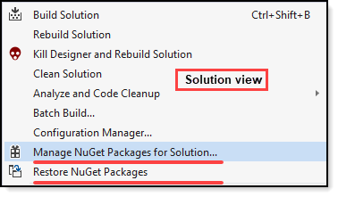
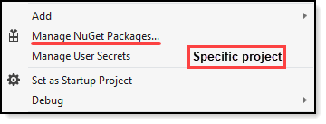
Visual Studio/NuGet
Available from solution view (we will see this shortly)
Available at project level (we will see this shortly)

Slide 22
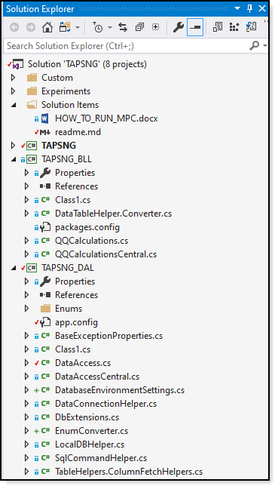
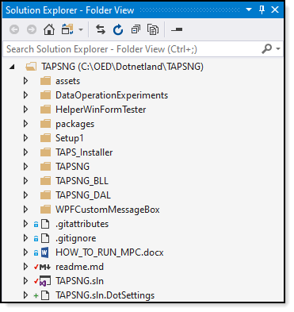
Basic IDE tour
Solution explorer window
Left is solution view
Right is folder view

Slide 23
Basic IDE tour
Solution explorer window
Property window
Document outline window
Toolbox

Slide 24
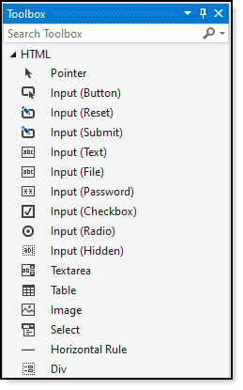
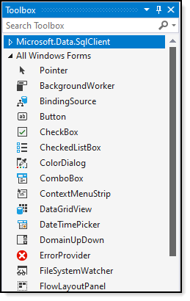
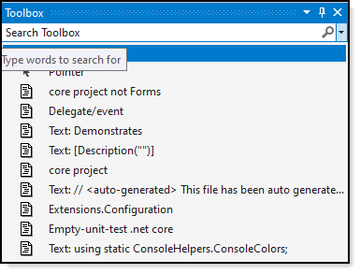
Basic IDE tour
Toolbox
Robust for windows and cross platform projects
Not so for web and would not except it to be as IntelliSense makes up for this
Drag-n-drop code

Slide 25
Basic IDE tour
Property window
Document outline window

Slide 26
Tips

Slide 27
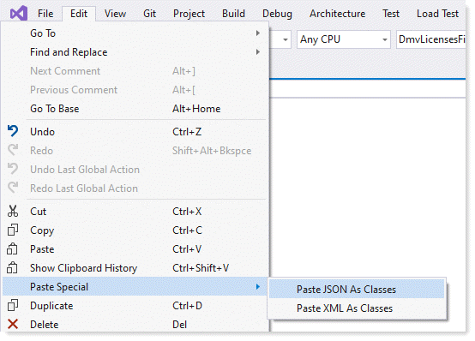
Tip: Paste special

Slide 28
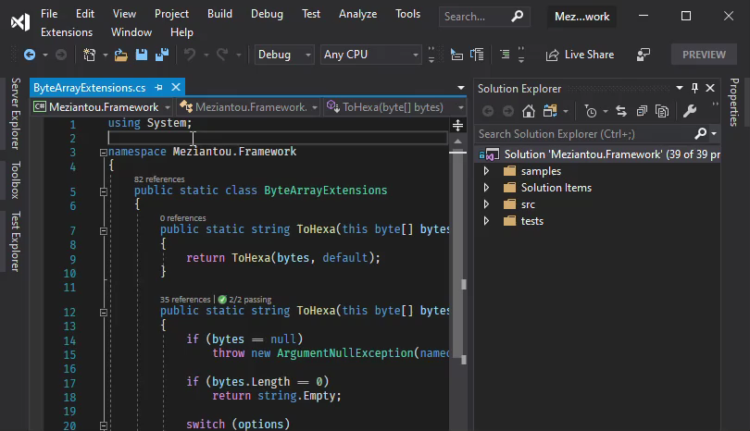
Tip: Find file

Slide 29
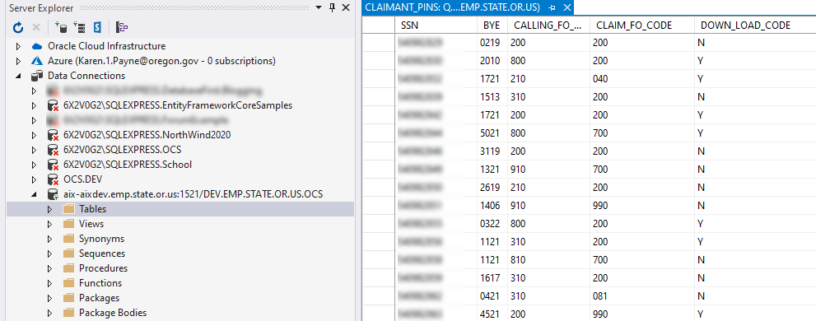
Basic IDE tour
Server explorer window

Slide 30
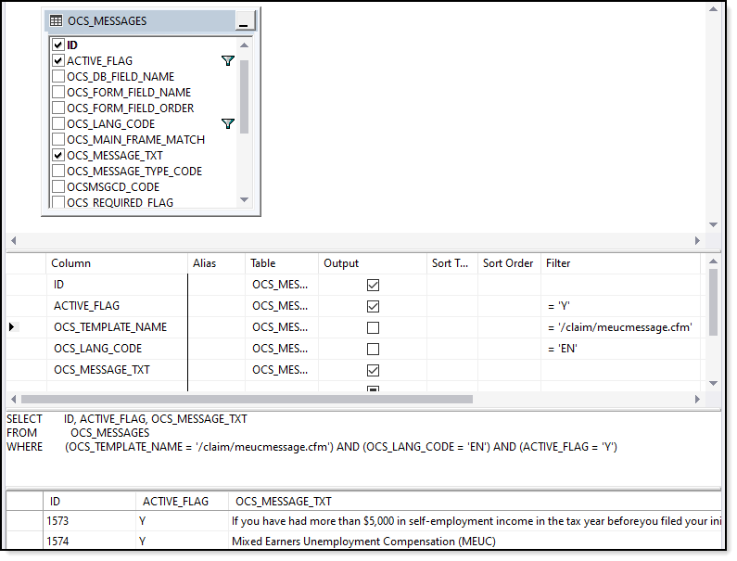
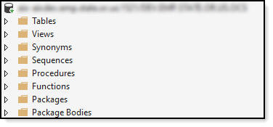
Basic IDE tour
Server explorer window

Slide 31
Code Snippets
Code snippets are small blocks of reusable code that can be inserted in a code file using a right-click menu (context menu) command or a combination of hotkeys. They typically contain commonly used code blocks such as try-finally or if-else blocks, but they can be used to insert entire classes or methods.
?: operator (ternary) need to do this yourself w/o Resharper

Slide 32
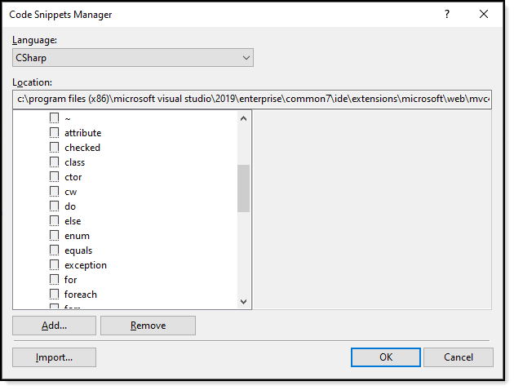
Code Snippets Manager CTRL+K.CTRL+B

Slide 33
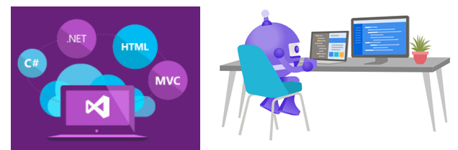
Getting started
With coding in Visual Studio

Slide 34
FYI
Pace is to fast, use chat window or email
Something does not make sense, may ask to hold it until after class
Can’t find answer to question in a timely, will get back after class

Slide 35
.NET Framework - retired
Is used to create and run software applications. . NET apps can run on many operating systems, using different implementations of . NET. . NET Framework is used for running .
Windows applications
Console applications
Web application
Web services
Windows Services

Slide 36

.NET Core Framework - current
TODO

Slide 37



Data providers support
Microsoft SQL-Server
Oracle
MySQL
PostgreSQL
SQLite
Firebird
Level of support is dependent on the provider e.g. Oracle

Slide 38
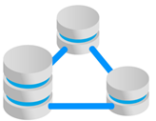
Connecting to data
Data providers either native or from a company like Oracle
Microsoft provides templates to write your own provider
Entity Framework Core
https://docs.microsoft.com/en-us/ef/core/providers/?tabs=dotnet-core-cli

Slide 39



Familiar for some
JavaScript
C#
JavaScript
C#

Slide 40
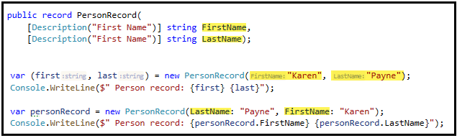
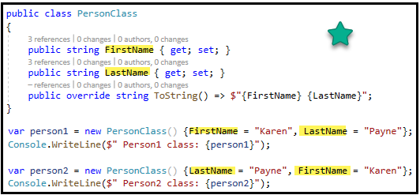
C# 9 is current version
We will use
Many features of version 9, not all e.g. Top-level programs
Have choices (When and when not to use)
Will use features from C# 8
Notes:
C# 9 – feature list https://devblogs.microsoft.com/dotnet/welcome-to-c-9-0/
p

Slide 41
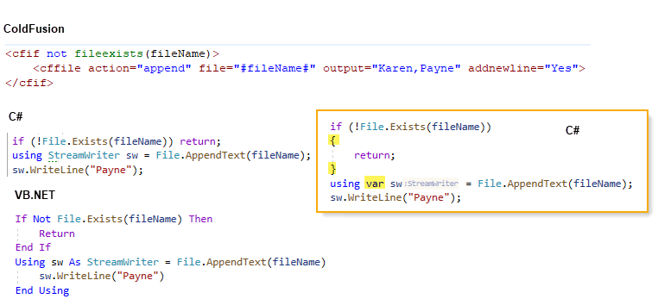
IF statement in 3 language

Slide 42
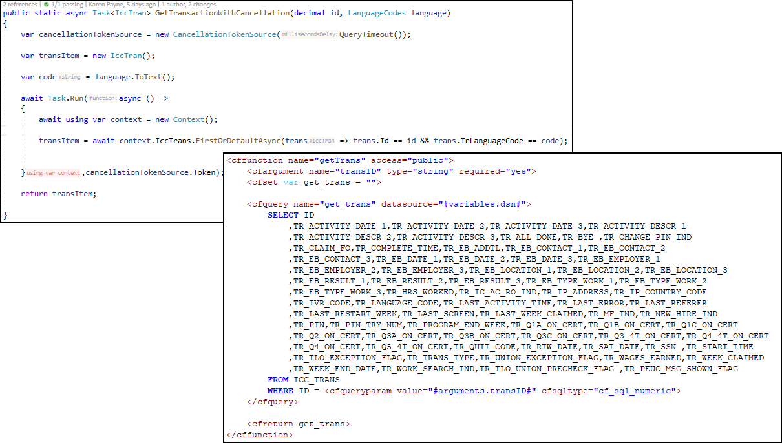
Data access – C# Entity Framework Core

Slide 43
Anatomy of a solution in Visual Studio

Slide 44
Elements for complex application solutions

Slide 45
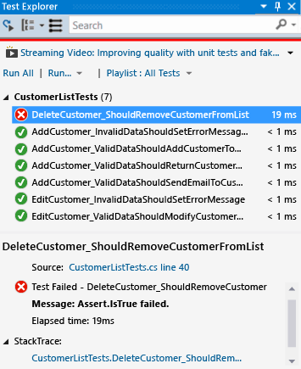
Unit test
Visual Studio supports various ways to test
Will cover the basics-advance
Create from usage

Slide 46
Unit test in general
Increase time to deliver
More stable product
Not everything needs test
Somethings require human testing

Slide 47
Unit test gherkin
Typical Gherkin steps look like:
Gherkin Scripts: connects the human concept of cause and effect to the software concept of input/process/output.
Gherkin Syntax:
Feature: Title of the Scenario
Given [Preconditions or Initial Context]
When [Event or Trigger]
Then [Expected output]

